Slide 1
Data Consumers
01

Slide 2
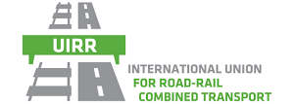

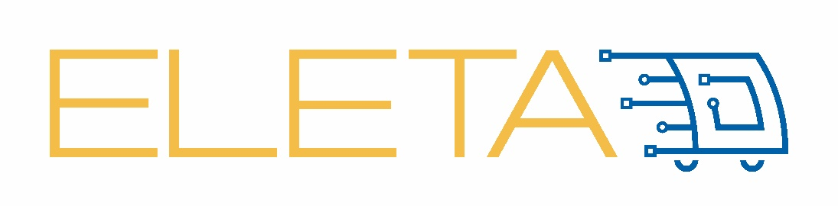

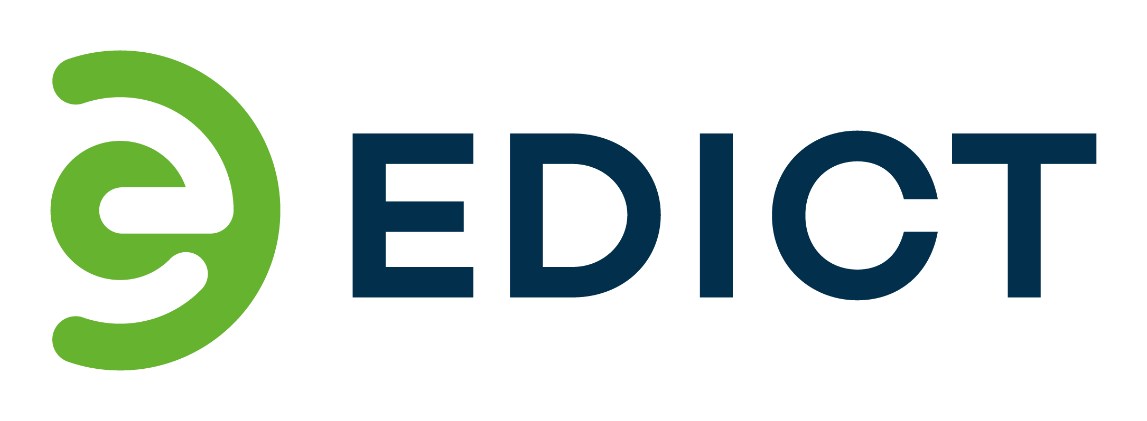

Roland Klüber
    Master in Business Information Systems, PhD in Management
    CEO of Consilis, and Partner of Theron Advisory Group
      focus on interim-management and IT-based business ecosystem transformations in multi-modal E2E logistics systems
    supporting UIRR for almost a decade in
      various multi-modal EU R&D projects (e.g. )
      digital transformation initiatives & IT architecture design challenges
  CEO
    Consilis GmbH
    Fostering client’s business model innovation and digital transformation in global health, energy, engineering & logistics business ecosystems
    International Union for Road-Rail Combined Transport (UIRR)
    industry association for the sector of Combined Transport in Brussels transposing needs to EU legislation, standardisation, services to sector, and R&D projects
    100+ Combined Transport Operators, Terminal Operators, and partners
  Consilis GmbH
  representing UIRR s.c.

Slide 3
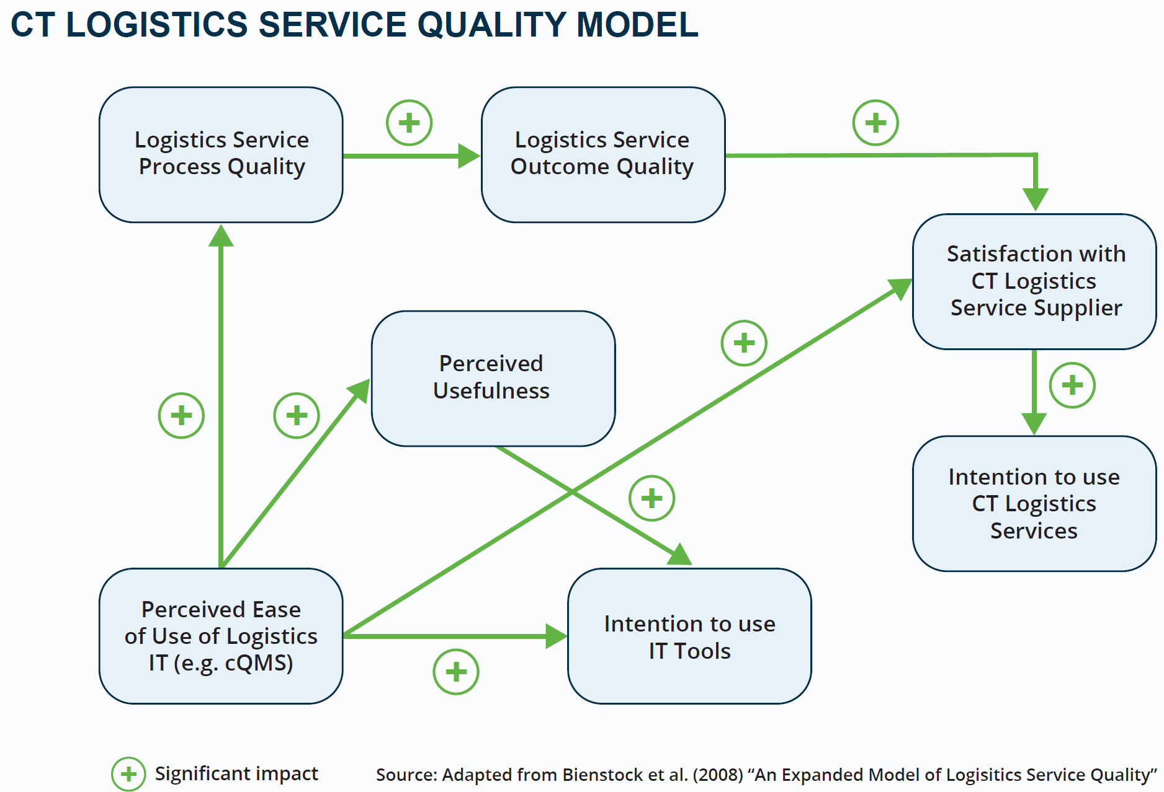

Reduced Interoperability Challenges of Combined Transport
WHY: Lever to increase attractiveness of CT
(most carbon-free landbound transport mode)
Purpose: Enhance Data Interoperability & Service Quality
LSP
IM
TO
EDICT
CTO
RU
Many stakeholders
Gaps in end-to-end data exchange
Scarce & isolated quality information
Gap Closing
Shipper/
Consignee
Accurate + shared data as basis to improve service quality
CTO: Combined Transport Operator, TO: Terminal Operator, RU: Railway Undertaking
LSP: Logistics Service Provider, IM: Infrastructure Manager
Notes:
Enhance Data Interoperability for all CT stakeholders – overcome E2E data gaps and focus on integrating data sources. Data quality is critical. Standardisation of processes, transaction data, master data and reason codes for interruptions and delays is not mature and widely used today. EDICT provides solution paths in several areas to overcome mental silos and “pockets of data” (e.g. reason code harmonisation).

Slide 4
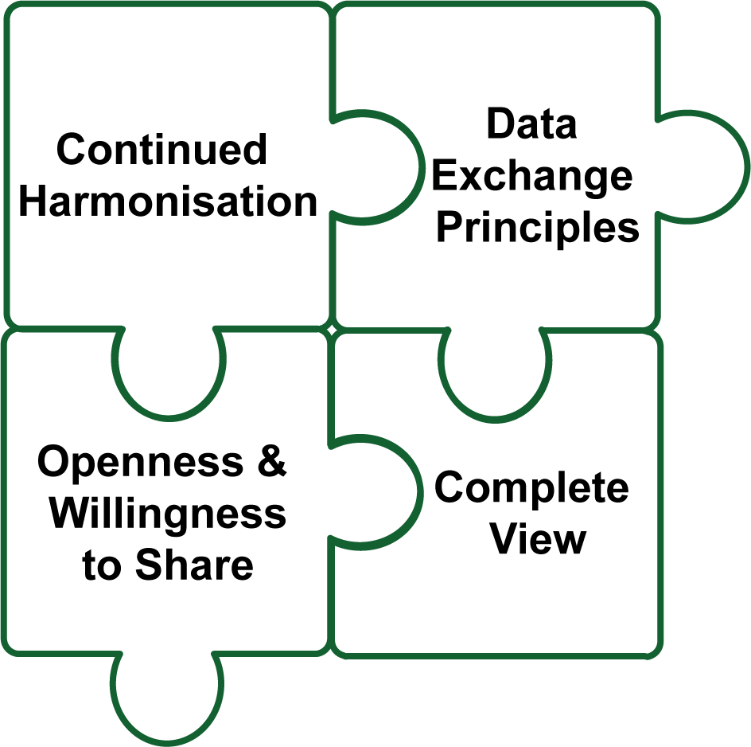

Roland Klüber
Building blocks for multi-modality
Continued harmonisation of data and semantical interoperability of IT systems and IT platforms
Foster multilateral data exchange principles (e.g. data for data, federated data governance, EMDS for freight)
Increase openness & willingness to information sharing facilitating modal choices of shippers towards rail
Complete view: Information about goods, safety, CO₂ footprint with sufficient digital security
E2E interoperability bridges towards increasing data value
Provide an international train number (surrogate)
Value of data for customers: transform data to information (“leading to action”) for terminals, CTOs and shippers – easily accessible and cost-efficient!
Increase plannability (e.g. avoid business ecosystem irritations if legs are not bookable or traceable)
Silo-crossing prevention and exception management processes increasing responsiveness

