Slide 1
Data Providers
02

Slide 2
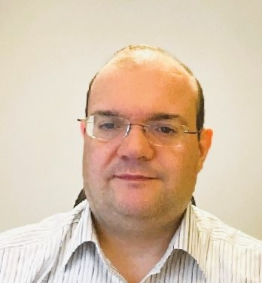
Miguel Figueres-Esteban
Telecommunications Engineer and PhD in Psychology
20 years of experience in railway safety.
Area Head of Digital Transformation and Training at Renfe
Developing a Safety Enterprise Architecture for advanced risk management
Developing a business knowledge graph to support safety data governance
Renfe Group
leader in rail transport for passengers and goods
point of reference in the mobility sector in Spain
5,000 trains every day in Spain, and more than 500 million passengers a year
about 15,000 committed employees who are proud of their work and the most outstanding rates for punctuality, quality and satisfaction
Renfe is working to make the train the star of mobility in Spain, and expand business across borders​
Area Head of Digital Transformation and Training
Renfe
Notes:
Miguel is Telecommunications Engineer and PhD in Psychology. In 2019 Miguel joined Renfe as the Head of Human Factors. Currently he is the Area Head of Digital Transformation and Training, focused on the development of a Safety Enterprise Architecture for advanced risk management. ​
​
Renfe Group is the leader in rail transport for passengers and goods and a point of reference in the mobility sector in Spain. With 5,000 trains running every day in Spain, more than 500 million passengers a year, about 15,000 committed employees who are proud of their work and the most outstanding rates for punctuality, quality and satisfaction, Renfe is working to make the train the star of mobility in Spain and, at the same time, expand our business and cross borders​

Slide 3
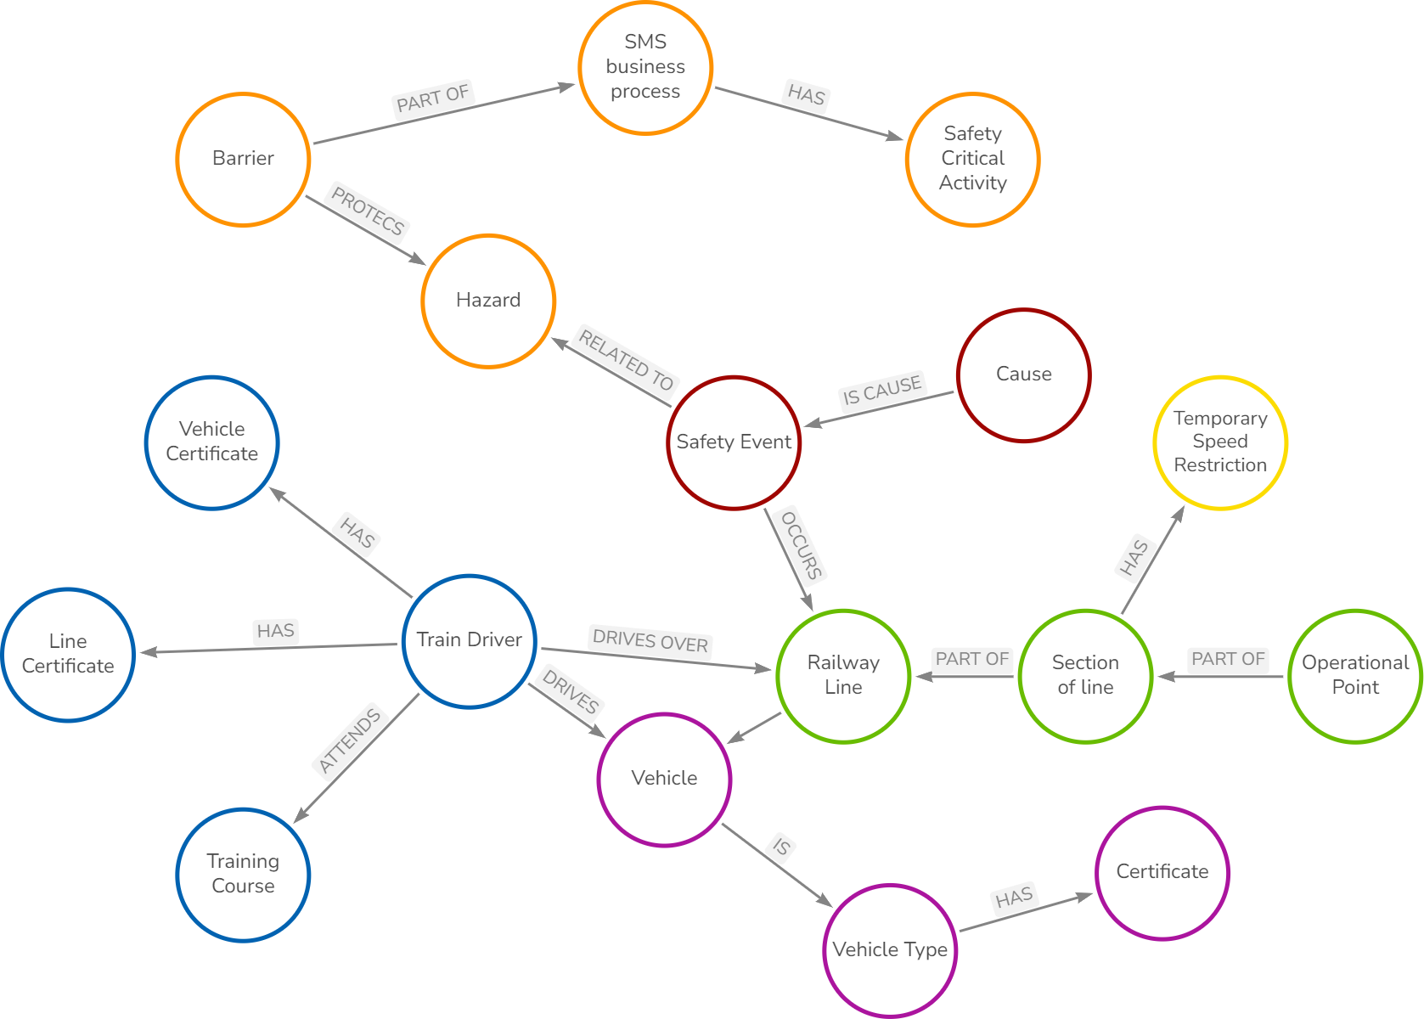
Miguel Figueres-Esteban
Safety Knowledge Graph as an enabler for Dynamic Risk Management at Renfe
Strategic project of the Renfe digital transformation programme
for Dynamic Risk Management (DRM)
to assess the safety level and the safety performance of the Safety Management System according to the CSM ASLP
DRM requires advanced data acquisition systems - Renfe is developing a Safety Enterprise Architecture (SEA)
core of the SEA is a semantic layer based on a Safety Knowledge Graph aligned with ERA ontologies
to enable the right integration of different data sources at Renfe
to facilitate data exchange with future European safety systems such as the Information Sharing System (ISS)
Notes:
Renfe is developing an ambitious digital transformation programme to pave the way for Dynamic Risk Management (DRM) to assess the safety performance of Safety Management Systems. DRM requires of advanced data acquisition systems and Renfe is developing a Safety Enterprise Architecture (SEA) for it. This presentation shows how the core of this SEA is a semantic layer based on a Safety Knowledge Graph to enable the right integration of different data sources at Renfe.

Slide 4
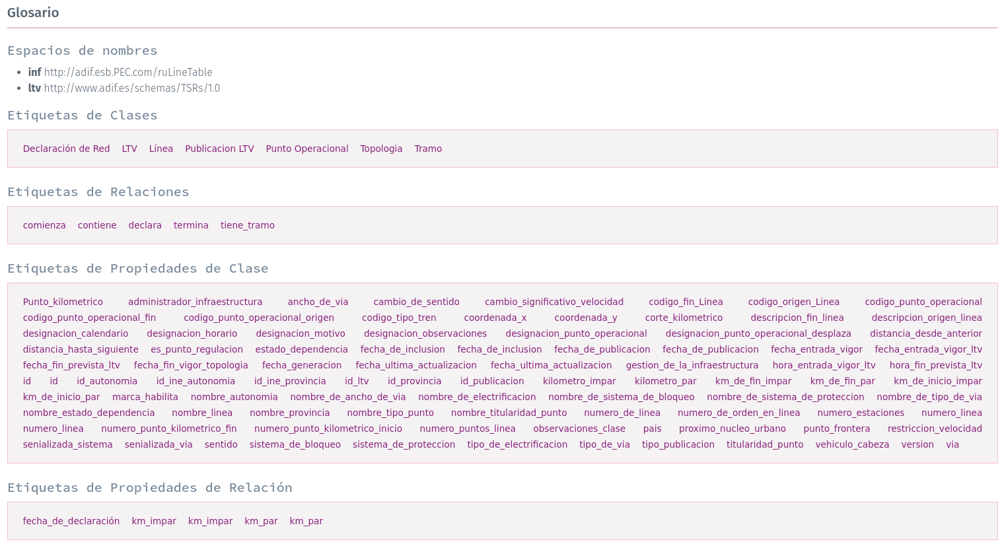
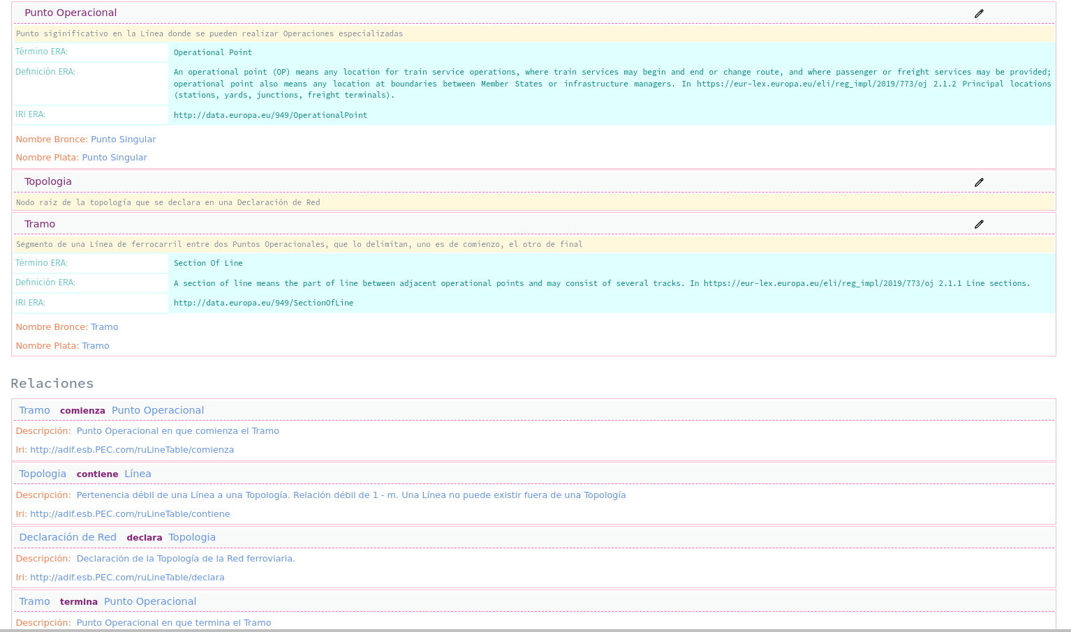
Miguel Figueres-Esteban
Working on Property Graph and RDF
Renfe Vocabulary
ERA Vocabulary
Notes:
Renfe is developing an ambitious digital transformation programme to pave the way for Dynamic Risk Management (DRM) to assess the safety performance of Safety Management Systems. DRM requires of advanced data acquisition systems and Renfe is developing a Safety Enterprise Architecture (SEA) for it. This presentation shows how the core of this SEA is a semantic layer based on a Safety Knowledge Graph to enable the right integration of different data sources at Renfe.

