Slide 1
Data Consumers
01

Slide 2

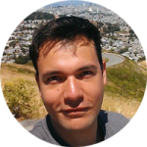
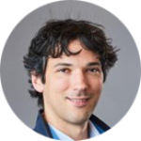
Julián Rojas​
    Data Interoperability and Semantic Web researcher at Imec and Ghent University
    Focus mainly on the design of cost-efficient system architectures for scalable and interoperable data exchange at Web scale
    Applied research on transportation domain,
    including public transport, logistics and infrastructure
    Collaborating with ERA for the last 4 years on developing semantic interoperability solutions such as the ERA Vocabulary and Knowledge Graph.
  Researcher
  Imec
    Imec
    World's leading independent nanoelectronics R&D hub
    Combines nanotech expertise with data and AI

Slide 3
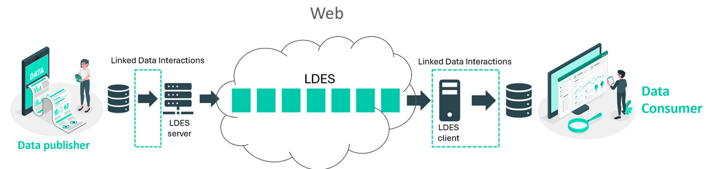
Julián Rojas
Interoperable and continuous data exchange on the Web with Linked Data Event Streams​
      Linked Data Event Streams (LDES) specification as a uniform, scalable, domain-agnostic and semantically interoperable data exchange interface for the Web.
      Publish historic and up-to-date data that allows consumers to travel back in time (e.g., for training AI models) and remain in-sync with a given data source.
      Proof-of-concept that applied LDES to generate and continuously publish the ERA Knowledge Graph.
Notes:
Interoperable and continuous data exchange on the Web with Linked Data Event Streams​
​
Linked Data Event Streams (LDES) specification is an interoperable approach for data exchange on the Web. It will highlight its vision, benefits and challenges. Lastly, it will show the results obtained in a proof-of-concept that applied LDES to generate and continuously publish the ERA Knowledge Graph.​
​

