Slide 1

  Data providers – Data consumers
  European Union Agency for Railways

Slide 2
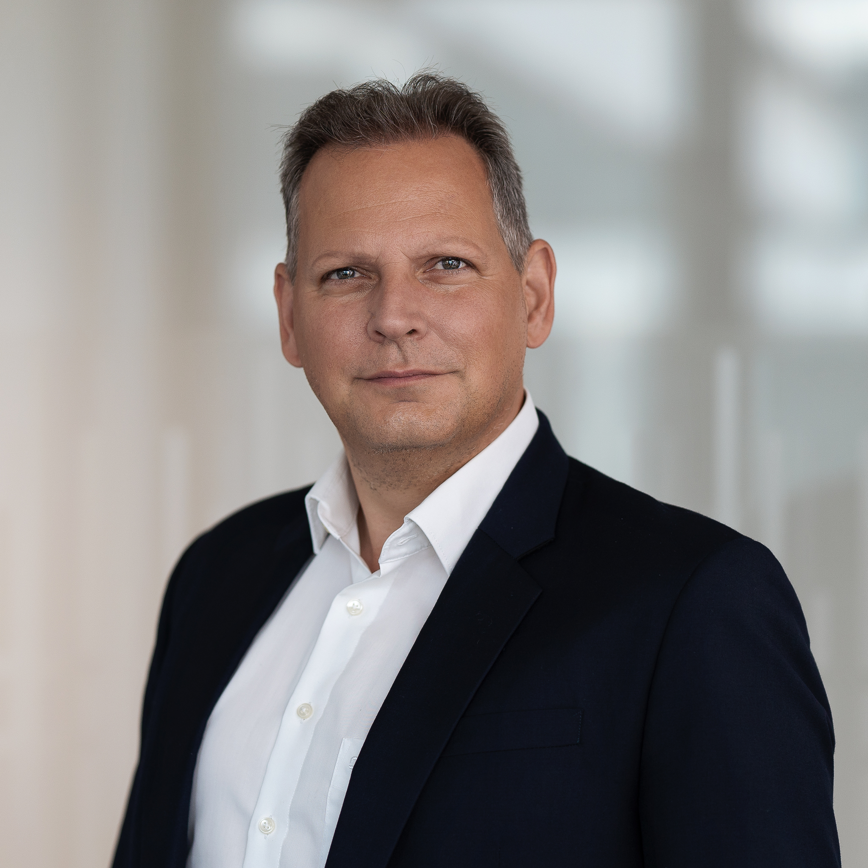


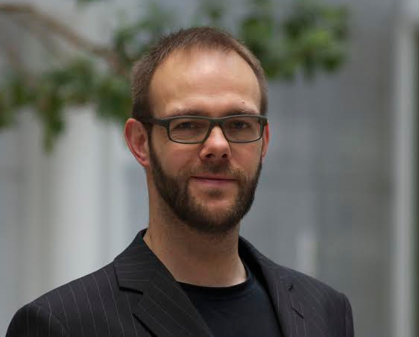



HARALD REISINGER
RAILNETEUROPE
JULIAN ROJAS
MATTHIAS VANDEN AUWEELE
IMEC
INFRABEL
  Harald Reisinger
  RailNetEurope
INGO RITTER
GILLES PETERHANS
DB GROUP
UIP
  European Union Agency for Railways
ROLAND KLUBER
MIGUEL FIGUERES- ESTEBAN
CONSILIS / UIRR
RENFE

Slide 3
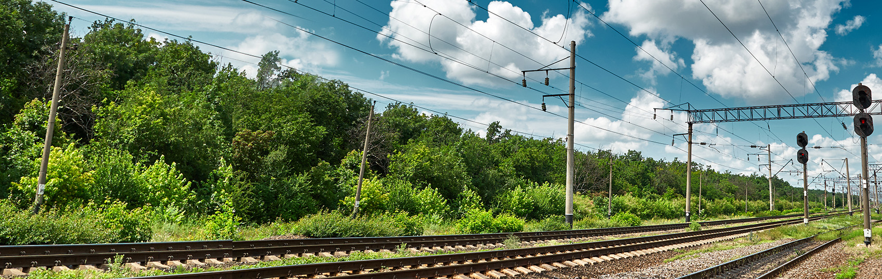
Data providers and Data consumers

Slide 4

Harald Reisinger
    Responsible for the operation, implementation, and roll-out of RNE's digital services
    Chairman of the PRIME digital subgroup since 2019
    RNE’s CFO:
      oversees RNE's finances
      coordinates the implementation of CEF and TEN-T funding projects for RNE and other companies in the railway sector
  CIO, CFO
    RailNetEurope (RNE)
    association of European Rail Infrastructure Managers (IMs)
    umbrella organisation that helps coordinate its Members' international processes in the areas of Capacity Management, Traffic Management, Corridor Management, IT and Sales & Legal Matters
  RailNetEurope

Slide 5
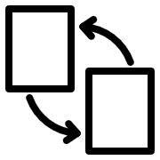





Data providers and Data consumers
Shareable
Several approaches possible to achieve the goal
Transportable
    What are the needs of data consumers?
    Which challenges are data providers facing?
    Which requirements and challenges will we face in the coming years? How can we deal with them?
    Railways are often still oriented towards 'national,' 'manual,' and 'annual' practices.
    How do we evolve towards a European, digital, and flexible approach?
‘Data and information are the gold of the future.’
Accurate
Relevant
Timely
Secure
Notes:
“Data and information are the gold of the future" is a statement often heard.
However, they must follow the principles defines by STARTS :​
❖ Sharable ​
❖ Transportable (from the archiving site) ​
❖ Accurate ​
❖ Relevant ​
❖ Timely ​
❖ Secure ​
​
There are several approaches to achieve this and we would like to understand better what the needs of the data consumers are, and which challenges the data providers are facing. Which requirements and challenges will we face in the coming years and how can we deal with them? Railways are still often oriented "national", "manual" and "annual", how do we move towards a European, digital and flexible approach?”​

Slide 6
Data Consumers
"Which are the needs of the Data Consumers"

Slide 7
Polling Question - slido
"Which organisation to do you represent in this meeting?“
* European Body
* Infrastructure Manager
* Railway Undertaking
* Terminal/Service Facility
* Other
"Which of these factors contributes the most to a higher value of data?
* 100% data quality
* Data centrally available for all (machine readable, standardised format,...)
* Automated data genaration and exchange

Slide 8
Data Providers
"Which are the challenges of the Data Providers"

Slide 9
Polling Question
"Which organisation to do you represent in this meeting?“
* European Body
* Infrastructure Manager
* Railway Undertaking
* Terminal/Service Facility
* Other
"Which barrier do you consider the most important one the sector is facing today?”
* Lack of governance on the data level
* Lack of vision and regulatory frameworks on data (open data, dataspaces,...)
* Lack of standardisation of data formats (ontology, TSIs,...)
* Lack of financial means to implement

Slide 10
Data Providers and Data Consumers
THANK YOU FOR YOUR ATTENTION

Slide 11
Data Providers and Data Consumers
"Which enablers could facilitate data providers and consumers "

