Slide 1
Data Providers
02

Slide 2
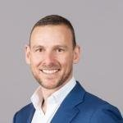
Gilles Peterhans
Study of finance and economics at the University of St. Gallen in Switzerland
various operating positions in the railway industry
management experience as CEO of a rolling stock leasing company and a railway undertaking
Secretary General of UIP – International Union of Wagon Keepers, since January 2013
Secretary General
UIP – International Union of Wagon Keepers
umbrella association of national associations from fourteen European countries with seat in Brussels
Representing more than 250 freight wagon keepers and ECMs with more than 245,000 freight wagons, performing 50 % of the rail freight tonne-Kilometres throughout Europe.
UIP wants to secure on the long term the future of rail freight transport.​
UIP
International Union for Wagon Keepers
Notes:
Mr. Gilles Peterhans studied finance and economics at the University of St. Gallen in Switzerland. After he graduated, he transitioned through various field of operating positions in the railway industry and acquired extensive management experience as CEO of a rolling stock leasing company and a railway undertaking. Since ​
January 2013, he acts as Secretary General of UIP – International Union of Wagon Keepers.​
​
The UIP – International Union of Wagon Keepers, with its seat in Brussels, is the umbrella association of national associations from fourteen European countries, thus representing more than 250 freight wagon keepers and ECMs with more than 245’000 freight wagons, performing 50 % of the rail freight tonne-Kilometres throughout Europe. UIP wants to secure on the long term the future of rail freight transport.​

Slide 3
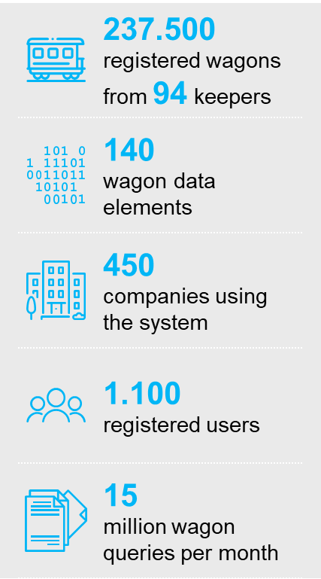
Gilles Peterhans
RSRD² is the source for wagon reference data

Slide 4
Gilles Peterhans
RSRD² allows easy access to freight wagon data

