Slide 1
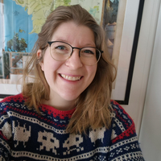
Veronika Heimsbakk
Capgemini Norway
OPENING: KEYNOTE SPEECHES

Slide 2
The Role of Knowledge Graph at The Norwegian Maritime Authority
Veronika Heimsbakk

Slide 3
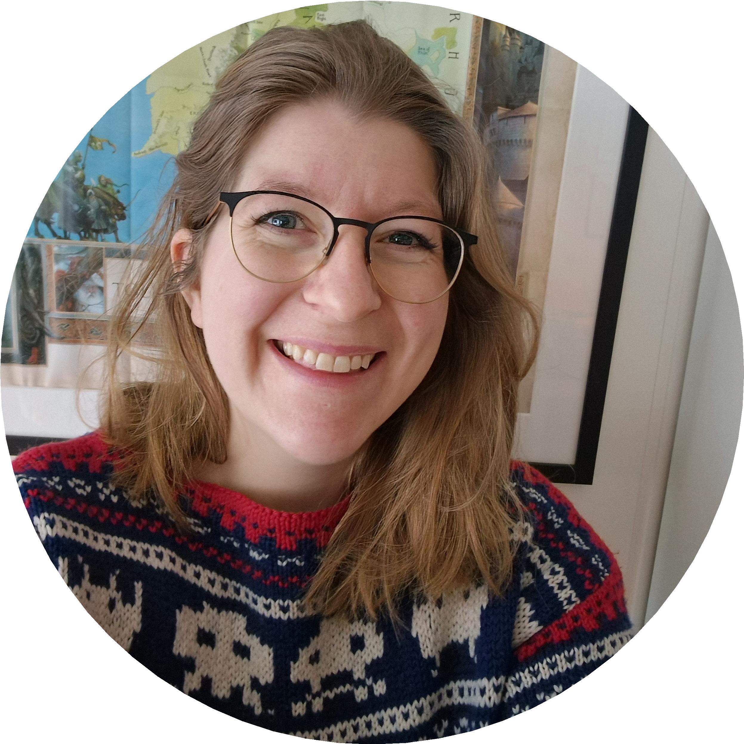
The Role of Knowledge Graph at The Norwegian Maritime Authority
Veronika Heimsbakk
Knowledge Graph Lead | Insights & Data Nordic veronikaheim
veronikaheimsbakk
veleda

Slide 4
The Norwegian Maritime Authority (NMA)
Shall have sufficient control over their demand, and how the agency at all times delivers on this mission.
Demand: authorizations granted by the legislature
Delivery: the agency’s activity

Slide 5
Data sources
Main data source: ∼200 regulations, in Norwegian.
Additional sources: SQL-databases, Excel spreadsheets, domain expert knowledge, SFI

Slide 6
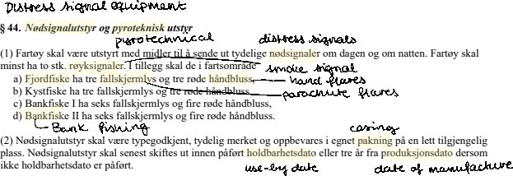
Challenges
One regulation by hand ∼80 hours. Total of ∼12 000 hours.

Slide 7
Hypothesis
Hypothesis It is faster to identify context, concepts and relationships using Natural Language Processing than manual interpretation.
It is faster.
It is not faster.

Slide 8
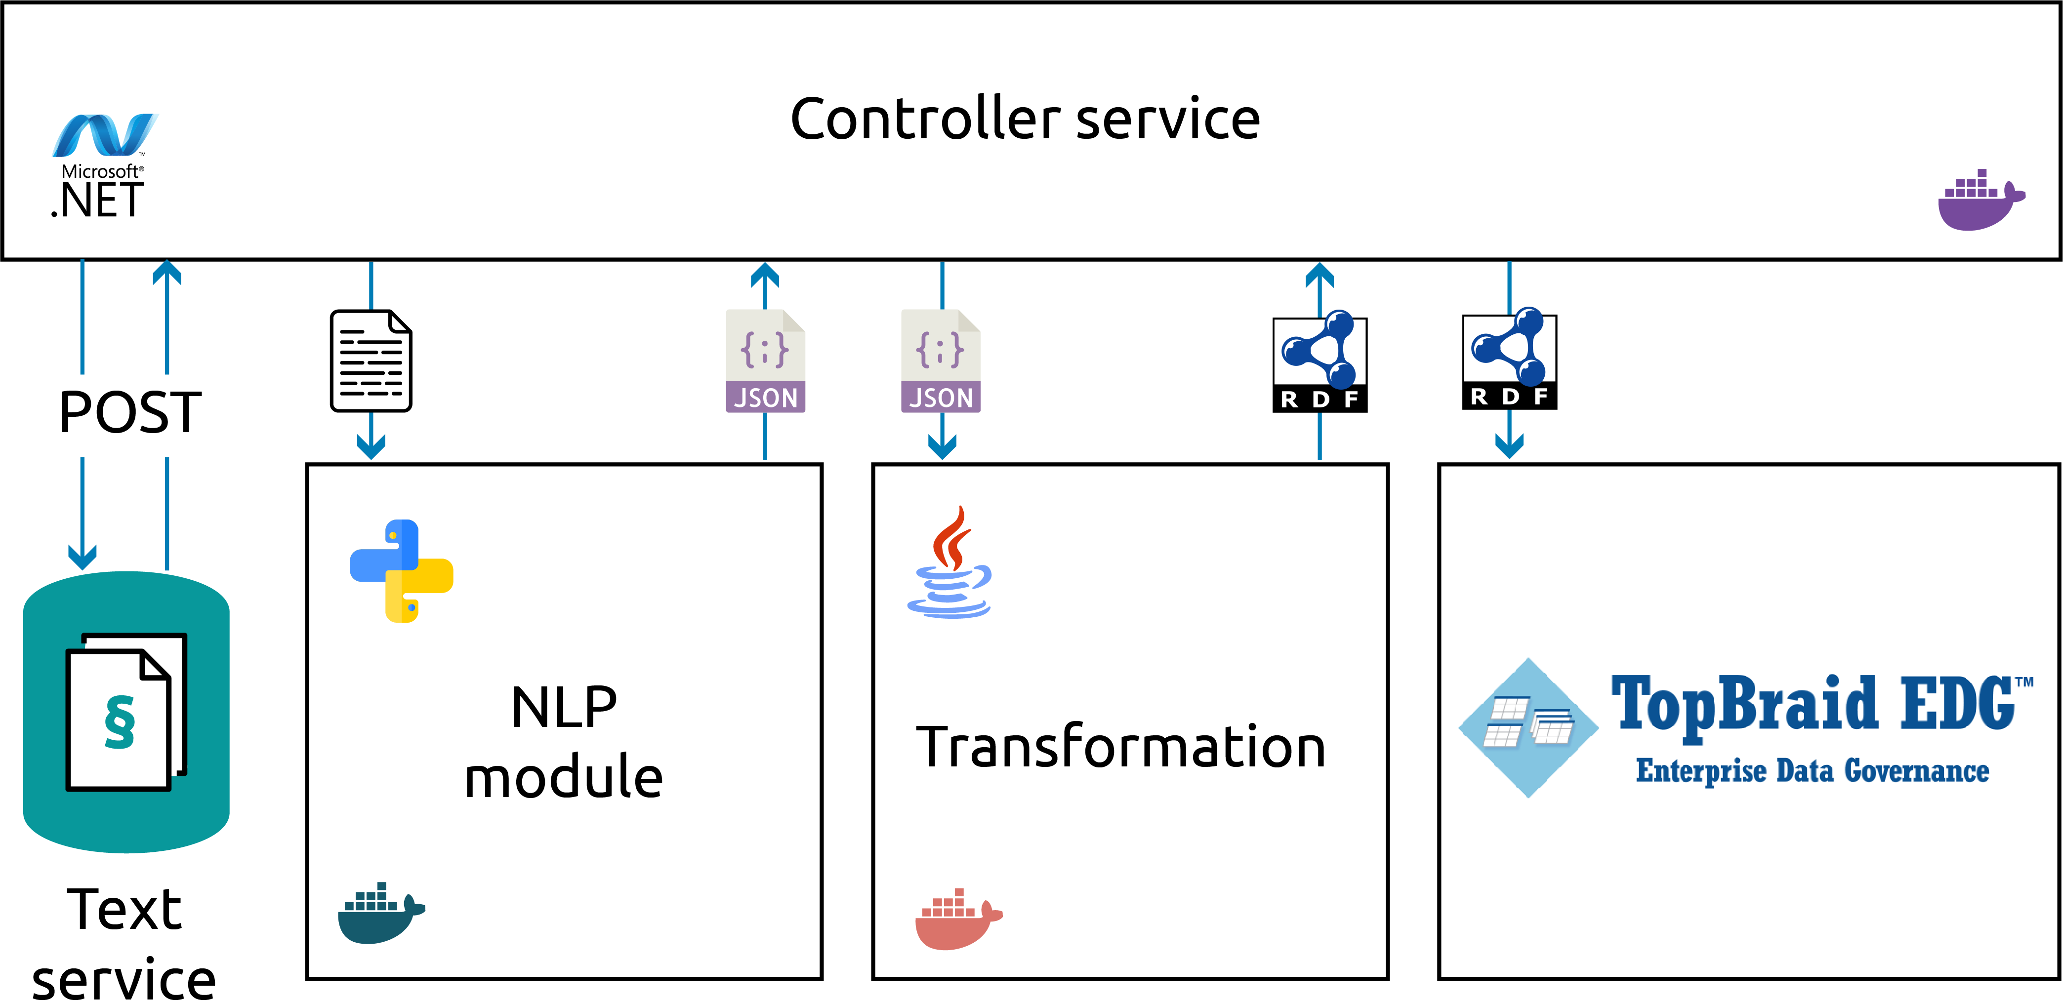
Building the pipeline

Slide 9
Regulatory requirements as RDF
Requirement
"Elektriske anlegg"@no
REG201311221404S1v0
a
label
generalScope
BuiltDate_a19920101
property
REG201311221404S23P1v0
chapterTitle
"Brann, maskineri og elektro"@no
eliReference
property
"regulation/2013/11/22/1404/part/1/chapter/3/section/23/subsection/1"
ElIn_max50

Slide 10
Scopes
Requirement
Scope
REG201311221404S1v0
a
path
datatype
builtDate
a
generalScope
BuiltDate_a19920101
date
property
minInclusive
REG201311221404S23P1v0
label
"Elektriske anlegg"@no
"1992-01-01"
property
Scope
a
ElIn_max50
path
electricalInstallation
datatype
maxExclusive
volt
50

Slide 11
Why SHACL?
Verbose RDF Turtle vocabulary, compared to OWL. Expressive descriptions through constraints.
Logical constraint components.
Compound scopes
Alternatives
Negation
RDF models under a closed world assumption.
Validation of RDF instances.
Our paper on the topic:
Using the Shapes Constraint Language for modelling regulatory requirements https://arxiv.org/abs/2309.02723

Slide 12
Our final Knowledge Graph
OWL ontologies (TBox)
Vessel types
Vessel
Inspection
Legislation
Trade areas
Education
SFI classification system
Data graphs (ABox)
Regulatory requirements (SHACL)
Personal certificates (Use of SHACL validation for decision making.)
Checkpoints and activities (NMA vocabulary)
External vocabularies
RDF/RDFS, XSD, OWL, SHACL, SKOS, QUDT Unit, Time

Slide 13
Challenges
Maintaining the code base.
New legal scopes require new pattern matching implementations.
Ensuring that the NMA is comfortable in the wonders of semantic technologies. Ensure proper documentation of every aspect and knowledge exchange.
Finetuning NLP accuracy.
Incorrect hits
Negation
Compound scopes

Slide 14
The road ahead...
Certificate
property
Scope
PhysicalPerson
a
Person
certificate _{dateTime}
a
Inspector
VesselType
string
responsible
string
perform ^{code}
created
^{IMO} vesselType
edBy
string
Inspection
onVessel
Vessel ^{owner}
ShipOwner
a
LegalPerson
code
deviation
checkpoint
orgnum
created Deviation
deviationType
location
Checkpoint
checkpoint
Requirement
dateTime
string
Location
DeviationType
order
followUp
dateTime
created
code
Order
severity
string
Severity

Slide 15
Thank you!
Veronika Heimsbakk veronika.heimsbakk@capgemini.com
veronikaheim veronikaheimsbakk veleda

