Slide 1
TC278 WG3 SG4 - Transmodel CEN European Reference Data Model for Public Transport Information
,
Advantages of
using a model-driven
design approach
WHEN CREATING
DATA EXCHANGE PROTOCOLS
Session 2: Data exchange standardisation in Telematics Technical Specifications for Interoperability
Ulf Bjersing
ulf.bjersing@hogia.se
ERA Rail Data Forum, Verona, 18.-19. June 2024

Slide 2
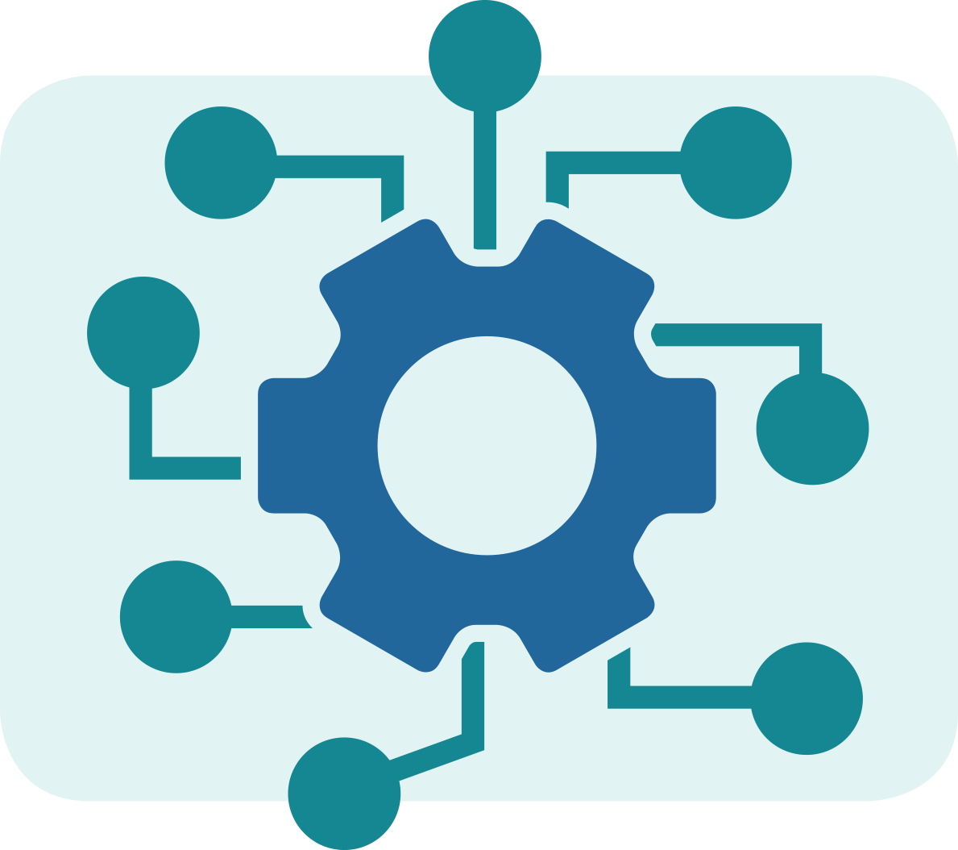
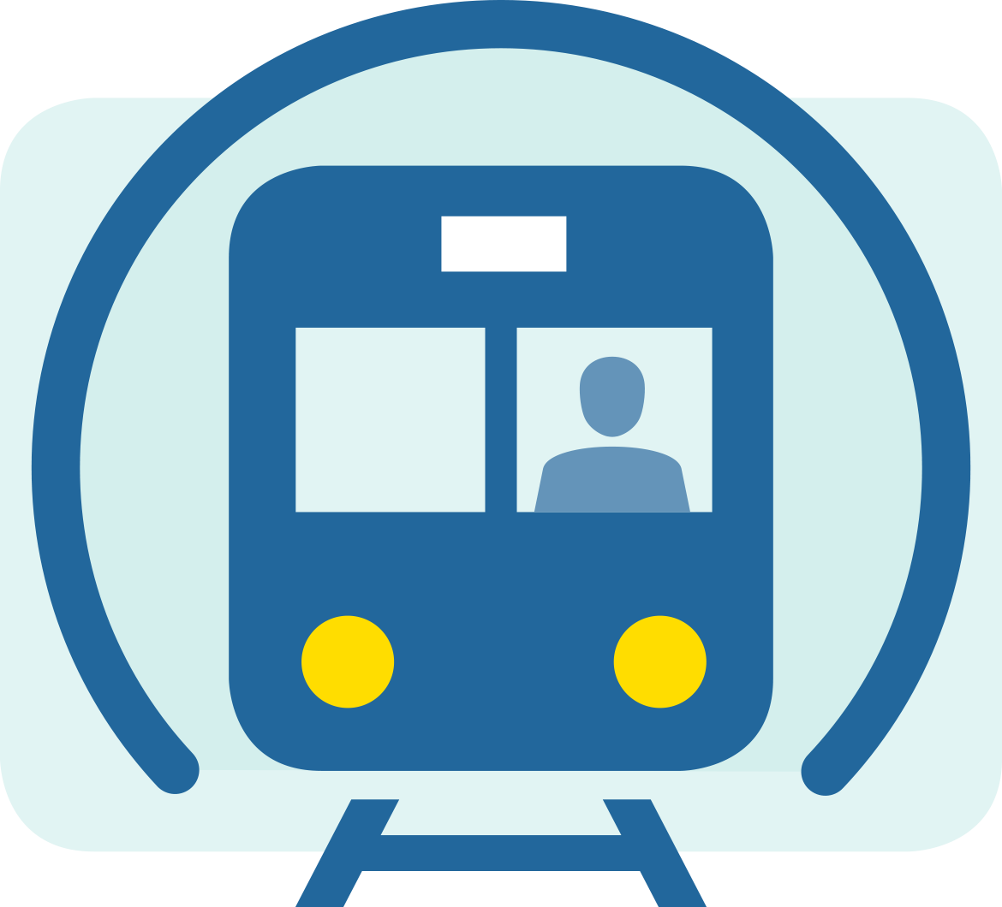
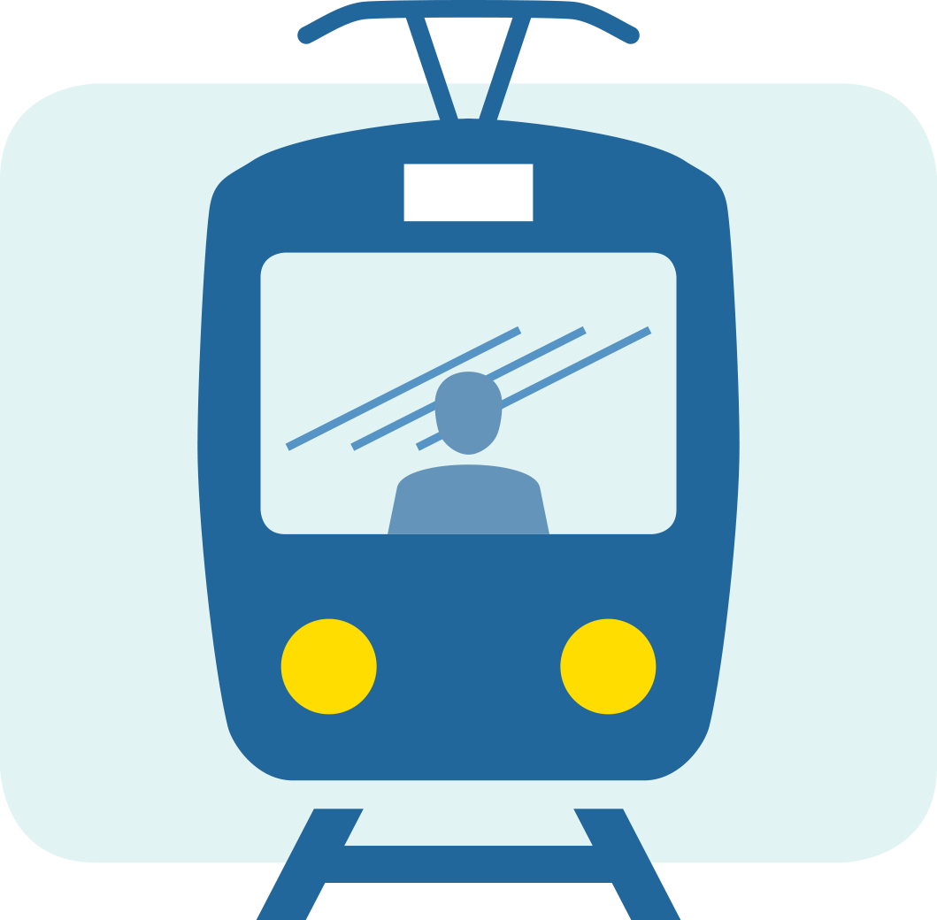
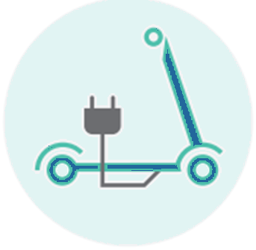
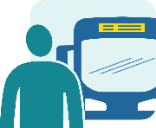
Multimodality and interoperability
It will be much easier to achieve the goal of interoperable systems, if all the systems are using similar definitions, structures and meanings for their data.
ERA Rail Data Forum, Verona, 18.-19. June 2024
Notes:
I will speak of multimodality and interoperability from a perspective of experiences with CEN TC278 WG3 standards.
But first let us remind ourselves of the traveller.
The reason for all our combined efforts is to promote public transport and help our travellers get from their origin to their destination smoothly.
There should be seamless, correct and relevant multimodal travel information that is consistent across different information channels and the different modes of public and alternate transport.
There is a need to clearly present the services available before, during and after the travelling takes place, also including any alterations, cancellations, delays or incidents
At the same time there are also other aspects to consider.
One such aspect is how to produce these services using available vehicles and staff resources in an efficient manner.
I have worked for over 30 years helping regions integrate public transport information across metro, buses, trams, boats, commuter and regional trains and finding solutions how to exchange the required information between different technical systems from different providers and used for different transport modes by different stake holders.
I experienced early that it is very hard to do this without all parties having a shared understanding of the exact meaning of the elements and attributes in the exchanged information.
This led me to understand the importance of standardisation and to join the work in the CEN Transmodel working group many years ago. Over the years I have also participate in other aligned CEN working groups as well in the non-profit association ITxPT that brings together different stakeholders from the industry, operators and authorities in the bus, heavy rail and other public transport sectors, promoting innovation and standardisation.

Slide 3
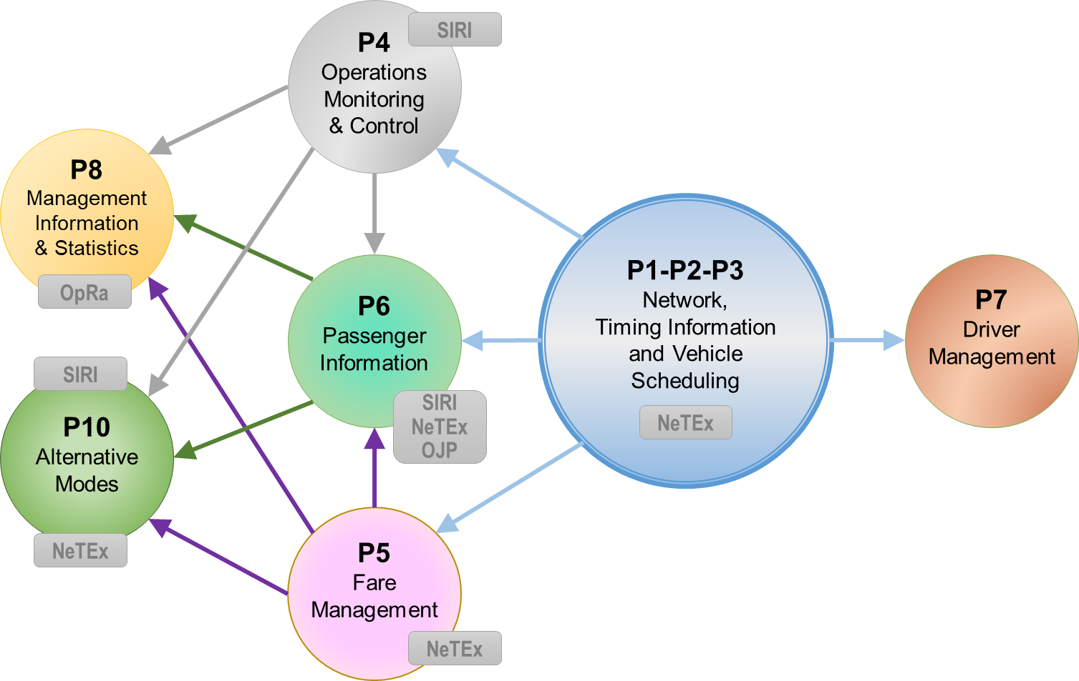
Transmodel – a conceptual data model
Transmodel : short name for the European Norm “Public Transport Reference Data Model” (EN 12896)
Transmodel provides a common language & data structures to describe semantics of the Public Transport domain
Transmodel covers many Public Transport domains and is divided into 10 parts:
Common Concepts
Public Transport Network
Timing Information & vehicle scheduling
Operations Monitoring & Control
Fare Management
Passenger Information
Driver Management
Management Information & Statistics
Alternative modes
ERA Rail Data Forum, Verona, 18.-19. June 2024
Notes:
The CEN Transmodel working group has existed for many years with participants from several countries and
has maintained and extended the multimodal CEN European Reference Data Model for Public Transport Information over the years.
It covers many aspects shared between the different public transport modes
such as bus, coach, trams and metro, but also heavy rail.
However, it does not cover all aspects of heavy rail, for instance, it does not go into the details of infrastructure capacity management process for train paths.
Still, it provides a certain level of integration with and mapping to such data
to allow for also using Transmodel
to provide precise passenger information
also for heavy rail.

Slide 4
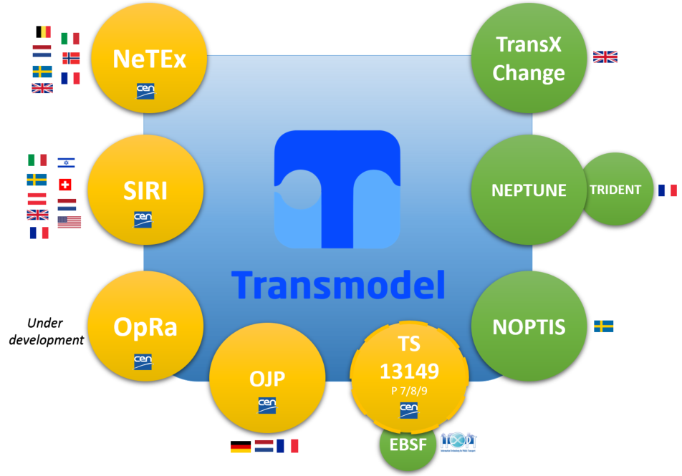
Transmodel based exchange protocols
ERA Rail Data Forum, Verona, 18.-19. June 2024
Notes:
Transmodel lays the foundation to several data exchange protocols
used to exchange planning and real time data
between different stakeholders in public transport.
Multiple data exchange protocols, across different types of implementations,
are based on the same shared public transport conceptual data model
using a common framework and consistent data semantics.
NeTEx is one example, focused on the planning data,
But also EPIP,
EPIAP - Provides necessary information for assessment of the accessibility of site(s), vehicles and on vehicle-site interaction for impaired persons
Accessibility to railway stations platform heights for boarding trains etcetera.

Slide 5
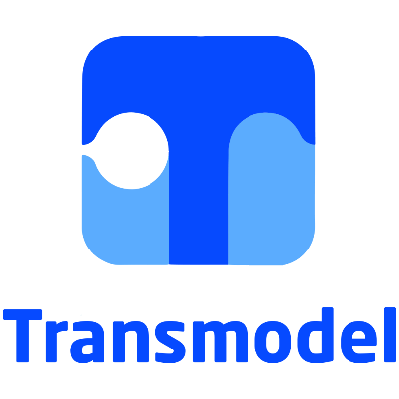
Methodology - Model-driven design
Object–oriented modelling method UML 2 is used for describing, specifying, documenting and visualizing the conceptual data model.
ERA Rail Data Forum, Verona, 18.-19. June 2024
Notes:
A conceptual model's primary objective is to convey the fundamental principles and basic functionality of the system/domain which it represents.
A conceptual data model is
implementation independent.
The model – driven design follows the steps: conceptual model → physical model →implementation (schema)

Slide 6
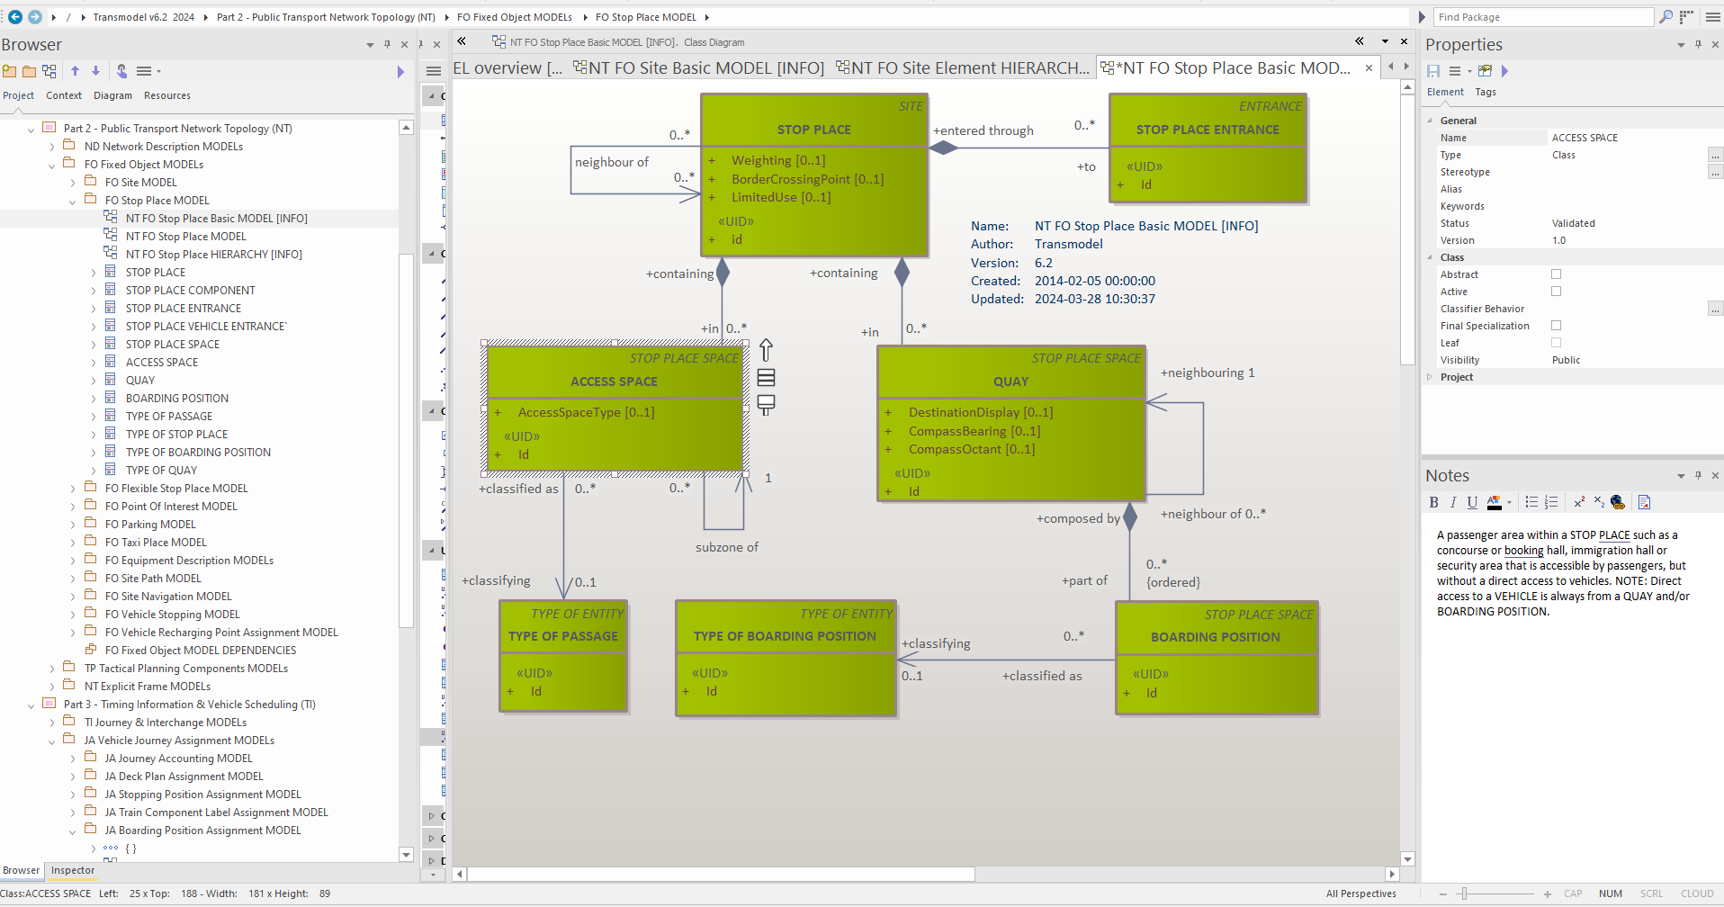
ERA Rail Data Forum, Verona, 18.-19. June 2024
Notes:
On screen Sparx EA, a tool to work with the UML describing the conceptual model .
On left m diff parts with their models and concepts As an example, here is the Transmodel STOP PLACE that can be used to represent a railway station or a bus terminal, tram stop etc
STOP PLACE - A place comprising one or more locations where vehicles may stop and where passengers may board or leave vehicles or prepare their trip.
A STOP PLACE may contain QUAY s - A place such as platform, stance, or quay side where passengers have access to PT vehicles, Taxis, cars or other means of transportation.
BOARDING POSITIONS -A location within a QUAY from which passengers may directly board, or onto which passengers may directly alight from a VEHICLE.
In parallel with UML there is also the W3C Web Ontology Language (OWL) . There are many similarities between UML and OWL but also some differences.
Using both languages in combination and maybe in different stages may be a good proposition.
In the history of UML, it has encompassed features from other modelling languages allowing it to replace them, so there is a good case for a future unification of the two languages.
One challenge we encounter vis-a-vis semantics is how to handle when the same basic concept is named differently by stake holders coming from different backgrounds, even worse is when the same term is used for different concepts. This is addressed in Transmodel by relying heavily on the precise definition of each term as shown above.

Slide 7
TC278 WG3 SG4 - Transmodel CEN European Reference Data Model for Public Transport Information
,
Thank you!
Additional videos and white-papers available at https://transmodel-cen.eu/
ERA Rail Data Forum, Verona, 18.-19. June 2024
Notes:
Finally, it is my hope that I have been able to give you
an overview of the CEN Transmodel modelling approach
and promote the idea to think in terms of
agreed models
agreed terms
agreed usage
across all aspects of multimodal transport.
Thank you!

