Slide 1
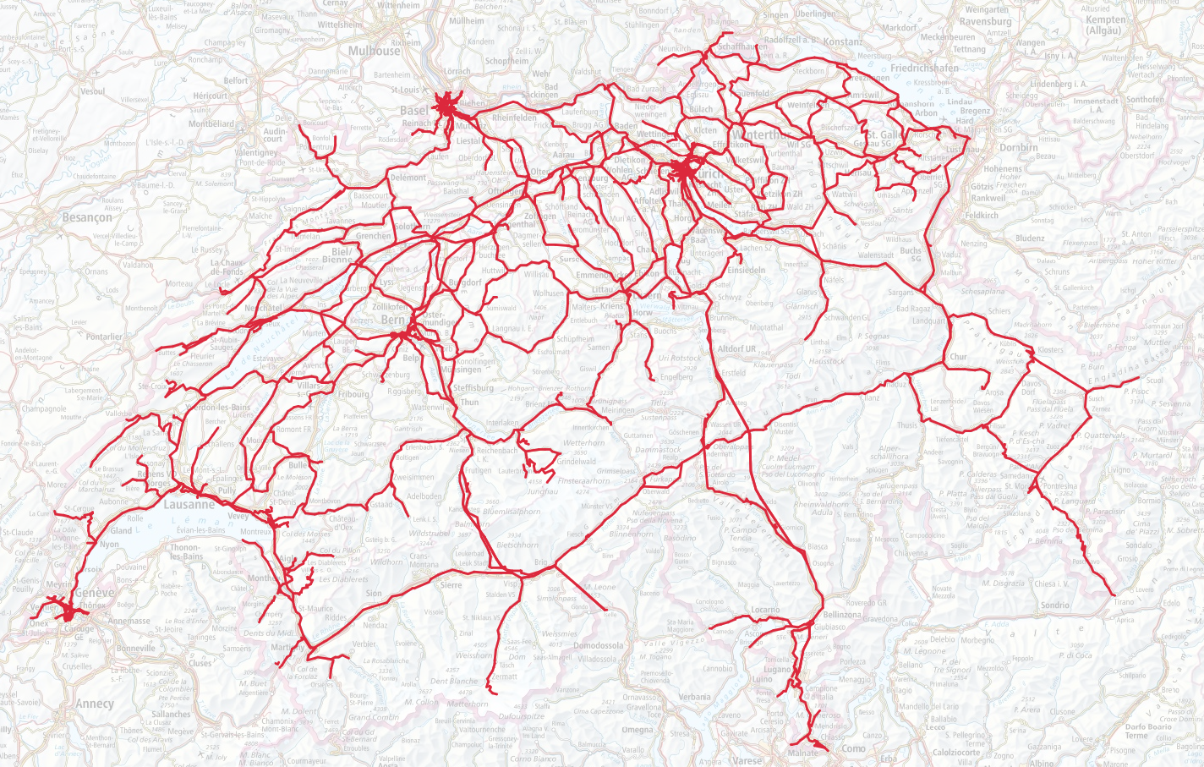
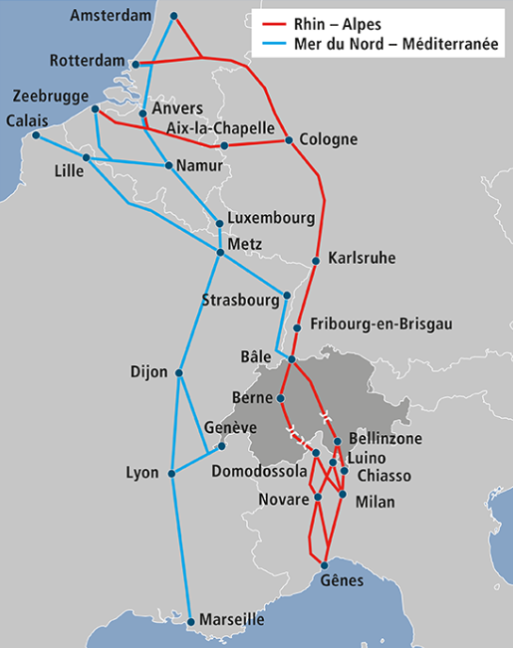
Swiss rail network
Total network 5124 km
55 infrastructure manager
Interoperable network 3754 km
17 interoperable infrastructure manager
Biggest CFF/SBB/FFS → 3011 km
2nd BLS 449 km
3rd SOB 123 km
Smallest OeBB → 4,1 km
Non interoperable network 1370 km
38 infrastructure manager
Backbone of the north-south freight corridors

Slide 2
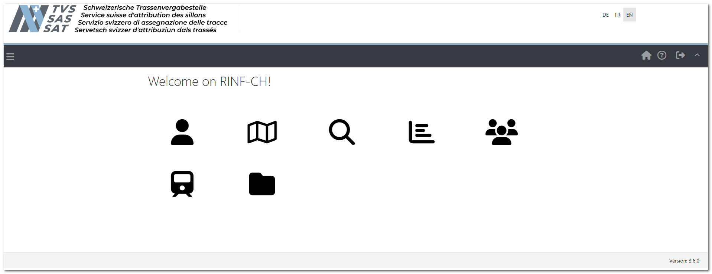
RINF situation in Switzerland
Own RINF-CH
Responsibilities TVS (NRE)
Data collection
Data transmission
Exploitation and continued development

Slide 3
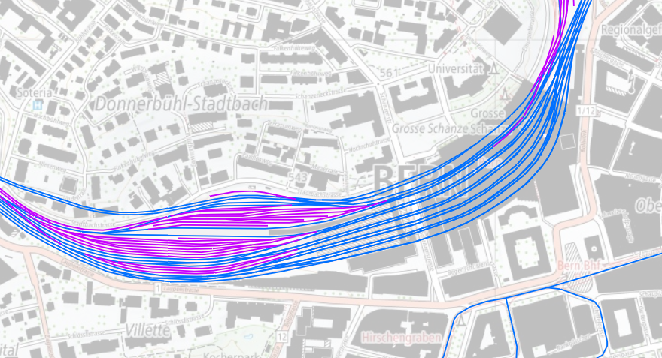
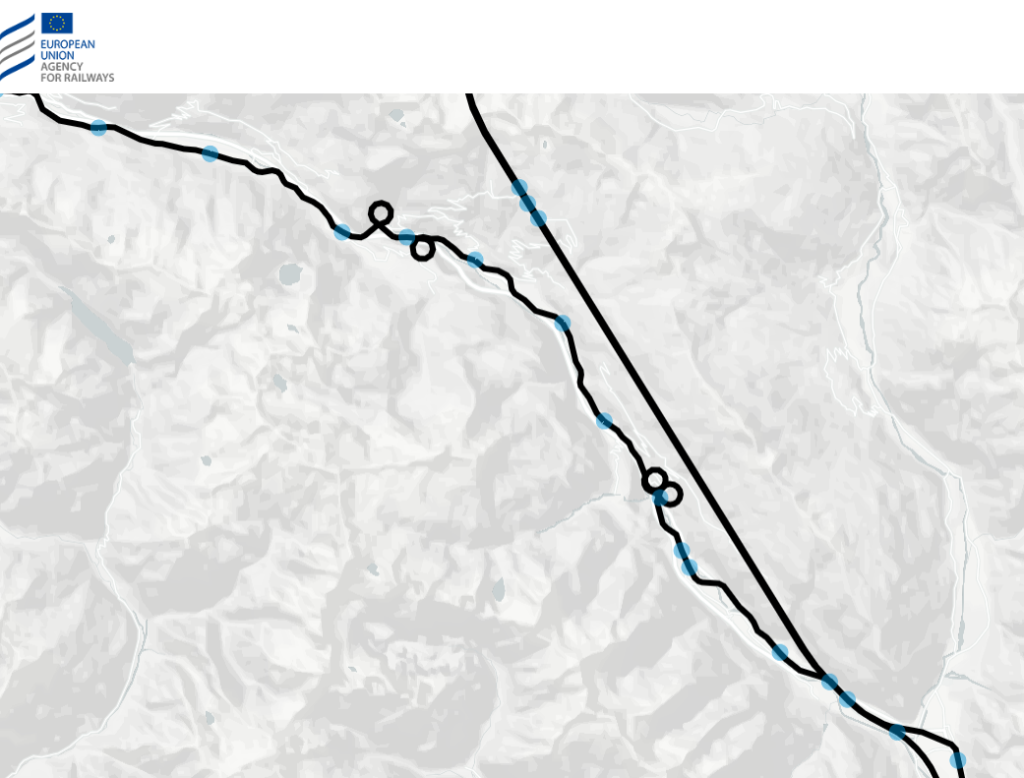
Accurate geometry
IMs deliver the geometries
SOL
OP
RNT (incl. Siding)

Slide 4
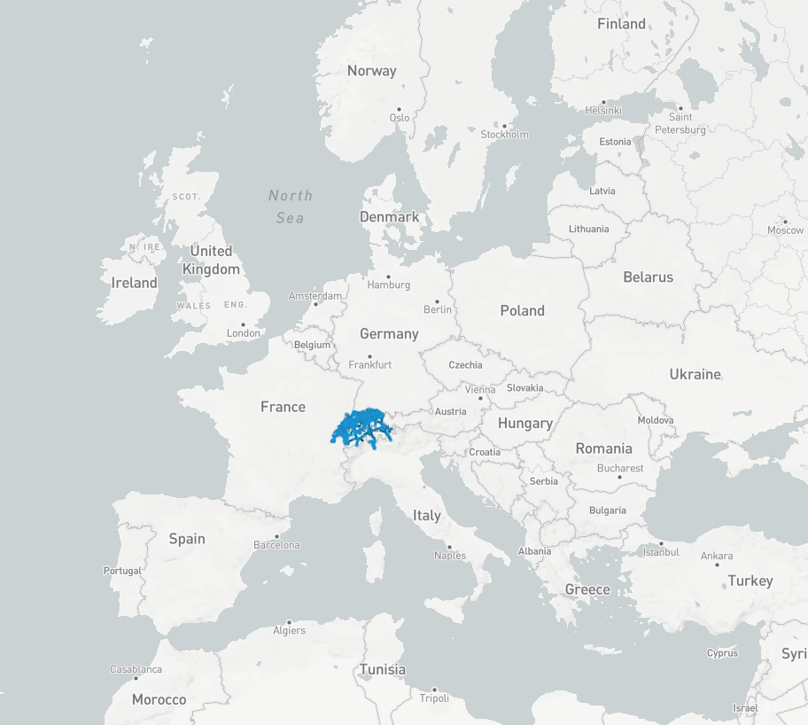
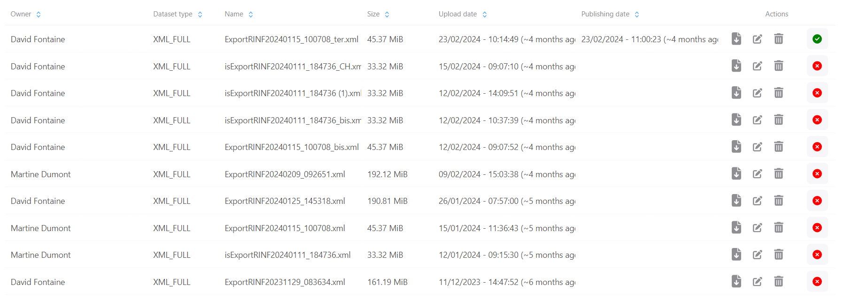
From .XML to .RDF
Switzerland was a volunteer for the import in the new ERA environment

