Slide 1


European Rail data interoperability through Semantic Web:
ERA rail ontology
An EU Rail System without Digital Barriers
18th June Verona| Rail Data Forum
Notes:
Semantics driving FAIR data in Railways
Semantics = is operationalized using linked data
WHY, WHAT WHERE we go and imoact
Hace cinco años que la Agencia ha arrancado su nuevo, role
5 años en los que la transformación digilta ha cambiado radicalmente
La Agencia en sus strategy workshops digitales ha estudiado cual es la contribución que Podemos hacer al sector
Como desde el avance de las tecnologias digitales hoy, la agencia puede conrtibuir a un cambio necesario ..
The digital transformation problem today … costly
In the Core .. Super specific system engineering staff complex ProRail Statement
In the Clio
Internally .. Disconnected data sets .. Impossible to answer questions such us it s this accident
N2N Hell of API
Why we approach semantic technologies (money.. Eu data policy )
Note.. This is not about open data.. This is about browsability of your data structure so every technician and every person knows where the information is .. Their rules and

Slide 2
Railway ¨data ¨ ecosystem
Weather station
Capacity allocation
Operations centre
Maintenance works planning
Ticketing
Level crossing
Civil engineering & slopes/curves
Service track
Data exchange needed
Costly data transformations
70% of the cost of ERTMS deployment engineering hours
Ticket vendors without business model
The hell of the API paradigm
Main track
Rail network maintaining
Obstacle
Station platform
Switch monitoring
Driver
Station
Signalling equipments / ERTMS
Rolling stock
Junction
Signal box
Beacon
ECM
Catenary lines
Traction sub-station
Notes:
Many physical assets scattered all over the railway topology
Physical assets in movement handled and operated by multiple actors

Slide 3
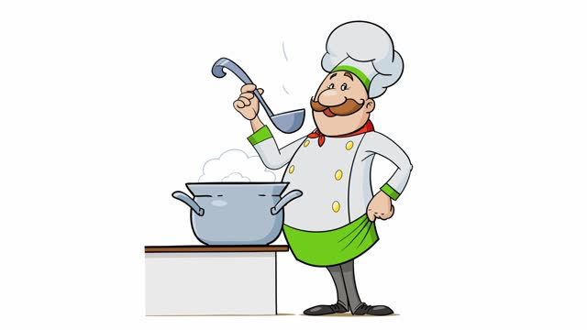
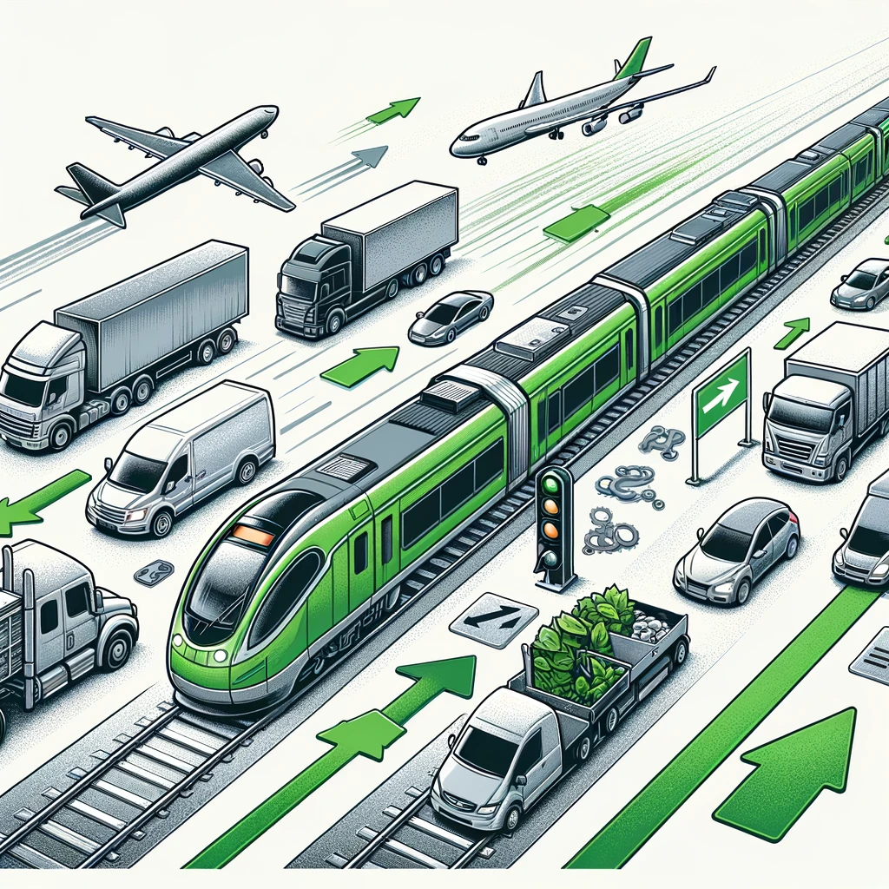


Cooking the Modal Shift from a 0101010101001 perspective
Interoperability
Knowledge !!!
Green Culture
Modal Shift
Notes:
I think that previous speakers have provided us the clue to the recipe…
A recipe from0101010 perspective of course
In order to make a green transport related decision we need to know

Slide 4
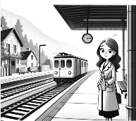

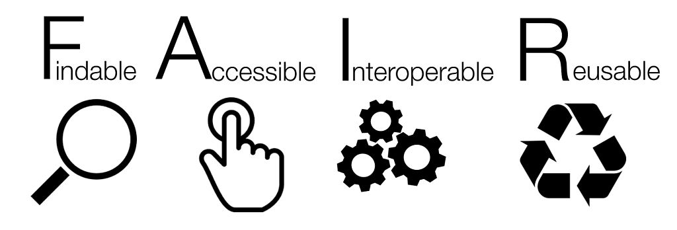



Zooming… IN
@Interoperability & Knowledge
Interoperability
Knowledge !!!
Route to Verona…
SEMANTICS
Notes:
Zooming in @ Interoperability and knowledge :
Interoperability and knowledge is definitively powered by FAIR principles and Semantics

Slide 5


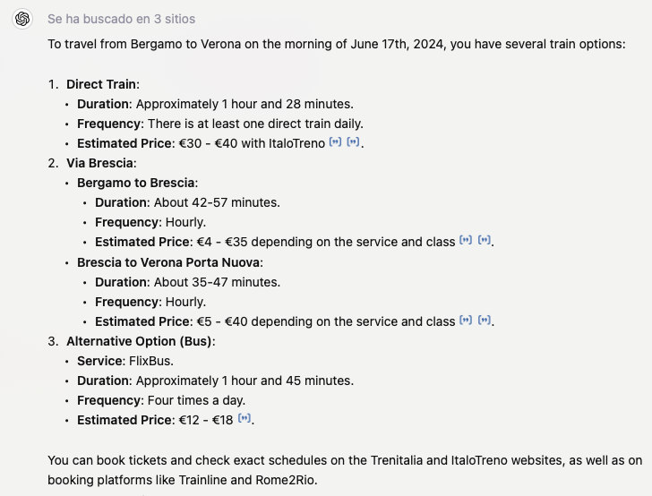



Findability
Q1. How can search engines find reliable rail information –including cheapest offer?
Q2. How can freight carriers find the full freight offer and track their freight throughout the logistic chain?
Notes:
We should not neglect the tremendous power of the search engines in the passenger decision making process
And also in the freight domain..
Accurate results only/by applying semantics .. Link to scientific demonstration
Why you can trace a flight in real time using flight radar – punctuality statistics included but no disclosure in rail domain?
Till now .. It has been protected and it has not worked.. Changes needed

Slide 6




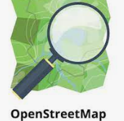

Accessibility
Retrievability by humans and machines
Browsability
Unique and persistent Identifiers. URIs
Use of open and standard protocols
Open data models
Data accessible under well defined conditions
KG
Notes:
Accessibility in the context of the FAIR principles means that data should be retrievable and accessible under well-defined conditions and through well-defined protocols. Key components are ..

Slide 7



Reusability and Interoperability
Data generated by one part of the system can be effectively utilized by other parts.
G2G
B2G
B2B i.e. harmonized Data Prep
    70% of the cost of ERTMS deployment engineering hours is data transformation
KG
KG
data provision to Register of Infrastructure
models semantically lifted
Notes:
Common Sense
The super high cost of data transformations ….
Important steps taken ..
Once only principle, alignment between legal rail transport data provisions
Important steps: MB decision .. Cascade effect in our stakeholders that are the full rail sector , ERA ontology RINF.. Legally Binding.. , ERA in the Data Spaces..
In the B2B .. The Agency is also system authority PLC and OP alignment location codes reference lists .. Taf tap data model … telematics.. Next year data preparation
In the

Slide 8
Semantics
      = W3C world wide web open communication protocols
      = adoption of well-known and largely used open standards
      = A wider network of available human resources, integrating both human and machine uptake of tasks, with a reduced need for highly specialized knowledge
      === lower cost through economy of scale & no vendor lock in
      ===. Off-the-self
Huge SELF !!! Internet Self!

Slide 9


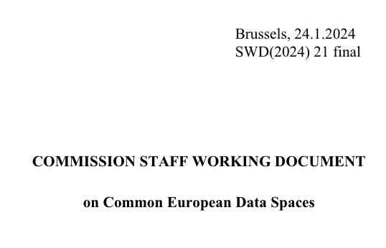

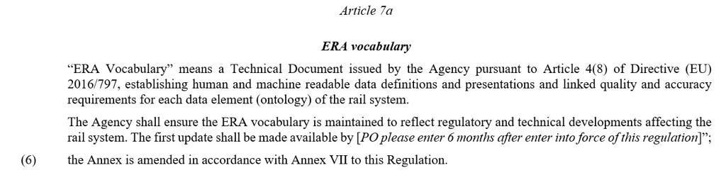
ERA ontology & ERA Knowledge Graph !
What about … ?
A standard ..
in use …
human and machine readable
and . . legally binding!!!
Notes:
Imagine … we could use a standard
(at the same time ..based on open well maintained secure web standards in use for a much wider community .. Internet community)
in use (currently 27 eu member states provide data …
because it is legally binding….
but then if we are in the right direction .., massive interoperability
Towards ERA DATA TSI

Slide 10
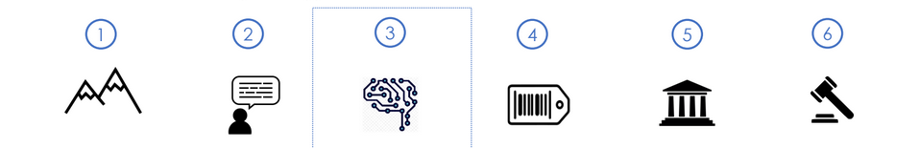
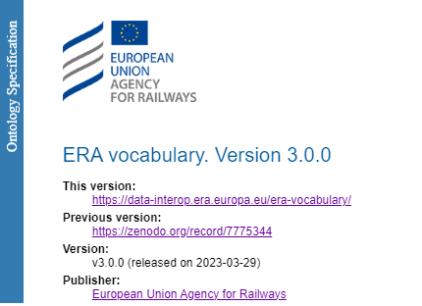
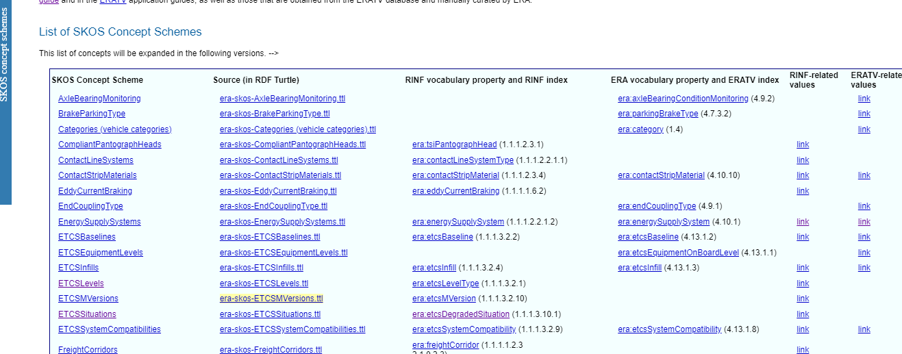

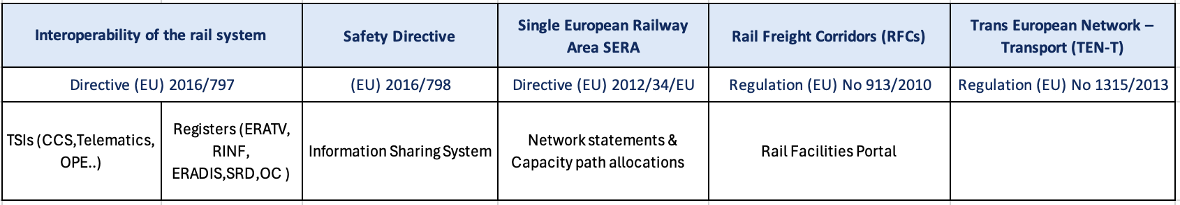
FAIRification at scale @ERA
Vision and Principles
Use Case Tree
Building the data architecture blocks and artefacts, pipeline
Data Assets Management
Data Culture
Data Governance
Notes:
Where we go…

Slide 11
Some numbers …
More than 36 million triples​ (statements)
More than 31k lines of mappings​
More than 100 shacl shapes – business rules ​
+270k track segments described​
+50k stations described​
+50k geo-referenced objects (lat/lon)​
+2k Vehicle Types described​
27 countries covered​
Grown up people problems…
Industrial Knowledge Graph
Notes:
How did it start?

Slide 12
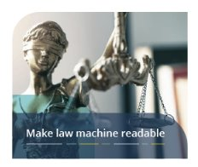
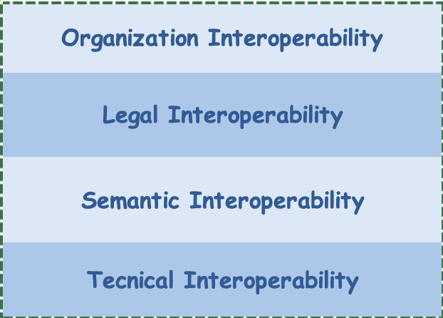
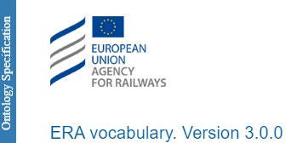
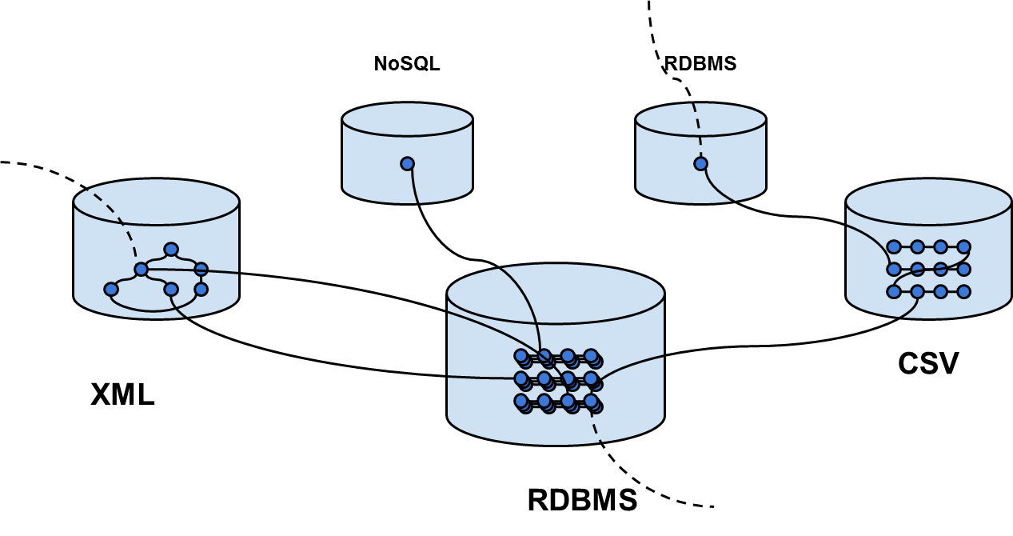
Law as Code and…Code as Law
Ontology as an instrument to harmonize law
glossary terms and taxonomies in the legal texts
KG
RDF triplestore
Legacy
Databases
Linked data is not a technology is a mindset,
an enabler towards data centricity
towards knowledge management
Documents and Reports
Notes:
Quality proof
A bidireccional relationship

Slide 13


Rail Ontologies in bloom
2019
2024
Alone in the dessert
Rail Ontologies blooming as Mushrooms

Slide 14
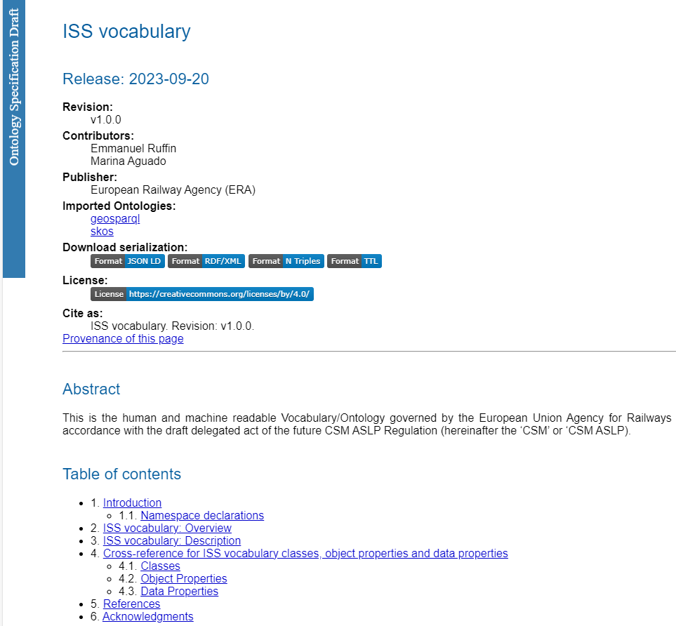
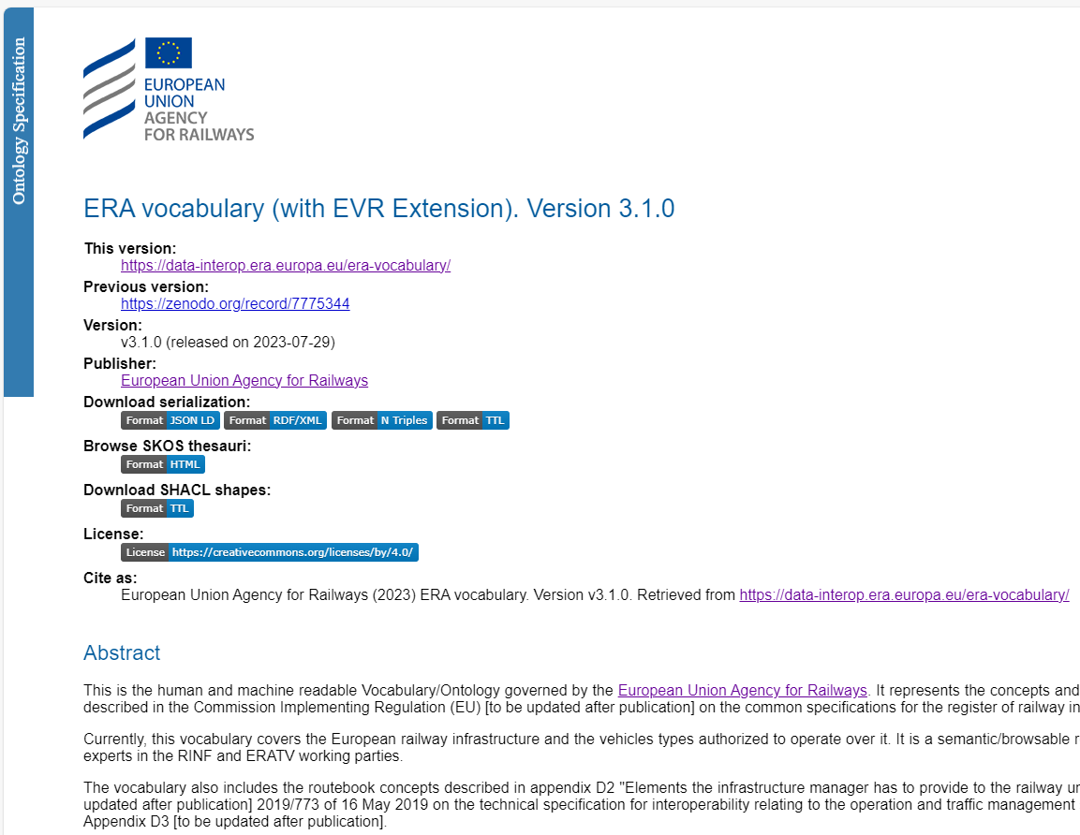
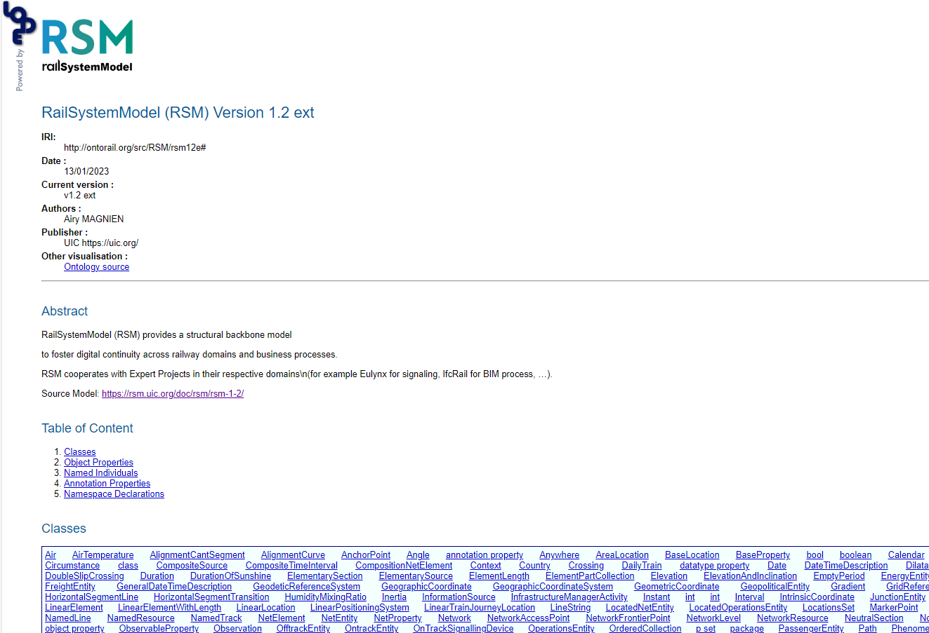
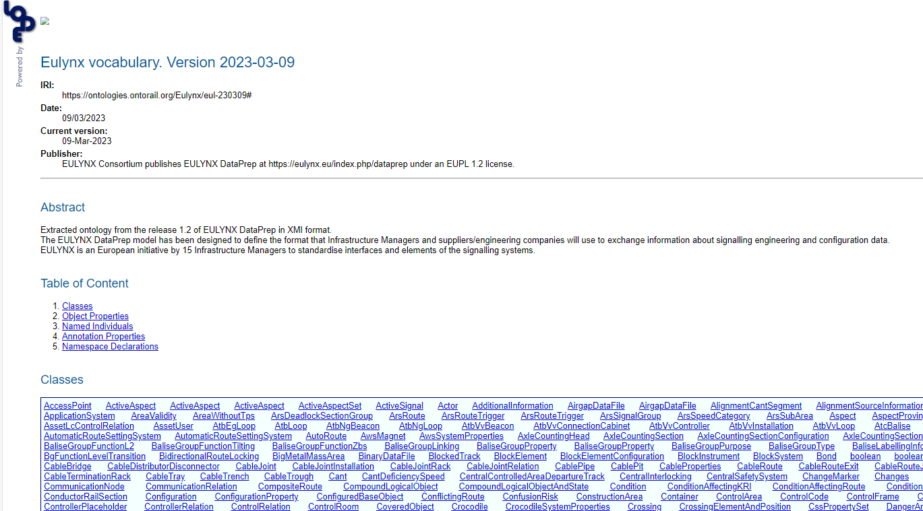
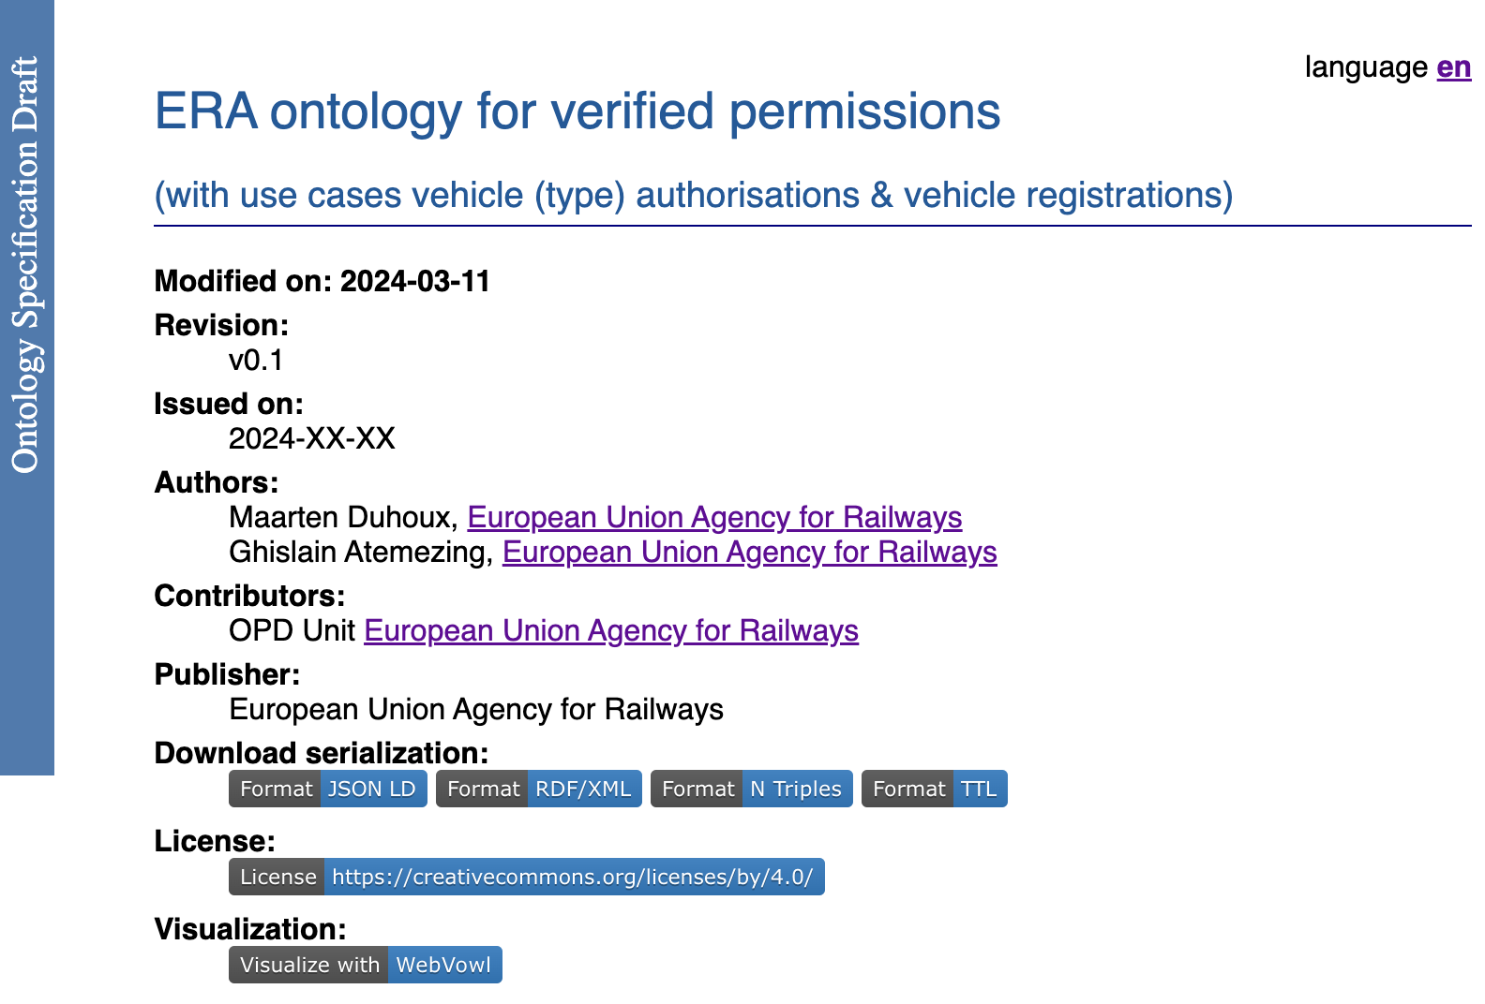
Rail Ontologies in bloom

Slide 15













Who is reusing our ERA ontology
Who is reusing ERA data ?
RU
Data Consumers
IM
Data Providers
Notes:
Ukraine
Demo from TraffikVerker… RIS from RNE
Transformations for GISCO…
Open StretMaps ARGIS

Slide 16
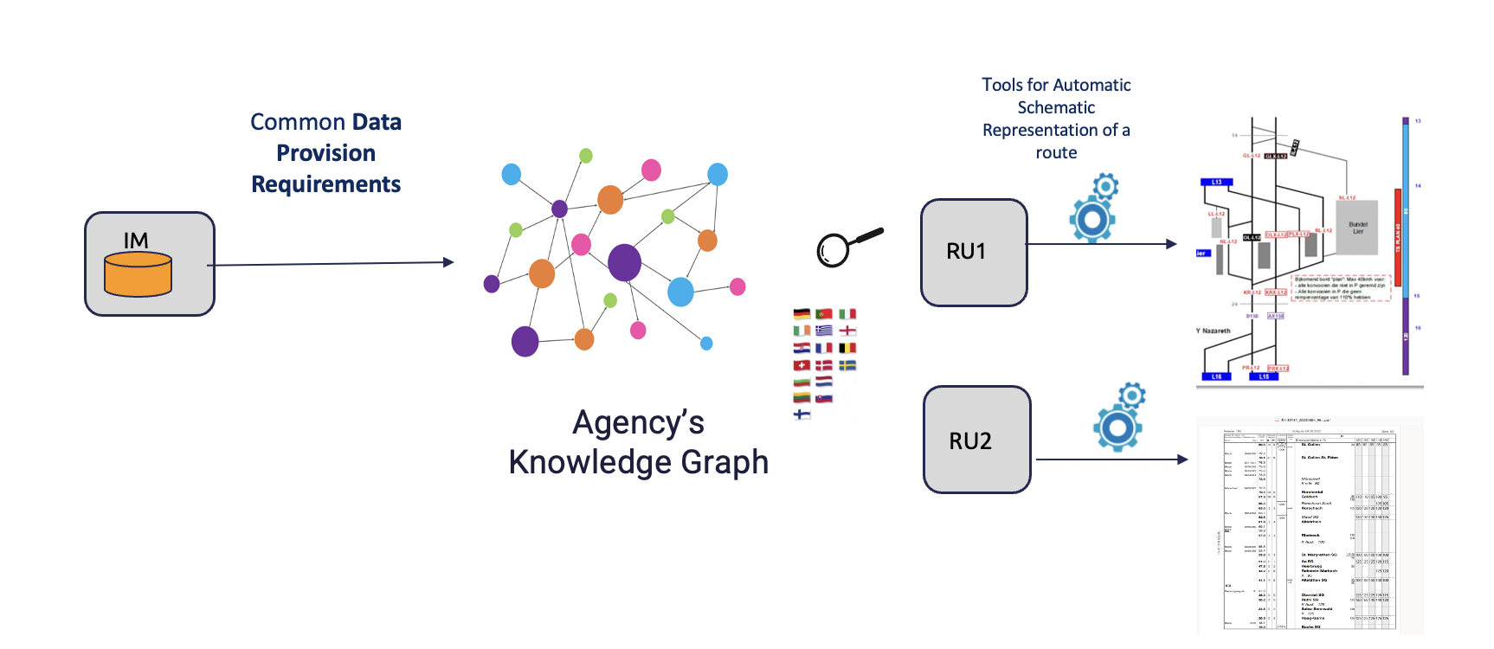
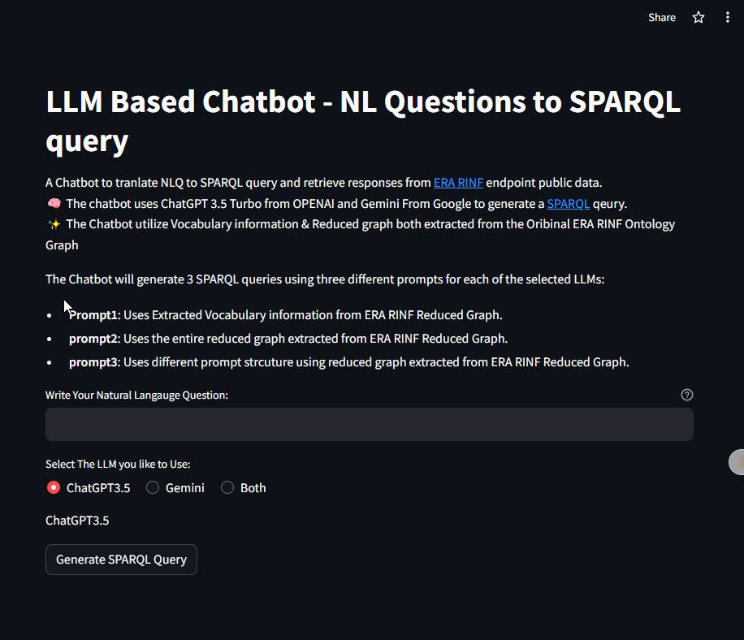
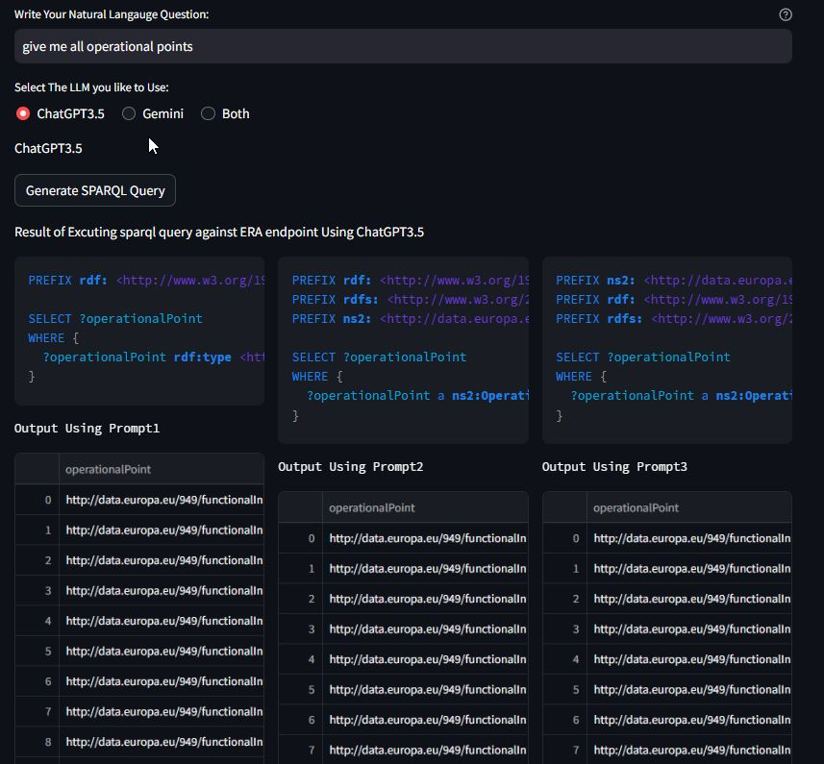

What´s next ?

Slide 17
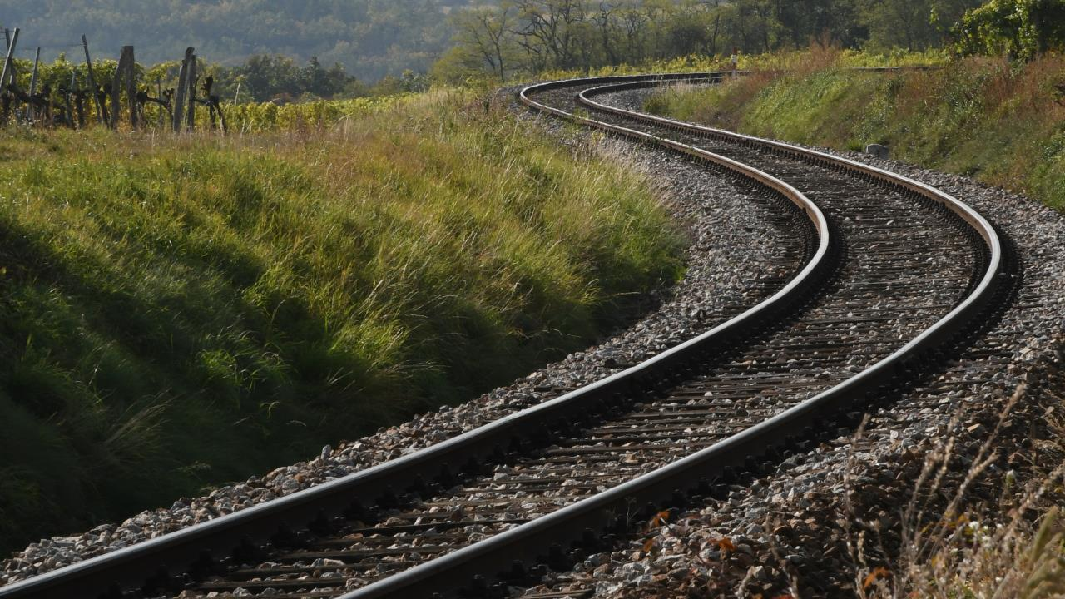
THANK YOU
Moving Europe towards a sustainable and safe railway system without frontiers.
Follow us:

