Slide 1



RAIL DATA FORUM 2024
Delivering ERA-ontology for EU-RAIL use cases
Marina Aguado (ERA)
Ralph Mueller (EU-RAIL)
18/06/2024 | Verona
Photo: Adobe Srock / by Serjiob74

Slide 2
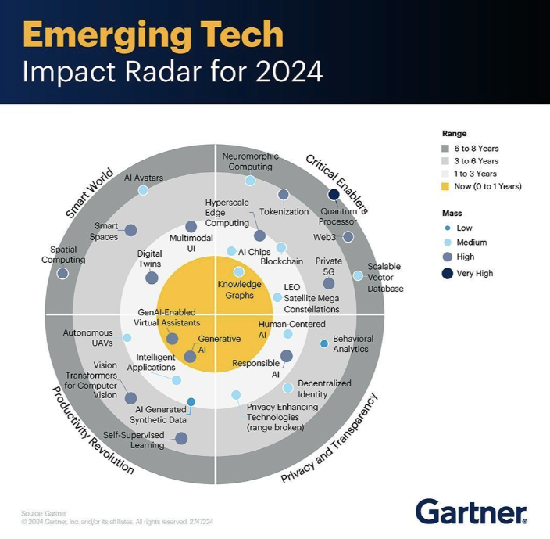
Knowledge Graphs (ontology) are emerging enablers
The benefits of ERA/ EU-RAIL collaboration on a railway ontology
increased interoperability by serving precise use cases / solving real problems
automatic reasoning
shared vocabulary
Notes:
Inspired from the HF case from Eurocontrol, already well implemented in the aviation sector., this methodology has been customised to better meet the needs of the railway sector and be consistent with the railway regulatory framework when a need for change is identified.
This methodology can be used for any change: from a small change to a more complex change involving many subsystem changes (ie organisational change, IT change…). A thorough description of the desired change is needed, as it may be necessary to break it down and study the interactions in several separate parts, that may not have been identified at first, this includes different systems, subsystems, teams, activities...
This methodology is composed of five steps, as can be shown in figure
This methodology should be applied from the start of a change i.e. when the need for change is identified. End-users should be involved from the very beginning, with the aim of identifying the specific HOF topics that will be included in the risk management process (and independent assessment, when needed, following requirements of Regulation EU 402/2013).
To increase efficiency, this methodology can be carried out in parallel or using the same resources (e.g. existing documentation, meetings/workshops…).
The methodology should be guided or used by a HOF specialist, and if not available by someone with HOF expertise. People using this methodology should be specifically trained to use it. Several roles mentioned can be fulfilled by the same individual, especially for smaller companies and/or smaller changes.
In conformity with chapter 1.6, this methodology should ensure that HOF is integrated in change management in a balanced manner to avoid pressure or influence, as far as possible. The first question in determining whether to apply this methodology is: could this change have any impact (direct/indirect) on staff carrying out safety-related tasks?

Slide 3
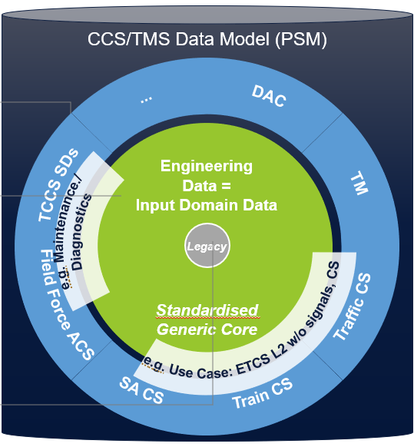

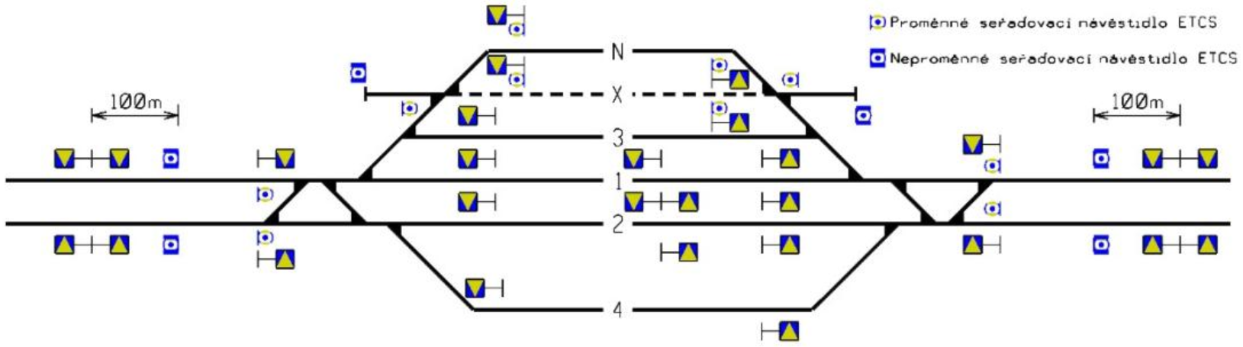
Planning, building, operating and maintaining SERA
Data configuration & interface specifications (incl. diagnostic data) derive from ERA-ontology CCS/TMS Data Model
„Does the data comply with the CCS/TMS Data Model?“
ERA
Ontology
Geolocalised data
Correct and up-to-date from track geometry data provider
OR
New measurement that shall have at least 10 cm and should have 1 cm tolerance.
„Is the balise at least in 5,0 m distance from the fouling point?“
CCS/ TMS data model
Validation
Tool*
raw data
config data
Tool supported asset engineering
CCS planning rules
* Validation tool will be developed by MOTIONAL Sub Group 4 (Digital Enablers)
Notes:
Inspired from the HF case from Eurocontrol, already well implemented in the aviation sector., this methodology has been customised to better meet the needs of the railway sector and be consistent with the railway regulatory framework when a need for change is identified.
This methodology can be used for any change: from a small change to a more complex change involving many subsystem changes (ie organisational change, IT change…). A thorough description of the desired change is needed, as it may be necessary to break it down and study the interactions in several separate parts, that may not have been identified at first, this includes different systems, subsystems, teams, activities...
This methodology is composed of five steps, as can be shown in figure
This methodology should be applied from the start of a change i.e. when the need for change is identified. End-users should be involved from the very beginning, with the aim of identifying the specific HOF topics that will be included in the risk management process (and independent assessment, when needed, following requirements of Regulation EU 402/2013).
To increase efficiency, this methodology can be carried out in parallel or using the same resources (e.g. existing documentation, meetings/workshops…).
The methodology should be guided or used by a HOF specialist, and if not available by someone with HOF expertise. People using this methodology should be specifically trained to use it. Several roles mentioned can be fulfilled by the same individual, especially for smaller companies and/or smaller changes.
In conformity with chapter 1.6, this methodology should ensure that HOF is integrated in change management in a balanced manner to avoid pressure or influence, as far as possible. The first question in determining whether to apply this methodology is: could this change have any impact (direct/indirect) on staff carrying out safety-related tasks?

Slide 4
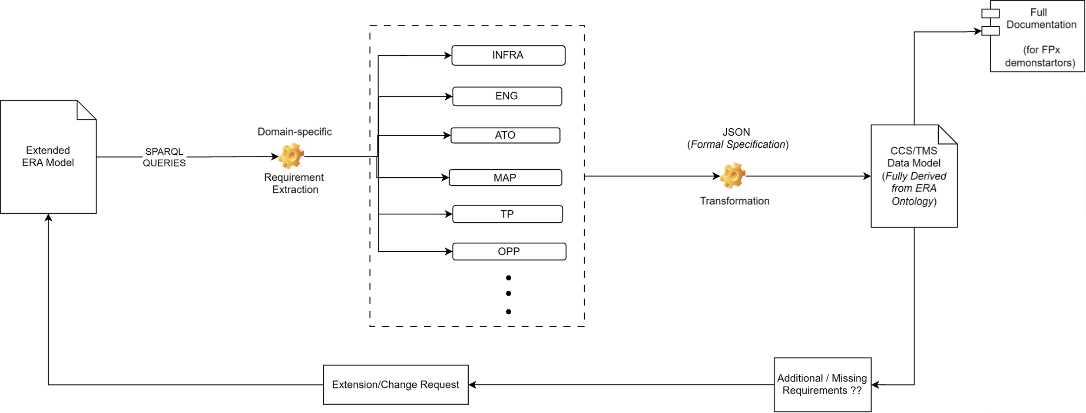
More than 500 use cases require Rail Infra and Topology information
Continuous use of ERA Ontology for extraction of CCS/ TMS Data Model as projects (use cases) need specific model
ERA
Ontology
CCS/ TMS data model
Notes:
Inspired from the HF case from Eurocontrol, already well implemented in the aviation sector., this methodology has been customised to better meet the needs of the railway sector and be consistent with the railway regulatory framework when a need for change is identified.
This methodology can be used for any change: from a small change to a more complex change involving many subsystem changes (ie organisational change, IT change…). A thorough description of the desired change is needed, as it may be necessary to break it down and study the interactions in several separate parts, that may not have been identified at first, this includes different systems, subsystems, teams, activities...
This methodology is composed of five steps, as can be shown in figure
This methodology should be applied from the start of a change i.e. when the need for change is identified. End-users should be involved from the very beginning, with the aim of identifying the specific HOF topics that will be included in the risk management process (and independent assessment, when needed, following requirements of Regulation EU 402/2013).
To increase efficiency, this methodology can be carried out in parallel or using the same resources (e.g. existing documentation, meetings/workshops…).
The methodology should be guided or used by a HOF specialist, and if not available by someone with HOF expertise. People using this methodology should be specifically trained to use it. Several roles mentioned can be fulfilled by the same individual, especially for smaller companies and/or smaller changes.
In conformity with chapter 1.6, this methodology should ensure that HOF is integrated in change management in a balanced manner to avoid pressure or influence, as far as possible. The first question in determining whether to apply this methodology is: could this change have any impact (direct/indirect) on staff carrying out safety-related tasks?

Slide 5
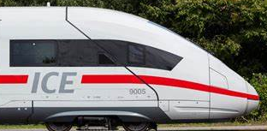

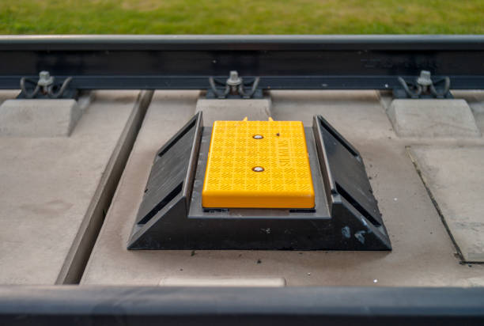
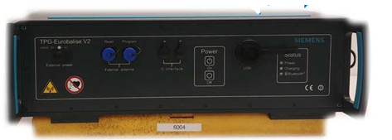
Delivery is key
Use case 1: ETCS Balise programming
CCS/TMS
(XMLs)
Program
(C++)
ERA
Ontology
Input
CCS/ TMS data model
raw data
infra
represented by
eng
output
based on
.tlg
CCS/TMS
(JSON)
(data-model)
CCS/TMS
(XSD)
Input
exchange Info
generate
connect
install
load
Notes:
Inspired from the HF case from Eurocontrol, already well implemented in the aviation sector., this methodology has been customised to better meet the needs of the railway sector and be consistent with the railway regulatory framework when a need for change is identified.
This methodology can be used for any change: from a small change to a more complex change involving many subsystem changes (ie organisational change, IT change…). A thorough description of the desired change is needed, as it may be necessary to break it down and study the interactions in several separate parts, that may not have been identified at first, this includes different systems, subsystems, teams, activities...
This methodology is composed of five steps, as can be shown in figure
This methodology should be applied from the start of a change i.e. when the need for change is identified. End-users should be involved from the very beginning, with the aim of identifying the specific HOF topics that will be included in the risk management process (and independent assessment, when needed, following requirements of Regulation EU 402/2013).
To increase efficiency, this methodology can be carried out in parallel or using the same resources (e.g. existing documentation, meetings/workshops…).
The methodology should be guided or used by a HOF specialist, and if not available by someone with HOF expertise. People using this methodology should be specifically trained to use it. Several roles mentioned can be fulfilled by the same individual, especially for smaller companies and/or smaller changes.
In conformity with chapter 1.6, this methodology should ensure that HOF is integrated in change management in a balanced manner to avoid pressure or influence, as far as possible. The first question in determining whether to apply this methodology is: could this change have any impact (direct/indirect) on staff carrying out safety-related tasks?

Slide 6
Delivery is key
Use case 2: ATO segment profiles
CCS/TMS
(XMLs)
Program
(C#)
ERA
Ontology
Input
CCS/ TMS data model
raw data
infra
represented by
map
based on
output
CCS/TMS
(JSON)
(data-model)
CCS/TMS
(XSD)
Ato.xml
generate
Notes:
Inspired from the HF case from Eurocontrol, already well implemented in the aviation sector., this methodology has been customised to better meet the needs of the railway sector and be consistent with the railway regulatory framework when a need for change is identified.
This methodology can be used for any change: from a small change to a more complex change involving many subsystem changes (ie organisational change, IT change…). A thorough description of the desired change is needed, as it may be necessary to break it down and study the interactions in several separate parts, that may not have been identified at first, this includes different systems, subsystems, teams, activities...
This methodology is composed of five steps, as can be shown in figure
This methodology should be applied from the start of a change i.e. when the need for change is identified. End-users should be involved from the very beginning, with the aim of identifying the specific HOF topics that will be included in the risk management process (and independent assessment, when needed, following requirements of Regulation EU 402/2013).
To increase efficiency, this methodology can be carried out in parallel or using the same resources (e.g. existing documentation, meetings/workshops…).
The methodology should be guided or used by a HOF specialist, and if not available by someone with HOF expertise. People using this methodology should be specifically trained to use it. Several roles mentioned can be fulfilled by the same individual, especially for smaller companies and/or smaller changes.
In conformity with chapter 1.6, this methodology should ensure that HOF is integrated in change management in a balanced manner to avoid pressure or influence, as far as possible. The first question in determining whether to apply this methodology is: could this change have any impact (direct/indirect) on staff carrying out safety-related tasks?

Slide 7

Delivery is key
Use case 3: Standardised user interfaces
Generating CCS/TMS data model schema based on ERA-ontology
Generating CCS/TMS files based on CCS/TMS schema
CCS/TMS files’ role in Engineering
Kilometric information in CCS/TMS files
Catalog of symbols
CCS/TMS files to User Interfaces views
See demo movie:
https://rail-research.europa.eu/system_pillar/system-pillar-outputs/
Notes:
Inspired from the HF case from Eurocontrol, already well implemented in the aviation sector., this methodology has been customised to better meet the needs of the railway sector and be consistent with the railway regulatory framework when a need for change is identified.
This methodology can be used for any change: from a small change to a more complex change involving many subsystem changes (ie organisational change, IT change…). A thorough description of the desired change is needed, as it may be necessary to break it down and study the interactions in several separate parts, that may not have been identified at first, this includes different systems, subsystems, teams, activities...
This methodology is composed of five steps, as can be shown in figure
This methodology should be applied from the start of a change i.e. when the need for change is identified. End-users should be involved from the very beginning, with the aim of identifying the specific HOF topics that will be included in the risk management process (and independent assessment, when needed, following requirements of Regulation EU 402/2013).
To increase efficiency, this methodology can be carried out in parallel or using the same resources (e.g. existing documentation, meetings/workshops…).
The methodology should be guided or used by a HOF specialist, and if not available by someone with HOF expertise. People using this methodology should be specifically trained to use it. Several roles mentioned can be fulfilled by the same individual, especially for smaller companies and/or smaller changes.
In conformity with chapter 1.6, this methodology should ensure that HOF is integrated in change management in a balanced manner to avoid pressure or influence, as far as possible. The first question in determining whether to apply this methodology is: could this change have any impact (direct/indirect) on staff carrying out safety-related tasks?

Slide 8
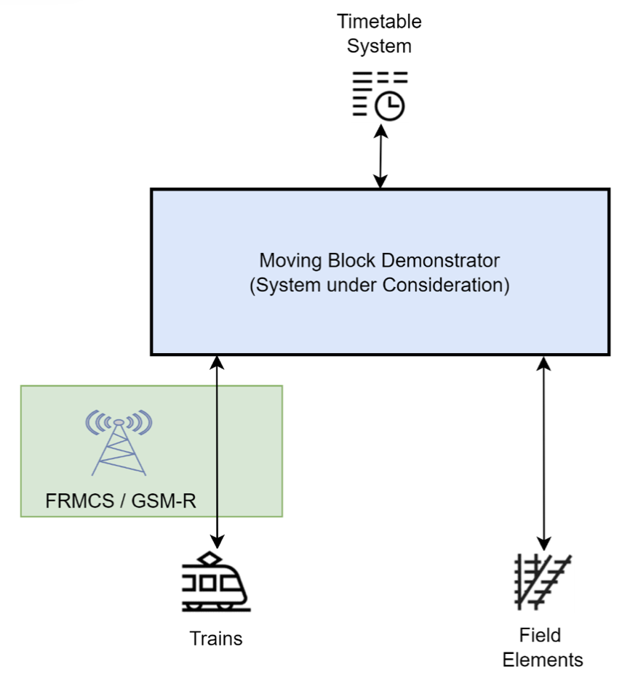
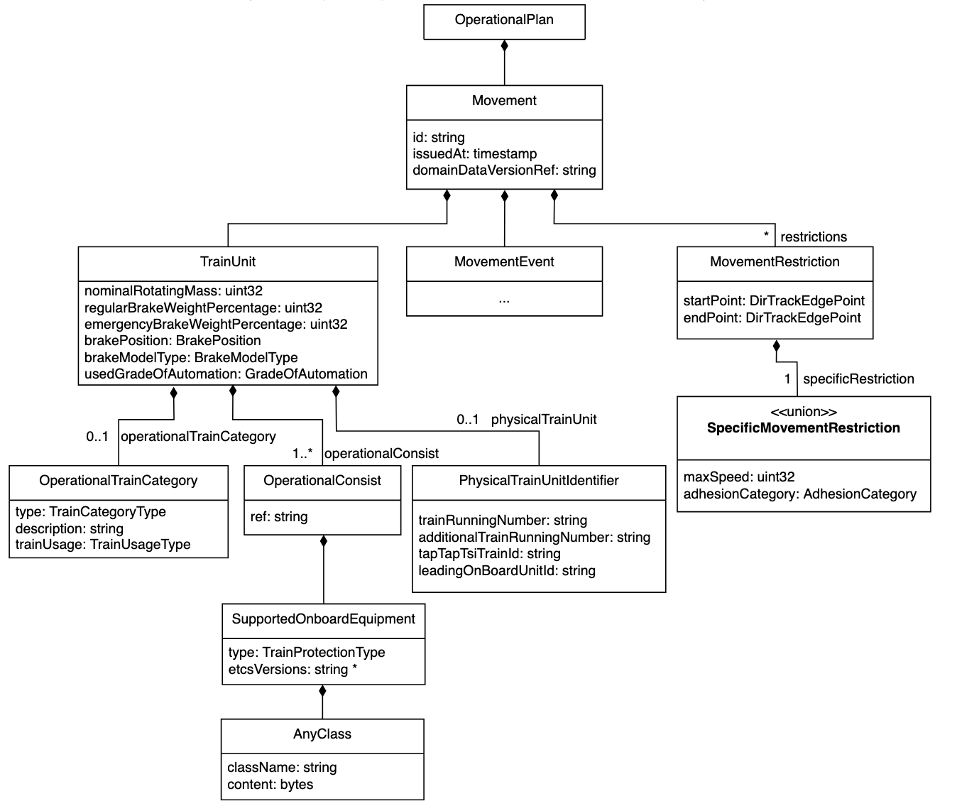
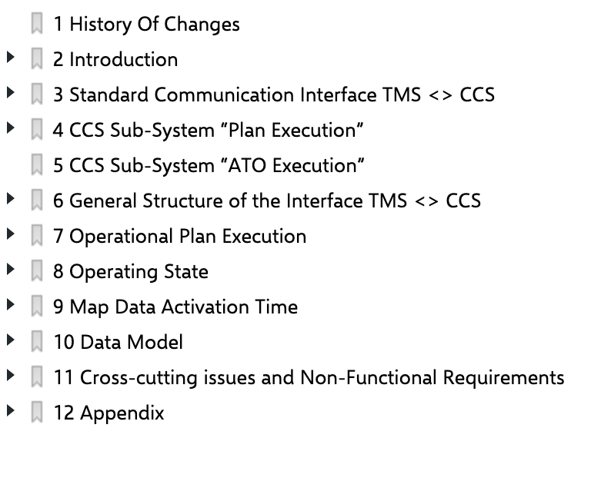
Delivery is key
Use case 4: Moving block
Specification
Data Model
Actual data
ERA
Ontology
Interface CCS-TMS Specification
References
class diagrams
and definitions
CCS/ TMS data model
For more information see EU-RAIL R2DATO WP 27, 44 and 45 (https://projects.rail-research.europa.eu/eurail-fp2/)
Notes:
Inspired from the HF case from Eurocontrol, already well implemented in the aviation sector., this methodology has been customised to better meet the needs of the railway sector and be consistent with the railway regulatory framework when a need for change is identified.
This methodology can be used for any change: from a small change to a more complex change involving many subsystem changes (ie organisational change, IT change…). A thorough description of the desired change is needed, as it may be necessary to break it down and study the interactions in several separate parts, that may not have been identified at first, this includes different systems, subsystems, teams, activities...
This methodology is composed of five steps, as can be shown in figure
This methodology should be applied from the start of a change i.e. when the need for change is identified. End-users should be involved from the very beginning, with the aim of identifying the specific HOF topics that will be included in the risk management process (and independent assessment, when needed, following requirements of Regulation EU 402/2013).
To increase efficiency, this methodology can be carried out in parallel or using the same resources (e.g. existing documentation, meetings/workshops…).
The methodology should be guided or used by a HOF specialist, and if not available by someone with HOF expertise. People using this methodology should be specifically trained to use it. Several roles mentioned can be fulfilled by the same individual, especially for smaller companies and/or smaller changes.
In conformity with chapter 1.6, this methodology should ensure that HOF is integrated in change management in a balanced manner to avoid pressure or influence, as far as possible. The first question in determining whether to apply this methodology is: could this change have any impact (direct/indirect) on staff carrying out safety-related tasks?

Slide 9
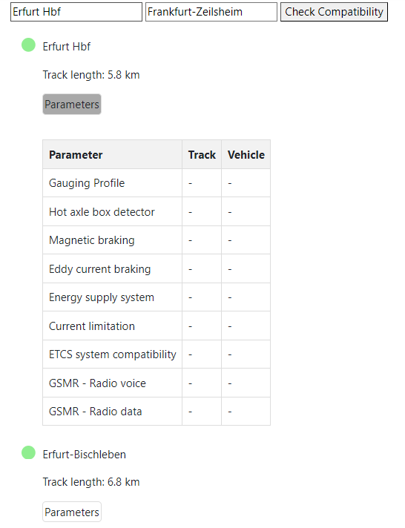
Delivery is key
Use case 5: Route compatibility check
ERA
Ontology
Compare properties along track section with the vehicle properties.
RINF data
CCS/ TMS data model
Infra
Operational points
TrackEdgeLink
Please mind: CCS/TMS Data Model is only applicable for ETCS-only railway lines and trains: The target system
Notes:
Inspired from the HF case from Eurocontrol, already well implemented in the aviation sector., this methodology has been customised to better meet the needs of the railway sector and be consistent with the railway regulatory framework when a need for change is identified.
This methodology can be used for any change: from a small change to a more complex change involving many subsystem changes (ie organisational change, IT change…). A thorough description of the desired change is needed, as it may be necessary to break it down and study the interactions in several separate parts, that may not have been identified at first, this includes different systems, subsystems, teams, activities...
This methodology is composed of five steps, as can be shown in figure
This methodology should be applied from the start of a change i.e. when the need for change is identified. End-users should be involved from the very beginning, with the aim of identifying the specific HOF topics that will be included in the risk management process (and independent assessment, when needed, following requirements of Regulation EU 402/2013).
To increase efficiency, this methodology can be carried out in parallel or using the same resources (e.g. existing documentation, meetings/workshops…).
The methodology should be guided or used by a HOF specialist, and if not available by someone with HOF expertise. People using this methodology should be specifically trained to use it. Several roles mentioned can be fulfilled by the same individual, especially for smaller companies and/or smaller changes.
In conformity with chapter 1.6, this methodology should ensure that HOF is integrated in change management in a balanced manner to avoid pressure or influence, as far as possible. The first question in determining whether to apply this methodology is: could this change have any impact (direct/indirect) on staff carrying out safety-related tasks?

Slide 10
Roadmap to increasing success:
Serving further use cases
CCS/TMS Data Model V 1
fully derived from ERA-Ontology
publication of ERA Ontology (extended by pre-binding concepts)
EU-RAIL data validation tool
2024
6
9
12
feed back from EU-RAIL uptakes of ERA Ontology and its derived CCS/TMS Data Model for fostering an amended version of ERA Ontology
uptake by EU-RAIL Innovation Pillar projects of ERA Ontology, e. g.
Digital register (R2DATO WP 27)
Lighthouse Brenner digital engineering (MOTIONAL WP 27)

Slide 11

THANK YOU
Moving Europe towards a sustainable and safe railway system without frontiers.
Follow us:

