Slide 1
Gilles Peterhans
UIP - International Union of Wagon Keepers
OPENING: KEYNOTE SPEECHES

Slide 2
Navigating the industrial revolutions
Opportunities and challenges
1st INDUSTRIAL
REVOLUTION
STEAM POWER
Mechanical production with water and steam power
2nd INDUSTRIAL
REVOLUTION
ELECTRIFICATION
Mass production through assembly lines and electricity
3rd INDUSTRIAL
REVOLUTION
AUTOMATION
Digital revolution (the use of electronic and IT systems)
4th INDUSTRIAL
REVOLUTION
DIGITALISATION
Industry 4.0 (industrial production combined with modern information and communication technology)
CHANGE MANAGEMENT
Change management encompasses all measures used to change the strategies, structures, processes and behavior
Notes:
BEFORE TURNING DIGITALISATION INTO PERFORMANCE, WE NEED STILL NEED TO TURN TO THE DIGITAL REVOLUTION.
Industry 4.0 is driven by disruptive trends including the rise of data and connectivity, analytics, human-machine interaction, and improvements in robotics.
Operationally intensive sectors, such as transportation will experience the greatest change because many companies in these sectors employ large numbers of people for tasks particularly suited for automation or digitization.

Slide 3
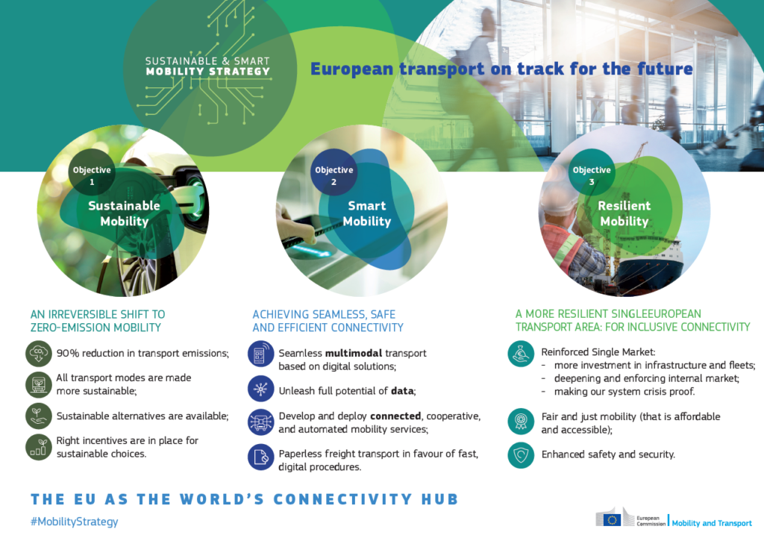
Transport and environmental policy
Big picture: green deal and sustainable transport
High-speed rail traffic across Europe
2x by 2030
3x by 2050.
Rail freight to increase by:
+50% by 2030
+100% by 2050
Rail should be able to compete on a level-playing with road-only transport by 2030 when it comes to the internalisation of external costs

Slide 4
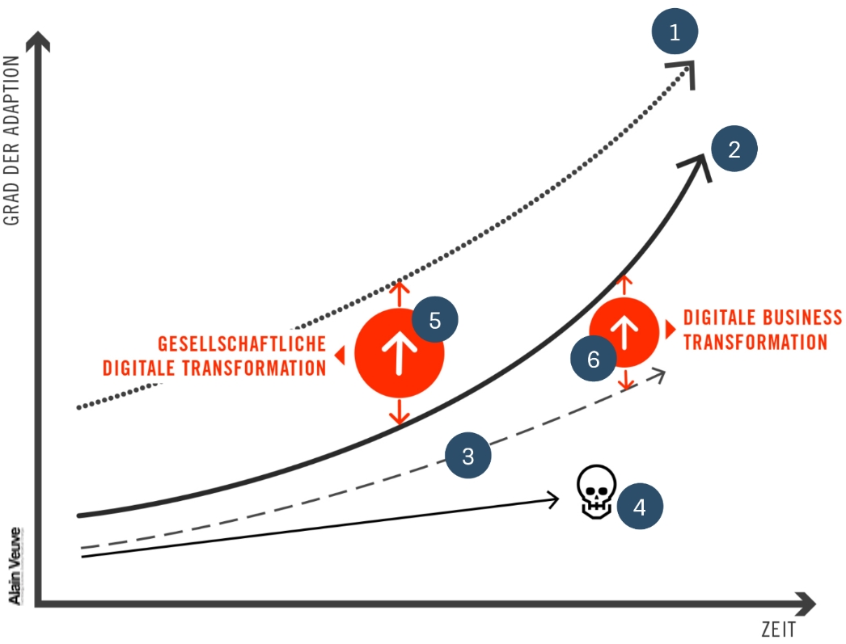
A real revitalisation of the rail freight market…
a better modal split for railways need new realities: our future is digital
1
Technological evolution:
always ahead
Acceptance of technology by the customers
Adaption curve of the average company
Adaption curve of a death-bound company
Digital transformation of the society
Digital business transformation
2
3
4
5
6
Source: Alain Veuve: „The digital transformation modell‘“;
URL: http://www.alainveuve.ch/digital-transformation-model/ [December 2016]
Notes:
Technology does not cause change, it only enables, facilitates and accelerates change that already wants to take place!

Slide 5
Achieving seamless, safe and efficient connectivity
ChalLenges in achieving a digital transformation
THE NEED FOR DIGITAL TRANSFORMATION IS NOT RECOGNIZED OR LACKS THE NECESSARY COMMITMENT.
DIGITAL SOLUTIONS ARE ONLY SOUGHT FOR INDIVIDUAL PROBLEMS INSTEAD OF WORKING ON AN OVERALL STRATEGY.
DIGITAL activities are not targeted or embedded in existing corporate strategies.
THERE IS LITTLE OR NO TRAINING.
AUTOMATION IS NEGLECTED. INSTEAD, TRADITIONAL WORKPLACE CONCEPTS ARE APPLIED.
THERE IS A LACK OF INNOVATION IN IT SOLUTIONS.
THE BUDGET FOR DIGITIZATION IS TOO SHORT-SIGHTED.
THE IT ORGANIZATIONAL STRUCTURE IS NOT FLEXIBLE ENOUGH.
THE DATA CENTER INFRASTRUCTURE IS OBSOLETE.

Slide 6
Achieving seamless, safe and efficient connectivity
TAF/TAP TSI/Registers/OperationaL databases: unleash full potential of data?
Notes:
Recommendation 5: The Task force recommends that ERA clarifies the status of the registers of the Interoperability Directive and which are the source for the accurate and legal information about authorisations, explains how in practice they should be used, studies how operational databases such as RSRD2 could fulfil the sector needs for operational data and how such databases could interact with the registers.

Slide 7
Aspects of Digital Transformation
Defining the way forward
COLLABORATE
In a fragmented industry, internal and external collaboration are key to ensure digital transformation fits into interoperability objectives
MAKE INFRASTRUCTURE
& ASSETS DIGITAL
Define digital infrastructure and digital assets. Ensure compatibility of solutions to create conditions for new collaborations and business offers.
DEFINE NEW BUSINESS PROCESSES
Develop new but common processes, existing processes may not be digitized and automated but disappear.
CREATE INTELLIGENT SYSTEMS
Connection with the Internet makes objects intelligent (Internet of Things). Sharing data, information and knowledge to deliver benefits (Big Data and Data Mining)
Notes:
Enabling data-informed actions in the broader end-to-end value chain but also limiting consumption, resource waste, and emissions!

Slide 8
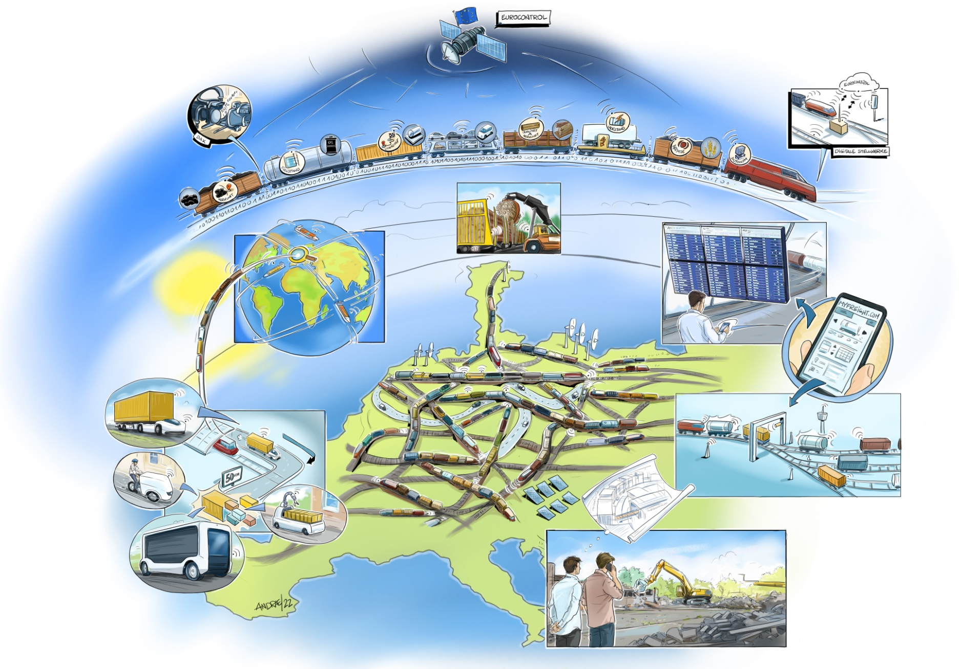
Pathway to Transform rail freight
Vision for a digital, automated, connected and Customers focused rail freight
Green Deal needs more rail freight
Rail freight need new realities to cope with shippers’ expectations and digitalisation
Digitalised, Automated, Connected and Customer focused (DACC) Rail Freight System:
Connected to the ports and urban nodes
Flexible with help of modular systems
Digital processes to improve customers’ experience
Digital infrastructure
Integrated in land planning to ensure capacity
Fully Digital Freight Train Operations
Seamless and multimodal operations
Copyright: UIP
Notes:
If rail is to convince a greater modal shift to rail freight, it needs to listen to the needs of its freight customers.
Even a company with the best tools, newest technology, and immense resources is unlikely to scale up a 4IR transformation successfully if the workforce is not engaged on building its capabilities and shifting mindsets for successful digital transformations

Slide 9
OUTLOOK...
THE SECRET TO CHANGE IS TO FOCUS ALL YOUR ENERGY NOT ON FIGHTING THE OLD, BUT ON BUILDING THE NEW.
socrates
Policy-makers have to choose between protecting the past from the future, or protecting the future from the past.
Tim O’ReillY
Notes:
Tim O'Reilly (born 6 June 1954) is the founder of O'Reilly Media (formerly O'Reilly & Associates). He popularized the terms open source and Web 2.0.

