Slide 1
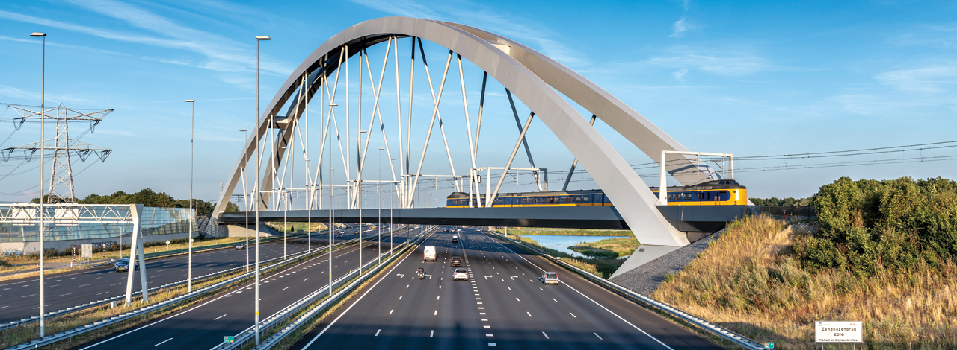
Principles for Useable Data
Rail Data Forum – June 2024 – Gerben Schut – ProRail NL

Slide 2
Introduction – About me
Gerben Schut – Information Architect – ProRail NL
17 years of railways experience
Started development of IMX / IMSpoor
Infrastructure data: RINF, TENtec, RNE
Infrastructure data structures: OTL, IMX, ERA vocabulary
People first:
when people communicate, systems will communicate

Slide 3
What is Useable Data?
Google:
Put simply, data usability refers to the ease with which data can be accessed, understood, and used to inform business decisions.
People (users!) wants your data
Trust
Common knowledge / documentation
Use common principles
Knowing the users

Slide 4
Principles for making useable data
Definitions
Identification
Context
Locations: use stable reference systems
Quality
It is not about the model

Slide 5
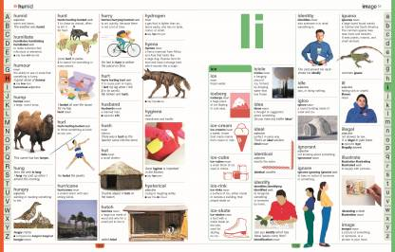
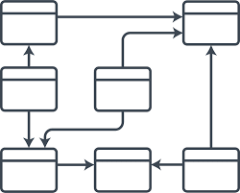
Definitions
Use of common definitions
Structure: relations, properties -> OTL / Ontology
Making definitions vs using definitions
The model

Slide 6
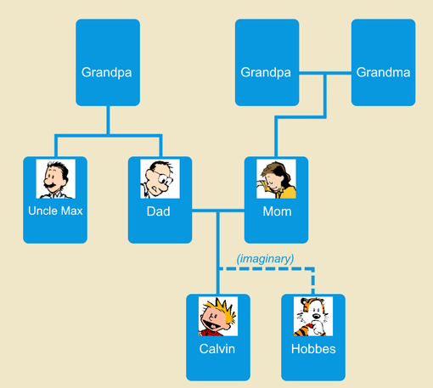
Identification
Human identification vs M2M identification
Context is everything
Stability

Slide 7
Location
The used referencing system makes the useability
Universal vs “own” referencing systems
OP: Amsterdam
SOL: Ams - Utr
OP: Utrecht

Slide 8
Quality
Can I use it for …. ?
Validation framework – open for users
Metadata
Documentation

Slide 9
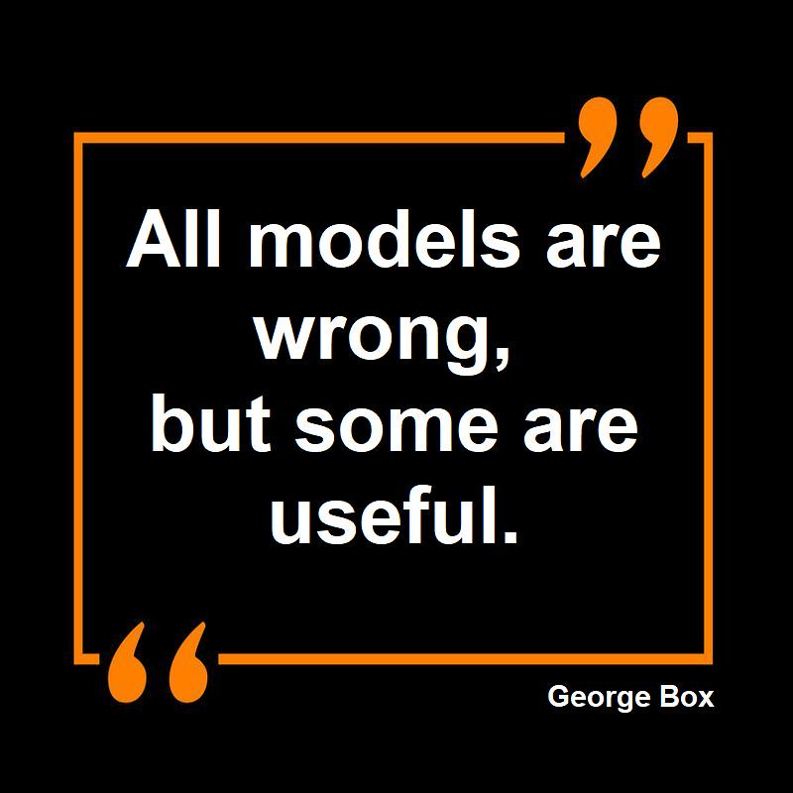
Its not about the model
A good model will help, but:
Models won’t solve issues with:
Data governance
Mismanagement
Organizational issues
Data quality
Etc.

Slide 10
Thank you / Questions

