Slide 1
Work Shop - Telematics Freight TAF TSI Rail Data Forum, Verona 18-19/06/2024 Mickael VARGA

Slide 2
Aim of this Workshop
Intro of workshop and expectations
Intro to interactions (CT + Rail)
Understanding key requirements CT and rail transport
Sorting of results (session 2 +4)
Analysis of additional issues: Enablers / blockers / gaps
Roadmap elements + building
Opportunities for fast track (activities / solutions)
Wrap-up

Slide 3
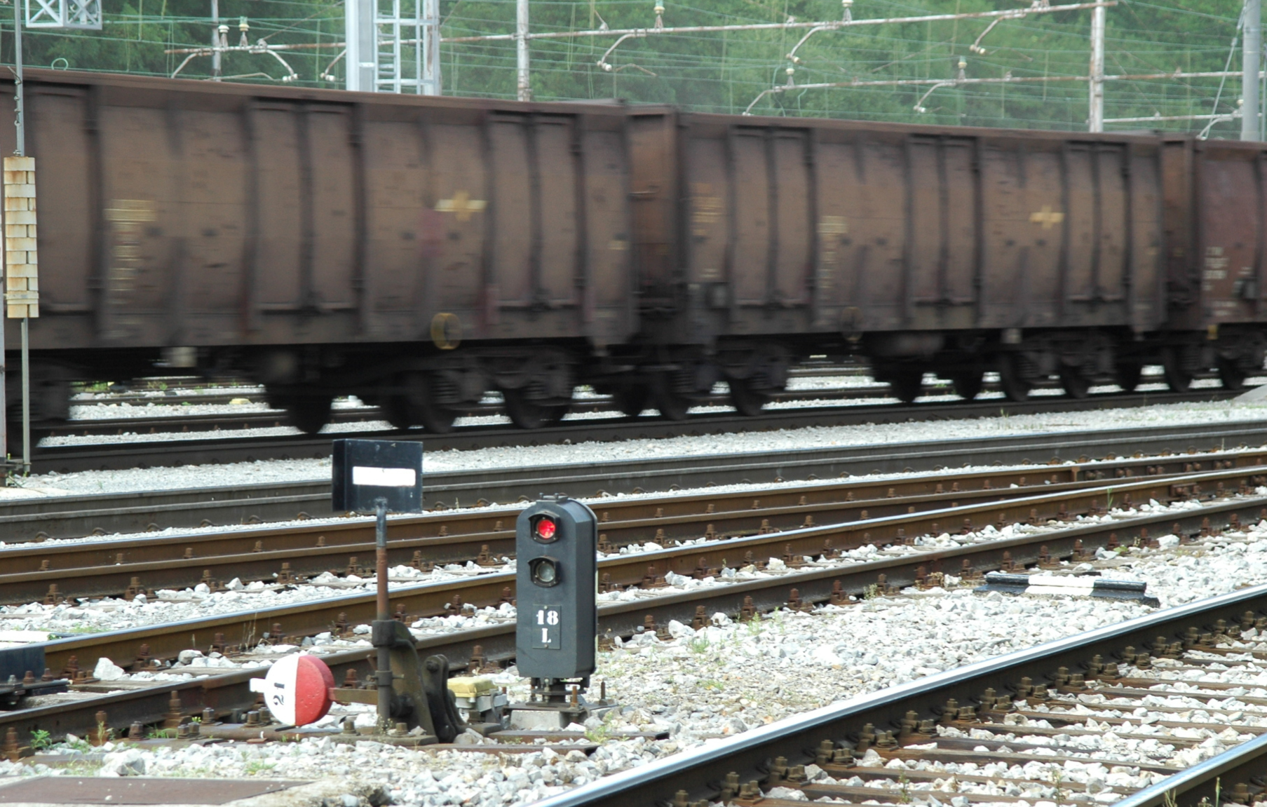
TAF TSI Regulation – backbone for data exchange
Commission Regulation (EU) No 1305/2014: TSI TAF
European COMMISSION IMPLEMENTING REGULATION (EU) N° 2021/541 of 26 March 2021 amending Regulation (EU) No 1305/2014 as regard the simplification and improvement of data calculation and exchange and the update of the Change Control Management process*
* https://eur-lex.europa.eu/legal-content/EN/TXT/PDF/?uri=CELEX:32021R0541&from=EN

Slide 4
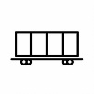
TAF TSI functions Regulation (EU) 2021/541
Reference data
for rail loctions and for companies
Railways > Infrastr. Managers communication
Path request
Train composition
Railways > Railways communication
Consignment order
Wagon events
Wagon keepers
Rolling stock reference database
Terminals
Train run and forecast
Service disruption
Estiamted time of interchange
Estiamted time of arrival
Consignment order
Train ready
Train composition
Train ready
Train run and forecast
Service disruption
Estiamted time of interchange
Estiamted time of arrival

Slide 5
TAF TSI process Regulation (EU) 2021/541
Planning…
Operation…
After…
Consignment Note
Train Preparation
Post-Trip
Path Request
Train Running Forecast
Wagon Movement
Consignment order message
Request
Confir-mation
Refusal
Confirma-tion
Train Composi-tion
Train ready
Train Running and forecast
Service Disruption
Estimated Time of Arrival (ETA) or of Inter-change (ETI)
Wagon events
To improve the quality and producti-vity
4th ERA TAF TSI Regional Workshop (Italy, Slovenia and Croatia)

Slide 6
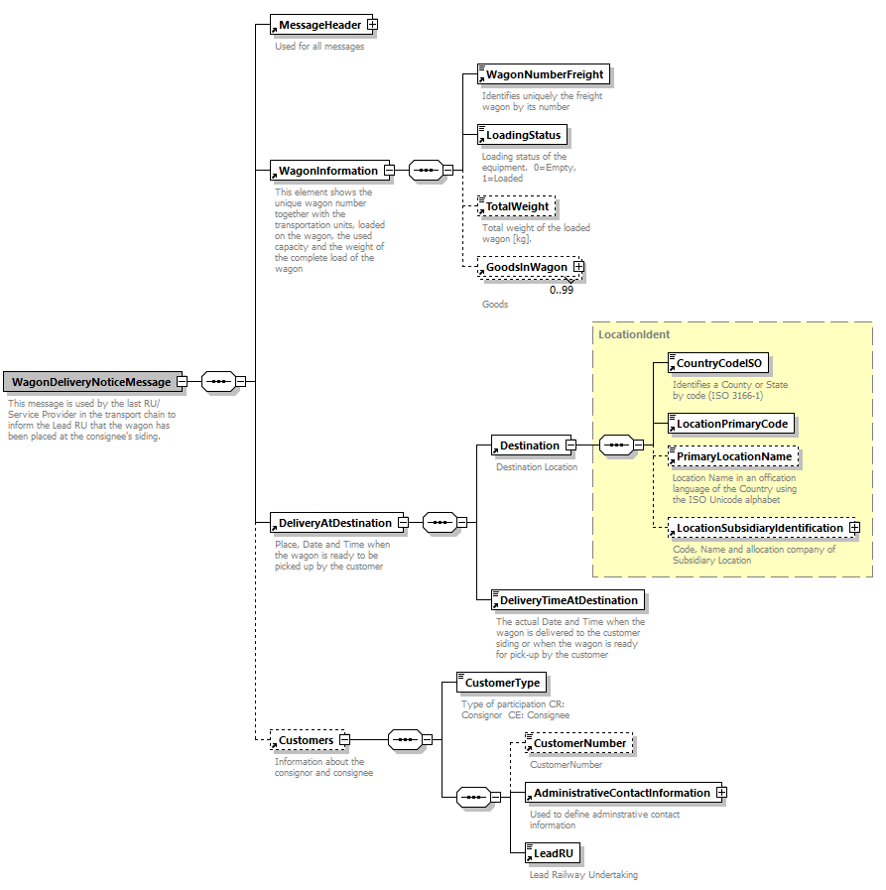
Content of TAF TSI – XSD definition

Slide 7
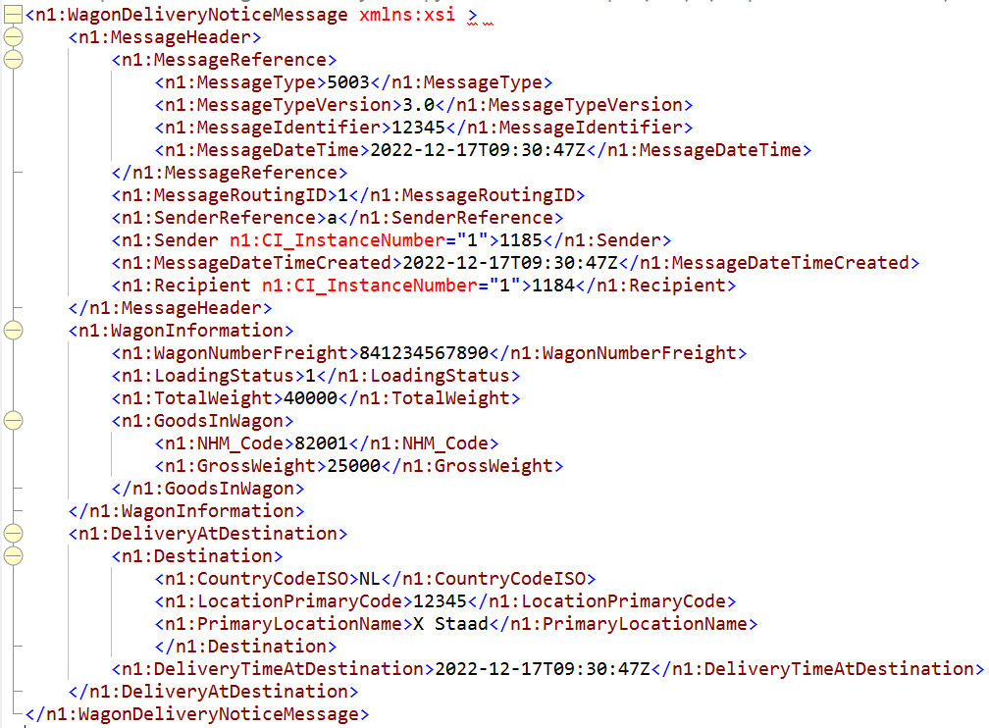
Realisation of TAF TSI – XML message

Slide 8
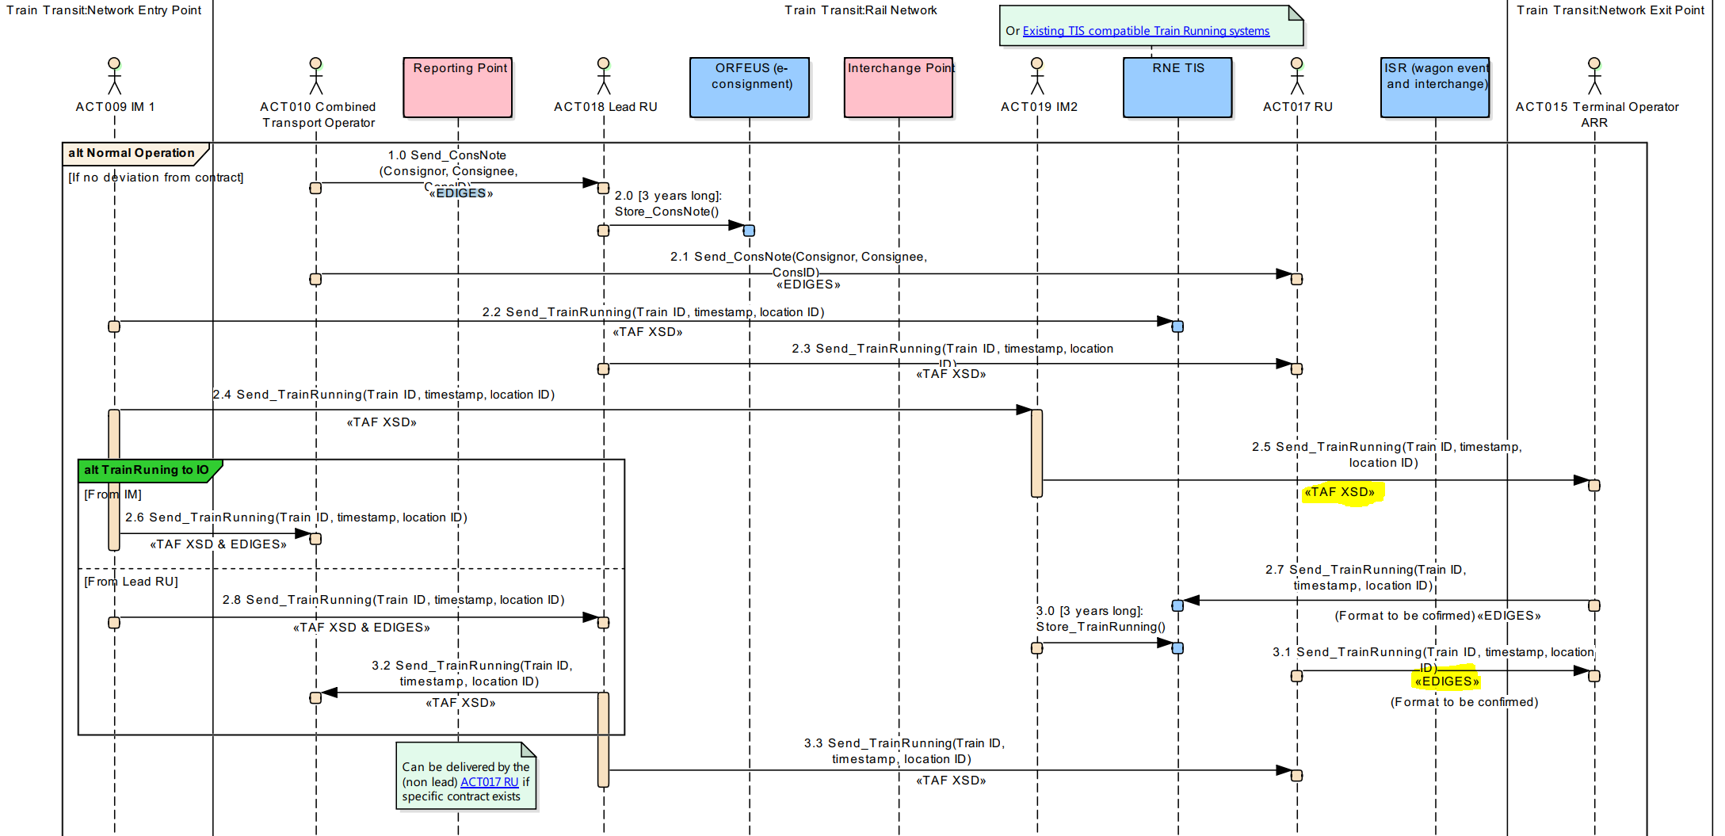
TAF TSI – example interaction railways with CT
→ Challenges in harmoization of message interfaces and underpinning business processes.

Slide 9
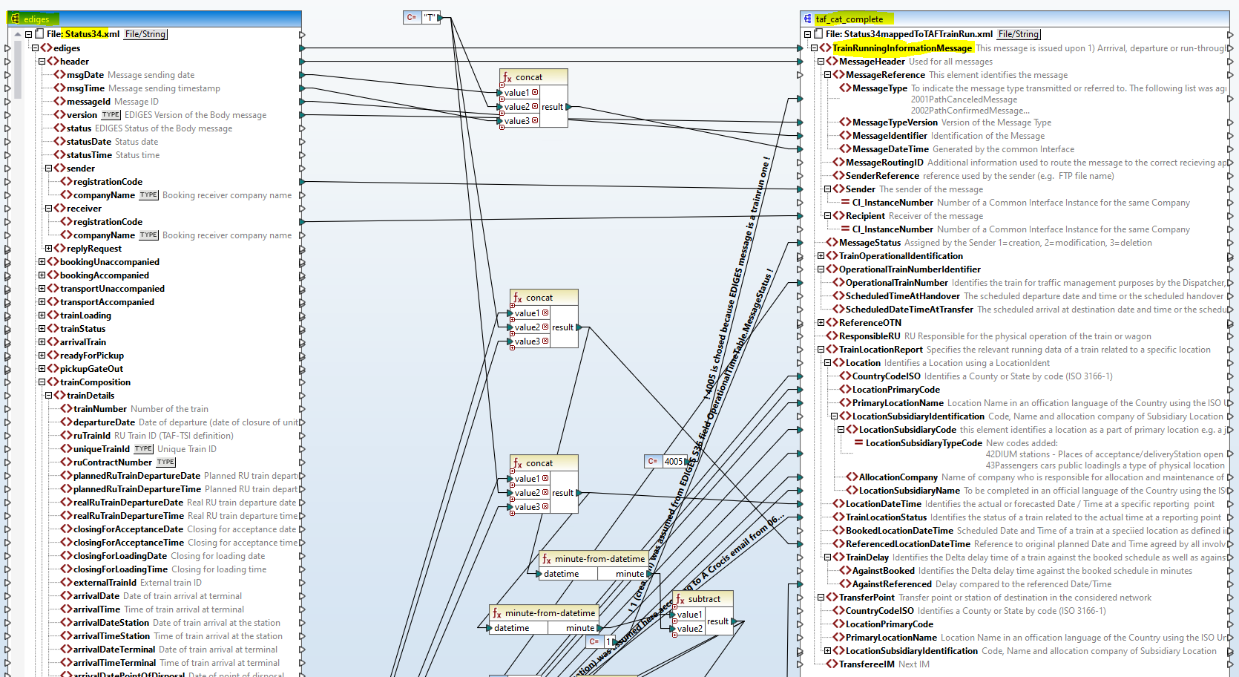
TAF TSI – example interaction railways with CT
→ Challenges in harmonisation of message interfaces and underpinning business processes.

Slide 10
Presentations of Combined Transport and Rail Operators
JSG
UIRR

Slide 11
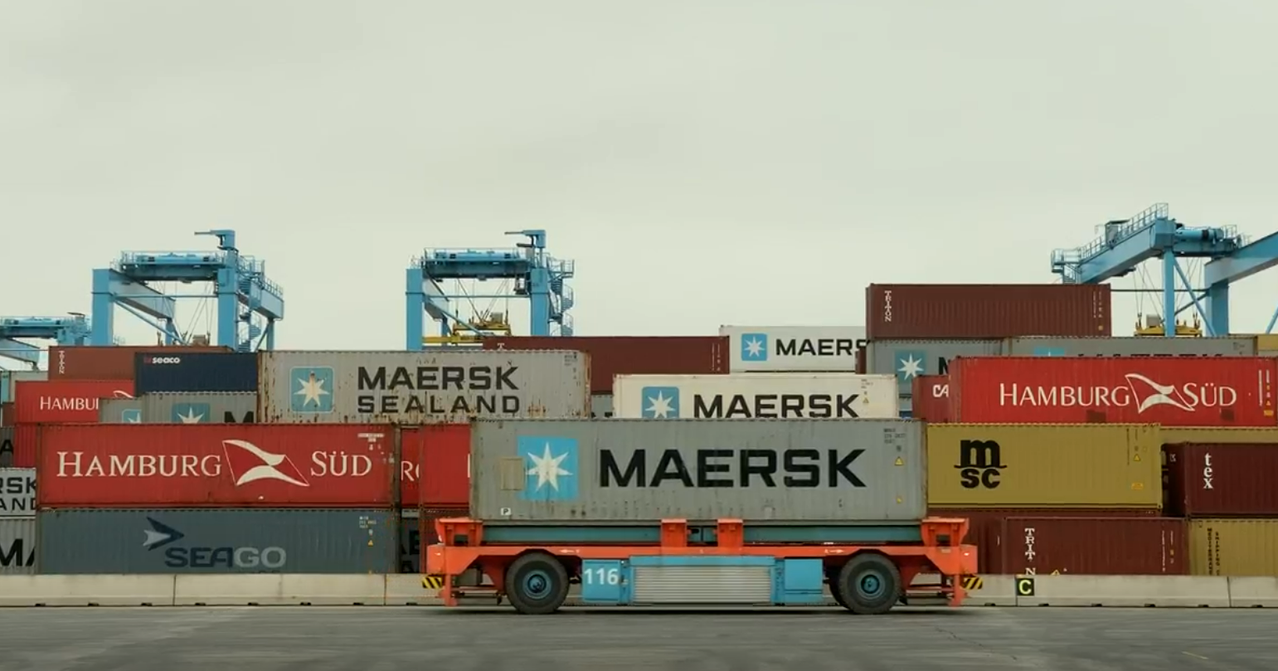
Conclusions session 2 (18/06/2024)
 | Ulf | Brede | Christian
Enablers | Focus must be on the passengers as users and on the usage of TransModel | One price must be communicated by data provider through different channels to the user High quality data is needed which is usable and brings value for user | Clear definitions of domains is key for semantics / linked data usage
Blockers |  | Data definitions are not clear and interpretable per user | Open data released by data provider should not lead to uncontrolled distribution to the user Too much administration can be burden fall small users for implemetation
 | Adrien
Enablers | Combination of the fragmented data by the data provider to the user
Blockers | Information provision to user is not dense enough

Slide 12
Conclusions session 4 (18/06/2024) - 001
 | Julian | Ingo | Roland
Enablers | Historic data for users are important (time machine), they should be synceable with current data | More and reasonable amount of sensors for improved train run estimations to better inform the user | Enhancement of Estimated time of arrival for combined transport user
Blockers |  | XML is not an enabler for systems with hundreds of millions of messages Integration of same data X times in Y systems | Gaps of information exchange and lack of quality between RUs and combined transport Combined transport terminals are very heterogeneous in their data exchange: this leads to lose customer
Statements | Proofs of concept are needed before application of a solution Good and commonly agreed standards for useable quality data are needed for the user | Good translation of legal requirements to business / technical people in the enterprise is key | Harmonisation of data, semantics across different modes of transport via federated governance is key for successful combined transport
ToDos | Data provider embrace semantics data solution to improve data connectivity and quality Building blocks, ready to be used, are needed for future data solutions (with use case) | How can we (railways, as data provider) make users of other modes of transport to use rail ? Cooperation of data exchange with other modes of transport must be deepened No Member State thinking (silo) please | To transport data into value for customers LSPs and Shippers needs (as data user) aligned / linked data and processes as integrating with railways

Slide 13
Conclusions session 4 (18/06/2024) - 002
 | Mathias | Miguel | Gilles
Enablers | Train your employees, build enterprise competence centre Publish as data provider your quality data at right moment to the right data consumer | Get indicators to improve your future activities and to reduce risks: one tool is for that knowledge graph / ontology | Data provider pays for rail wagon data publication, as this is needed for the user, data access is free of charge
Blockers | Bad reference data set by data provider in data exchange interfaces (see crocodile problem) |  | Mileage exchange is not necessary anymore as GPS information per wagon is available at 99,9% within UIP members Over regulation might be a burden
Statements | Use knowledge graph, semantics data and enterprise ontology |  | One data upload centrally by data provider, all user served Data authorisation is role / context based
ToDos | Data provider has to put its data into the right context Building blocks, ready to be used, are needed for future data solutions (with use case) | Working on data identification for safety governance Learning from each other by data sharing will increase to better data exchange | User / customer should be in the centre by adopting existing tools (and not by creating new tools)

Slide 14
Conclusions session 4 (18/06/2024) - 003
 | Harald
Enablers | Shareable data and reusable data with high quality are needed from a central source
Blockers | To reduce 200 national parameters (silo) to a reasonable amount We are still in member state thinking (silo)
Statements | Make always proof of concept before starting developing Safety is important but should not harm innovation
ToDos | We need stable baselines (no moving targets please !) for IT development + deployment Enable cooperation and trust for data exchange between user and data provider

Slide 15
Tag crowd from Sessions 2 and 4

Slide 16
Proposed topics to be discussed in the Telematics Freight WS
What are combined transport data exchange needs ?
What is data quality and value for users ? Who are the users and how to deliver LaaS ?
How much regulation is needed for implementation stimulation ?
How to ensure good link from telematics data exchange to rail ontology model ?
Do we go for public or open data ? What is sharable ?
How to ensure that smaller actors can follow implementation of rail data exchange (building blocks / tools) ?
(with enablers, blockers and gaps)

Slide 18
Slido question N°1
Question 1 | What is (road-)rail freight Combined Transport ?
Answer 1 | Transport where the major part of the European journey is by rail and any initial and/or final legs carried out by road
Answer 2 | Rail freight Combined Transport does not exist
Answer 3 | Transport where the major part of the European journey is by road and any initial and/or final legs carried out by rail
Answer 4 | Transport where a part is on tramways and another one on funiculars

Slide 19
Slido question N°2
Question 2 | How many Combined Transport Terminals do we have in the European Union ?
Answer 1 | +/- 100
Answer 2 | +/- 50
Answer 3 | +/- 800
Answer 4 | >1000

Slide 20
Slido question N°3
Question 3 | What is the market share of rail freight in the EU transport market (tons-km) ?
Answer 1 | +/- 50%
Answer 2 | +/- 30%
Answer 3 | +/- 20%
Answer 4 | > 50%

Slide 21
Slido question N°4
Question 4 | What is the market share of rail Combined Transport in the EU rail freight transport market (tons-km) ?
Answer 1 | +/- 5%
Answer 2 | +/- 10%
Answer 3 | +/- 50%
Answer 4 | +/- 20%

