Slide 1
David Fontaine
Rail Data Forum
Verona 18 – 19 Juin 2024

Slide 2
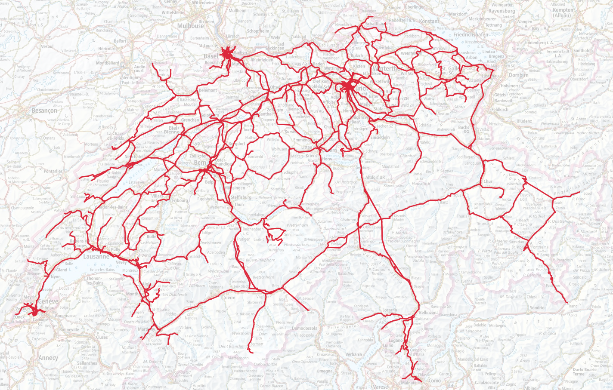
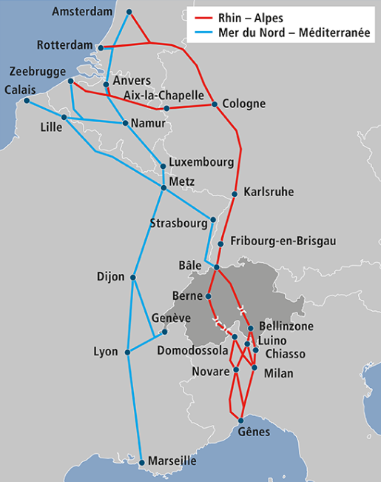
Swiss rail network
Total network 5124 km
55 infrastructure manager
Interoperable network 3754 km
17 interoperable infrastructure manager
Biggest CFF/SBB/FFS → 3011 km
2nd BLS 449 km
3rd SOB 123 km
Smallest OeBB → 4,1 km
Non interoperable network 1370 km
38 infrastructure manager
Backbone of the north-south freight corridors

Slide 3
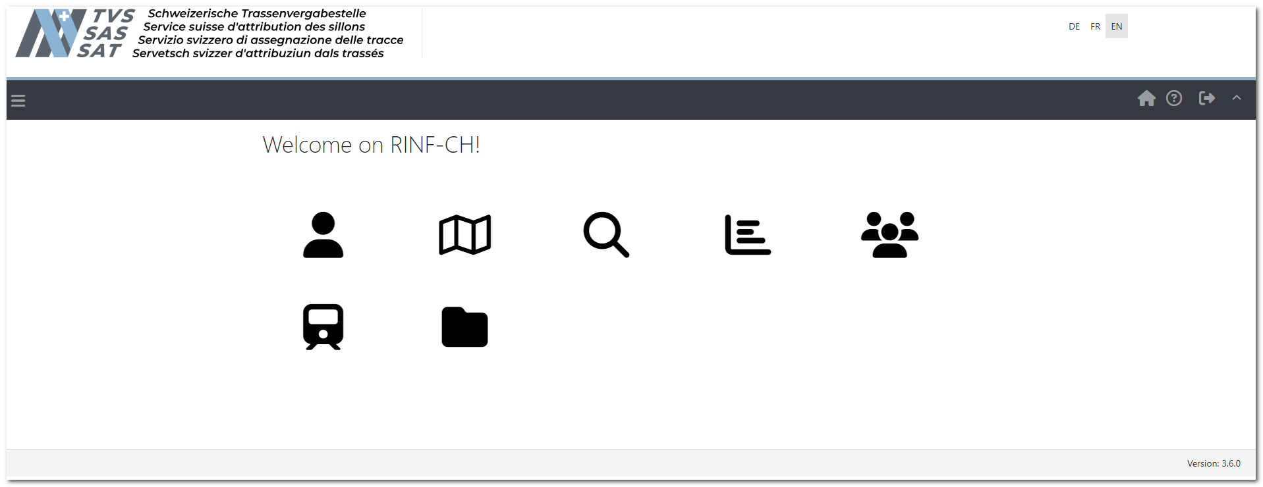
RINF situation in Switzerland
Own RINF-CH
Development through the ministry (NSA) (2015-2020)
Handover to TVS in 2021
Responsibilities TVS (NRE)
Data collection
Data transmission
Exploitation and continued development

Slide 4
Data collection in Switzerland
3 biggest IMs provide monthly data according to the full delivery model.
Geometric network data quality not yet achieved.
Currently, around 100 parameters have been delivered out of the 189 requested under the current implementing regulations.
Other IMs have just delivered their geometric data and have now to edit manually the ERA parameters.
Parameter collection has just begun. Only about 10% of parameters have been completed.
Particular attention is focused on this parameter collection as a priority.
This quantity is clearly insufficient to meet the required quality standards.
Currently, we focus on the collection of data for the RCC.

Slide 5
Difficulties encountered in data collection
Handover from the ministry (NSA) to TVS (NRE).
Personnel turnover.
Loss of knowledge.
Biggest IMs didn't believe in the RINF project.
The focus was placed on them first.
Smaller IMs were sidelined.
Collecting data is an arduous task for IMs.
Not all data is digitalized.
Not all data exists.
Border point management difficulties with some neighboring states.
Impact on network continuity.

Slide 6
Challenge for the coming months
Specifications for the changes of the new EU regulations are not yet defined.
It's difficult to keep developers available and to respect the expected milestones.
Deadlines for delivery of new data are very (too) tight for IMs.
It's currently difficult to stay focused on ERA issues.
New EU regulation with all its innovations absorbs all resources.
Disjointed follow-up of the various topics.
RCC
New ERA platform
Accurate geometry
Things are moving very quickly despite a pronounced administrative slowness.

