Slide 1
Data on infrastructure:
An indispensable requisite of planning and operation of Railway Undertakings
ERA – Rail Data Forum
WS #2 Infrastructure data as the backbone of railway data
Verona
19.06.2024
Götz Walther
VDV – Berlin

Slide 2
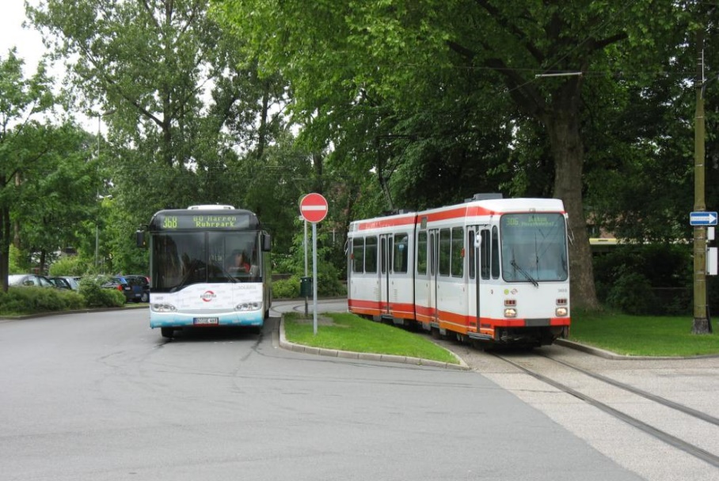
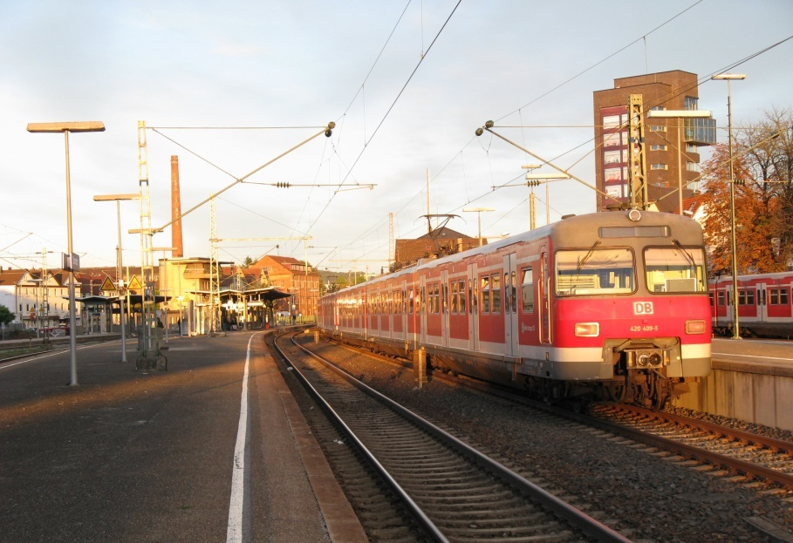
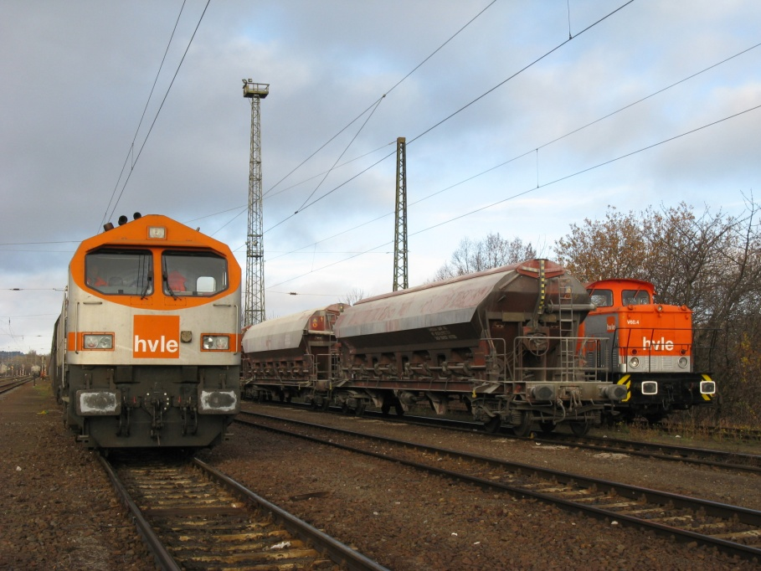
VDV and its members
pictures: Götz Walther
  As a sector association the VDV represents the interests of about 700 member companies active in the fields of public passenger transport (rail and road) and rail freight traffic in Germany.
  In the rail sector Railway Undertakings (RU) as well as Infrastructure Managers (IM) are members of VDV.
  Ordinary members by divisions
  BUS >300
  TRAM >75
  Passenger Rail Transport >80
  Rail Freight Transpot >135
  Transport Authorities (pass.) >50
including IMs

Slide 3
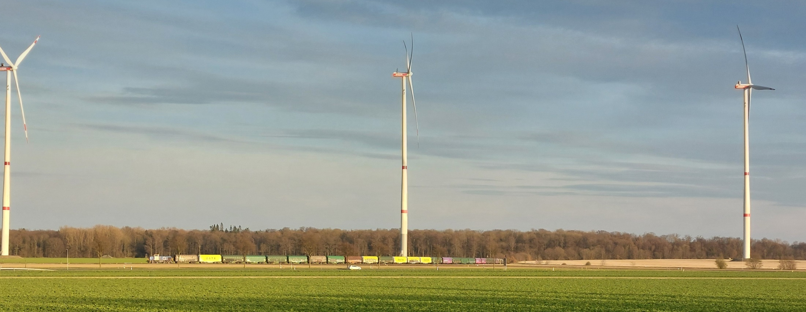
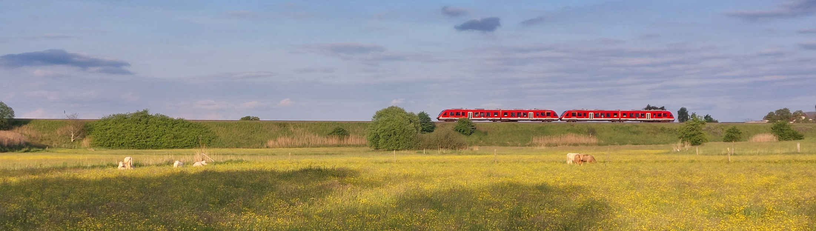
services to freight customers …
Task of “the railway” – RUs & IMs ?
… or passengers
pictures: Götz Walther
Prerequisite: data on infrastructure

Slide 4
Infrastructure data character of data
  static infrastructure data, e. g.
        e. g. data stored in RINF
  data / information as result of static data, e. g.
        information as result of RINF data
        combination with procedures or with RU-data
  dynamic data, e.g.
        train pathes/timings
        train position/real time position
        forecast
  commercial data, e.g.
        prices/infrastructure fees
        opening times/service times
Notes:
Introduction/basics; probabely known to anybody of you. But just in case to recall it. As it‘s already complex enough. I‘m cncentrating here on the first two characters of data.

Slide 5
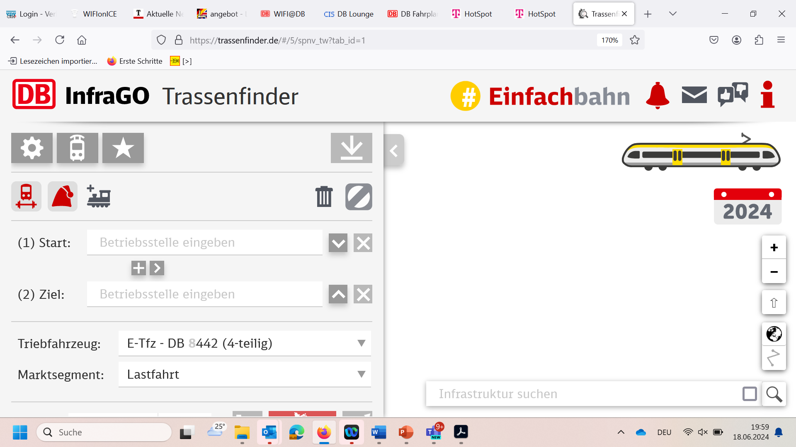
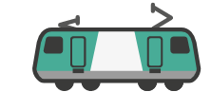
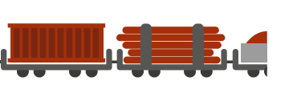
services to freight customers or passengers static infrastructure data
  Data directly relevant for the client
  Passenger services, e. g.
        operational points / „stations“
        platforms
  Freight services, e. g.
        operational points
        tracks for loading/unloading
        terminals / „rail ports“
        harbours
        (industrial) sidings
  Data relevant for RU‘s internal
  planning and/or operations, e. g.
  line characteristics (distances, gradients)
  identification of track
  performance parameters
  signalling system
  location of signals
  layout of stations, yards etc.
IM‘s input
source of symbolic drawings: DB InfraGO AG
TASK of RU: create and operate services
Notes:
The business of Railway Undertakings is best service for clients, i. e. freight customers or passengers. In order to design, plan and operate their services the Railway Untertakings are needing a broad scale of data of the infrastructure on which they are operating or desire to operate for planning and operation (preparation, during operations, after operations),

Slide 6
static infrastructure data needs and expectations → challenges
  availability of data
  content of data
  form of data provision & usability
  quality/reliability/accuracy
  version management
  process for clarifications (feedback)
    existence of data (!) ?
    match to needs/expectations?
    granularity of data?
    more / other content needed?
    directly/on request ?
    paper/pdf/maps/tables ?
    API/App/IT-tool ?
    routing function ?
    relevance ?
    actual situation
    future changes
    ex-post
    user friendly approach?
Notes:
The data has to be provided by the Infrastructure Managers in the detail and format necessary.

Slide 7
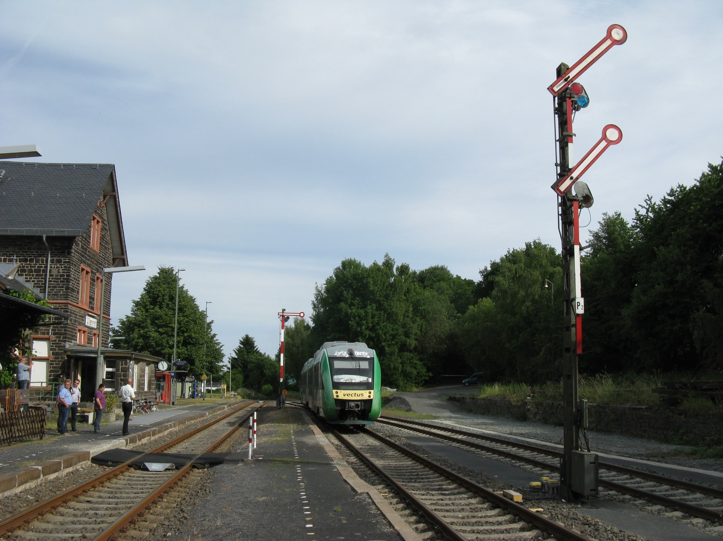
static infrastructure data → use case: platform
RINF: 1.2.1.0.6.4 + 1.2.1.0.6.5
use case with relevance to the passenger & planning/operations
picture: Götz Walther

Slide 8
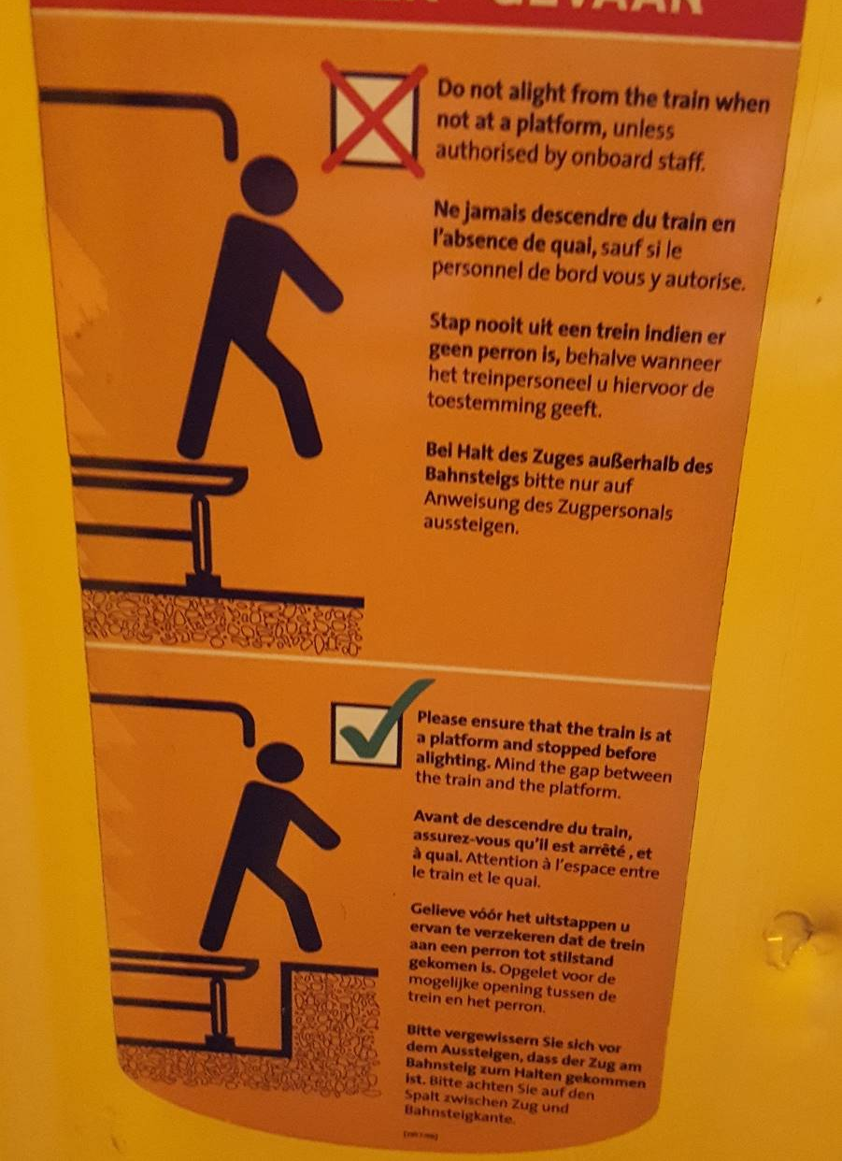
services to freight customers or passengers static infrastructure data → use case: platform
  Example Passenger services, e. g.
        platform
  RINF 1.2.1.0.6 PLATFORM
Notes:
The business of Railway Undertakings is best service for clients, i. e. freight customers or passengers. In order to design, plan and operate their services the Railway Untertakings are needing a broad scale of data of the infrastructure on which they are operating or desire to operate for planning and operation (preparation, during operations, after operations),

Slide 9
static infrastructure data → use case: platform
RINF: 1.2.1.0.6.4 + 1.2.1.0.6.5
Bahnsteiglänge & Bezeichnung
Bahnsteig mit optionaler Kombi-Bezeichnung
Bahnsteighöhe & Bezeichnung
Bahnsteige mit unterschiedl. Systemhöhen
+ Informationen über Besonderheiten
Platform length & identification
optional combined identification
Platform height & Bezeichnung
Special cases of different heights per platform
+ information on special situations
Notes:
Challenges: correct data provision, identical interpretation RU/IM

Slide 10
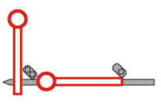
static infrastructure data → use case: platform
RINF: 1.2.1.0.6.4 usable length of platform
Bahnsteignutzlänge je Gleis
richtungsbezogen (falls unterschiedl.)
in Bezug auf die Halteposition
in Bezug auf den Fahrweg
← A
Platform length per track
in relation to direction of travel
in relation to stopping position/signals
in relation to route
B →
C →
platform length = 200 m (as built)
usable length in direction A ← = 200 m
usable length in direction B → = 180 m
but: in case of trains with loco+coaches the distance
platform-signal might influence the usable length ← B
usable lenght A → C /A ← C
= 100 m
drawing: VDV, source of signal drawings: EBA, train: DB InfraGO AG
Notes:
Challenges: Different „data owners“ within IM; accuracy of data provision

Slide 11
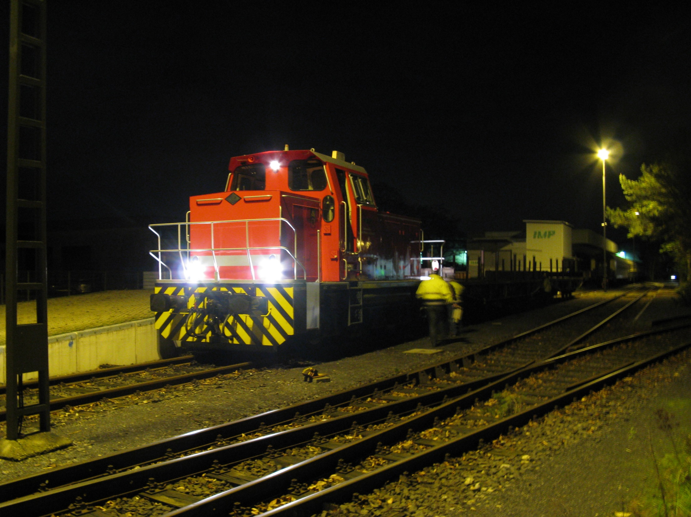
services to freight customers or passengers
static infrastructure data → use case: access points for freight
use case with relevance to the freight customer
& planning/operations
BSM in Monheim
picture: Götz Walther

Slide 12
services to freight customers or passengers static infrastructure data → use case: access points for freight
  Freight services, e. g.
      operational points
        functions
            tracks for loading/unloading
            terminals / „rail ports“
            harbours
            (industrial) sidings
  RINF 1.2 OPERATIONAL POINT
  RINF 1.2.2 SIDING
  1.2.0.0.0.4
        Type of operational point
        Type of facility in relation to the dominating operational functions.
  1.2.0.0.0.7
        Schematic overview of the operational point in digital form
        1.2.2.0.0.2
        Identification of siding
        Unique siding identification or unique siding number within OP
source of symbolic drawings: DB InfraGO AG

Slide 13
static infrastructure data → use case: access points for freight challenges
  RU + IM:
        clear definition of functions & features
        structure of static data on infrastructur
        structure of information
  owner / RU
        identification of infrastructure data for freight customers
        form of publication?
  IM / RU
      Identification of data: for planning / for operations
      form of delivery to the relevant personnel

Slide 14
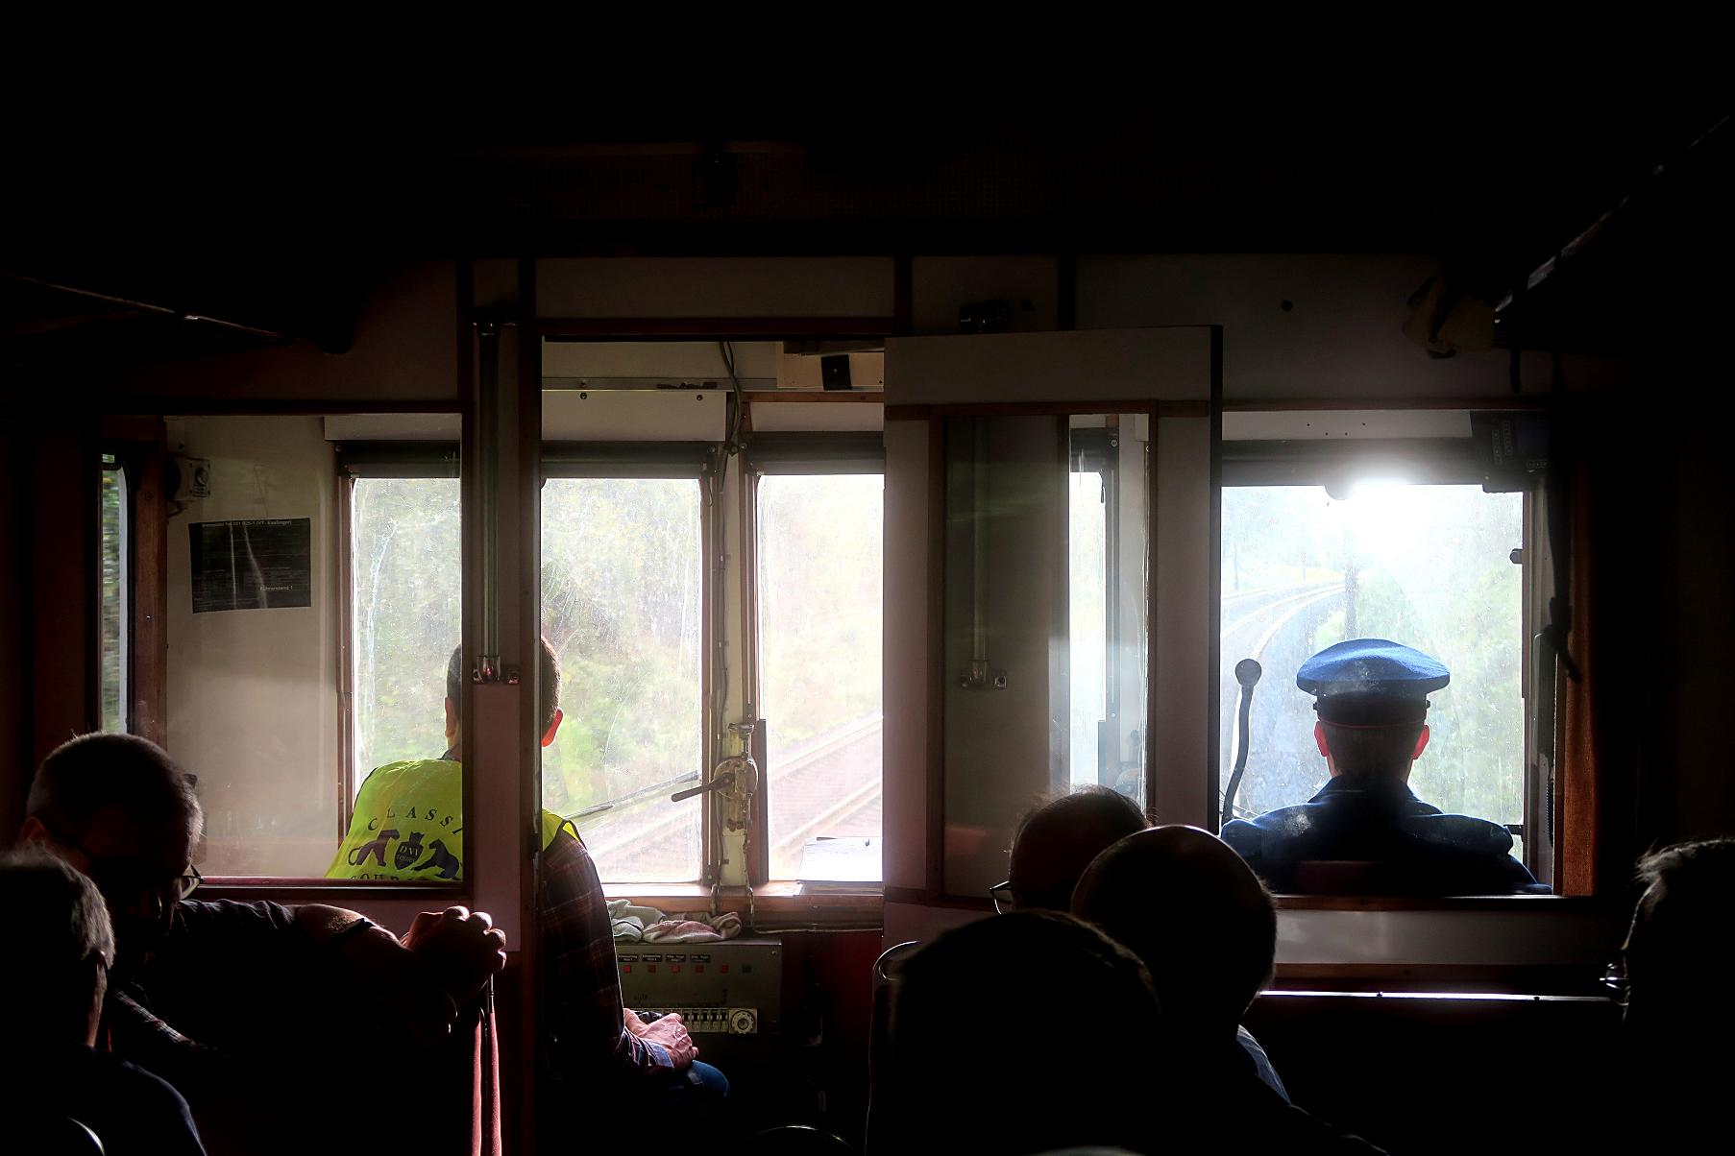
services to freight customers or passengers static infrastructure data → use case: route knowledge
use case with relevance for planning/operations
picture: Hans-Jürgen Schulz

Slide 15
services to freight customers or passengers static infrastructure data → use case: route knowledge
  Data relevant for RU‘s internal
  planning and/or operations, e. g.
  line characteristics (distances, gradients)
  identification of track
  performance parameters
  signalling system
  location of signals
  layout of stations, yards etc.
  RU‘s task
  Safe operation of the railway
  SMS processes
        competence management
        staff rostering
        documentation for drivers (route book)
        route knowledge
source of symbolic drawings: DB InfraGO AG
RU‘s services:
Notes:
The business of Railway Undertakings is best service for clients, i. e. freight customers or passengers. In order to design, plan and operate their services the Railway Untertakings are needing a broad scale of data of the infrastructure on which they are operating or desire to operate for planning and operation (preparation, during operations, after operations),

Slide 16
static infrastructure data → use case: route knowledge
SMS-process:
  definition of route knowledge (VDV standard 755 (2016))
        “ ‘Route knowledge’ is the knowledge of such special features of the route acquired by observing the route and consulting the operational documents, which the driver needs as a supplement to signals and timetable documents in order to be able to drive on the route safely and according to schedule on his own responsibility.”
  … “Data on infrastructure: An indispensable requisite of planning and operation” … ?
    Background of route knowledges goes is based far in the history of the railway system.
    In the last decades the railways have invested a lot in modern systems.
    Data is much better available in advance.
    Influence availability of data may have on the process of route knowledge.

Slide 17
Route knowledge – revision of VDV-Standard 755 (2023/24) one of the tasks: clearer idetification of content
  Draft of revised Definition of route knowledge (2023)
  “ ‘Route knowledge’ is a competence of the locomotive driver for the safe driving of a route with knowledge of location-related features - as a supplement to driver's cab displays, signals, orientation signs and the documents available to the locomotive driver (e.g. route book, …)”.
  A generic identification of these ‘features’ which are supplementing the other above mentionted sources of information has been publishes as Annex 1 of VDV-Standard 755 (draft 2023)
  The draft 10/2023 analyses the features and, if fitting, names the relevant position in TSI OPE, Annex D2
  Analysis in regard to RINF parameters still under way.

Slide 18
VDV-Standard 755 example of analysis of D2 content and route knowledge
D2 2.2.3
Location, type and name of all fixed signals relevant for trains
D2 2.3.3
Location, type and identification of fixed signals that protect danger points
D2 3.2.7
Type of signalling system and corresponding operational regime (double track, reversible working, left or right hand running, etc.)
Concerning location and recognizability of the signals, special features are:
Assignment to the track (if irregular),
Different signal locations for parallel lines
Possibilities of confusing signals
Permanently restricted visibility of signals (here: Compensation: speed of the train)
Exit signals without exit pre-signaling for group exit signals (including information on how the assignment to the track is made (e.g. light signal high/low; form signal high/low; verbal consent),
  Challenges
        Clear+unambigous understanding of categories of RINF & TSI OPE D2
        Which „additional“ information can be provided by IM ? How ???
        IM as data owner.

Slide 19
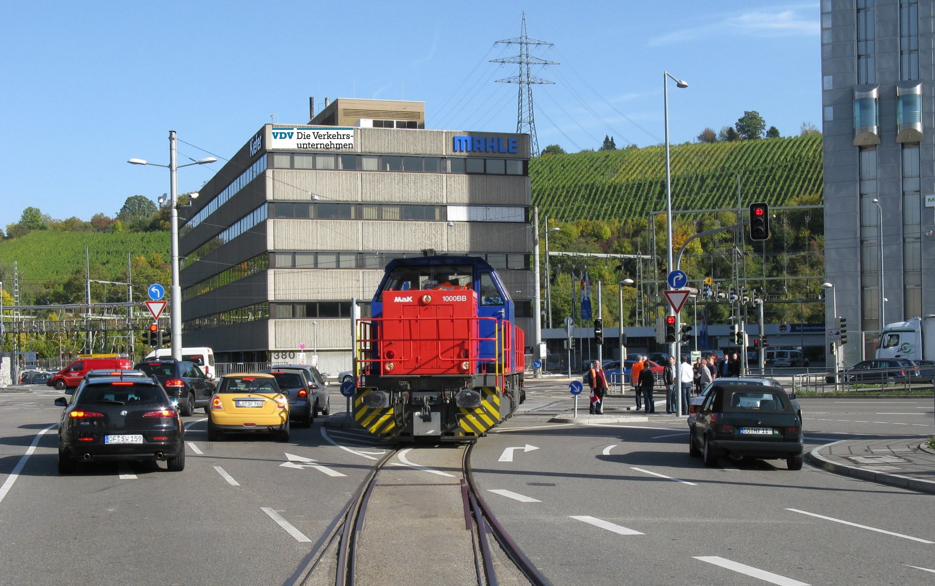
Findings ?
picture: Götz Walther

Slide 20
static infrastructure data findings of the workshop on Rail Data Forum
It‘s your task !

Slide 21
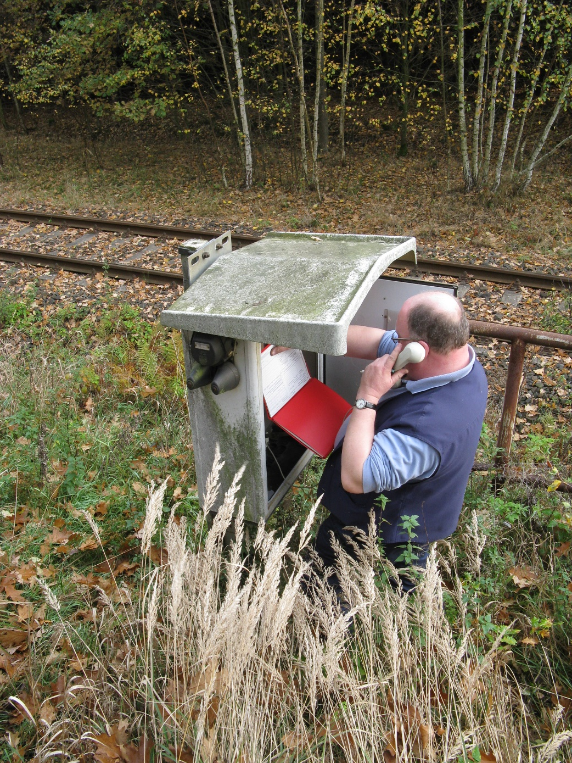
contact
  Götz Walther
  Fachbereichsleiter Eisenbahnbetrieb
  Head of Railway Operations
  Leipziger Platz 8
  D- 10117 Berlin
  Tel. +49 30 399932-13
  mobil: +49 163 5797979
  walther@vdv.de
  www.vdv.de
photo: Götz Walther
Notes:
Abschlussfolie

