Slide 1
RDF 2024 Data quality workshop
19/06/2024
Photo: Adobe Srock / by Tarasylo

Slide 2
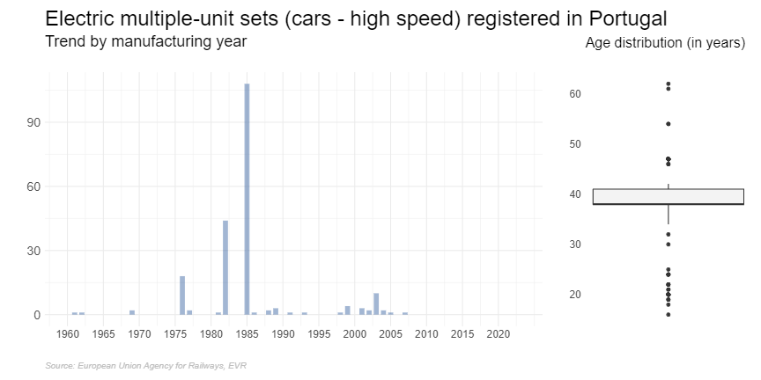
Data quality in railways

Slide 3
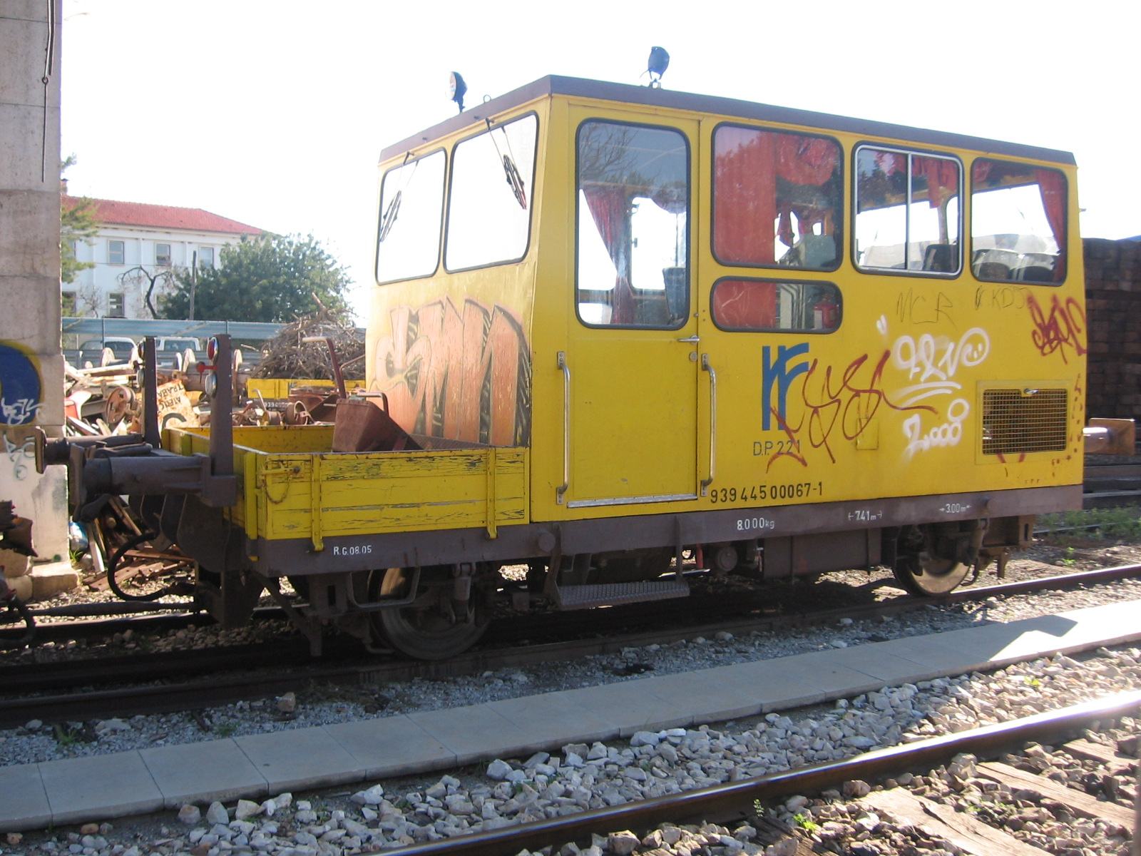

Slide 5
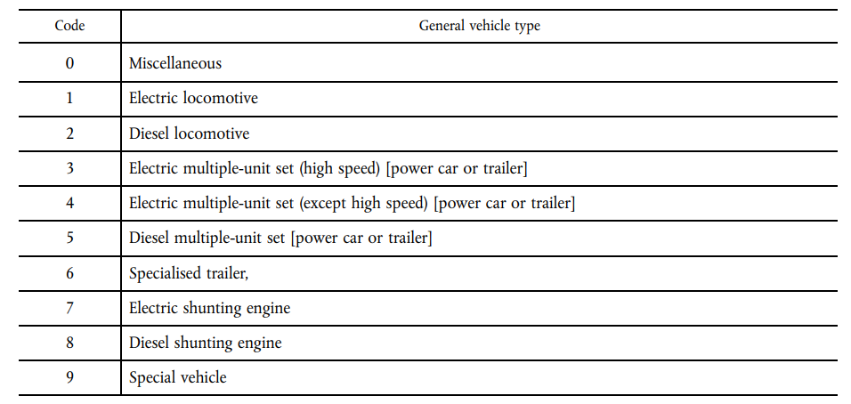

Slide 6
Data quality in railways
Why do quality issues emerge?
Railway data is generated by thousands of organisations, aggregated through various parallel channels
Most issues emerge from misinterpretation, unharmonised definitions, low scrutiny or lack of care
Why are quality issues not addressed?
Some issues are not strictly ‘issues’ from a single organisation’s perspective
Limited feedback loop
Limited sense of urgency
Limited access to comparative data
Technical limitations
Why should the railway sector have a stronger focus on promoting data quality?
Increasingly railway data is used for statistical AND operational purposes, hence data is of greater value
What should change to improve data quality?
Dedicated resource allocation for data quality reviews – data cannot be trusted blindly
Possibility for aggregators to review, refuse, and in some cases adjust data
Broader uptake of linked data
Simplification of definitions and channels
For more info on the Task Force on Data Quality: ESG-TF-Data-Quality-Final-report_en.pdf (europa.eu)

