Slide 1


Semantic Interoperability using the SAREF suite of ontologies
Presented by: Cornelis Bouter (TNO)
For: ERA Rail Data Forum 2024
DD/MM/YYYY

Slide 2


What is SAREF? (1)
In the year 2013 the European Commission launched the first initiative to build a common ontology in close collaboration with the Smart Appliances industry, which resulted in the creation of the Smart Applications Reference (SAREF) ontology.
Smart devices and their measurements are central in the existing SAREF core specification
SAREF is a commonly agreed and standardized ontology
with currently 12 extension in different domains,
a shared model of consensus that facilitates the matching of existing assets in the smart applications

Slide 3
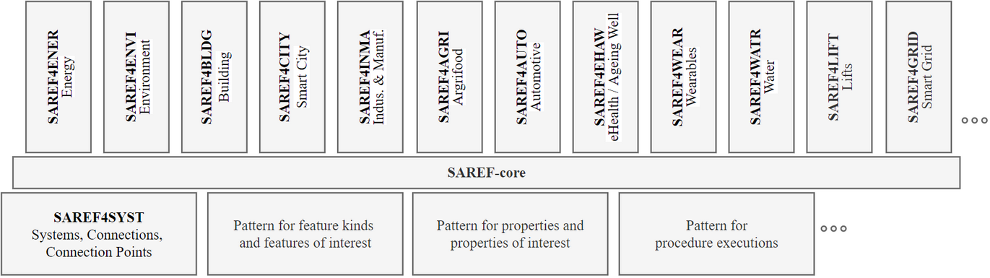
What is SAREF? (2)
All extensions have been developed under stimulus and continuous support of the EU Commission in collaboration with ETSI.
Notes:
Energy
Environment
Building
Smart Cities
Industry and Manufacturing
Smart Agriculture and Food Chain
Automotive
eHealth/Ageing-well
Wearables
Water
Lift
Smart Grid

Slide 4
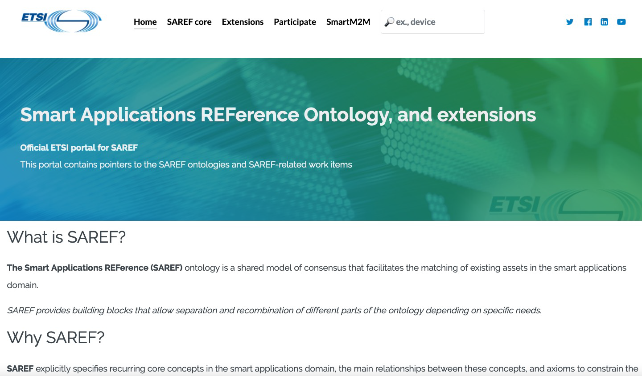
What is SAREF? (3)
An public ETSI portal has been developed, open for the SAREF community and industry stakeholders, which provides the SAREF ontology documentation.
  Technical specifications
  Documentation
  Ontological design guidance on top of documentation
  Version control
  Source code
  Requirements
  Tests
  Examples
  Issue tracker
https://saref.etsi.org/
SAREF provides a portal with user friendly documentation of the SAREF suite of ontologies
4

Slide 5

What drives SAREF standardisation?
  Semantic interoperability is a key element of the digital transformation
  Cross-sector semantic interoperability is a key to assure the evolution of the IoT and the related services to industrial/commercial markets
  Need for open and standardized interfaces among networked devices (often from different vendors) constituting these IoT systems
  Need to abstract from specific details of individual standards and create an abstraction layer based on a commonly agreed semantics with a high level model - a reference ontology
  SAREF standardisation is crucial to provide a common methodology for the ontologies integration, that are a essential part of technologies applications (e.g. AI, Digital Twins)
  ETSI has already invested on the SAREF open portal and to support an ontology expertise across European academy and industrial partners
  The ontologies have dynamic structure so that standardisation support will need to be continued
5

Slide 6
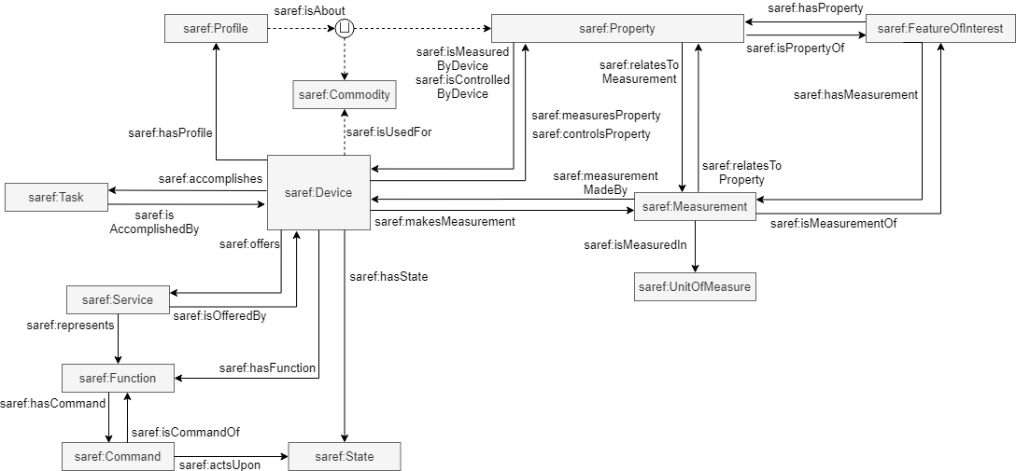
SAREF Core
Based on:
- Semantic Sensor Network/SOSA Ontology
- OGC Observations, Measurements, and Samples
Note: SAREF core version 3.1.1

Slide 7
SAREF core
Based on:
- Semantic Sensor Network/SOSA Ontology
- OGC Observations, Measurements, and Samples
Note: SAREF core version 3.1.1

Slide 8


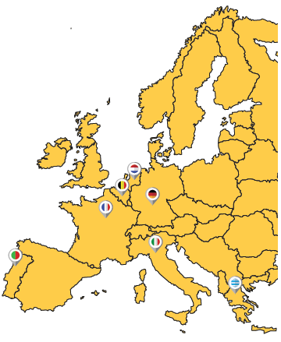
Success story: H2020 Interconnect
Semantic Interoperability for energy efficiency
- Make domain standards interoperable with each other
EN 50631-1 (EEBUS SPINE/SPINE-IoT)
EN 50491-12-2 (S2)
H2020 Large Scale Pilot (2019-2024)
https://interconnectproject.eu/
Interoperable solutions connecting smart homes, buildings and grids
Uses SAREF suite of ontologies as pillar for deploying semantic interoperability on a large scale
50 partners, 7 pilots in Europe

Slide 9
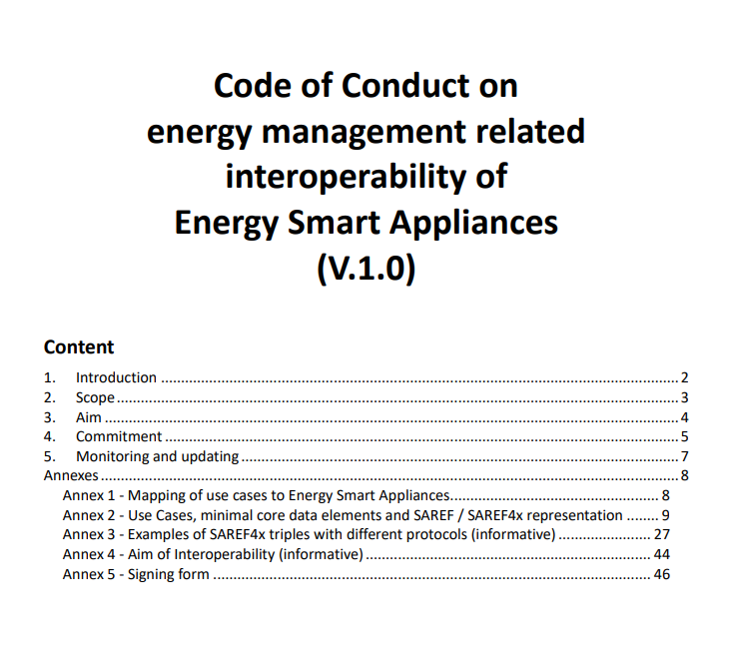
Success story: JRC Code of Conduct for energy related management of Energy Smart Appliances
Signed by ten appliance manufacturers and a HEMS manufacturer
Two main challenges:
• ”The definition of the principles for data sharing among appliances, home & building automation systems, EV chargers, aggregators, DSOs”
• ”The development of Interoperability requirements for ESA Stakeholders”
See: Code of Conduct for Energy Smart Appliances | JRC SES (europa.eu)

Slide 10
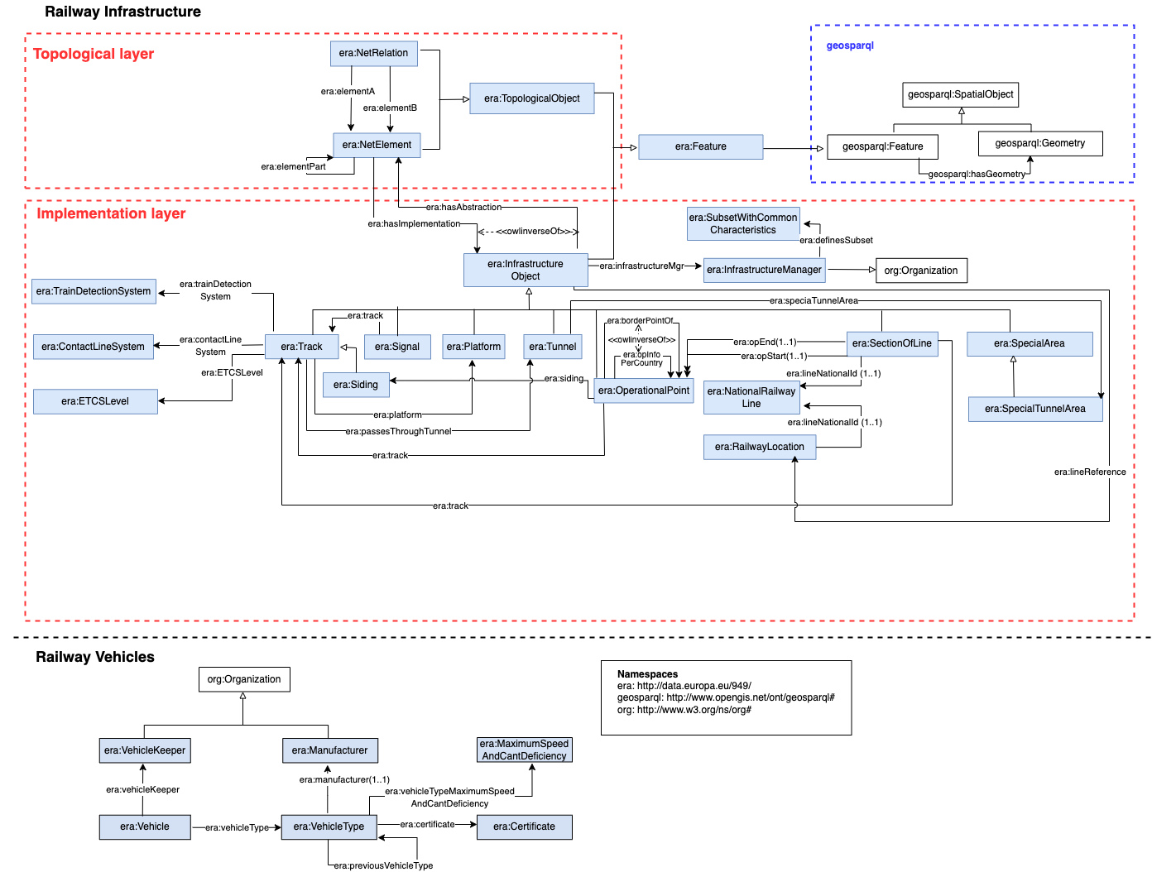
Comparison to ERA Vocabulary
RDF Vocabularies
- Extensible & reusable
- Global identification
- Standardisation & governance
Different scope:
- SAREF: Device measurements and functions
- ERA Vocabulary: railway infrastructure
- ERA Vocabulary: railway vehicles
Ontology alignment!

Slide 11
Conclusion
SAREF suite of ontologies:
- Standardisation of devices and their measurements and functions
- Governed by ETSI Technical Committee Smart M2M
Complementary to ERA Vocabulary:
- SAREF: Device measurements and functions
- ERA Vocabulary: railway infrastructure
- ERA Vocabulary: railway vehicles

Slide 12

Any further questions?
Contact me:
cornelis.bouter@tno.nl
laura.daniele@tno.nl

