Slide 1
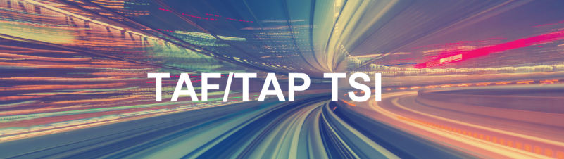


RU-IM communications
Session 2 – Data exchange standardization in Telematics TSI
18/06/2024
Christian Weber, SNCF, RU/IM Telematics JSG

Slide 2





RU-IM digital applications – Overview
IM Production System
RU Production System
Common (RNE, ERA)
Train operation
TAF/TAP Train Preparation & Running messages
Train operation
Path design and allocation
TAF/TAP Path Allocation dialogue messages
Path request
Infrastructure capacity & availabity
Capacity Model
Capacity Needs
Cap. Supply Plan
Capacity needs
Network description
Network description
Network Statement
IM Route Book

Slide 3
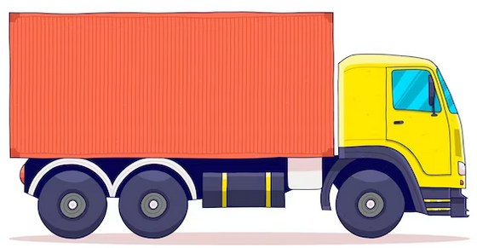

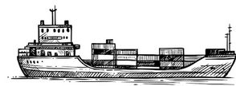
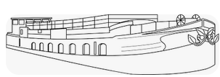






Combined Transport – Overview from RU
RU Contractual Carrier
Operator
of Rail Service Facility
Operator
of Rail Service Facility
Operator
of Rail Service Facility
Operator
of Rail Service Facility
First mile
Transit RU1
Last mile
Origin RU
Transit RUn
Destination RU

Slide 4
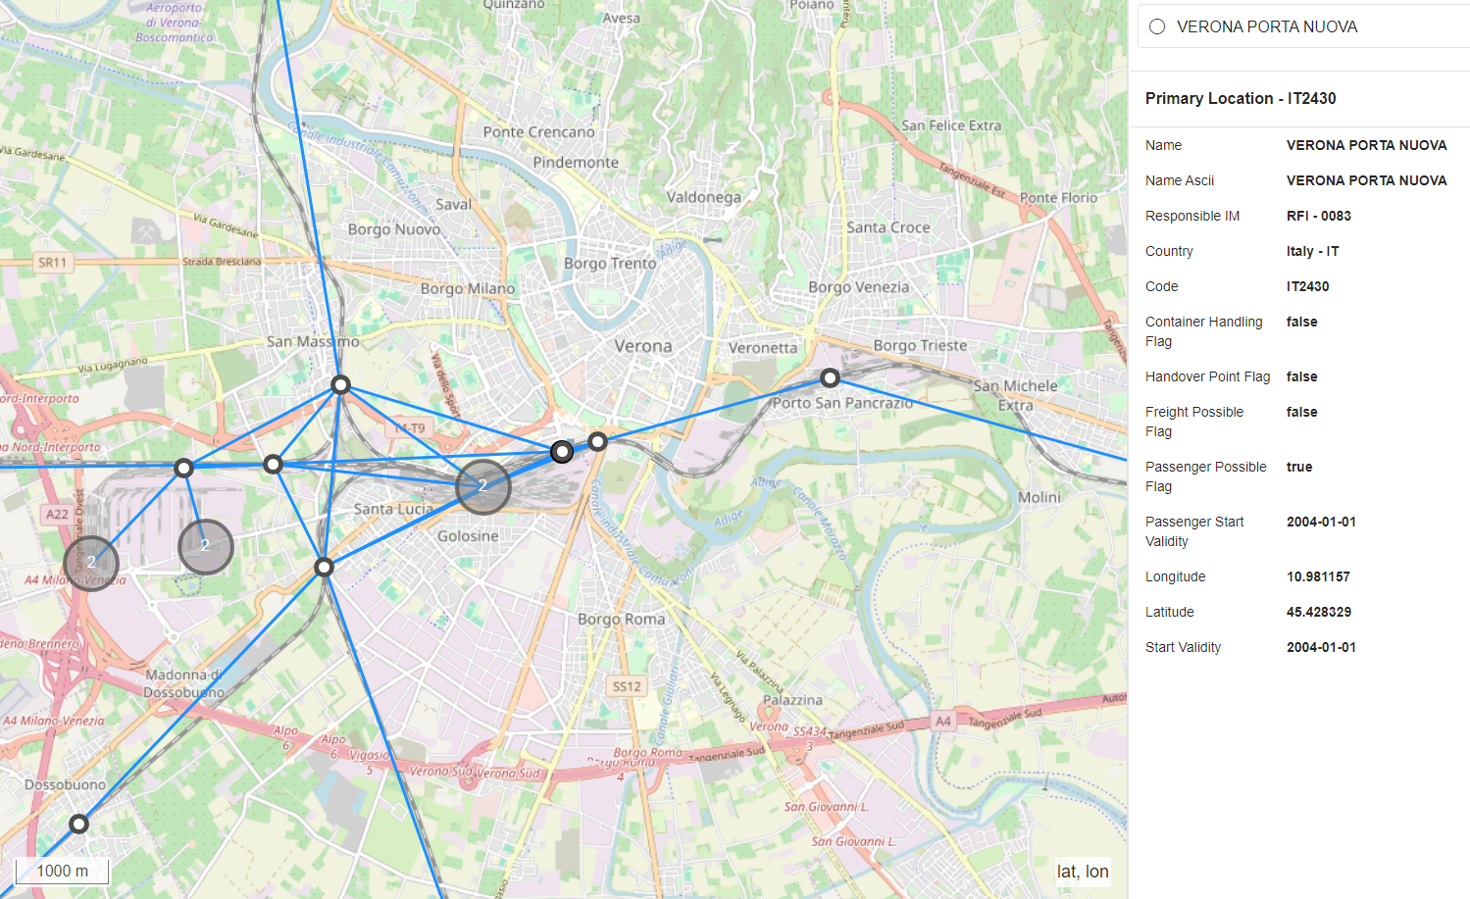
Railway Infrastructure System (RIS)
At 31/03/2024 :
61.011 Primary Locations (PLCs)
55.106 Subsidiary Locations (SLCs)
52.719 segments

Slide 5
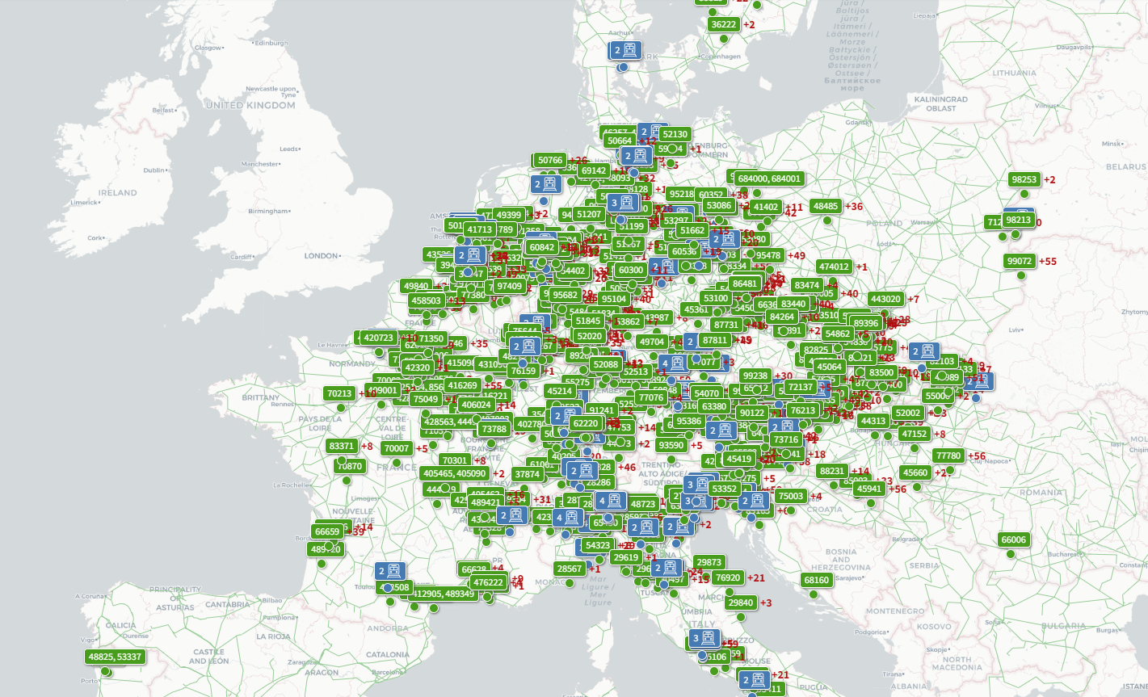
Train Information System (TIS) – Overview
International freight, passenger and national freight trains can be followed in Train Information System
Nearly 30.000 trains can be identified daily in the Train Information System
5.000 users from 200 companies connect every month with Train Information System
Approximately 5 million TAF/TAP TSI messages exchanged daily in Train Information System
5

Slide 6
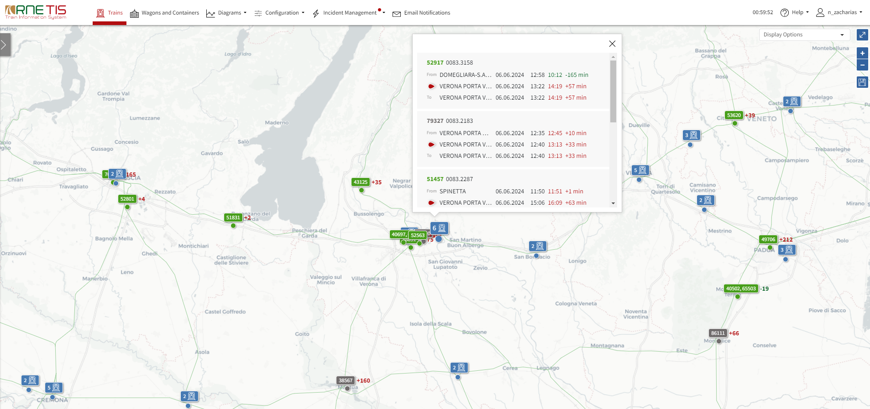
Train Information System (screenshot 1)

Slide 7
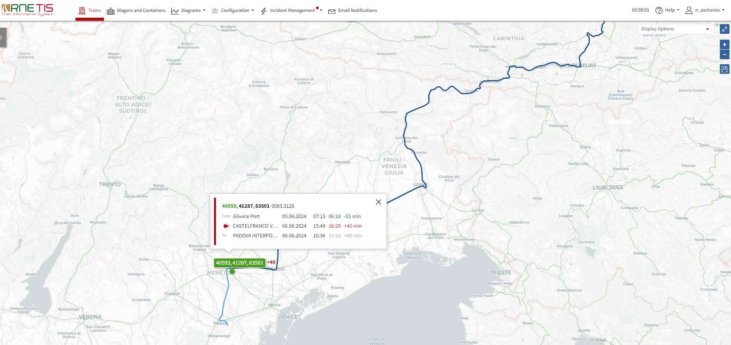
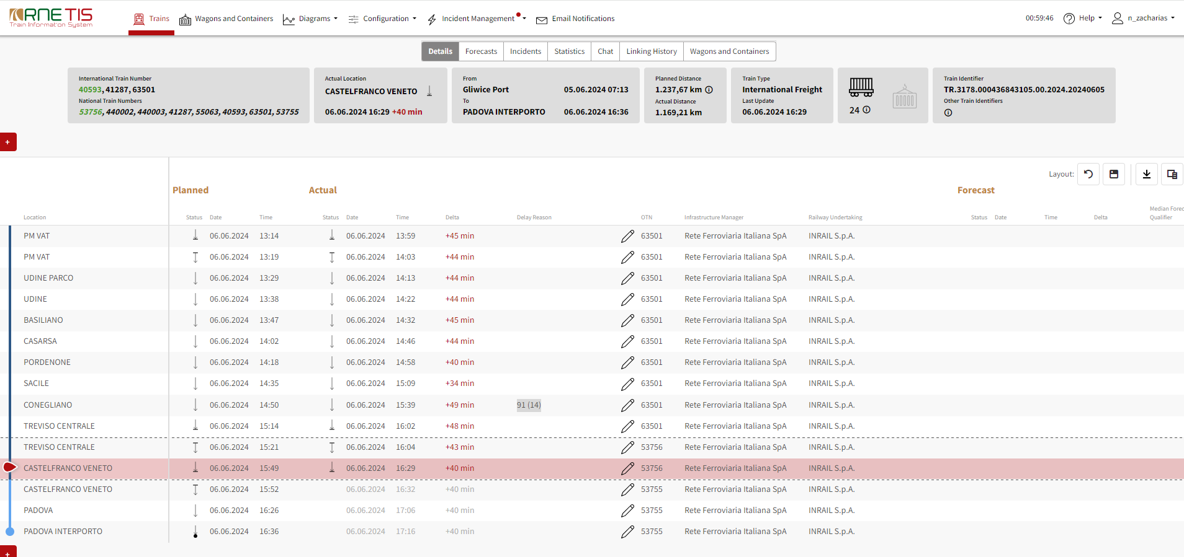
Train Information System (screenshot 2)

Slide 8
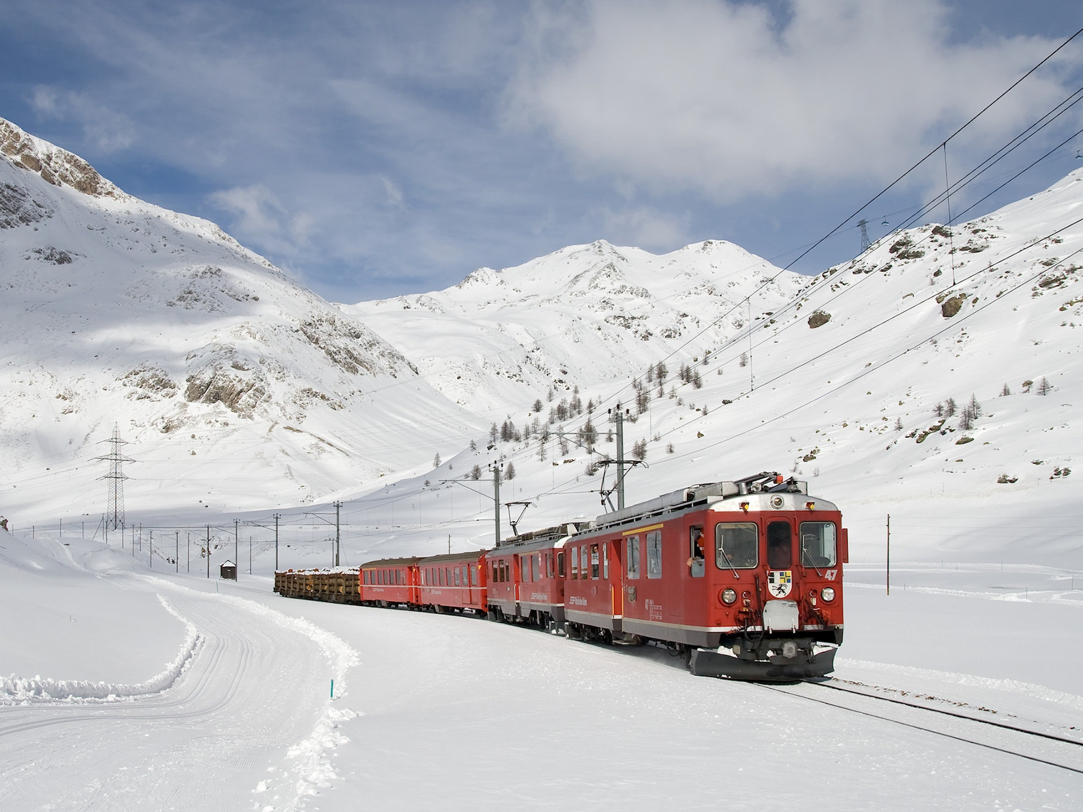
Thank you !
Grazie mille !
Thanks!
More information on the RU/IM Telematics Joint Sector Group : http://taf-jsg.info/

