Slide 1
Transmodel based multimodal booking infrastructure
Implementation of national multimodal information and ticketing in Norway
Brede Dammen
brede.dammen@entur.org
ERA Rail Data Forum, Verona, 18.-19. June 2024

Slide 2
Governance
The Government
Ministry of Transport
Railway Directorate
Entur AS
MMTIS open data requirements

Slide 3
“Together we can go further”

Slide 4
Why use Open Standards?
💁
How do you describe a bus stop?
How do you describe a rail service?
How do you update a specific journey with real time forecast?
How do you describe seating arrangements?
How do you describe access rights and conditions?
How do you describe static and dynamic pricing rules?
Technical data exchange formats for public transport data exchange
💁
💁
💁
💁
💁
NeTEx
(exchange format static
data - Timetables)
SIRI
(exchange format dynamic
data - real time data)
Because open standards
Establishes common terminologies and concepts → All speak the same “language”
Allows exchange their data at predictable ability & cost → All use a common exchange format
Prevents national, sector or provider-specific format lock-in → Increases interoperability and markets opportunities
Transmodel
(Conceptual data model)
✅
✅
Reference model for information in the public transport sector
✅

Slide 5
NeTEx and SIRI profiles
NeTEx and SIRI Standard
NeTEx and SIRI is highly flexible
Multi-purpose
Most aspects of public transport
Many options for structuring (similar) data
NeTEx for planned and SIRI for real-time
Scope and usage is specified / limited by a Profile
Textual but technical description
Data content restrictions (e.g. cardinality)
Conventions (e.g. ID structures, versioning, data overriding)
EU profile for minimum requirements for trip planning and fares (under development)
National profiles for extra usage as operations, extra data one country need, and more use cases supported
Nordic NeTEx and SIRI Profiles
EU profiles
(NeTEx: stops, network, timetable, fares and SIRI)

Slide 6
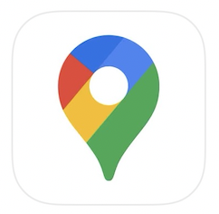
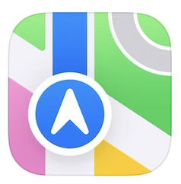
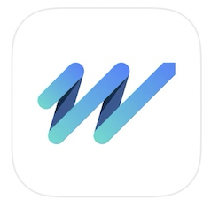
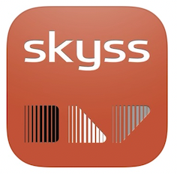
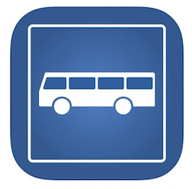
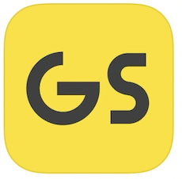
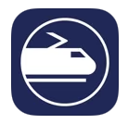
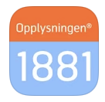
Data flow
Sporadic feedback
USERS
Open data
NeTEx
SIRI
GTFS
GTFS RT
PTA/PTO
ENTUR
NSR
Manual edits
by PTA’s
🖥️
NAP
National Stop Registry
Planning systems
~60 feeds
NeTEx
Nordic profile
⚙️
Timetable database
OpenTripPlanner
Trip calculation
Real-time systems
~60 feeds
SIRI (ET, VM, SX)
Nordic profile
⚙️
OpenTripPlanner currently provides
about 1 billion responses per month.
Real-time hub

Slide 7
Data flow with blocks
PTA/PTO
ENTUR
NSR
Examples of closed data can be:
Blocks
Dead-runs
Train composition
Unpublished lines
Explicit access is granted by the source data owner.
Manual edits
by PTA’s
🖥️
National Stop Registry
Planning systems
~60 feeds
NeTEx
Nordic profile
⚙️
Timetable database
Closed data
NeTEx
Real-time systems
~60 feeds
SIRI (ET, VM, SX)
Nordic profile
⚙️
🔒
Real-time hub

Slide 8
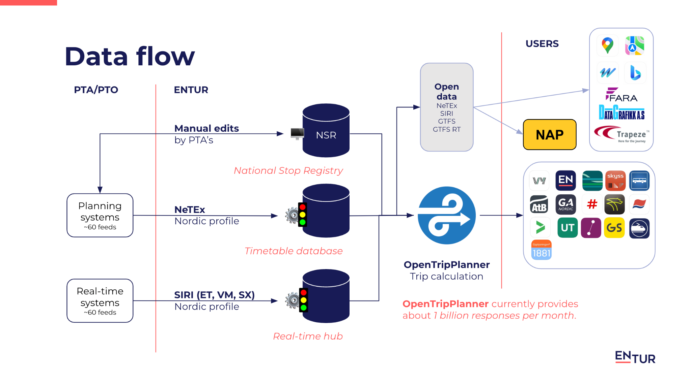
Dataflow sales and booking
Open data NeTEx/(GTFS)
PTA/PTO Entur Users
National product database
NAP
NeTEx
ABT
Inventory (quotas & yielding)
Offers engine
NeTEx
Rolling stock
Entur Seating & reservations

Slide 9
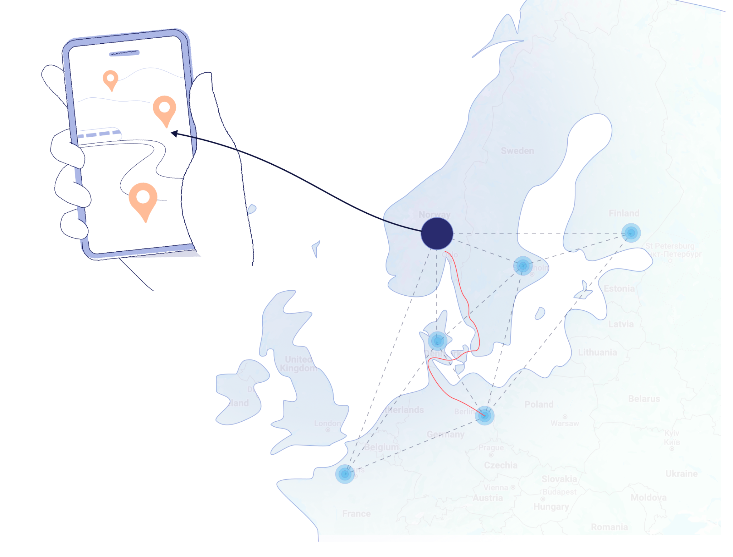
Summarize
Personalized by adding a price to any trip plan result
All rail products are sold through a Transmodel infrastructure
Fare collaboration rail + public and private mobility supported
Dynamic pricing and yielding supported
Multimodal by design
Aligned with the MMTIS - EU Delegation Regulation
Done right – we can scale

Slide 10
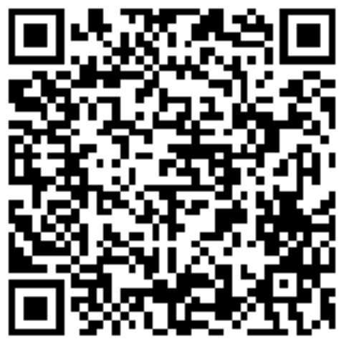
Brede Dammen
brededammen
Journey Planner, Team Owner
+47 907 96 684
brede.dammen@entur.org

