Slide 1
Alignment of Ontologies in the Railway Sector to Transport Reference Data Models
RAIL Data Forum 2024, 18th and 19th June
Notes:
ERA Semantic Approach Futurology…
Strategy .. University .. Prof.. Research
However .. I would like you to learn why the tool
To get your engagement
To help us to im
Prove and to go towards a common data scenario
Correction: also Austria and Sweden is on ad hoc basis. So, the highlighted ones asked officially to participate regularly
Georgia KOTOUFOU Operational Data Unit Project Officer Office: A327 Mobile: +33 622696115 Tel: +33 327096 500
Please consider the environment before deciding to print this email
From: KOTOUFOU Georgia <Georgia.KOTOUFOU@era.europa.eu> Sent: Thursday, November 9, 2023 8:57 AM To: AGUADO Marina <Marina.AGUADO@era.europa.eu> Subject: RE: NSA meeting
After the ERA Call, the following asked to participate regularly:
First Name
Last Name
Member State
Johannes
Brunner
Austria
Meeri
Sõerd
Estonia
Laurynas
Venčkauskas
Lithuania
Andrea
Rigoni
Luxemburg
Alexander
Östman
Sweden
Jérôme
Hunziker
Switzerland
Some from Italy & Spain also attend, but more on ad hoc basis (because I keep them in the communication).
They could write to me or to the functional email and I will give them access to the TWGs and forward the meeting invitations .

Slide 2
Motivation (I)
Cities publish open data, but such data sources are not necessarily interoperable…
I would like to publish in formats and structures that are easy to use
Publish
Publish
Publish
Extract
Extract
Extract
I use GTFS
I use my own CSV format
I am providing a Web service

Slide 3
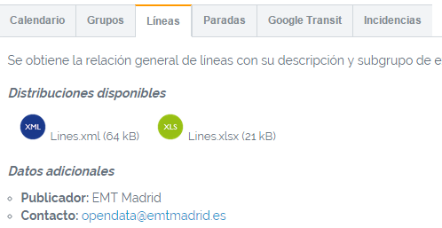
Motivation (II)
http://datosabiertos.malaga.eu/dataset/lineas-y-horarios-bus-paradas
http://opendata.emtmadrid.es/Datos-estaticos/Datos-generales
http://datos.santander.es/dataset/?id=paradas-bus
http://opendata.caceres.es/dataset/autobuses-caceres
https://www.zaragoza.es/ciudad/risp/buscar_Risp?&temas_smultiple=Transporte

Slide 4
Motivation (III)

Slide 5
Our goal… Ontologies for the transport sector that reuse existing work
Addressing the FAIR recommendations
Create ontologies that harmonise the way in which data is being provided by all these cities and transport authorities/providers
Reuse existing ontologies whenever possible to:
Facilitate interoperability
Avoid duplicate efforts
For the Transport sector:
Reuse well-known upper-level or domain-specific external ontologies, i.e. Organizations, Time, Units of Measure, GeoSPARQL
Reuse transport reference data models, e.g. Transmodel
Reuse internal ontologies within the organization, i.e. core ontologies or domain-specific
How to reuse?
Concepts in reusable ontological resources may be extended whenever additional attributes or relationships are required beyond the original concept in the reused resource.

Slide 6
Some initial results
Work on the reuse of Transmodel in the Public Bus Transport Ontology (https://www.semantic-web-journal.net/system/files/swj2612.pdf) in the context of Ciudades Abiertas project: “Applying the LOT methodology to a Public Bus Transport Ontology aligned with Transmodel: Challenges and Results”
Problem statement: Data not interoperable. Publication of data as GTFS feeds as well as using ad-hoc formats and APIs.
Requirement: Alignment with European policies, in particular the regulation 2017/1926 that states that starting December 2019:
“In order to develop a harmonised and seamless provision of multimodal travel information services and to support interoperability across the Union, a harmonised set of interoperable data exchange formats and protocols based on existing technical solutions and standards across different transport modes should be used at the national access point. “
“For exchange of static scheduled data (such as public transport, long distance coach and maritime including ferry), the relevant data in the national access point should use the CEN data exchange standard NeTEx CEN/TS 16614 based on the underlying conceptual data reference model Transmodel”
“For exchange of dynamic public transport data, the relevant parts of the CEN public transport data exchange standard SIRI CEN/TS 15531 and subsequent upgraded versions or any machine-readable format fully compatible should be used.

Slide 7
Challenges in the reuse of Transmodel
Transmodel component ontologies already had been developed previous projects (e.g., SNAP), but complex and not complete. Project focused on the GTFS transposition of some concepts in Transmodel and NeTEx
It was necessary to resort to the reuse of the non-ontological UML Transmodel specification. Thus, we were faced with the challenge of reusing a semantically rich and complex non-ontological resource
Adaptation of the Linked Open Terms (LOT) methodology

Slide 8
Transmodel components and Standards

Slide 9
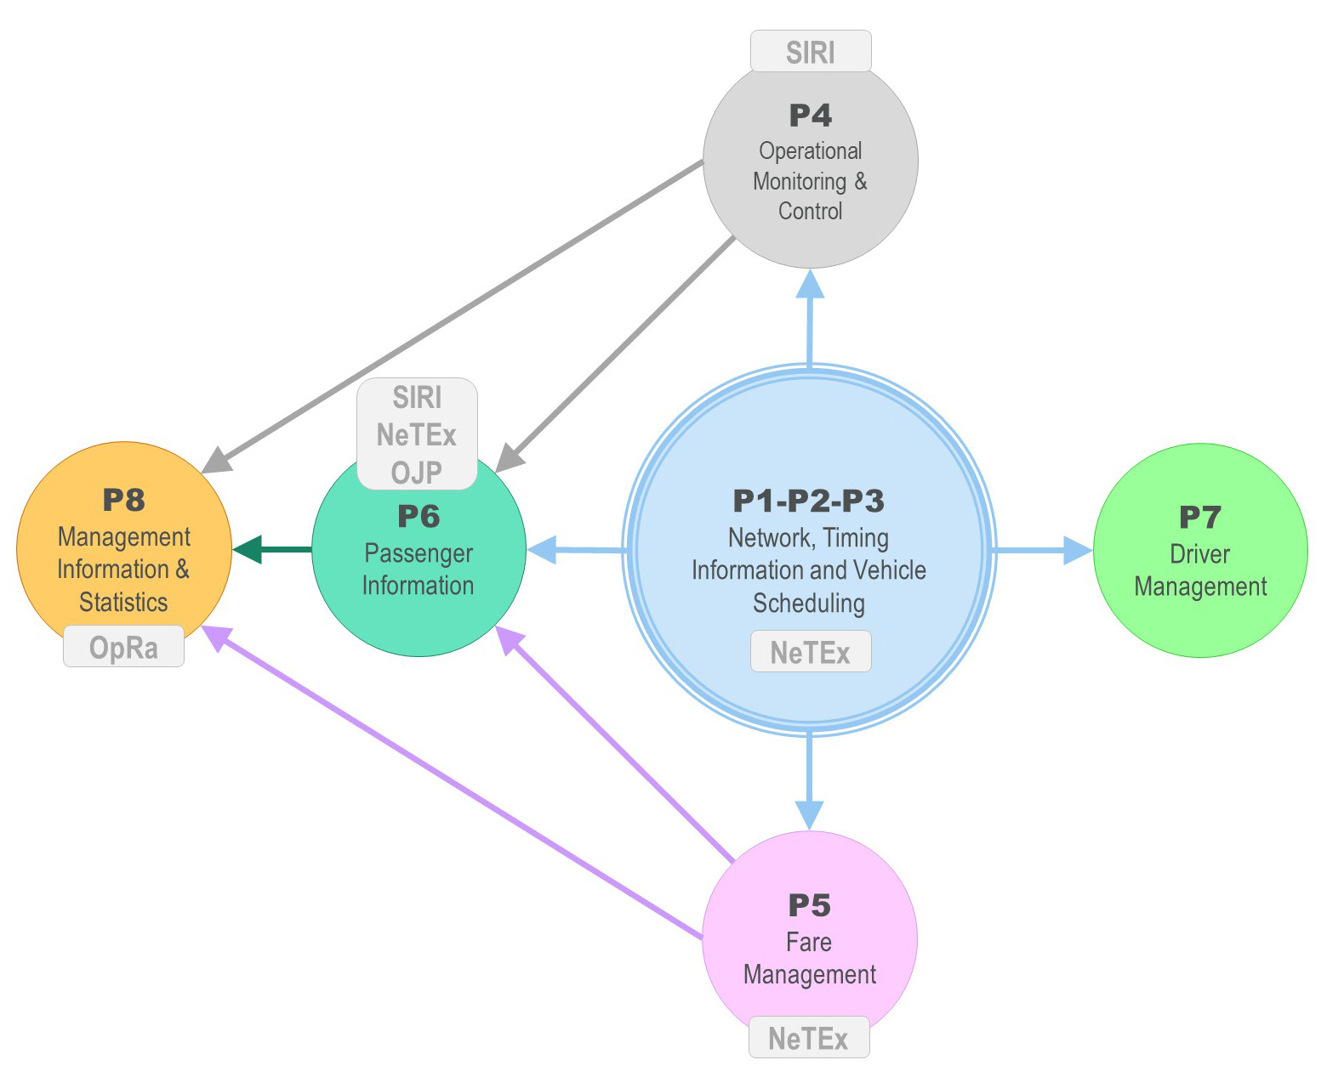
Transmodel and its UML specification
https://www.transmodel-cen.eu/model/index.htm

Slide 10
Transmodel UML specification
Eight sub-domains:
Network
Timing Information
Vehicle Scheduling
Operational Monitoring and Control
Fare Management
Passenger Information
Driver Management
Management Information and Statistics.

Slide 11
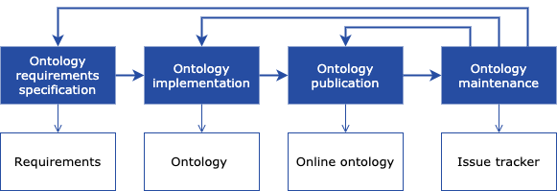
Adaptation of LOT methodology https://lot.linkeddata.es/

Slide 12
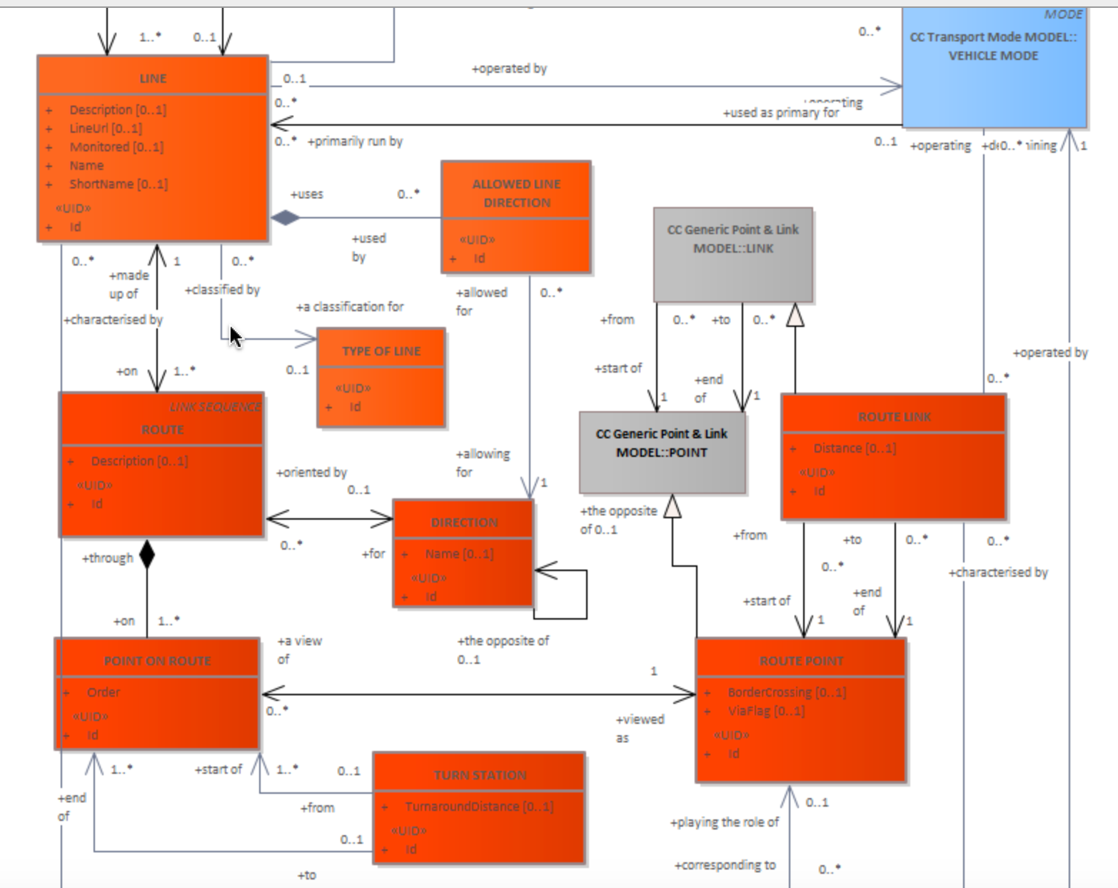
Adaptation of LOT methodology: NOR transformation of UML Transmodel Network Building Blocks

Slide 13
Public Transport Ontology at a glance
https://github.com/CiudadesAbiertas/vocab-transporte-autobus/

Slide 14
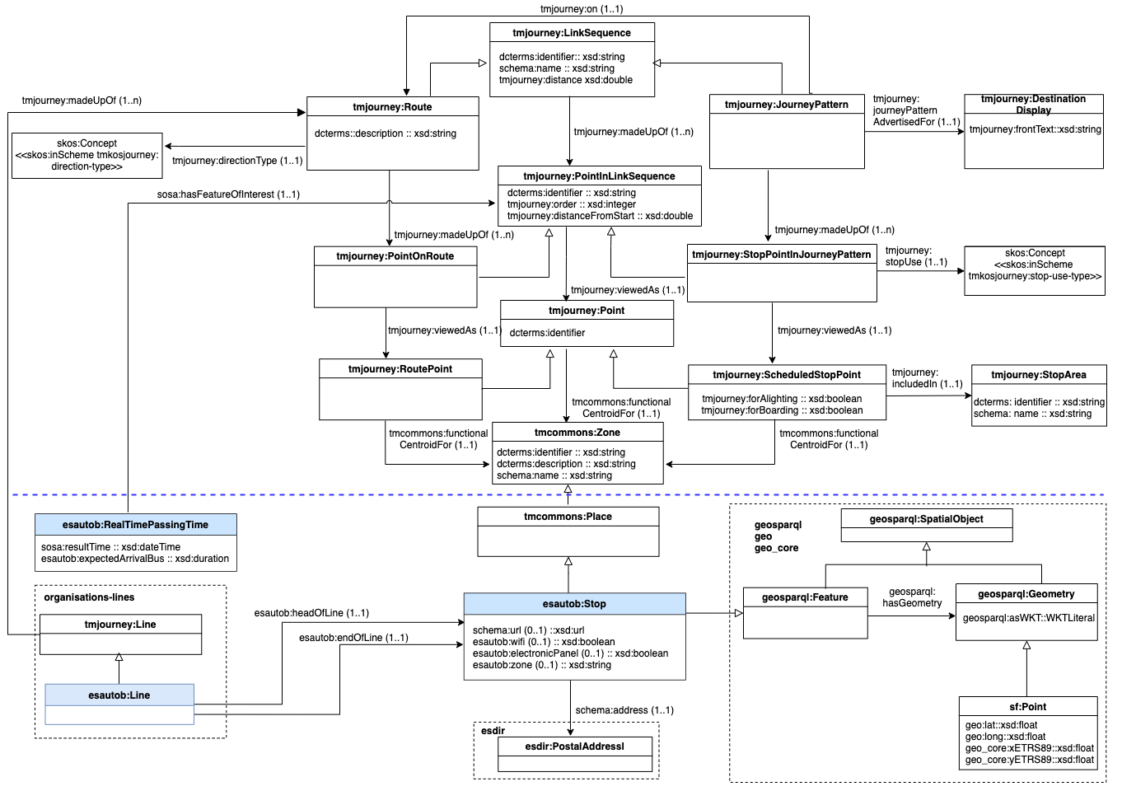
Adaptation of LOT methodology: Ontology forward engineering consists in the implementation of the relevant parts of the reused resource
https://github.com/CiudadesAbiertas/vocab-transporte-autobus/

Slide 15
Challenges in integrating Transmodel in Public Bus Transport Ontology
Documentation is scattered and there are different versions available
Extensive information on standards vs. lack of information on implementation or examples
Complex UML Transmodel specification
The same concept with different semantics (Transmodel, NeTEx)
Concepts that are not represented in the Transmodel UML specification
Complexity of the ontology that is reusing Transmodel, e.g. Public Bus Transport ontology module that covers bus routes and journey patterns

Slide 16
Integrating Transmodel in ERA
Link with some of the infrastructure concepts
E.g., stations
Connection of the data model to ticketing: Fare Management https://www.transmodel-cen.eu/model/EARoot/EA6/EA1629.htm
Connections with concepts related to Persons with Reduced Mobility (PRM): Common Concepts and Generic Accessibility Model https://www.transmodel-cen.eu/model/EARoot/EA1/EA5/EA8/EA241.htm

