Slide 1
Conceptual Data Model supporting operations
Airy Magnien, UIC
Rail Data Forum, Verona, 18 June 2024

Slide 2
CDM as “work in progress”
S2R LinX4Rail, 2023
Dual (federated PIM + X2-Rail4 as PSM)
ERJU FP1: MOTIONAL
CDM as output of WP30
S2R In2Rail, 2018
“Bridge between models”
Conceptual model
Formalism: UML class diagr.
Derived from railML3® (based on RTM)
Platform-independent (PIM)
XML/JSON/Protobuf exchange formats
Available as a spec
Hybrid model
PIM + PSM
RDF/OWL and UML (PIM), JSON sch. (PSM)
RDF (PIM),JSON/Protobuf (PSM)
Open federation of public models: RSM (RTM), EULYNX DP, IFC, TRANSMODEL, ERA voc., …
PIM: Open license (see Ontorail), PSM: non-public
Conceptual model
PIM
RDF/OWL, SHACL
RDF serial. In conjunction with other industry formats
Federation as LinX4Rail + upper or external ontologies
Open license (EUPL 1.2)
Notes:
Sources: X2Rail-2 D6.4, esp. Appendix B about In2Rail

Slide 3
Sample use case Standardized European Checkpoints
Follow-up of « intelligent video gates » by FP5-TRANSF4MR
For train monitoring at terminals or borders
Cameras, RFIDs, other sensors to
identify wagons and containers
check rolling stock and load condition

Slide 4
Data Requirements: Aspects
Asset management aspect (FP5, FP3?)
Vehicles, their components, their state of repair…
Topology aspect (FP5, …)
Placement of vehicles in a formation: order and orientation…
Geometry aspect (FP5)
Location of components along the formation, incl. side and height
Functional characteristics aspect (Digital twin)
Encoding characteristics relative to running simulation: traction, braking, resistance to forward movement

Slide 5
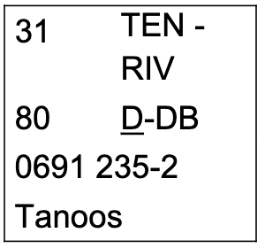
Data requirements: “abstraction”
Operational view
“locomotive”, “wagon” …
Foreseen usage
Operator requirements
Structural or catalogue view
“Class 66”, “Shinkansen 700T series”, “Baureihe 103” …
(Manufacturing) type definition
Manufacturer response to requirements
Physical view
“103-001”,
Serial number (maybe combined with the above)
Inventory of assets
Notes:
”Abstraction” stands between quotation marks: the three levels can be displayed on the same abstraction level (M1), and this is what RSM currently does.

Slide 6
Loading the Matrix
Any rolling stock “aspects” can meaningfully be considered at different “levels”:
Legend: D : defined ; U : used
Level ↓ Aspect → | Asset Management | Topology | Geometry | Functional charact.
Operational req. | D: vehicles | D: op. planning | U: op. execution | U: op. simulation
Constr. type | D: components | U (D: trainsets only) | D: at vehicle level | D: nominal, degraded
Physical assets | U: diagnosis, state of repair | U: marshalling | U: diagnosis portals | U: degraded modes
of special interest to EU Checkpoints
This pleads for keeping the “aspects” well separated from “levels”,
Keeping the model small:
4 aspects + 3 levels = 7 basic ontologies with 4 x 3 = 12 applications

Slide 7
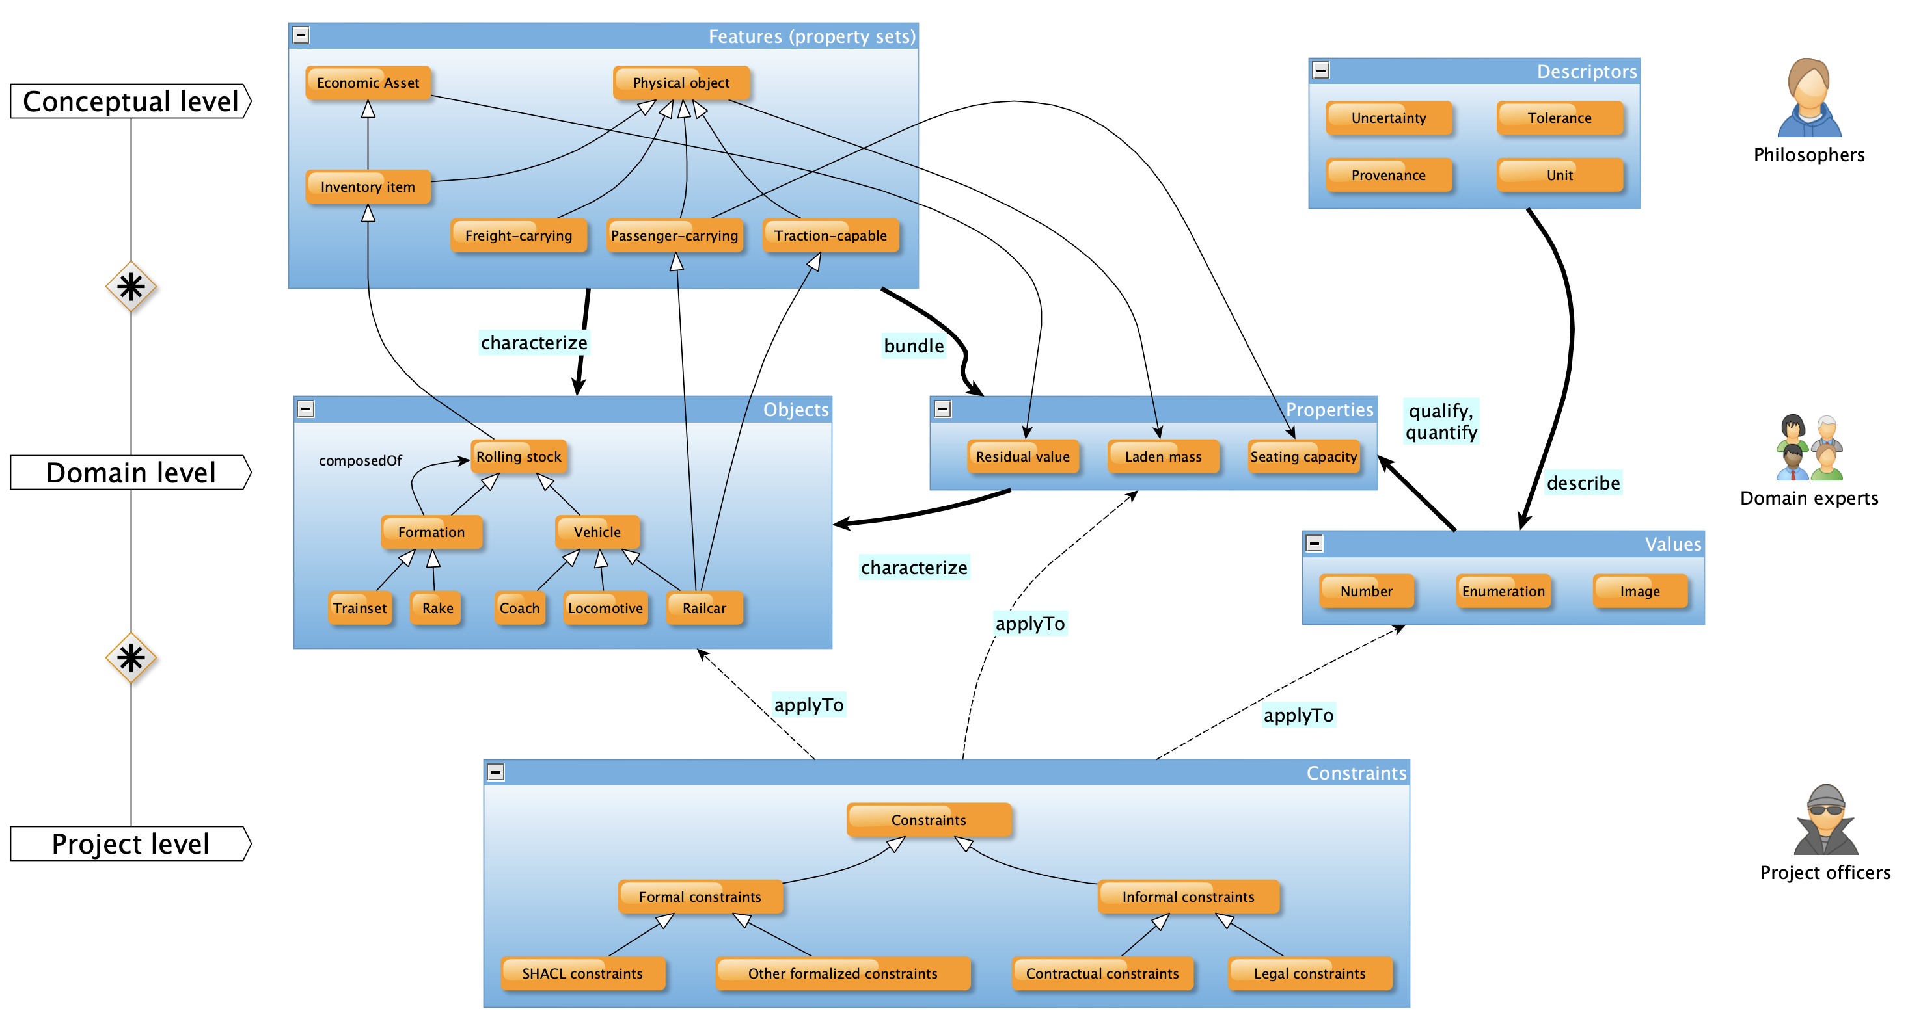
Not only “conceptual”…

Slide 8
Not only data…
… but information tailored to needs
Owner is BLS
EVN 12345678
A coach in an inventory
Of type Bs231
A coach in catalogue
An empty mass
“Coach mass is 40.1 t”
“Coach mass is 40 t”
in metric tons
Tolerance +/- 0.1 t
Measured on 11/6/2024
Using KEMEK scale
Uncertainty +/- 0.05 t
Information is sufficient for performing conformity assessment. Conformity assessment fails because sensor is no longer calibrated.
Traceability can always be provided to the necessary extent.
Last calibrated 9/5/2023

Slide 9
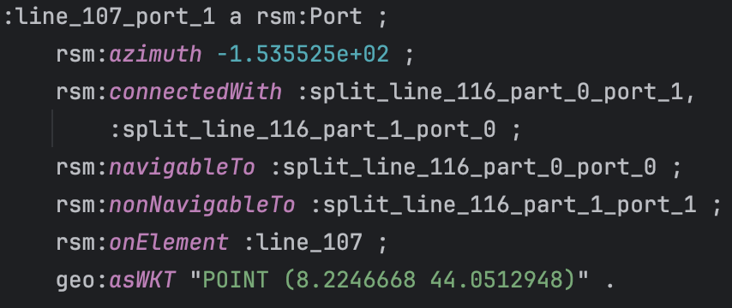
Not only model…
ISO/IEC 13249-3:2016
… but also: data using same syntax as model + equivalent binary formats for M-to-M exchange + associated industry standard formats

Slide 10
… executable code too
RDF/OWL is open to “too many solutions”, fit for all kinds of purposes:
APACHE JENA framework, using Java: industry-strength
PROLOG: elegant, as ontologies are based on First Order Logics
Python + libraries: fine for proof of concept, at least
For advanced data queries (SPARQL + extensions):
GraphDB…
… and other open source software

Slide 11
CDM for maintenance
General support of specifications + measurements + predictions
… all of them having their own time history
All series can be stored “live” in memory for comparison (full semantic alignment + no naming collision)

Slide 12
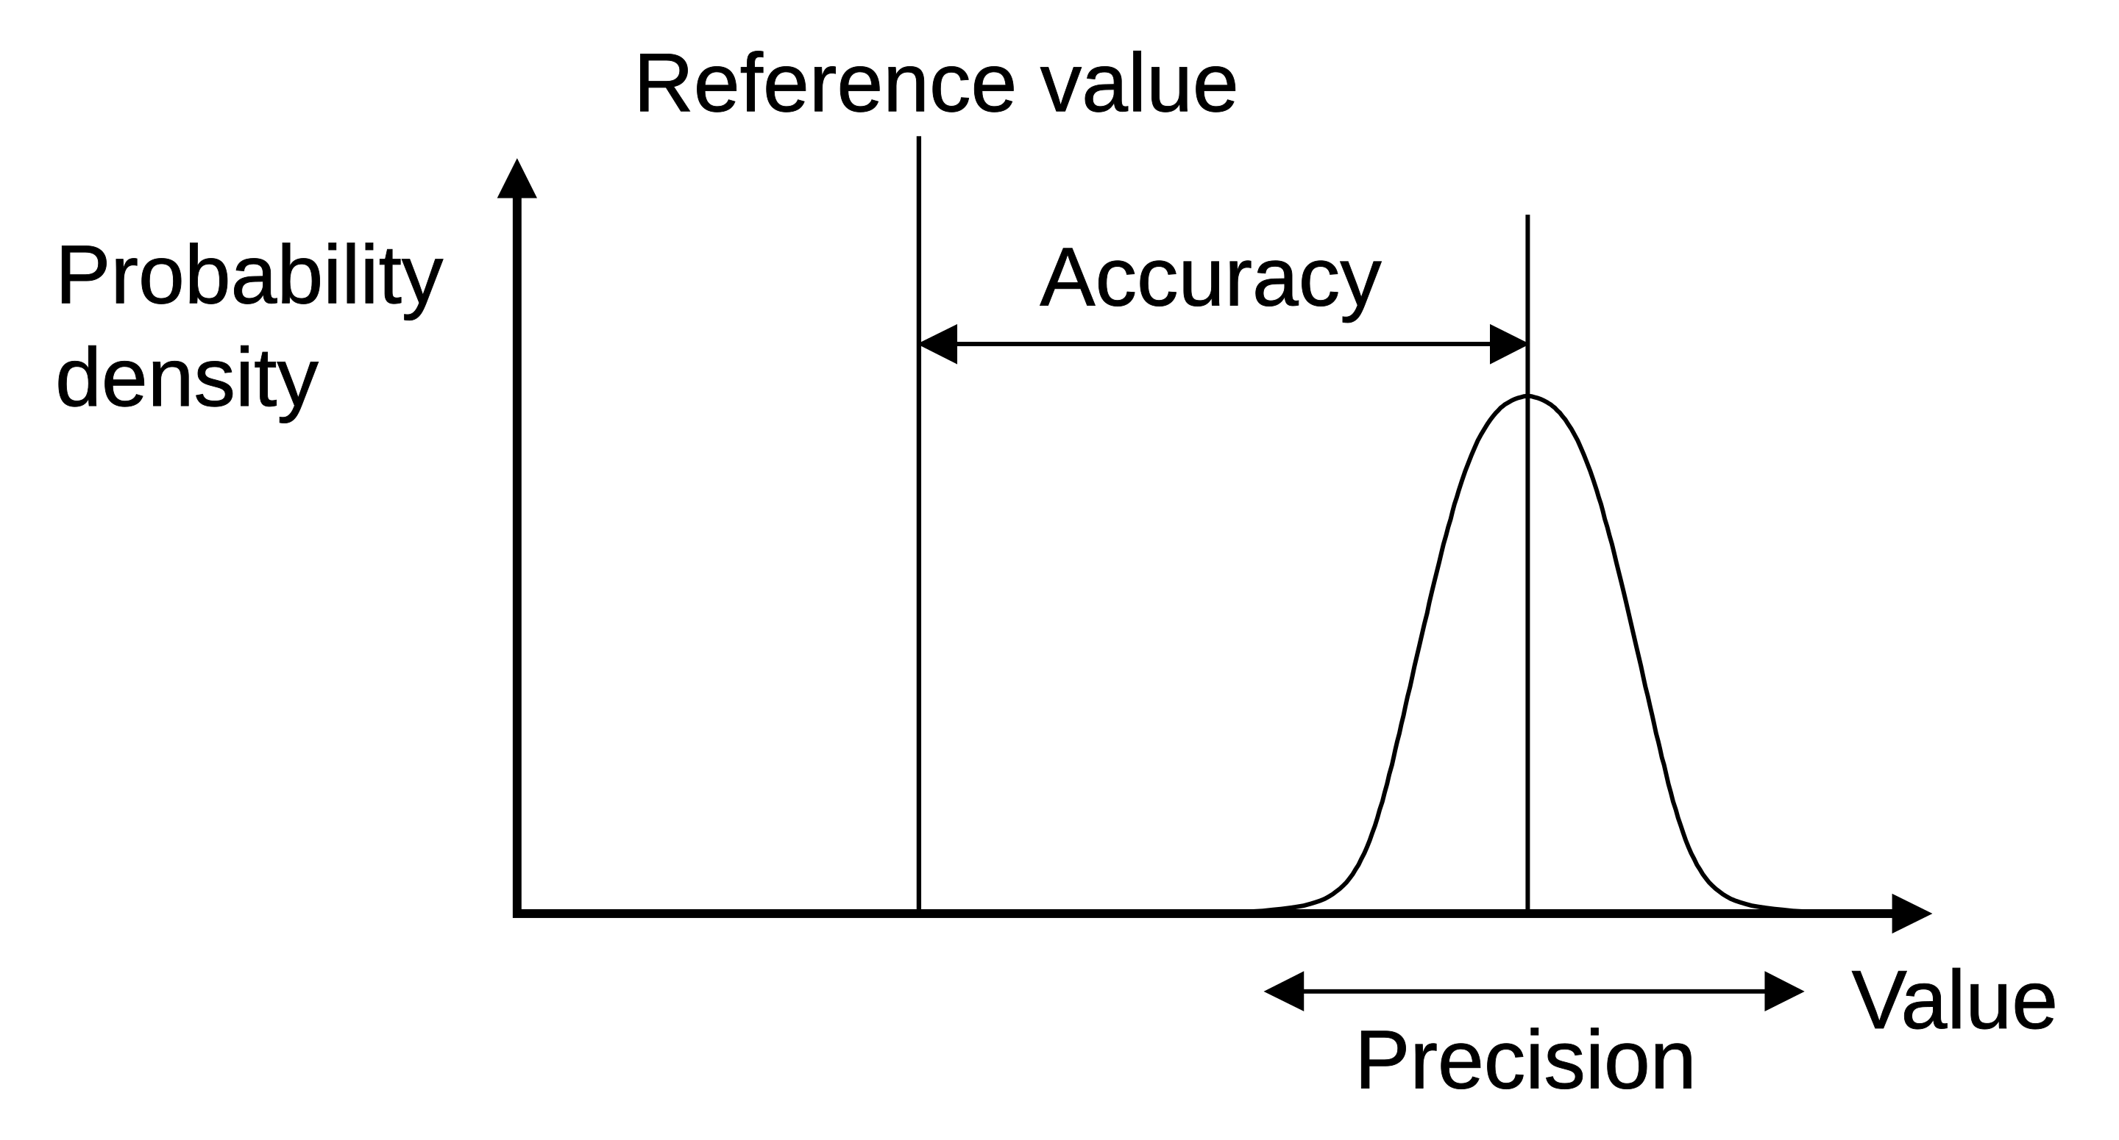
CDM does metrology
For which purpose CDM rests on open standards and best industrial practice, e.g. :
W3C SOSA/SSN (observation, sampling, actuation / semantic sensor network) ontologies
… extended to specifications and predictions (since RSM 1.2)
Using standard representation of quantities and units: e.g. QUDT and/or UCUM ontologies
With explicit metadata about property values: provenance, sensor calibration data, tolerances, confidence intervals, etc.
Credit: Wikipedia (see notes)
Notes:
Image credit: from Wikipedia https://en.wikipedia.org/wiki/Accuracy_and_precision#/media/File:Accuracy_and_precision.svg.

Slide 13
… the story goes on …
Provisional GitHub (awaiting ERJU-managed repository):
https://github.com/UICrail/SemanticRSM
In particular, the built-in wiki:
https://github.com/UICrail/SemanticRSM/wiki

