Slide 1
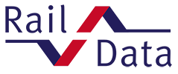
RU–RU Communication
RailData experience

Slide 2
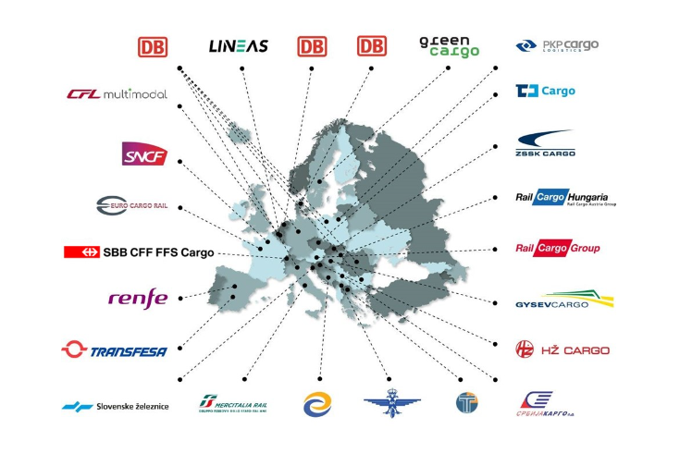
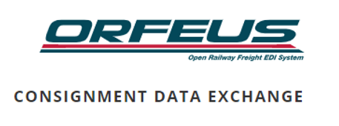
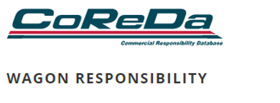
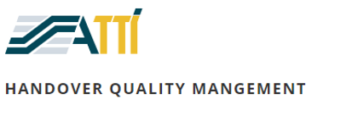
A few words on RailData
The main purpose of RailData is to develop, implement and run centralised IT Systems, designed to ensure data exchange between European freight Railway Undertakings, as well as with Wagon Keepers and other relevant companies.
Created in 1995 as a special group of the ... It has its own governance and budget with its members.
The benefits we bring
Commercial information
Track & Trace
Facilitates customer information
Enable TAF-TSI compliance

Slide 3
RU-RU Communication
ECN
RU Contractual
Carrier
First mile
Last mile
Origin RU
Transit RU1
Transit RUn
Destination RU
RU Operating
a movement
WSM
H30
Train
Comp.

Slide 4
RU-RU Communication
Some figures :
WSM: 24m. sent / year (0.76 per sec)
ECN: 0.97m. sent / year (1.8 per min)
H30 : 0.92m received / year
RUs : ~30
Strengths :
Enable TAF-TSI compliance for our users
System performance and stability
Critical service for RUs operations
Challenges :
Data quality
Align users on latest versions of interfaces
Opportunities :
Expand Electronic Consignement note
Expand users : The more data the more value
Densify information
Information on first and last mile

Slide 5
RU-Other parties Communication
First mile
Last mile
Origin RU
Transit RU1
Transit RUn
Destination RU
WSM
H30
Train
Comp.
TRI (fw)
Wagon
Perf.
RSRD
/GCU
TRI

Slide 6
RU-Other parties Communication
Some figures :
PLC datbase: ~ 67k
Wagons : ~240k
TRI : 49 m. received/year (1.5/sec)
Mileage updates : 28.5m / year
Strengths :
TRI allows to increase number of WSM
Partnership with RNE
Links elements related to transport (consignment, wagon, train, mileage)
We only provide indirectly “TAF real time RU to RU train communication”
Challenges :
Data mapping (ex: PLC to ENEE/UIC location codes, Train IDs)
Not all trains are covered / Some trains filtered
Data governance
Opportunities :
Digital Train Composition
Provide more value/services through the links between existing features

