Slide 1
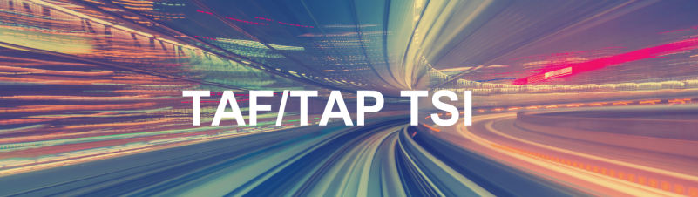


RU point of view in Combined Transport
Workshop 4 – Telematics Freight
19/06/2024
Christian Weber, SNCF, RU/IM Telematics JSG

Slide 2
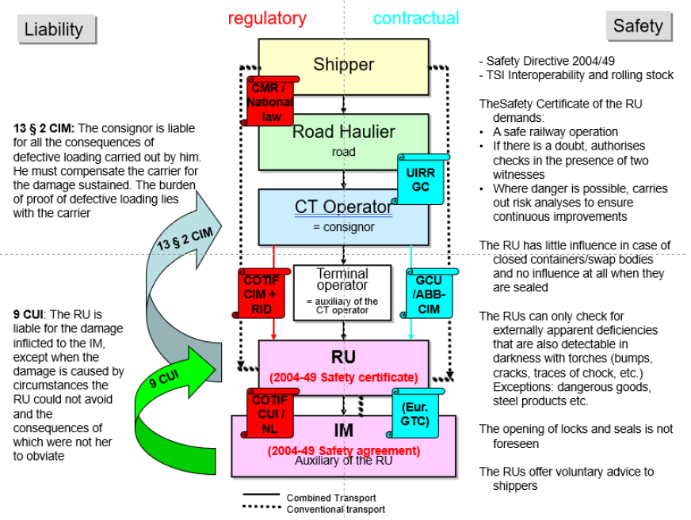
Roles and responsibilities of the Combined Transport actors

Slide 3





RU-IM digital applications – Overview
IM Production System
RU Production System
Common (RNE, ERA)
Train operation
TAF/TAP Train Preparation & Running messages
Train operation
Path design and allocation
TAF/TAP Path Allocation dialogue messages
Path request
Infrastructure capacity & availabity
TAF/TAP Temporary Capacity Restriction messages
Capacity needs
Network description
Network description
Network Statement
IM Route Book

Slide 4
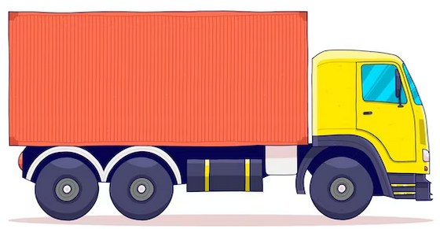
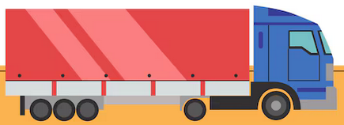
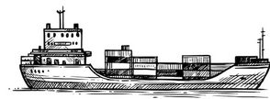
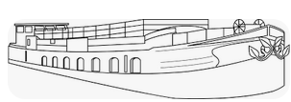






Combined Transport – Overview from RU
RU Contractual Carrier
Operator
of Rail Service Facility
Operator
of Rail Service Facility
Operator
of Rail Service Facility
Operator
of Rail Service Facility
First mile
Last mile
Origin RU
Transit RU1
Transit RUn
Destination RU

Slide 5
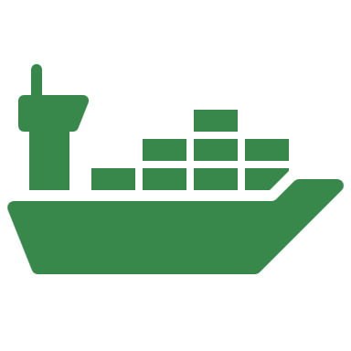




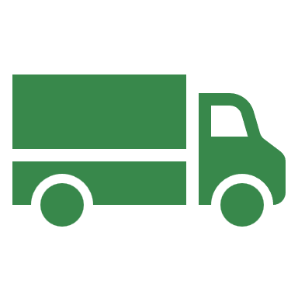
High data quality and availability as key enabler for competitive rail freight transport services
Complex transport chains with large number of shipments on high number of O/Ds
Port
Authorities
Terminal
Shipment
Wagon
keeper
RU 1
RU 2
RU 3
Consignee
Consignor
Port
IM 1
IM 2
IM 3
Customer expectations
High reliability/adherence to committed delivery time
High transparency (e.g., location, ETA) and proactive management by RUs
Competitive cost (high asset utilization)
Requirements on data
High data availability and quality for all players in the rail freight ecosystem to manage business in a such a way as to meet customer expectations

Slide 6


The digital ecosystem will facilitate seam-paperless information flows between all rail freight actors
Building blocks of the Digital Ecosystem
SCHEMATIC
Customers
Railway Undertakings
Platform
Cust. 1
"Small" RUs
Standard platform interface
Lead RU
RUs
(xxx)
Owners
Cust. 2
Authorities
Commercial interfaces
Standard
Technology
API
API
Strong security
AU 1
Wagon Keepers
Digital Rail Freight Ecosystem
AU 2
1
2
3
4
5
1
2
3
4
5
WK 1
GCU¹
(WKs)
Raildata
(RUs)
Xrail²
(RUs)
RNE³
(IMs)
GCU¹
(WKs)
Raildata
(RUs)
Xrail
(RUs)
RNE²
(IMs)
…
3rd Party Data Platforms⁴
…
WK 2
Easy
access
3rd P 1
Open innovation
space
3rd P 2
Infrastructure Managers, Ports, Terminals
IM 1
IM 2
IM 3
Under consideration
of DTLF⁵
¹ Broker of the GCU Bureau (General Contract in Use for wagons)
² Xrail – the European standard for competitive and sustainable single wagonload transport
³ RailNetEurope
⁴ Consideration of 3rd parties, e.g., other modes, IoT platforms
⁵ Digital Transport and Logistics Forum : framework for electronic freight transport information exchange with authorities (eFTI)

Slide 7
Clear data governance principles to support a data exchange mindset
7

Slide 8
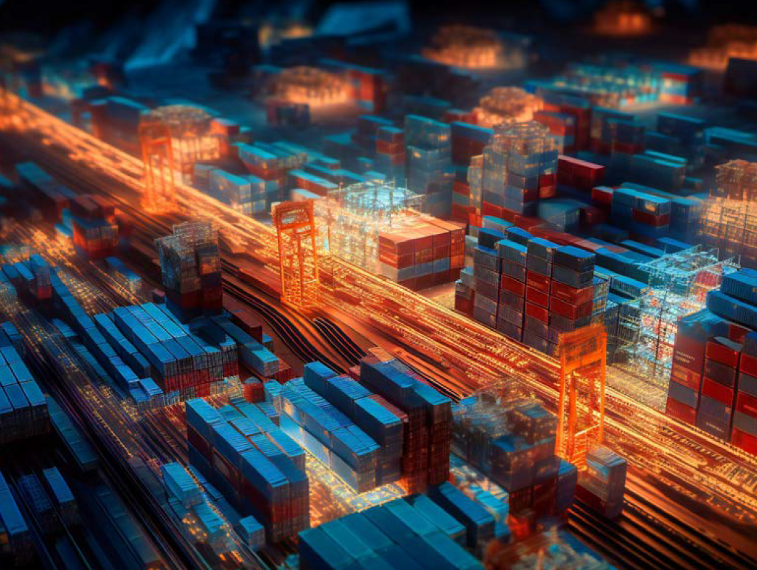
Thank you !
Grazie mille !

