Slide 1
^{Workshop: Data Quality}
Rail Data Forum 2024
18-19 June 2024

Slide 2
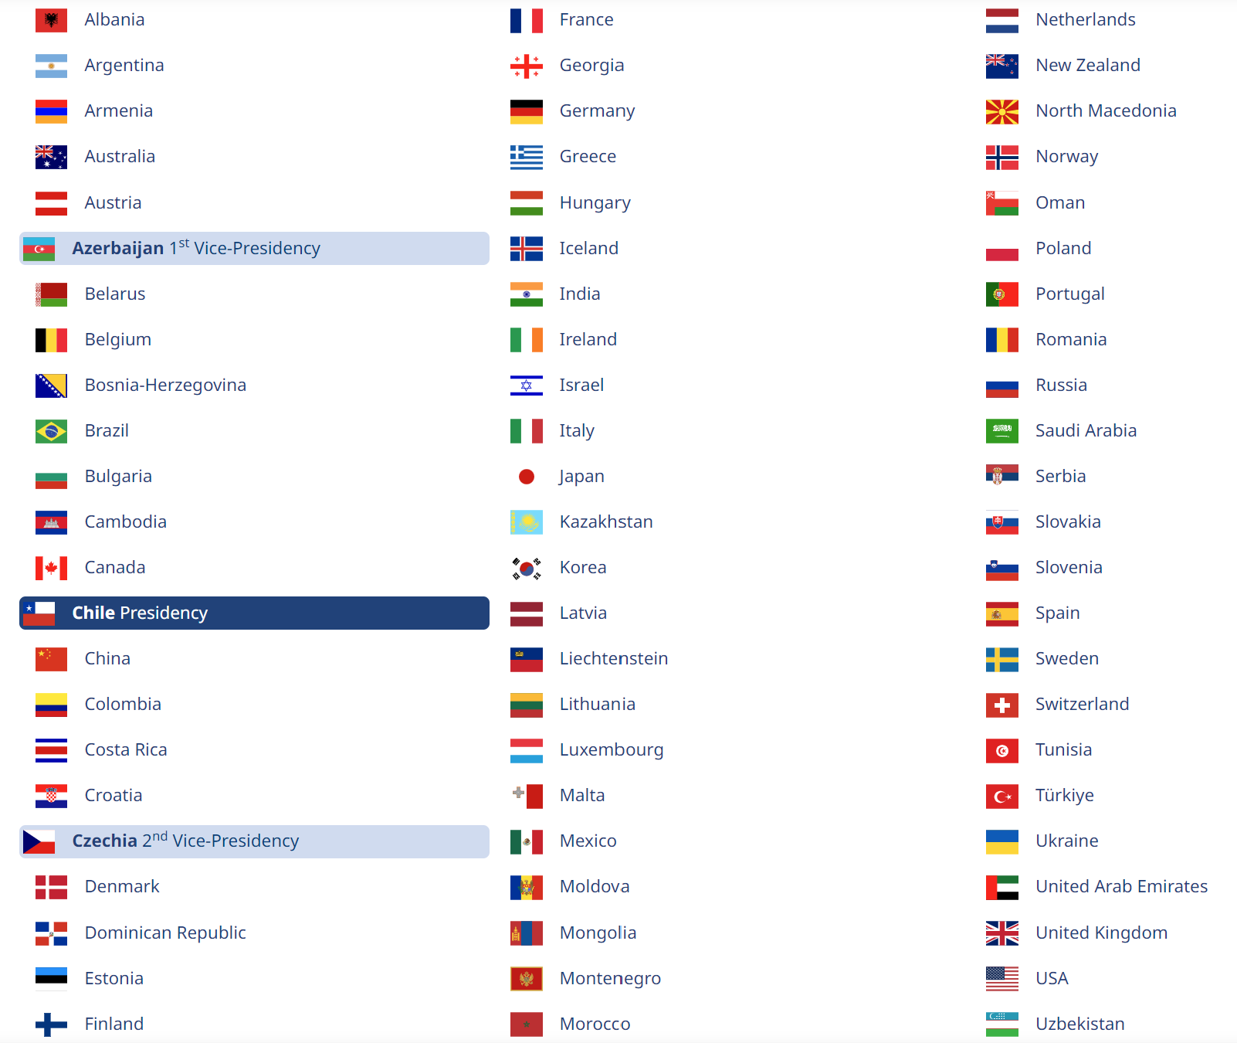
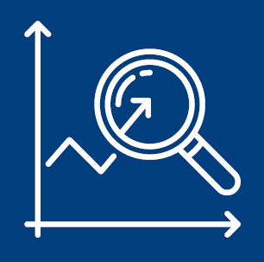
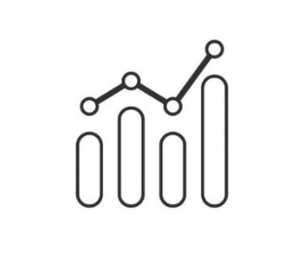
ITF is an intergovernmental organisation with 69 member countries. It acts as a think tank for transport policy. It is the only global body that covers all transport modes.
ITF databases are the only source of international transport statistics that include all modes of transport.

Slide 3
Which data does ITF collect?
Investment and maintenance spending in rail infrastructure
Capital value of rail infrastructure
Rail passenger and freight transport
Rail container transport (tonnes and TEU)
Rail infrastructure network (total, electrified)

Slide 4
Where does ITF collect data from?
Ministry of Transport
National statistical offices
UIC
Eurostat
Data provided to ITF are official statistics.

Slide 5
How does ITF assess the quality of received data?
Time consistency check in a country
The most recent data are compared to the time series and, in case, to other sources.
Consistency check among countries
Data in different countries are compared to see if there are outliers.
Calculation of indicators
Data are used to calculate a set of indicators to understand if the provided data are correct.

Slide 6
Validation App for ITF Outlook 2025

Slide 7
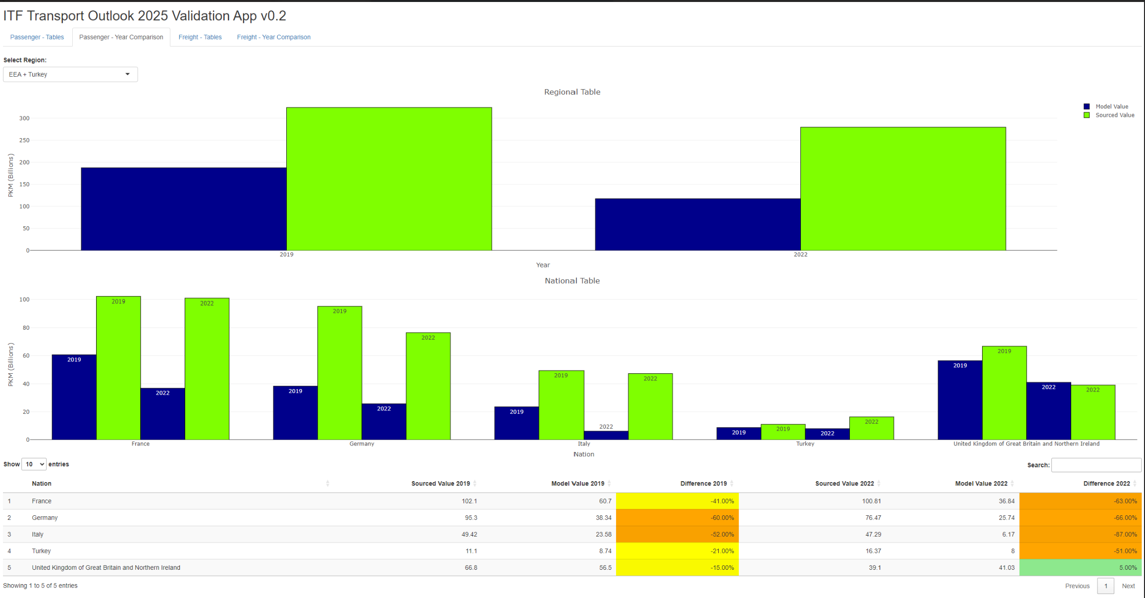
Validation App for ITF Outlook 2025

Slide 8
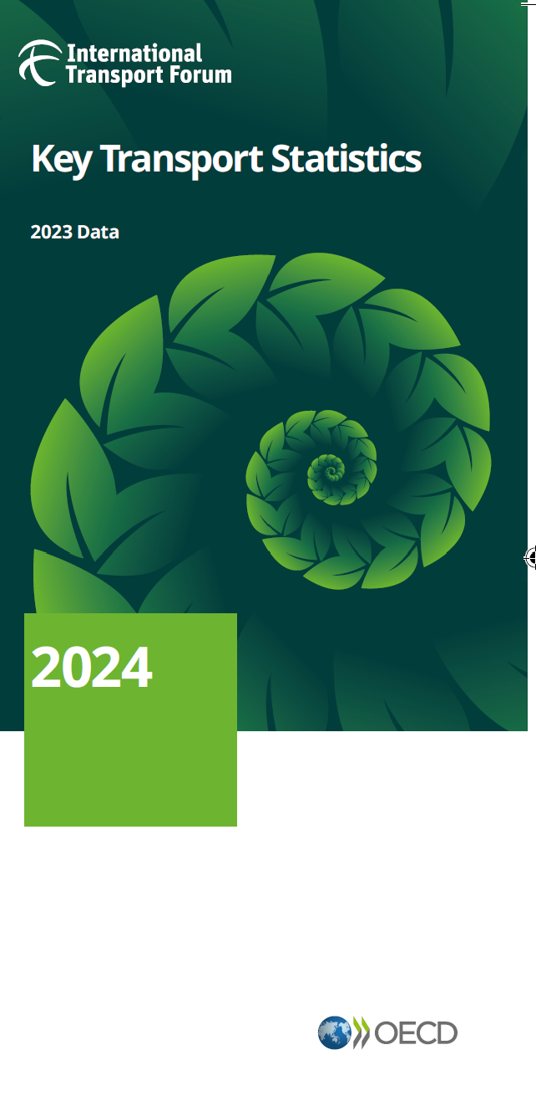
How does ITF use the rail data?
All data are published on the OECD Data Explorer.
Trends in the Transport Sector Statistics Brief
Spending on Transport Infrastructure Statistics Brief
Key Transport Statistics

Slide 9
Thank you
Rachele Poggi T +33 (0)1 73 31 25 54 E rachele.poggi@itf-oecd.org
Postal address 2 rue André Pascal F-75775 Paris Cedex 16

