Slide 1
Rail Data Forum Workshop Data Quality
19/06/2024
caroline.bailleux@nsarail.fgov.be

Slide 2
What will I talk about?
Mainly about CSI collection in Belgium : difficulties and solutions

Slide 3
What's my experience?
RID
Checks
Announce of composition
Merl In*
Accident reports
Transport document
CSI
Collecting data
Checking data
Sending to ERA
*Marschalling yard Emergency Response Live Inventory

Slide 4
What have I learned from my experience?
Data quality
Not self-evident
Ongoing challenge
Check
Training
Awareness

Slide 5
CSI collection in Belgium : difficulties and solutions

Slide 6
Common Safety Indicator : reminder
DIRECTIVE (EU) 2016/798 on railway safety

Slide 7
Common Safety Indicator : reminder Types of accidents and criteria (significant accidents)
Types of accidents :
Collision of train : - with rail vehicle
- with obstacle within the clearance gauge
Derailment of train
level crossing accident
Accident to persons involving rolling stock in motion, with the exception of suicides and attempted suicides
Fire in rolling stock
Other
+ accident involving the transport of dangerous goods (RID 1.8.5
+ Suicide & attempted suicide
Criteria :
killed or seriously injured person
Significant damage
Extensive disruptions to traffic
Each significant accident shall be reported under the type of the primary accident, even if the consequences of the secondary accident are more severe
Frequent reminders to RU’s needed

Slide 8
Common Safety Indicator : reminder
Precursors of accidents
Broken rail
Track buckle or other track misalignment
Wrong side signalling failure
Signal Passed at Danger when passing a danger point
Signal Passed at Danger without passing a danger point
Broken wheel on rolling stock in service
Broken axle on rolling stock in service

Slide 9
CSI : définitions
Death (killed person) :
any person killed immediately or dying within 30 days as a result of an accident, excluding any suicide
Serious injury (seriously injured person):
any person injured who was hospitalised for more than 24 hours as a result of an accident, excluding any attempted suicide
Not so easy to know

Slide 10
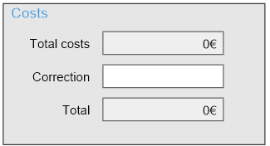
CSI : définitions
Significant damage to stock, track, other installations or environment:
damage that is equivalent to EUR 150 000 or more
IM (infrastructure) + RU (rolling stock)
Encoded by RU/IB ∑ Consolidate in the databank
Not immediately available
Not always fulfilled

Slide 11
CSI : définitions
Extensive disruptions to traffic:
suspension of train services on a main railway line are suspended for six hours or more
Implementation guidance for CSIs :
The section of the main railway line must be closed to normal operation for a continued period of six hours or more, even if trains are diverted via other lines
It is however recommended to consider here all railway lines on the national territory used for running trains.
Operation of railway vehicles for the purpose of either rescuing people or restoring service does not affect the threshold. If only one track of a multiple-track line is closed and train services on the other track(s) can continue, this event shall not be included.
Suspension of traffic not due to the accident should be excluded.

Slide 12
CSI : data collection process in Belgium
NSA BE : aggregation at Belgian level
IB
IM
RU’s
ERA
Comparison
Discussion
Correction
Collective decision
IB : Investigation Body
IM : Infrastructure Manager (Infrabel)
RU : Railway Undertaking

Slide 13
Process IB
In Belgium : IB = Manager of the accident database
Unique incident
Report RU
Report IM
Not easy !
Based on the comparison of several fields

Slide 14
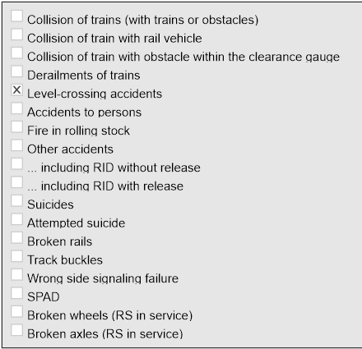
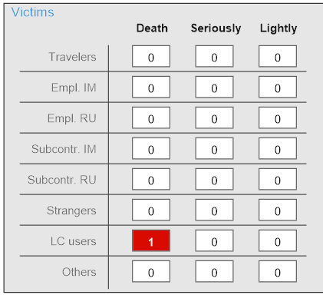
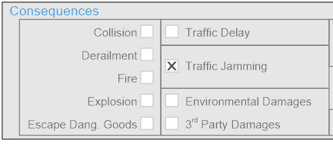
Process IB
In Belgium : IB = Manager of the accident database
Selection of “CSI accidents” (to send to NSA BE)

Slide 15
Process IM
Infrabel, the infrastructure manager in Belgium, provides high-quality data

Slide 16
Infrabel data quality
Belgian Infrastructure Manager
1 Data source
2 data collection
3 data control
4 Data preparation

Slide 17
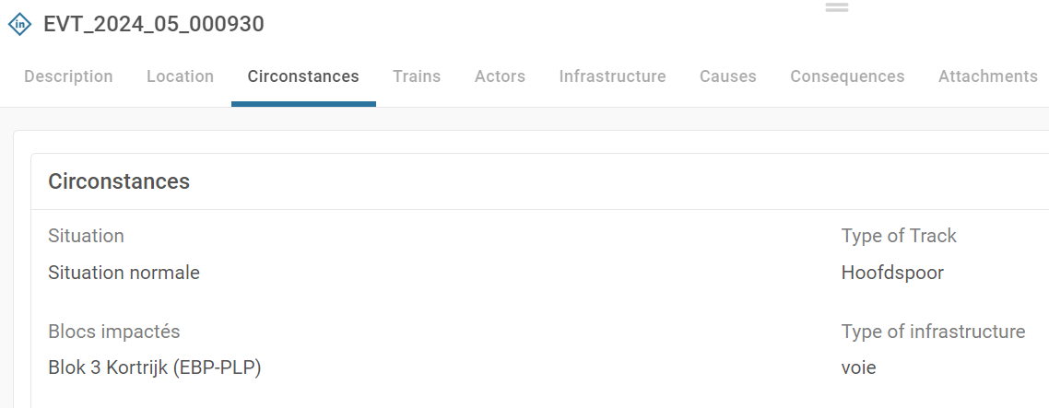
1 Data source
Database
16 years of history
Each Safety event is listed in Infrabel's ‘Railreport’ database. The announcement contains lots of information about the event. There are 3 levels of verification (editor – verifier - validator)
Example of information found for each safety event:
The selection of appropriate data sources is important to ensure the quality of the data collected and its relevance to the analysis.

Slide 18
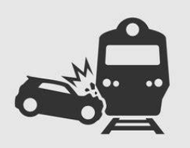
2 Data collection
Research
To extract useful data from the database, Infrabel uses a Business Intelligence platform to analyse Big Data and transform it into usable information.
And/of
And/of
Data collection involves setting up a suitable process and using the most appropriate collection tools for the chosen data sources.
We can export safety events based on various combined criteria such as victims, costs or traffic jamming.

Slide 19
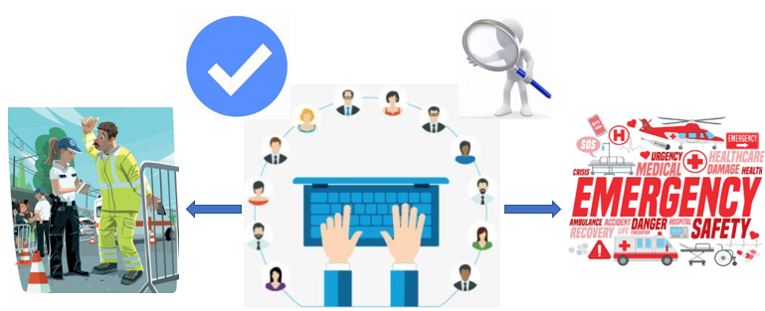
3 Data Control
Collaboration
Once the safety events have been collected, checks are made with our partners, such as our local agents and/or the Railway Police to ensure that the event is classified correctly.
Changes are made, for example, to the classification of the event (suicide or accident to person in volving rolling stock in motion).
Data cleansing ensures data quality by eliminating errors and unnecessary data for more accurate and relevant analysis.

Slide 20
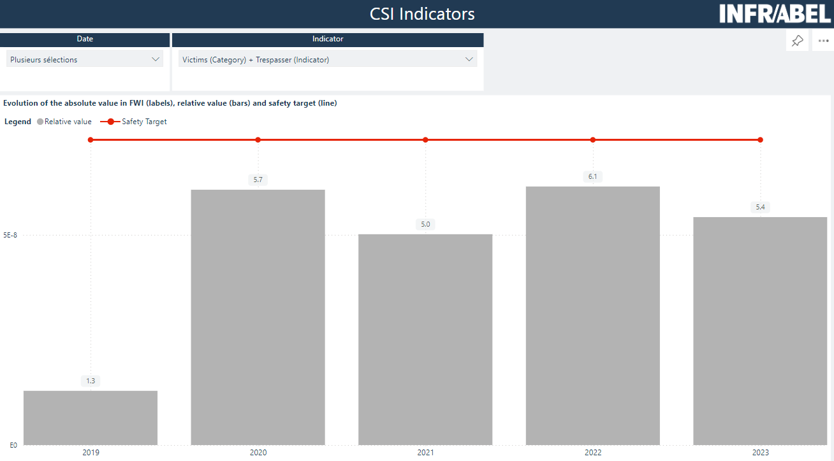
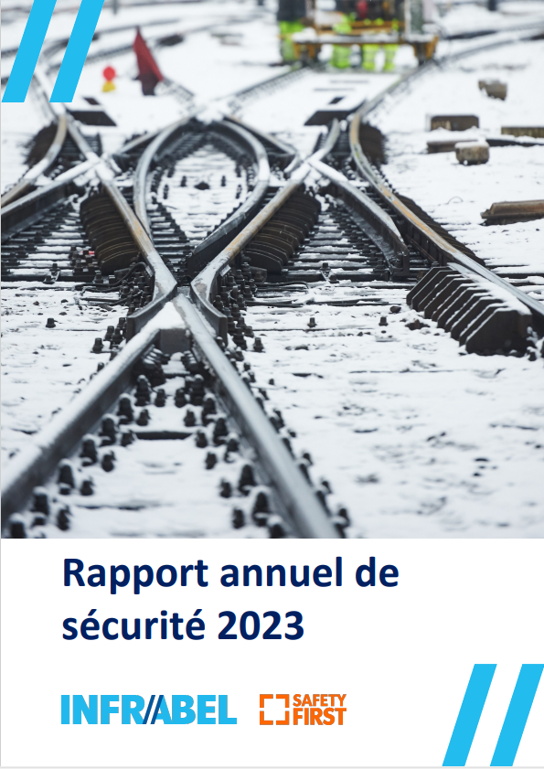
4 DATa praparation
Transformation and transfer
These data are then added together and converted into FWI for casualties and tr-km for accidents and precursors. The data can be viewed graphically to track changes. They are then transmitted to our competent authority.
Preparing data for analysis involves transforming, standardising and organising it to make it easier to use in the analysis and guarantee reliable and relevant results.

Slide 21
CSI : data collection process in Belgium
NSA BE : aggregation at Belgian level
IB
IM
RU’s
ERA
Comparison
Discussion
Correction
Collective decision
IB : Investigation Body
IM : Infrastructure Manager (Infrabel)
RU : Railway Undertaking

Slide 22
CSI : frequent discussions on…
Accidents to persons <> Suicides
Serious injury <> light injury
Category of people (discussion and consultation of the guidelines often needed) passenger - employee or contractor - level crossing user – trespasser - other person at a platform - other person not at a platform
Cost Not immediately available, not always fulfilled, ∑ infrastructure + rolling stock
SPAD : any occasion when any part of a train proceeds beyond its authorised movement → SPAD on main line or accessory line giving access to main line
track buckle : use of the tolerance depends on the reference speed of the line
…

Slide 23
CSI : some difficult-to-get figures
Contact point at IM to help RU’s
agreement

Slide 24
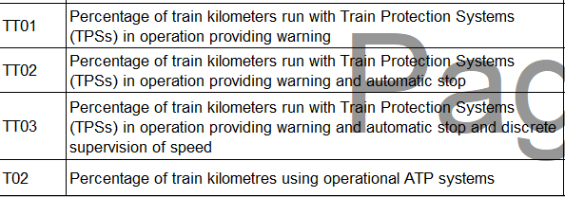
CSI : some difficult-t-get figures
Train-km with different train protection systems (TPS)
Several data to be combined:
Paths travelled by trains*
Train path equipment*
Train traction units*
Traction unit equipment*
* Shared data
*Data to be provided by IM
*data to be provided by RU
Cooperation set up between IM and RU

Slide 25
Conclusions
Data quality = Continuous improvement process
Check
Concertation
Set up of (technical) solution
Training / awareness

Slide 26
Thank you for your attention

