Slide 1

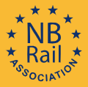
Workshop #7
From Certification to Authorisation,
challenges and issues
23-04-2024
Workshop #7 ERTMS conference 2024

Slide 2
Program of the workshop
Introduction of moderators
Method of the workshop
Subjects
Selection set of requirements, impact TSI 2023
Module to use
How to handle delays
Small changes/retrofit
Certification deliveries in stepwise authorization
Notes:
Samenvoegen onderwerpen

Slide 3



Introduction of Moderators
NB Rail:
      Lucca Macchi (Rina)
      Titia Los (DEKRA Rail)
NSA:
      Remco Arnoldus (ILT, The Netherlands)
Notes:
Very short introduction of ourselve.

Slide 4
Method of the workshop
Short introduction on every subject
Question or statement
Discussion among attendees
Summary of discussion on every subject
Notes:
Tell, everyone has to participate

Slide 5
Start of a project
Notes:
The journey from factory to real operation for vehicles goes via a lot of intermediate steps that can be challenging
Focus is on on-board systems, but infrastructure can come along too.

Slide 6
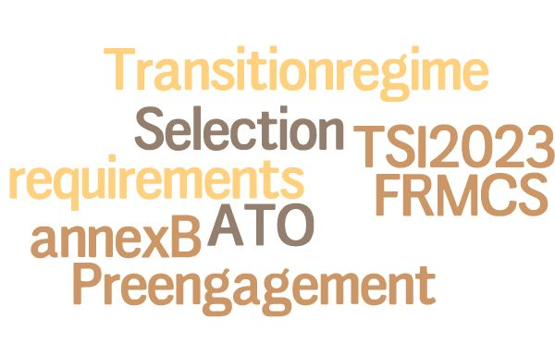
Start of a project

Slide 7
Transition regime
    Different phases of a project
    Design phase started after TSI enters into force
    Design phase started before TSI enters into force
    Production phase
    Vehicle in operation

Slide 8
Transition regime Error corrections
    Is it clear for you when to have the error corrections implemented of the registered errors as identified for the area of use?
Notes:
Explain Statement from ERA, ask if this is workable for you and do you see any challanges, i.e delays in a project.

Slide 9
Transition regime ETCS CMD
    Is it clear for you when to have a Cold Movement Detection into a vehicle?
Notes:
This is an utem that is of intresed within EU.

Slide 10
Transition regime CMD
    Point 4.2.2
1 | 2 | 3 | 4
Directly applicable when ETCS installed 1st time | Applicable from 1-1-2028 when ETCS installed 1st time | Applicable for new vehicle >1-1-2030 on the market | Not applicable
Notes:
Impact for NoBos and authorisation=> depending on the stage of the project it must be taken into account or not.

Slide 11
Summary discussion transition period

Slide 12
Modules to be used
    Subsystems
      SB+ SD or SF
      SH1
      SG (infrastructure)
      IC’s
      CB + CD
      CH1

Slide 13
Modules to be used
    Is it for all on-board projects (new vehicles and retrofit) better to use the SB+ SD module instead of the SH1 module?

Slide 14
Modules to be used
    Is it for all IC’s better to use the CH1 module instead of the CB+ CD module?

Slide 15
Summary discussion Modules

Slide 16
Delays in a project

Slide 17
Delays in a project
    Has the NoBo to anticipate to all delays of the applicant in order to deliver the certificates on time?

Slide 18
Summary discussion Delays in a project

Slide 19
Small changes and retrofit
    Even for all small changes (according to EC/2018/545 article 15) an assessment by a NoBo is needed.

Slide 20
Small changes and retrofit
    For retrofit projects one can use the results of the same version of an EVC installed on other vehicles?

Slide 21
Summary discussion stepwise authorisation

Slide 22
Stepwise authorisation
    Authorisation for Testing and
    Authorisation for placing into service
Notes:
To integrate into the other topics

Slide 23
Stepwise authorisation
    There is no difference for Authorisation for Testing and
    Authorisation for placing into service.

Slide 24
Summary discussion stepwise authorization

Slide 25
Thanks for participating in the workshop
- From certification to authorization -
The challenges and issues
By Lucca, Remco & Titia

