Slide 1

ERTMS Conference 2024 - Workshops
WORKSHOP 1
Standardisation and TSI Input Plan
Valenciennes 23/04/2024
Antoine Defossez, Soenke Kraft, Daniel Windisch, Friedemann Bitsch, Marc Sarrat

Slide 2



Agenda
Standardisation and TSI input Plan - Overview
Context and goal
STIP process
Topic input to TSI revision
Structure of STIP
Revision and approval
Q+A session
Onboard modularity
Topic presentation
Q+A session
50 Min.
20 Min.
Daniel Windisch, Friedemann Bitsch
Advanced Safe Train Positioning (ASTP)
Topic presentation
Q+A session
20 Min.
Antoine Defossez, Soenke Kraft
Marc Sarrat

Slide 3
ERTMS Conference 2024 - Workshops
Workshop 1
Standardisation and TSI Input Plan –
Overview
Valenciennes 23/04/2024
Antoine Defossez, Soenke Kraft

Slide 4




Context and goal
Innovation and Development activities
Standardisation, Regulation and Deployment
Europe’s Rail Joint Undertaking
European Standards
Deployment
Difficult transfer of R&I outcomes
Development of products
Investment plans
Broad deployment
Migration targets
CEN, CENELEC, ETSI
System Pillar (SP)
Innovation Pillar
(IP)
harmonised architecture of European Railway system
Harmonised operational concept
Development of specifications based on top-down system engineering approach
Development of innovative technical solutions
Demonstrator's to show feasibility
TSIs
IMs, RUs, suppliers
Standardisation and TSI Input Plan (STIP)
Collection of the topics from SP and IP relevant for harmonisation
Alignment with the EC request for TSI revision
Allocation of harmonisation channel and time planning to topics
EC request for TSI revision and standardisation
(EC, ERA)
align

Slide 5
Context and goal
Transfer of R&I results of EU-RAIL to the EU standardisation and regulation process
Support the harmonised introduction of improvements in to the European rail system, supporting competitiveness, interoperability, and safety.
EU-RAIL System Pillar coordinates the harmonisation outputs and needs from the EU-RAIL programme (both from the Innovation Pillar and System Pillar) within the Standardisation and TSI Input Plan (STIP)
Approval of the Standardisation and TSI Input Plan by the System Pillar Steering Group
  validated and complete view of the harmonisation outputs linked to EU-RAIL provided, endorsed by the European Commission, ERA, the European Standardisation bodies and the sector as a whole.

Slide 6
Context and goal
The Standardisation and TSI Input Plan (STIP)
should enable a more strategic alignment of the outputs of EU-RAIL with the
  TSI revision process, in particular to the EC request to ERA for TSI revision
  European standardisation process, and associated EC request.
support the delivery of mature input to harmonisation channels respecting existing processes, their ownership, and legal status.
EN standards
Single European Railway Area
Standards
TSI
SP documents
TSI
Flagship Projects
STIP
Harmonisation
EC request for TSI
System Pillar

Slide 7
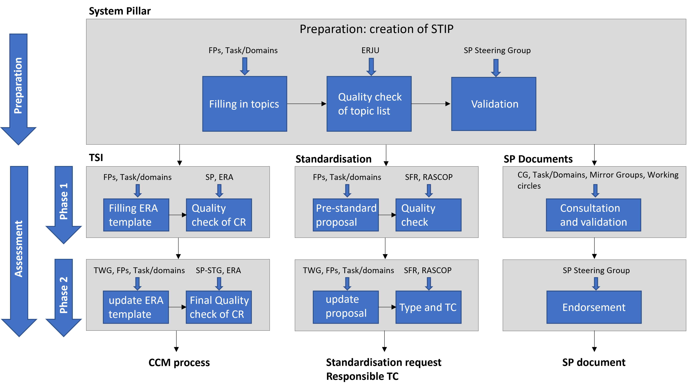
STIP process
Preparation and review of the STIP
Deliver mature input to existing harmonisation processes (TSI, EN standards,…)
Collection of topics delivered by FPs and task/domains
Quality check by ERJU
Review and validation in Steering Group
Review
Approval on 29/5/24
Input
Input
Topic descriptions sent to CCM and SFR
Assessment of proposals
Update by FPs and task/domains

Slide 8
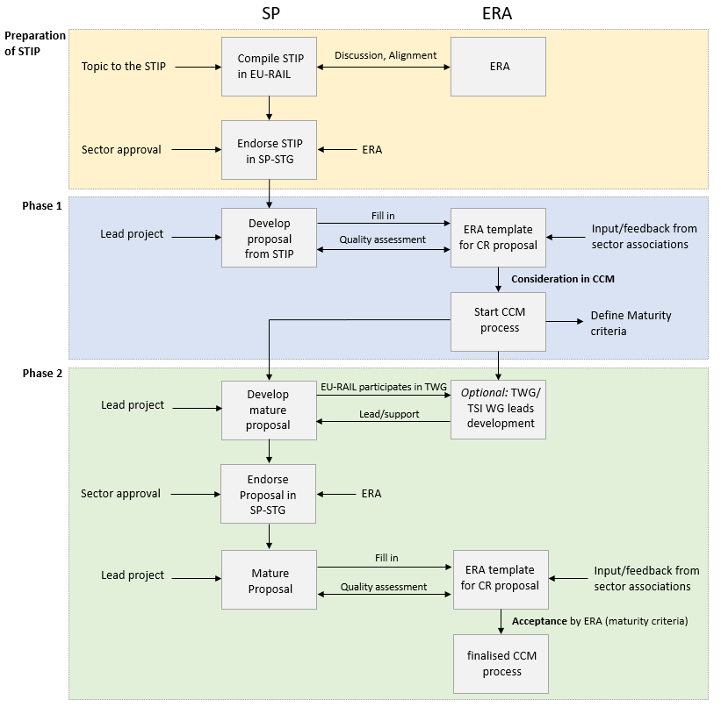
Topic input to TSI revision
Transfer of topics into the ERA CCM process for TSI

Slide 9

EU-Rail
SP
ERA Working Groups
ERA System Team
TSIs WP
OPE WP
CCS WP
TELEM WP
‘Tiger’ Team
WG
Standards
ERTMS CG
WGs
FP5/SP task 4
TWG Freight
TWG
Ope
Harm
Coord
Radio
Train Detect
ERA group
Reports to
Contributes to
Interface
EECT ETCS
EECT Radio
Working Party
EU Rail
Working group

Slide 10
Topic input to TSI revision / ERA side
Phase 1 - Creation of the Change Request
CR pre-assessment template
Phase 2 - Development of the solution (EU-Rail)
Possible cross-participation (e.g. DAC)
Proposal finally submitted to the WP according to the CCM process

Slide 11
Change Requests entry points
TSIs WP
OPE WP
CCS WP
TELEM WP
‘Tiger’ Team
WG
Standards
ERTMS CG
WGs
FP5/SP task 4
TWG Freight
TWG
Ope
Harm
Coord
Radio
Train Detect
EECT ETCS
EECT Radio

Slide 12
Content of the pre-assessment template
The pre-assessment template is Annex B of System Pillar document:
EU-RAIL and Harmonisation
Context and problem definition
Objectives
CR Proposed Solution
Economic assessment
Evaluation of the CR

Slide 13
Content of the pre-assessment template
Context and problem definition
1.1. Problem and problem drivers
1.2. Documents and References
1.3. Baseline scenario
1.4. Main assumptions
1.5. Stakeholders affected
1.6. Subsystems impacted
1.7. TSIs and registers impacted
1.8. Activity/Function impacted

Slide 14
Content of the pre-assessment template
CR Proposed Solution
3.1. Description
3.2. Regulatory impact linked to transition & migration (backward compatibility, categorisation)
3.3. Maturity (technology readiness level and specification availability)
3.4. Documentation

Slide 15
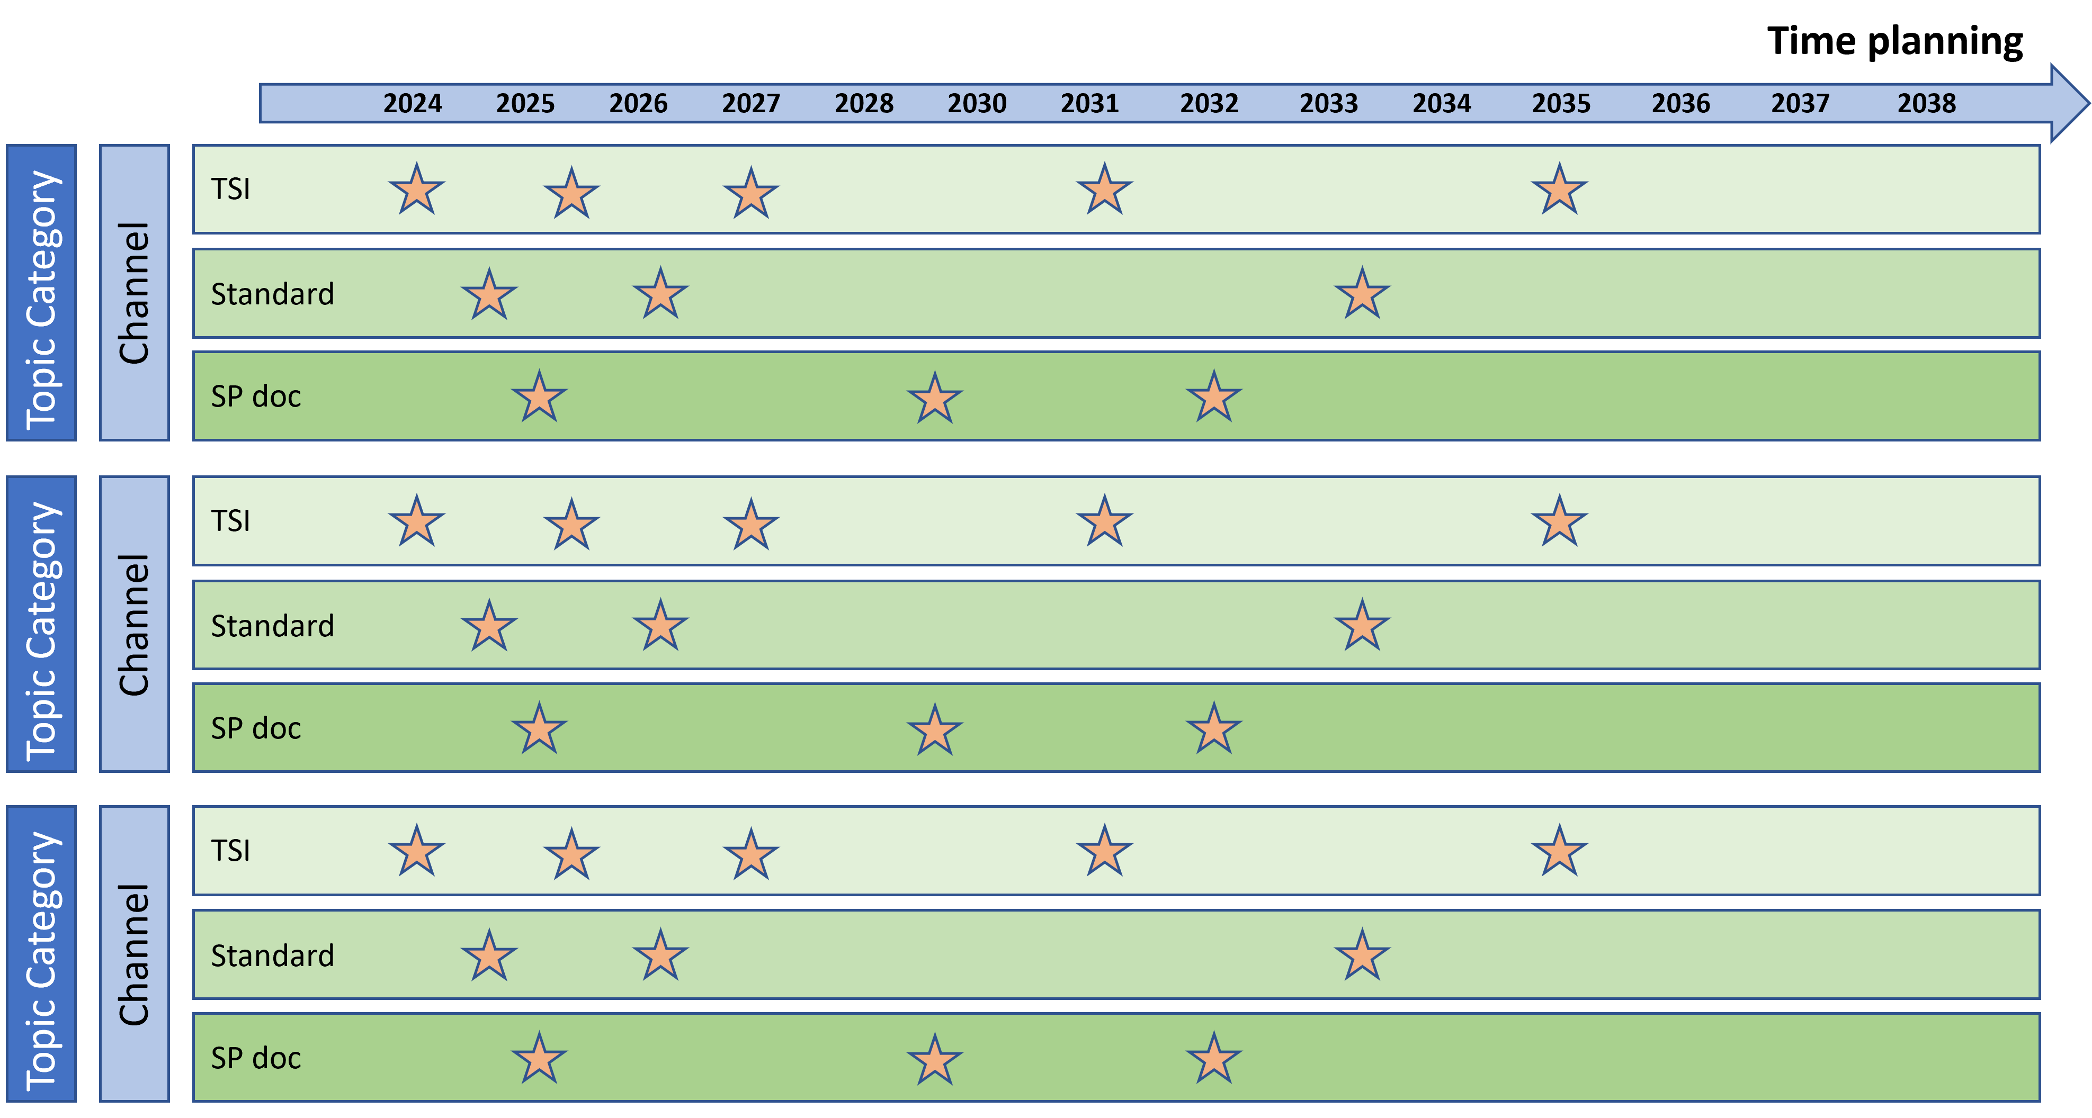
Structure of STIP
Topics in the STIP are structured according to:
Topic category (technical domain, subsystem, …)
Harmonisation channel (TSI, EN standard, SP document, others)
Time perspective (year of delivery to TSI CCM process/NWIP ESO, SP publication)
System Pillar
Delivery of potential harmonisation topics
Classification of topics
Innovation
Pillar
EC request for TSI revisions
Input for TSI revision
2027
2032

Slide 16


Structure of STIP
Category for topic classification
Category |  | Description
Main section
C1 | Operational harmonisation | Topics related to operational processes and rules
C2 | Evolvability and maintainability | Topics aiming at enhanced compatibility between versions and easy maintainability
C3 | TMS and CMS | Topics related to enhanced European TMS and CMS
C4 | ATO GoA2 | Topics related to ATO until GoA2
C5 | ATO GoA3/4 | Topics related to ATO until GoA3/4
C6 | Remote supervision and control | RTO as application independent from ATO Goa3/4 (can come earlier) specific applications, e.g. shunting yards,
C7 | ASTP | Topics related to enhanced odometry and localisation systems
C8 | FDFTO | Topics related to enhanced freight traffic including DAC
C9 | FRMCS | Topics related to new radio system
C10 | Onboard | Topics related to CCS onboard systems
C11 | Cybersecurity | Topics for cybersecurity in CCS systems
C12 | Safety management | Topics related to safety in CCS
C13 | PRAM | PRAM topics
C14 | Trackside assets | Topics related to CCS trackside assets
C15 | Traffic CS | Topics related to enhanced Traffic CS and interfaces to TMS/CMS
C16 | Driving control, Adhesion management | Topics related to adhesion management and driving control
C17 | Energy management and supply | Topics related to energy management and operational measures
C18 | Bridge dynamics | Topics related to vehicle-bridge dynamical interaction
C19 | Alternative propulsion, traction energy | Topics related to battery and hydrogen train
C20 | TCMS | Topics related to TCMS
C21 | Subsystem Components | Topics considering e.g. braking, environmental conditions etc.
C22 | Reduction environmental impact | Topics considering noise, air quality and climate change
C23 | Composite materials | Use of composite materials for lightweight design
C24 | ETCS CR enhancement | ETCS CR enhancements from ERA assessed by the SP
Additional topics
C25 | Digital asset management, data spaces and models | Topics related to data spaces, data models and asset engineering
C26 | Digital Twin | Topics related to Digital twin modelling and digital register
C27 | Virtual certification | Methods for virtual certification and implementation
C28 | Zero-Onsite-Testing | Use of simulations and lab testing procedures
C29 | Drones | Topics related to the use of drones in railway applications
C30 | Field force applications | Topics related to field forces (maintenance staff and machines)
C31 | Diagnosis, monitoring | Topics related to diagnosis, condition-based maintenance in railway applications
1. Classification of topics in categories
260 topics received from FPs, and SP
Consolidated into 31 categories
C1
260
C2
C…
UPDATE
2. Consolidation of topics within each category
To ensure overall consistency, some topics were amended, merged with other topics or in some cases removed.
Amendments concern: date of delivery (consistency with other topics), merging of overlapping inputs, modification of channel for consistency
Dates
Channel

Slide 17
Link with TSI request
STIP topics are aligned with the TSI enhancement of the EC request:
Stepwise CCS system evolution
Certification and vehicle authorization in the context of large deployments
New materials
Harmonization of ETCS engineering rules and operations-related system requirements to enable harmonization of operational rules
Integration of ERA registers
DAC
Cybersecurity
FRMCS
CCS trackside enhancements
Digital infrastructure information
ATO GoA3/4
Additional on-board CCS equipment modularity (incl. CCS-RST interface)
Advanced Safe Train Positioning
Digital capacity management
Further harmonization of operational rules for radio based ETCS-alone operation
Improving DMI
Digital traffic management
Energy saving measures
Alternative propulsion
Dynamic compatibility (bridge dynamics)
ERTMS reliability
Replacing on-track tests by testing in laboratories and virtual testing (simulation)

Slide 18
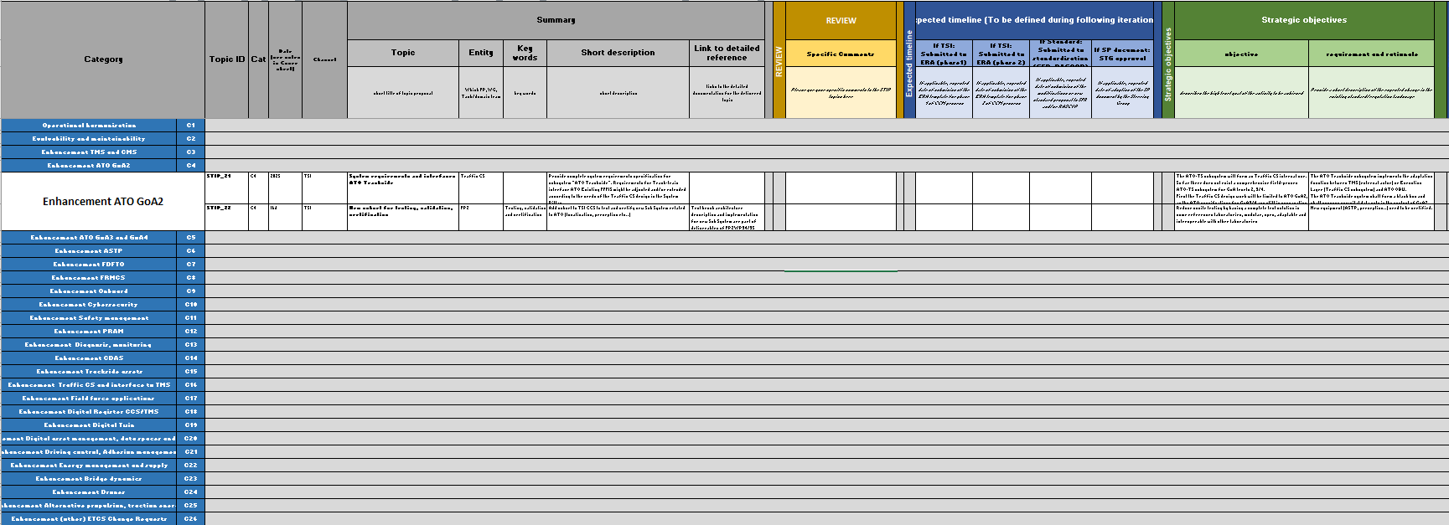
Use of STIP Table
Detailed information from tasks/domains/FPs
Summary for overview on topics

Slide 19
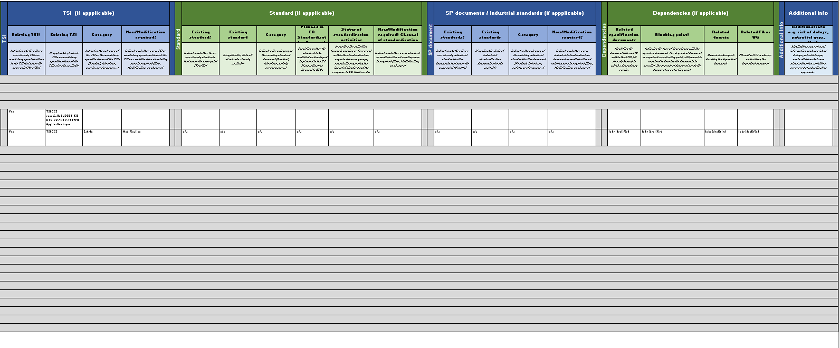
Use of STIP Table
Detailed information from tasks/domains/FPs

Slide 20
Review and approval
Following the deadline for receipt of comments of 9 February on the EU-RAIL Standardisation and TSI Input Plan, an initial assessment of the input was made. In total over 1200 comments were received. In order to properly process these, and amend and update the STIP, the revision and approval process follows the planning:
First STIP Draft V1.0: 21st of December 2023
Comments from sector: 9th of February
Issuance of STIP to SP-Steering Group: 17th April
(optional) Comments from sector on very critical issues that could prevent approval: 14th of May
Indented Approval of STIP at the SP Steering Group: 29th of May
The timing of review process was agreed with ERA and EC, and allows an appropriate iteration on those issues linked to the TSI mandate.
Issuance of STIP V1.0 to SP-STG
(optional) Comments to be provided
Approval at System Pillar Steering Group
STIP draft V1.0
Comments to be provided
21/12/23
09/02/24
17/04/24
14/05/24
29/05/24
Review by the sector
Comment resolution and alignment
Consolidation of STIP V1.0
Review by sector

Slide 21

Questions + Discussion
Any questions?

Slide 22
Discussion Points
Question in comments | Answer
What are the outcomes represented in the STIP? | The STIP reflects the programme and the outputs of EU-RAIL based on the legal framework set out in the Single Basic Act and agreed by the EU-RAIL Governing Board. The outputs of the programme relevant for harmonisation are included in the STIP, including topics both for short term harmonisation (TSI2027) and for medium and long term harmonisation.
What is the meaning of the dates in the STIP? | The meaning of the dates is described in the cover page and section 2.3. In principle, the date indicate when a STIP topic is mature enough to become an input to the existing harmonisation processes (TSI, EN standard). The question if harmonisation work should start before or after testing activities need to be answered case-by-case by the sector considering risk assessment.
Is there a prioritisation of the STIP topics? | The STIP reflects the programme and the outputs of EU-RAIL based on the legal framework set out in the Single Basic Act and agreed by the EU-RAIL Governing Board. There is an indirect prioritisation in terms of timing of development and proposed harmonisation channel. But a direct prioritisation beyond this has not been currently proposed.
When should topics be mandatory? | The decision for mandatory topics should consider among others interoperability, safety, requirements for authorisation. The decision on the allocation to a particular harmonisation channel is part of the assessment and endorsement by the sector of the STIP. In addition, the decision on harmonisation channel in certain cases is determined by processes outside of EU-RAIL, for example the EC request on the TSI revision. In these cases, the STIP aligns to the external processes to the extent possible.
Are the STIP topics assessed from an economical perspective using CBA? | The STIP reflects the programme and the outputs of EU-RAIL based on the legal framework set out in the Single Basic Act and agreed by the EU-RAIL Governing Board. An economic assessment of every output and element of work would not be feasible. For large and specific outputs, for example DAC, economic analysis may form a part of the work to be carried out within EU-RAIL.

Slide 23
ERTMS Conference 2024 - Workshops
Workshop 1
Outputs of EU Rail |
Standardisation and TSI Input Plan –
On-board Modularity
Valenciennes 23/04/2024
Daniel Windisch, Friedemann Bitsch

Slide 24

Motivation of Modularity
  Modularity is a parameter of the system architecture. It allows to breakdown a large complex system into smaller and manageable sub-systems (less complex sub-systems).
  Modularity in turn means well-defined interfaces, paving the way for harmonisation.
  The above two points immediately leads to simplification of system integration.
  Individual elements can be more easily manageable as their functionality is limited and more specifically defined.
  Modularity can be applied to various topics, e.g. network layers, functionality, sub-systems, … .
  Results can improve exchangeability, migration, upgradeability and competition in the market.
Notes:
Benefits for exchangeability: A sub-system can be replaced by another one with reasonable integration effort.
Benefits for migration: Sub-systems are individually migratable (introducing bug-fixes, improvements, new functionality), without affecting the other sub-systems.
Benefits for evolvability: Decomposition enables different life-cycle profiles of the different constituents (e.g. vehicle vs. ETCS vs. connectivity) (note: this requires also the interface to evolve).
Benefits for scalability: If the system needs to be expanded or modified, it is easier to add or modify specific modules rather than the entire system.
Benefits for competition in the market: Smaller sub-systems allow more suppliers to compete.
Benefits for maintainability: When a system encounters issues, failures or bugs, decomposition helps in isolating and localizing the problematic areas. It becomes easier to identify the specific module causing the problem, leading to quicker troubleshooting, debugging, update, replacement, repair and maintenance and block wise testing and validation of subsystems (simpler test benches).
Benefits for exchangeability: A sub-system can be replaced by another one with reasonable integration effort.
Benefits for migration: Sub-systems are individually migratable (introducing bug-fixes, improvements, new functionality), without affecting the other sub-systems, unless changes on external interfaces are needed that are not backward compatible (note: backward incompatible changes must be avoided, if possible).
Benefits for evolvability: Sub-systems support the evolvement of the overall CCS system (introduction of new technologies and functional enhancements). Decomposition enables different life-cycle profiles of the different constituents (e.g. vehicle vs. ETCS vs. connectivity) (note: this requires also the interface to evolve). Effort shall be made to avoid incompatible changes.
Benefits for scalability: Decomposing a system into modules of reasonable size enables economic beneficial scalability and reusability. The segregation of systems into smaller modules for scalability and reusability reasons shall base on real use cases backed up by business cases. If the system needs to be expanded or modified, it is easier to add or modify specific modules rather than the entire system in case of once a modification is introduced, interfaces between the modified module and the rest of the subsystem is not modified. In case of once a modification is introduced, interfaces between the modified module and the rest of the subsystem is not modified .
Benefits for competition in the market: Smaller sub-systems allow more suppliers to compete. The problem per sub-system is smaller and can be solved (i.e. a product can be provided) even if a particular supplier is not able to develop the entire CCS system. Also, the subdivision of the entire system into smaller components/sub-systems require a better specification, so that implementing should be easier. This is increasing competition in the market. Benefits for testability: With smaller harmonised subsystems there is the opportunity to capitalize (and solve) on the return of experience on failures having common occurrence

Slide 25
CCS On-board Modularity of TSI CCS 2023
CCS On-Board Modularity (see Subset-147)
  Subset-119: ETCS On-board / Rolling Stock
  Subset-139: ATO On-board / Rolling Stock
  Subset-130: ATO On-board / ETCS On-board
  [Subset-121: ETCS On-board / Train Display System
  – not contained in TSI 2023]
  Subset-126: ATO-OB / ATO-TS
  Subset-147: Basis for on-board modularity.
  First version of CCS Consist Network Communication
  Layers
  This will facilitate integration on the vehicles and help
  to decrease costs including approval process cost.
  This should be a major contribution for optimising
  deployment times.
On-board Recording Device (ORD)
Train Display System (TDS)

Slide 26
Overall approach of a
Common Onboard Communication Network
SSxxx
SSyyy
SSzzz
Overall approach described in SS150
Application
layer
xxx
yyy
zzz
zzz
SSxxx
SSyyy
SSzzz
Application
layer
Results of WP23+24
Middle layers
→ Next TSI
Middle layers
Lower layers
Eth
MVB
MVB
Eth
Ethernet
→ TSI2023
Lower layers
Before TSI2023
Target: Common Onboard Communication Network
  Many subsets describe more than the application layer of the communication stack
  Lower layers and middle layers not harmonized between the subsets
  Even for the same subset different solutions from different vendors were possible
  Provide a harmonized specification for
  lower and middle layers of the communication stack
  Lower layers already defined in TSI2023 SS147
  WP23+24: Extend SS147 to middle layers

Slide 27
Topics of STIP for On-board Modularity (1/2)
Train / Vehicle
On-board
repository – STIP 67
Advanced Safe Train Positioning – STIP 29/30
FRMCS On-board –
STIP 62
TI Enhancement
(S-034/-119/-139) – STIP 71
TI Adaptation for integrity handling and train length / overall consist length
(S-034/-119) – STIP 73
Examples:
Digital Map
Segment Profiles
Train Data
Ethernet CCS Consist Network (full stack)
(S-147)
– STIP 68
TDS FFFIS update (S-121)
– STIP 69
ETCS On-board
Train Display System (Multi DS) – STIP 70
Diverse Applications with API – STIP 72
ATO GoA 3/4 –
STIP 20
ETCS related UI representation –
STIP 74
Examples:
Passenger Information System
Diagnostics on-board – STIP 159
Automatic Processing Module – STIP 21
Perception – STIP 22
Remote Driving for ATO – STIP 23
Subsets for testing and certification – STIP 27

Slide 28
Topics of STIP for On-board Modularity (2/2)
STIP 72 API for other applications: Application Programming Interface to share data with other applications; example for passenger information: platform changes; speed and localisation information for display to the passengers.
STIP 71 TI enhancement: Facilitate integration, reduce investment risks; allow exchangeability of CCS on-boards. Allow ETCS/ATO on-board to be deployed on vehicles as a product from different vehicle suppliers. Possible examples:
  Driver ID exchange for having only one driver ID input
  Information to the vehicle on changed train data by the driver
STIP 73 TI adaptation for integrity handling and train length / overall consist length: Common standardised solution for passenger trains and freight trains using new technologies e.g. Digital Automatic Coupling. Allow cost efficient freight operation.
STIP 67 On-board repository: Establish the on-board repository as a service for multiple CCS applications (e.g. Passenger Information System, ETCS, ATO GoA 3/4 or Advanced Safe Train Positioning).

Slide 29
Questions in relation to On-board Modularity
Is there an unclear STIP topic in relation to On-board Modularity?
Is a STIP topic missing in relation to the on-board architecture?
Examples for STIP comments
  Train interface adaption for integrity handling and safe train length
    Shall also cover locomotive-hauled passenger trains (without DAC). / […] Why is it different from passenger trains as ETCS is agnostic if it is about passenger or freight trains?
Answer: agreed, passenger trains have been included in topic description
  ETCS on unfitted line
    We would like to know why this topic was rejected.
    Answer: The harmonized System is for ETCS L2 lines only and not support Level 1 and
    Class B systems

Slide 30
Questions in relation to On-board Modularity
Examples for STIP comments
  Train interface adaption for integrity handling and safe train length
    Regarding the STIP plan, I would not use the term “safe train length” in the description, because the terms currently defined in CCS TSI are “confirmed train length”, “safe consist length” and “overall consist length” , “safe train length” would be a term to be defined.
Answer:
Train Length – train length in case that overall consist length is not available
Overall Consist Length, see Subset-034 of TSI 2023: Input on the Train Interface that contains the following information: […]
  The nominal, min and max consist lengths on the side of the engine corresponding to cab A, counted from the end of the engine corresponding to the orientation of this cab A
  The nominal, min and max consist lengths on the side of the engine opposite to cab A, counted from the end of the engine corresponding to the orientation of this cab A
Safe Consist Length, see Subset-023 of TSI 2023: Information about the set of vehicles in rear of and (if any) in front of the engine, taking into account the side of the active cab which defines the front of the engine. […]
Confirmed Train Length (computed on-board for train integrity reporting), see Subset-026, §3.6.5.2.3 and §3.6.5.2.4 of TSI 2023:
  The train integrity information reported to the RBC shall consist of:
  Train integrity status information […] [and] Confirmed train length information […].
  The confirmed train length information shall represent the distance between the min safe rear end at the time the train was last known to be integer and the estimated position of the train front at the time when the train integrity information is sent to the RBC […].
Notes:
Answer, see Subset-023 of TSI 2023, Safe Consist Length:
Information about the set of vehicles in rear of and (if any) in front of the engine, taking into account the side of the active cab which defines the front of the engine. […]
The safe consist length information is composed of the six following values:
The nominal, min safe and max safe consist lengths in front of the engine, counted from the front end of the engine
The nominal, min safe and max safe consist lengths in rear of the engine, counted from the front end of the engine
Note: The difference between the min and max safe consist length is related to what is called coupling play and/or to any other uncertainties in the consist length information.
It allows to deduce the overall length between the two extremities of a train whose movements can be supervised by the ERTMS/ETCS on-board equipment:
In SM mode, regardless whether there are vehicles in front of the engine
In modes where availability of valid Train Data is necessary, in case there is no vehicle in front of the engine

Slide 31
Thank you for your attention!

Slide 32
ERTMS Conference 2024 - Workshops
Workshop 1
Outputs of EU Rail |
Advanced Safe Train Positioning
Valenciennes 23/04/2024
Marc Sarrat, SNCF

Slide 33
What is ASTP?
ASTP on-board
Users
GNSS RECEIVER
1D Safe Position 1D
IMU SENSOR
NAVIGATION
ENGINE
1D Safe speed
SPEED SENSOR
1D Safe Acceleration
ETCS ON BOARD
MAGNETIC SENSOR
Odometer Information
OTHER SENSORS
ATO ON BOARD
CCS on-board
BALISE READER DATA
User Applications
INTEGRITY
ENGINE
3D Position
TRAIN INTEGRITY
DYNAMIC ROUTE DATA
3D Velocity
OTHERS
EGNOS 4 RAIL DATA
3D Acceleration
COLD MOVEMENT DETECTION
3D Attitude
DIGITAL MAP DATA
22.04.2024
yymmdd_R2DATO_TITLE OF THE PRESENTATION
33

Slide 34





ASTP Roadmap
2024
2025
2026
2027
2028
2029
2030
2031
2032
2033
Main steps to reach an industrialised solution
Step 1
Funct. & perfo
Step 2
Safety and performance demonstration
Step 3
Interoperability, System Demo, Certification
STI 2027
STI 2032
Localisation GNSS SIL4
ERJU : Projet R2DATO (TRL6)
Spec / prototype / testing
ERJU Phase 2
System demo TRL7
ERJU Ph. 3
TRL8
EGNOS testbed prototype
EGNOS certified service
(TBC)
Certified
EGNOS Service

Slide 35
STIP for ASTP
2024
2025
2026
2027
2028
2029
2030
2031
2032
2033
STI 2027
STI 2032
Localisation GNSS SIL4
STI 2027 Main objectives
Basic advanced safe train positioning, odometry enhancement
Maybe enhance the performance in terms of accuracy
Specify the interface between an ASTP component and the EVC to prepare for future upgrades
Improve performances
Improve the robustness (by decreasing the dependency on slipping/sliding)
Modular architecture
STI 2032 Main objectives
Full advanced safe train positioning, absolute positioning
Accurate position and speed system
Separate building block as a service to serve the needs for multiple applications
Enable to move the track occupancy function from trackside to on-board
Allow the use of virtual reference points

Slide 36
ASTP inside ERJU
2024
2025
2026
2027
2028
2029
2030
2031
2032
2033
ERJU : Projet R2DATO (TRL6)
Spec / prototype / testing
ERJU Phase 2
System demo TRL7
ERJU Ph. 3
TRL8
ERJU Phase 1 : R2DATO
WP21: ASTP - operational needs
High-level user needs and system capabilities
System performance
WP22 : ASTP - System architecture, demonstrator design & RAMS
Specific solution design (8 ASTP demonstrators)
Testing activities
Preliminary Hazard Analysis
General assessment and evaluation of solutions and impact analysis
ERJU Phase 2 and 3
Work Definition on-going – will be aligned with 2032 TSI objectives
Implementation of actions mentioned in the phase 1 Gap Analysis:
Confirmation of performance requirements in a System Demonstrator
Confirmation of preliminary RAMS results and preparation of the certification process
In conclusion
Work perfectly geared towards TSI

Slide 37
Focus on architecture issues
At the end of the work carried out on the requirements in WP21, 20 open issues were listed
  Mainly about CCS on-board architecture
In 2024, we are going to produce technical notes on these open issues:
  Explaining the different points of view
  Listing the arguments for and against each point of view
We expect that System Pillar will be able to help us answer the questions raised in these technical notes.
[OI: FP2-ASTP-OPEN-ISSUE-3]: ASTP/ETCS functions allocation
The allocation of functions between ASTP and the ETCS on-board needs to be confirmed.
The separation of the localisation from the EVC requested in the 2027 TSI implies that a work must be carried out to separate the functions supported by the ATP and ASTP.
Modularity and architecture, as TSI objectives, are addressed in R2DATO

Slide 38
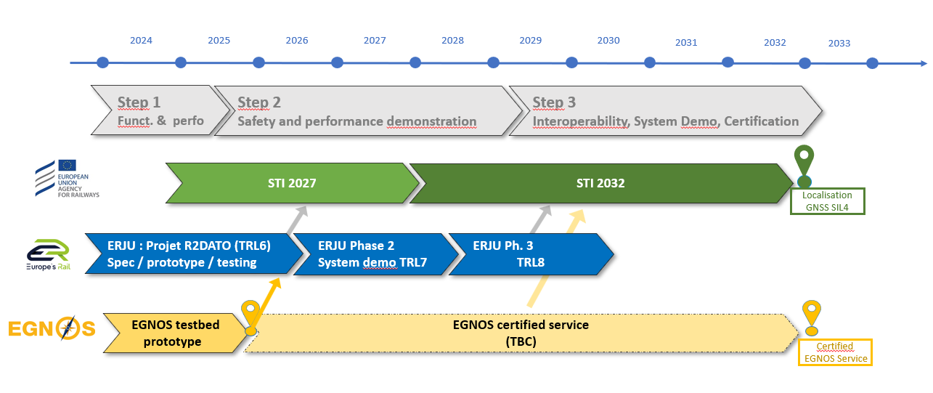
Focus on EGNOS for Rail
EGNOS for Rail in short:
EGNOS: European Geostationary Navigation Overlay Service.
Improves the performance and the safety of satellite geolocation systems, thanks to a set of ground stations.
  Six of the eight demonstrators developed in R2DATO intend to use GNSS using EGNOS application
  Several members (12 companies) of R2DATO co-signed a position paper requesting ERJU management to discuss the possibility of having an EGNOS for rail service demonstrator with the space agencies.
A proposal of work packages and task description aiming to tackle the topic of GNSS augmentation based on EGNOS has been initiated.
Managed by SNCF, including R2DATO partners, ERA, ESA and EUSPA
Main objectives & challenges
Provide an EGNOS demonstrator that will be used by suppliers for their safe rail localisation demonstrators
Prepare for the certification of an EGNOS for rail service (rail/space cross-acceptance)
A sensitive topic with an interdependent planning with the space sector

Slide 39

Thank you for your attention!

Slide 40
Open questions
What are the main challenges in achieving this roadmap ?
How do you foresee the organisation of ERJU Phase 2 regarding this topic?
  How many industrial solutions to be tested?
  Only one System demonstrator for all solutions?
What is the role of the agencies (rail and space) in making this roadmap easier ?

