Slide 1
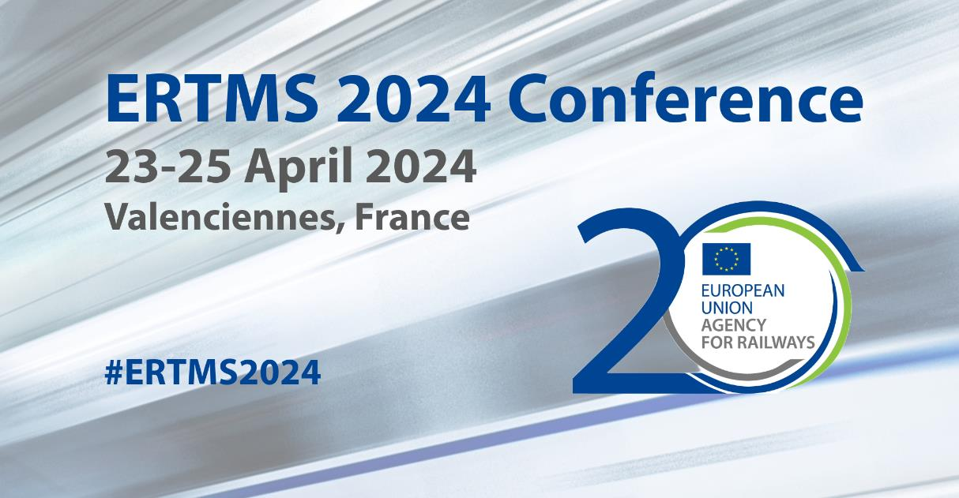
WS 8: How to succesfully introduce FRMCS on EU network and the vehicles? Migration Strategies and Challenges
Results of the Workshops: On board migration challenges
STRATEGIC
Coordinated approach and system view needed; all actors involved need to be prepared: vehicles maintenance periods, workshops, etc.
European coordination needed.
Easier certification/authorisation. Testing specifications needed. Common guidelines.
Change management versus authorisation procedures. How to manage life cycle.
Very short time frame.
No national variants/requirements.
Financing needed as soon as possible.
Priorities for migration of the different applications in addition to ETCS/Voice.
Need to focus on RUs needs and views.
TECHNICAL
Early preparation of vehicles taking into account the different configurations and types of vehicles, taxonomy of the train:
hardware preparation,
guidelines on antennas characteristics and locations,
cabling.
Solutions for avoiding upgrades of OB ETCS BL3 trains needed.
Upgrade path with minimum changes in already existing equipment: Dual GSM-R? Integrated products? Continuation of use of class B?
Only one HMI.
Lessons learnt from other sectors.
Cybersecurity solutions needed.
Stability and maturity of specifications. Delay on specifications and TSI is a risk.
More coordination needed in the specifications taking into account applications, e.g. telecom and signalling.
Flexible onboard configurations to reduce cost.
Product availability. Chipsets.

Slide 2
WS 8: How to succesfully introduce FRMCS on EU network and the vehicles? Migration Strategies and Challenges
Results of the Workshops: Trackside migration challenges
STRATEGIC
Guidance for migration needed, for short, medium and long term depending on the national starting point for deployment.
Consider prolonging life cycle of GSM-R.
Reduce parallel operations of GSM-R and FRMCS.
Funding needed as soon as possible.
Consideration of MNOs from different points of view: very different scenarios for use of MNOs. Specifications need to be flexible enough to cover the different scenarios:
Some IMs consider the use of MNOs only.
Others for fallback or reduced scenarios.
Some others do not consider the use of MNOs at all.
Business case for MNOs.
Time to market for the products.
Ease certification and authorisation processes. Laboratory tests needed.
Industry capacity to cope with the demand.
Business case for all the parties involved.
How to incentivise the urgency for deployment? Which is the killer applications and business case for digitalisation of railways.
TECHNICAL
Impact of new installations in existing installations, for example on already exiting MNOs.
Coexistence of frequencies, GSM-R, FRMCS in the same band and MNOs. Frequency planning for dual operation.
Reuse of assets.
Cybersecurity: how to reduce threats. How to certify it?
Interworking between GSM-R and FRMCS, how to handle handover.
Harmonised migration at the borders needed.
Lack of skilled resources for deployment and maintenance.
Upgrade of applications needed, for example RBC. Need of coordination and prioritisation.
Identification of the need for multipath from the different applications.
Product availability.
More coordination needed in the specifications taking into account applications, ex, telecom and signalling.

