Slide 1
The CCS Migration to SERA
ERA Conference, 23. April 2024

Slide 2
Agenda
What is “migration”
Support for national migration to the target system
Premises
System Pillar Migration targets
Feedback from sector survey on Migration Strategies

Slide 3
“Migration”
Moving from current/legacy systems into the Migration Targets
In the end, migration is daily business for railways when introducing new market product today and integrate it locally
System Pillar defining a set of recommendations and best practices
National “adaptation” developments
”Adaptation” always happens by adapting the national legacy system to a standard interface or to harmonized operational rules
National
Product
Usage
National
Architecture
National
bespoke
products
National migration plan: When to use which product
European
Product
Development
Harmonized
Target
Architecture
Available European products for Migration Target 1
Available European products for Migration Target 2

Slide 4
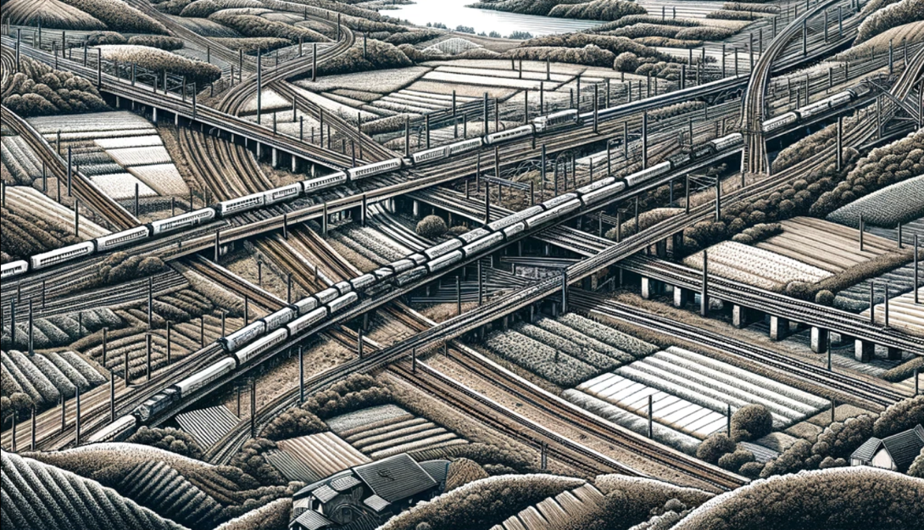
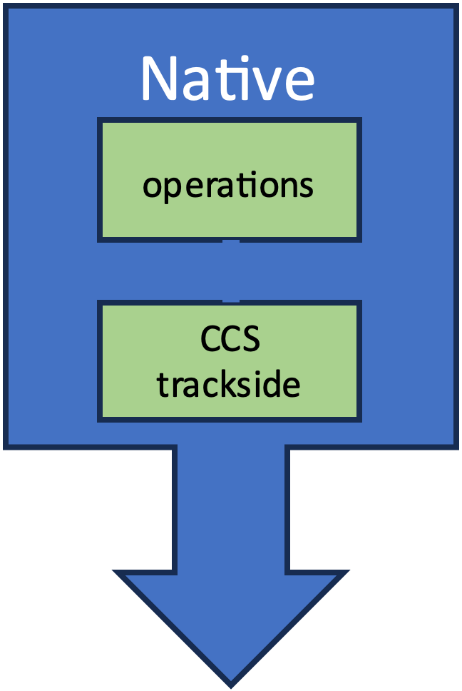
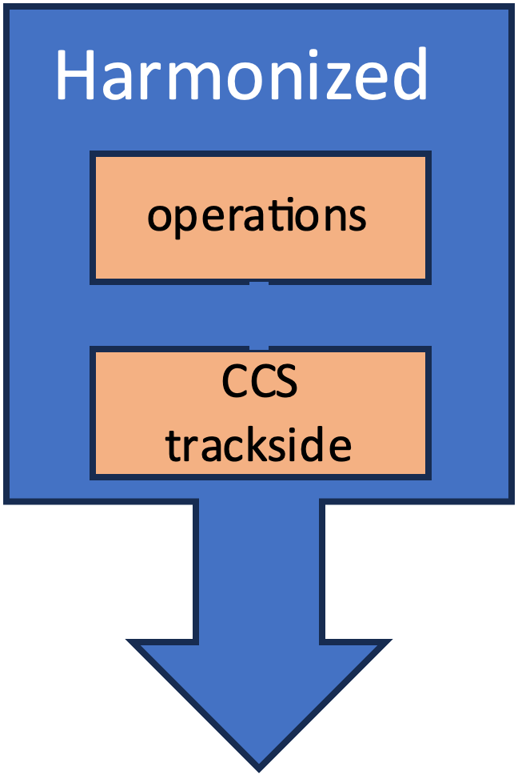
Typical pattern for trackside migration
Typically, the local adaptation (integration) happens line by line
A simple way to “adapt” is to use the full target architecture for new lines
Existing ETCS L2 lines would typically live up to their end of life like they were built
(but of course upgrades are possible and can be prepared early)

Slide 5
Support for national migrations
on European level
Analyse national migration challenges
Describe best migration practices and “lessons learnt”
Slim standard interfaces to simplify national “adapter” development projects
Propose migration steps that are realistic, economically viable and broadly accepted
Freedom of choice for migration strategy: Make "small steps" or “later but then complete big steps” migrations possible

Slide 6
Premises (current discussion state)
"Migration Target": Set of harmonized products ready for deployment
Full interoperability needs to be achieved in each Migration Target.
Each “Migration Target” needs to handle "mixed fleets", e.g., with vehicles having different abilities concerning train integrity and reliable train length information.
On trackside and onboard, the current traditional ETCS L2 implementations and the future target architecture will exist adjacent to each other (safe investments) and need to be connected and managed in parallel.
Current investments shall be reusable as much as possible, if later upgrades to the harmonized architecture are planned, to progressively come to just one set of operational rules and architecture in the full network.

Slide 7
Evolution of CCS and focus of work
Migration Target 1
Migration Target 2
Migration Target A
Train CS
Modularity extensions
CCS Consist Network
Multi Display Concept
Enhance Train Interface
ASTP / EVC Interface
Train CS
Modularity extensions
Existing CCS on board
up to GoA 2
Train CS
ASTP
Existing CCS on board
up to GoA 2
Train CS
ASTP
CCS on board
up to GoA 4
Stable Air gap
FRMCS
Stable Air gap
FRMCS
FRMCS
New Air gap
FRMCS
FRMCS
New Air gap
GSM/R
GSM/R
CCS trackside
Traffic CS architecture up to GoA 2
Digital Map
TCCS harmonized data model
CCS trackside
Traffic CS architecture up to GoA 2
Digital Map
TCCS harmonized data model
CCS trackside
Traffic CS architecture up to GoA 4
Digital Map
TCCS harmonized data model
Legend
Work in SP
Work in UIC
No change
Modelling work

Slide 8
Migration Target 1 (current discussion state)
Title: First set of solutions largely based on today’s technology
Timing: Starting from 2030
Available Products:
  Harmonized Trackside Protection System
  EULYNX based object controllers for trackside assets (available earlier)
  First modularisation and upgradeability for new CCS onboards
  FRMCS (available earlier)
  Trackside digital registry
  FDFTO/DAC, automated digital coupler
  Based on
    Operational harmonisation for ETCS Level 2 only
    Harmonized Cybersecurity
  Optional: TMS using harmonized interfaces, harmonized GoA2 products.

Slide 9
Migration Target 2 (current discussion state)
Title: Enhanced digitalization introducing new technology
Timing: Starting from 2035
Available Products:
  Full modular CCS onboard architecture for new CCS onboards
  Digital registry connected to all trackside systems
  All systems of the target architecture based on End-to-end security
Optional products:
  Remote Train Operation (RTO)
  Advanced safe train positioning
  Advanced DAC/FDFTO

Slide 10
Migration Target A (current discussion state)
Title: Automated European Railway
Timing: Independent. Application in specific areas.
Available Products:
  FRMCS-only CCS trackside/onboard
  ATO GoA 3/4
  Digital register share for all applications, incl. onboard

Slide 11
Feedback from sector survey on Migration Strategies
In 2023, The SP Migration Domain distributed 3 questionnaires to IM, RU and MoT to analyze existing CCS deployment situations and migration plans as a basis for designing a standard trackside and onboard migration roadmap.
Up to now (24/04/2024) the domain received in total 28 replies (11 IM, 13 RU, 4 MoT) providing useful information to characterize the main migration concerns in Europe.
Concerns
  Onboard: Authorization processes, lack of funding and resources will slow down migration, obsolescence of GSM-R and introduction of FRMCS.
  Trackside: Complicated national and EU regulations make migration slow and expensive
Expectations
  Mandatory alignment of onboard and trackside migration
  Long-term stable TSI and release planning
  Sufficient funding
  Simple, modular and compatible system requirements
  Positive business case all over the sector

Slide 12


Migration Target 1 CCS Trackside
Harmonized operational processes for all actors, incl. shunting, and degraded modes
Harmonized Trackside Protection System ("TPS", combining a cleaned-up interlocking and RBC functionality specialized on ETCS L2) and Execution and adaption layer (“EAL”). Based on System Version 2.3 or higher. TPS with several functional improvements:
  Moving Block and flexible/configurable or fixed positioning of movement authorities requested by the Traffic management system;
  Hybrid Train Detection, sensor fusion for trackside/onboard occupation sensors
  Seamless change of topology data
  Safe traffic management for any topology geometry without additional site-specific track geometry/functionality safety analysis work steps before the usage;
  Safe traffic control for mixed traffic with trains with or without train integrity/train length information;
  Small SIL 4 footprint and generic product safety cases;
  Supervised manoeuvres; harmonized ETCS shunting signals as implementation option;
  shared safe and secure computing environment (allowing data centers/clouds for running safe application, harmonized hardware or virtualisation abstraction interface);
  EULYNX interface to trackside EULYNX object controllers or Multi-OC.

Slide 13
Only as one step
Operational processes are strongly linked to the CCS trackside functionality. Together, they need precisely to fit together, also for proving their safety.
Out of this: Harmonising operational processes will change all TPS products of today anyway.
Such a step cannot be done again and again
Changing to a harmonized TPS now, and then change again to another architecture is no reasonable strategy
Therefore, it needs to be considered what the “one” step shall include.
Each railway with a different “pair” of processes and system functions
operations
operations
operations
operations
operations
operations
operations
operations
operations
operations
operations
operations
CCS trackside
CCS trackside
operations
operations
operations
CCS trackside
operations
operations
operations
CCS trackside
CCS trackside
operations
CCS trackside
operations
CCS trackside
operations
operations
CCS trackside
CCS trackside
CCS trackside
CCS trackside
CCS trackside
CCS trackside
CCS trackside
CCS trackside
CCS trackside
CCS trackside
operations
CCS trackside
CCS trackside
operations
CCS trackside
CCS trackside
CCS trackside
CCS trackside
CCS trackside
operations
operations
operations
operations
operations
operations
operations
operations
operations
operations
operations
operations
CCS trackside
CCS trackside
operations
operations
operations
CCS trackside
operations
operations
operations
CCS trackside
CCS trackside
operations
CCS trackside
operations
CCS trackside
operations
operations
CCS trackside
CCS trackside
CCS trackside
CCS trackside
CCS trackside
CCS trackside
CCS trackside
CCS trackside
CCS trackside
CCS trackside
operations
CCS trackside
CCS trackside
operations
CCS trackside
CCS trackside
CCS trackside
CCS trackside
CCS trackside

Slide 14
Infra-centric versus train-centric safety logic
Train 1
2
RBC: Movement authority
Train 2
Block ID 1
Block ID 2
Block ID 3
1
Interlocking: Reserved route
Train 1
Movement authority
Train 2
1
Infra-centric
Interlocking
Route management
Train-centric
Advantages
Simpler software
Just one system (lower granularity), no complex synchronisation
Just one generic system behaviour safety check, which is not site specific (like for an EVC today)
No block data/check needed in the safety logic.
Track control
Trackside protection system
“Block safety”
MA management
Safe sync
Train control
Radio Block Center
Track control
MA management
“Geometric safety”
Train control
Small SIL4 footprint
Generic Safety approval
“Geometric safety”

Slide 15
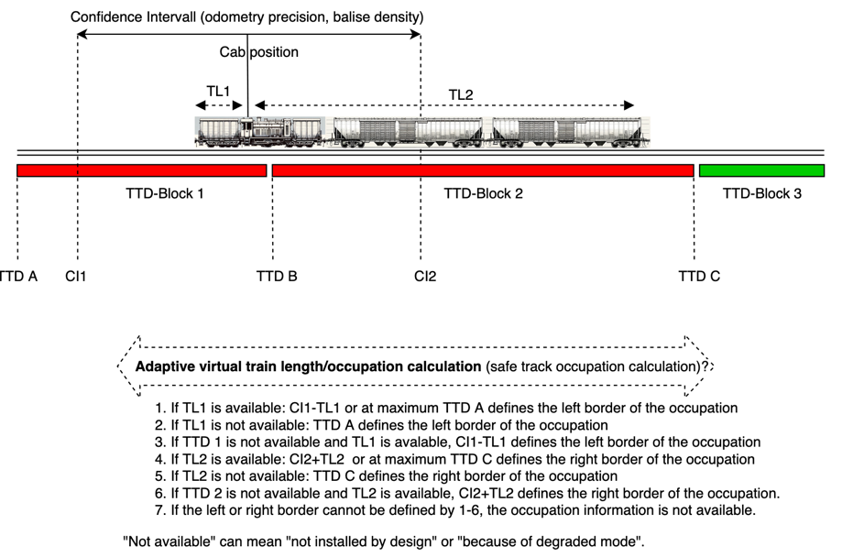
Sensor fusion, including Hybrid Train Detection
Allow flexible occupation calculation for “mixed” fleets with trains sending or not sending onboard information about train integrity and length information (“TI/TL”)
Scalability: Allow different densities of trackside sensors. Capacity usage depends on this density and train TI/TL capabilities
Make instant use of TI/TL features of modern trains to reduce train ahead times behind them and to allow an efficient and smooth traffic flow.
Layered architecture: Deliver always the same “occupation” independent from hardware or onboard system structures. Allow smooth migration of infrastructure and fleet capabilities without changing the safety logic.
A length information is only valid if integrity is known.

Slide 16
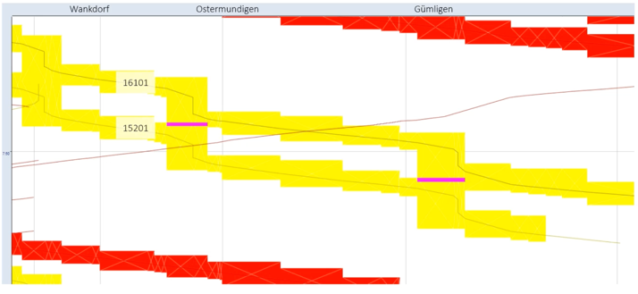
Moving Block = “borderless infrastructure”
Short train ahead times
Supervise manoeuvres
Less traffic flow conflicts in nodes and stations
No block structure adaptions needed if usage changes
Plan traffic flow based just on physical capacity
Flexible usage of tracks with multiple trains (e.g. platforms)
Optimize TTD structure seamlessly
Lower engineering effort
Operations can freely define blocks for the signaller user interface.

Slide 17
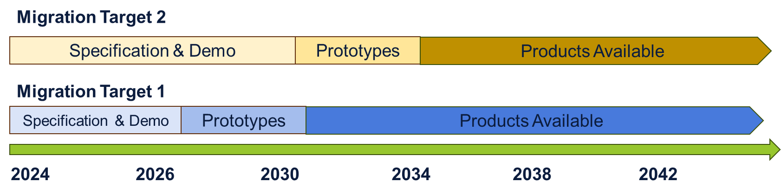
On-Board Migration Workshop
Foreseen onboard features vs. Migration Targets
Migration Target 1 (current discussion state)
Title: First set of solutions largely based on today’s technology
Timing: Starting from 2030
Available Products:
  Harmonized Trackside Protection System
  EULYNX based object controllers for trackside assets (available earlier)
  First modularisation and upgradeability for new CCS onboards
  FRMCS (available earlier)
  Trackside digital registry
  FDFTO/DAC, automated digital coupler
  Based on:
    Operational harmonisation for ETCS Level 2 only
    Harmonized Cybersecurity
  Optional: TMS using harmonized interfaces, harmonized GoA2 products.
Migration Target 2 (current discussion state)
Title: Enhanced digitalization introducing new technology
Timing: Starting from 2035
Available Products:
  Full modular CCS onboard architecture for new CCS onboards
  Digital registry connected to all trackside systems
  All systems of the target architecture based on End-to-end security
Optional products:
  Remote Train Operation (RTO)
  Advanced safe train positioning
  Advanced DAC/FDFTO
Migration Target A (current discussion state)
Title: Automated European Railway
Timing: Independent. Application in specific areas.
Available Products:
  FRMCS-only CCS trackside/onboard
  ATO GoA 3/4
  Digital register share for all applications, incl. onboard

Slide 18
On-Board Migration Workshop
Considerations and risks to define onboard migration strategies
Financial & Funding Considerations/Risks
Operational
Considerations/Risks
Legal Considerations/Risks
Other
Technological
Considerations/Risks

Slide 19
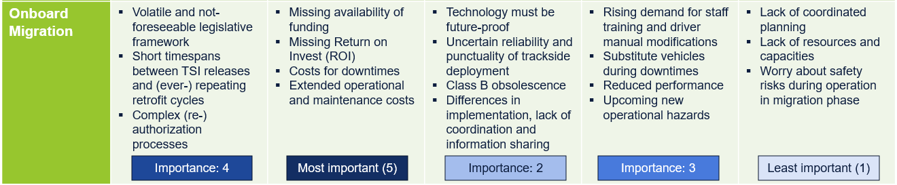
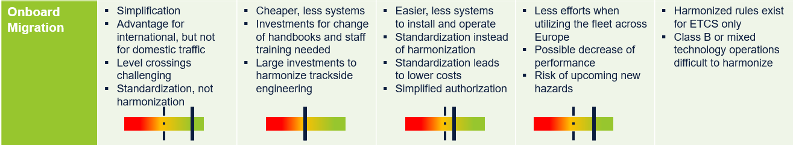
Main outputs from Questionnaire on CCS Migration
Considerations and risks to define onboard migration strategies

Slide 20
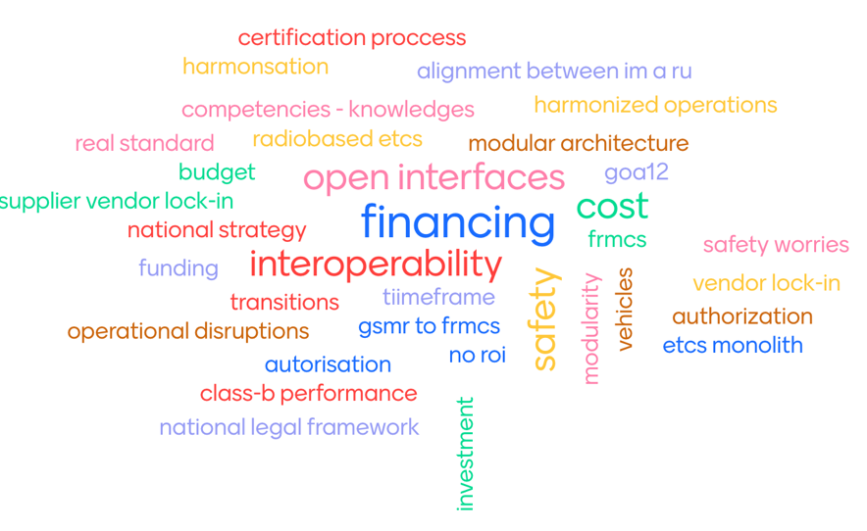
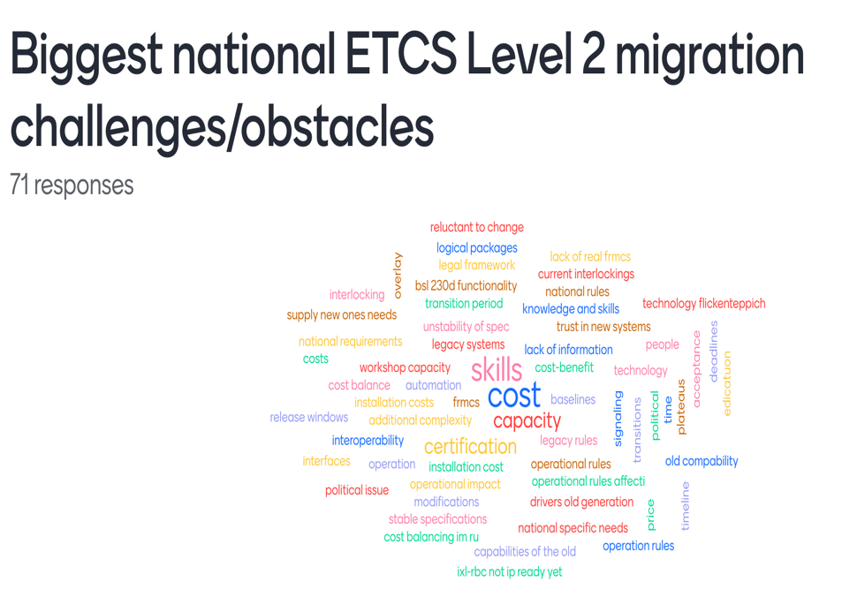
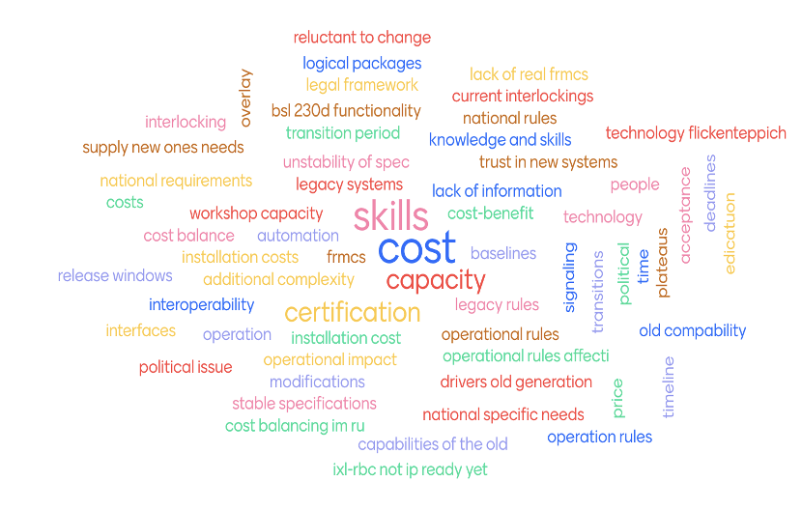
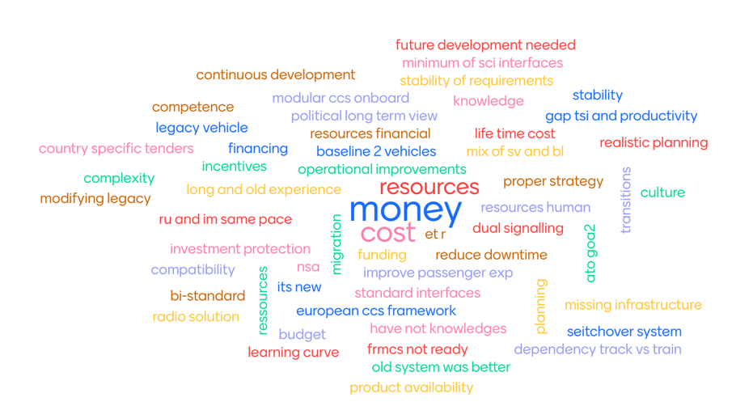
Voting

Slide 21
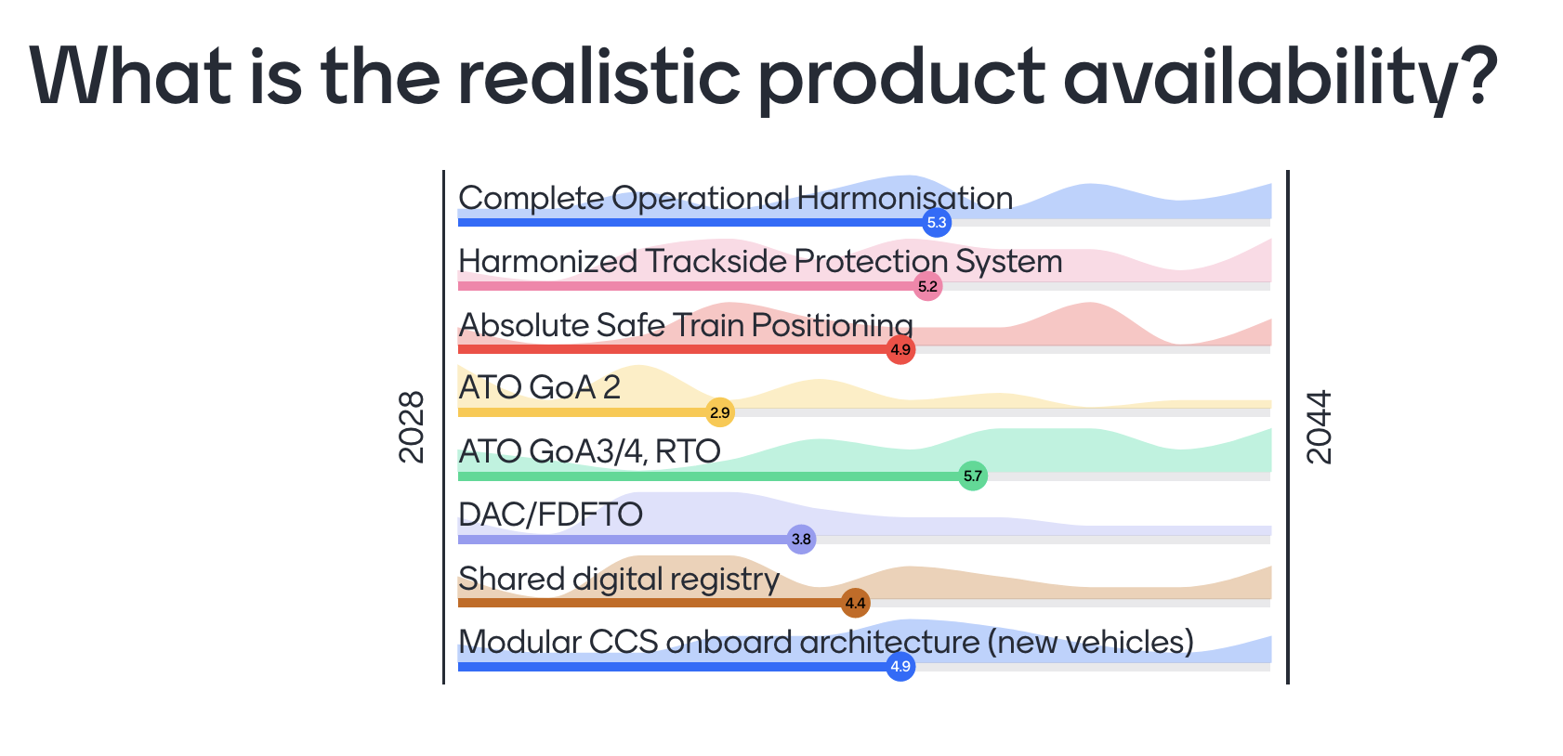
Voting

Slide 22
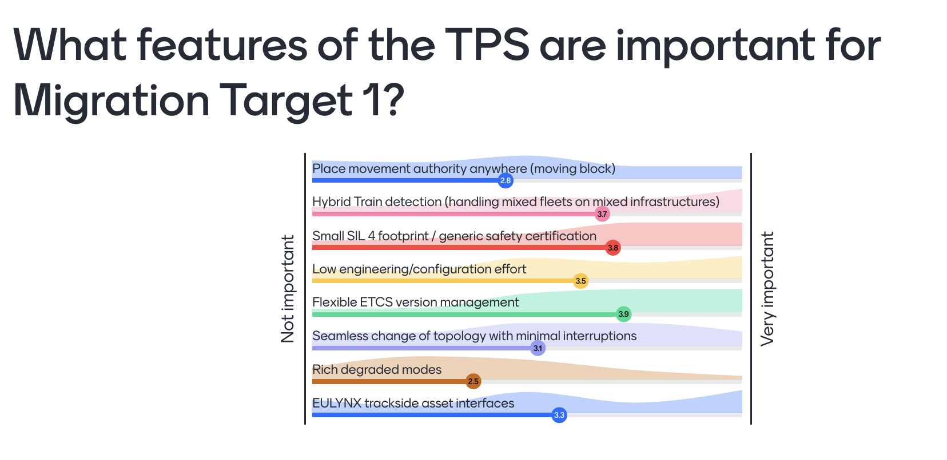
Voting: CCS trackside migration

Slide 23
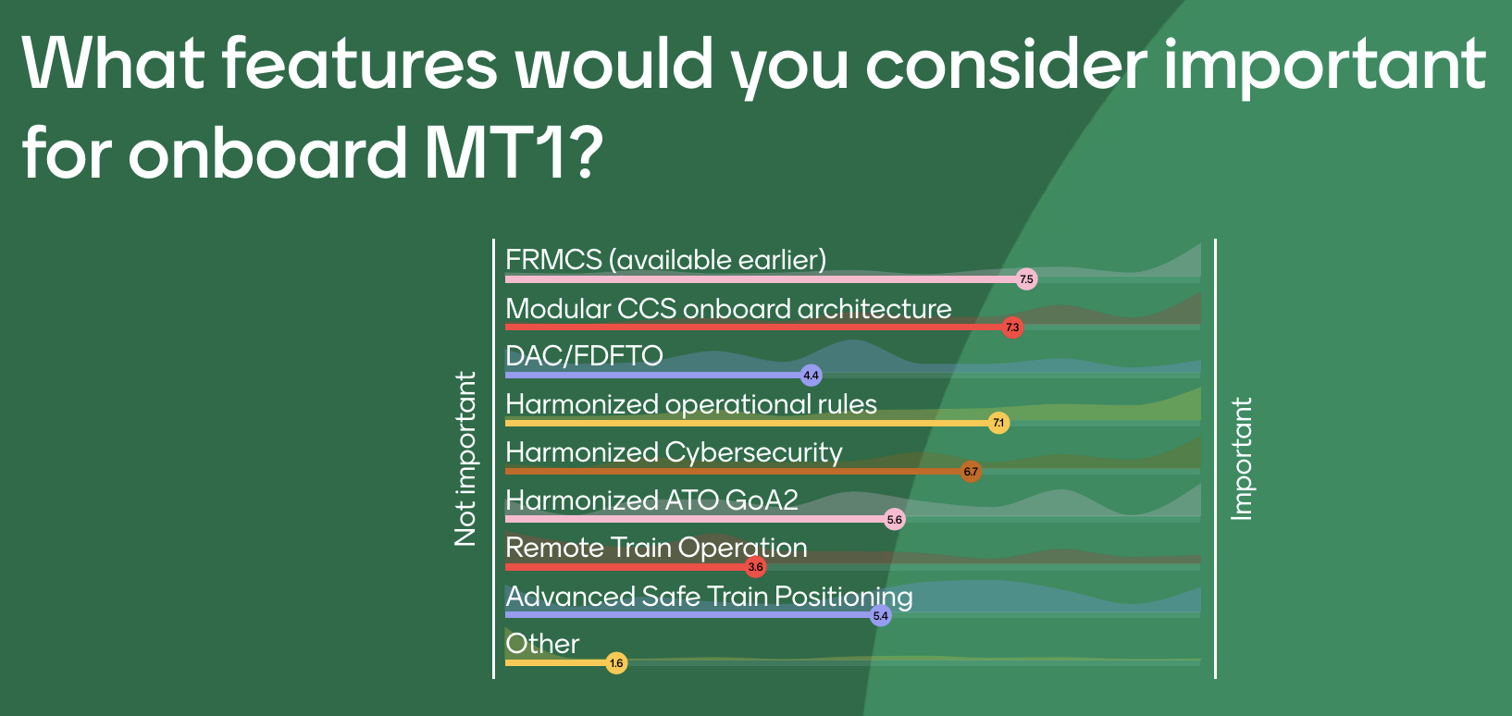
Voting: CCS onboard migration

Slide 24
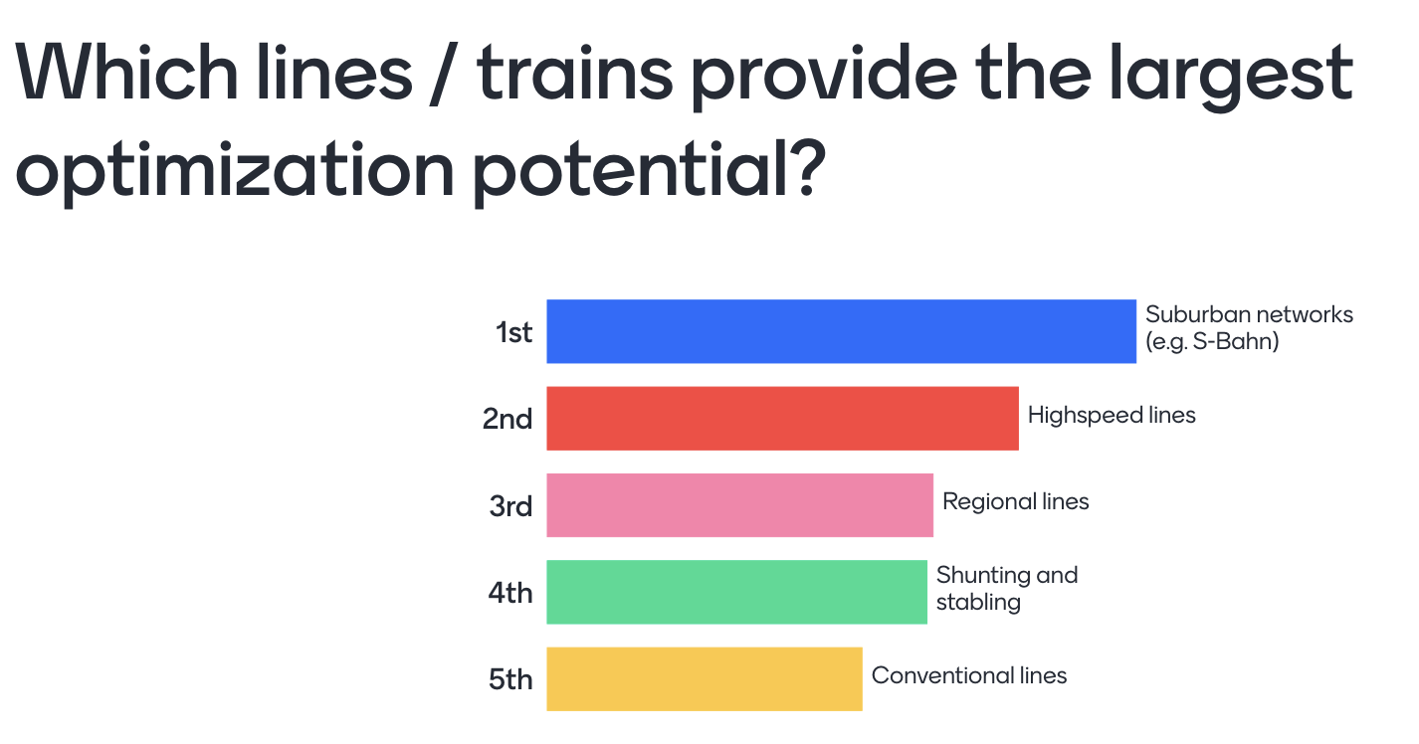
Voting: ATO GoA 3/4

