Slide 1
Trackside approval - return of experience from Applicants
Bahenský Michal
Hauner Markus
Koprowska Katarzyna
Marcoccio Stefano
Workshop on Trackside Approval, ERTMS 2024 Conference
23th of April 2024

Slide 2
1
Number of TA applications
Total number of all submitted applications to the Agency
Cost effects of submitted applications:
  Germany (DB)
  Poland (PLK)
  Czech Republic (SŽ)

Slide 3
Share of TA application
MS​ | 11/2023 | 03/2024
 | TA​ | TA​
AT​ | 1 delivered​ | 1 delivered​
BG​ | 3​ | 3​
CZ​ | 11​ | 14​
DE​ | 15 (+2 delivered)​ | 15 (+2 delivered)​
EELTLV​ | 1​ | 1​
EL​ | 5​ | 5​
ES​ | 28 (+2 delivered)​ | 28 (+2 delivered)​
EUROTUNNEL​ | 1​ | 1​
FI​ | 1​ | 1​
FR​ | 2​ | 2​
FR/IT​ | 1​ | 1​
HR​ | 1​ | 1​
HU​ | 2​ | 2​
IE​ | 1 (+1 delivered)​ | 1 (+1 delivered)​
IT​ | 20 (+5 delivered)​ | 20 (+5 delivered)​
NL​ | 1 (+2 delivered)​ | 1 (+2 delivered)​
PL​ | 4 (+1 delivered)​ | 4 (+1 delivered)​
PT​ | 2​ | 2​
RO​ | 1​ | 1​
SV​ | 1​ | 1​
11/2023
99 On going applications
+ 13 positive decisions
103 On going applications
+ 14 positive decisions
03/2024

Slide 4

How much does it cost?
ETCS L2, length of section 30km – 36 000 EUR
  ERA hourly rate – 130 EUR/h
  Duration: 14 months, application completed
  Additional costs: external consultants, internal efforts (41 568 EUR)
ETCS L2, length of section 113km – 23 497 EUR
  ERA hourly rate – 130 EUR/h
  Duration: 35 months, on-going application
  Additional costs: external consultants, internal efforts (52 860 EUR)

Slide 5

How much does it cost?
ETCS L1, length of section 17km – 29 380 EUR
  ERA hourly rate – 130 EUR/h
  Duration: 25 months, application completed
  Additional costs: external consultants, internal efforts
ETCS L2, length of section 210km – 28 113 EUR
  ERA hourly rate – 130 EUR/h
  Duration: 54 months, on-going application
  Additional costs: external consultants, internal efforts

Slide 6

How much does it cost?
ETCS L2, length of section 112km – 25 025 EUR
  ERA hourly rate – 130 EUR/h
  Duration: 28 months, on-going application
  Additional costs: internal efforts (14 500 EUR)
ETCS L1 based, length of section 7,5 km – 9 328 EUR
  ERA hourly rate – 130 EUR/h
  Duration: 28 months, on-going application – complete application
  Additional costs: internal efforts (5 500 EUR)

Slide 7
Important instructions and ERA fees
  Important instructions:
  Application and communication via the IT platform
  One-Stop-Shop (OSS)
  Complete functions list (→ otherwise ERA TA decision report cannot be used for the national authorization)
  Very detailled verification procedure in the issue-list (provision of engineering rules, standards, certificates, supplier related informations, etc.)
  ERA fees (Status 01/2024):
  ERA acc. EU 2021/1903 → Hourly rate 265€ (previously 130€)
  +
  One-off 464 € per application for the use of ERA‘s IT-platform OSS
  To date, the fees and charges valid in the year in which the application is submitted apply to current applications.
  In 2024, ERA presented a proposal for the dynamic adjustment of fee rates in the RISC. In the future, ERA fees should be calculated based on the “average workload” (→ This does not make TA procedures any more cost-effective)

Slide 8
2
Focus Points
Identified by Applicants on a various phases of TA process
  legal issues/guidelines
  efficiency of the process

Slide 9
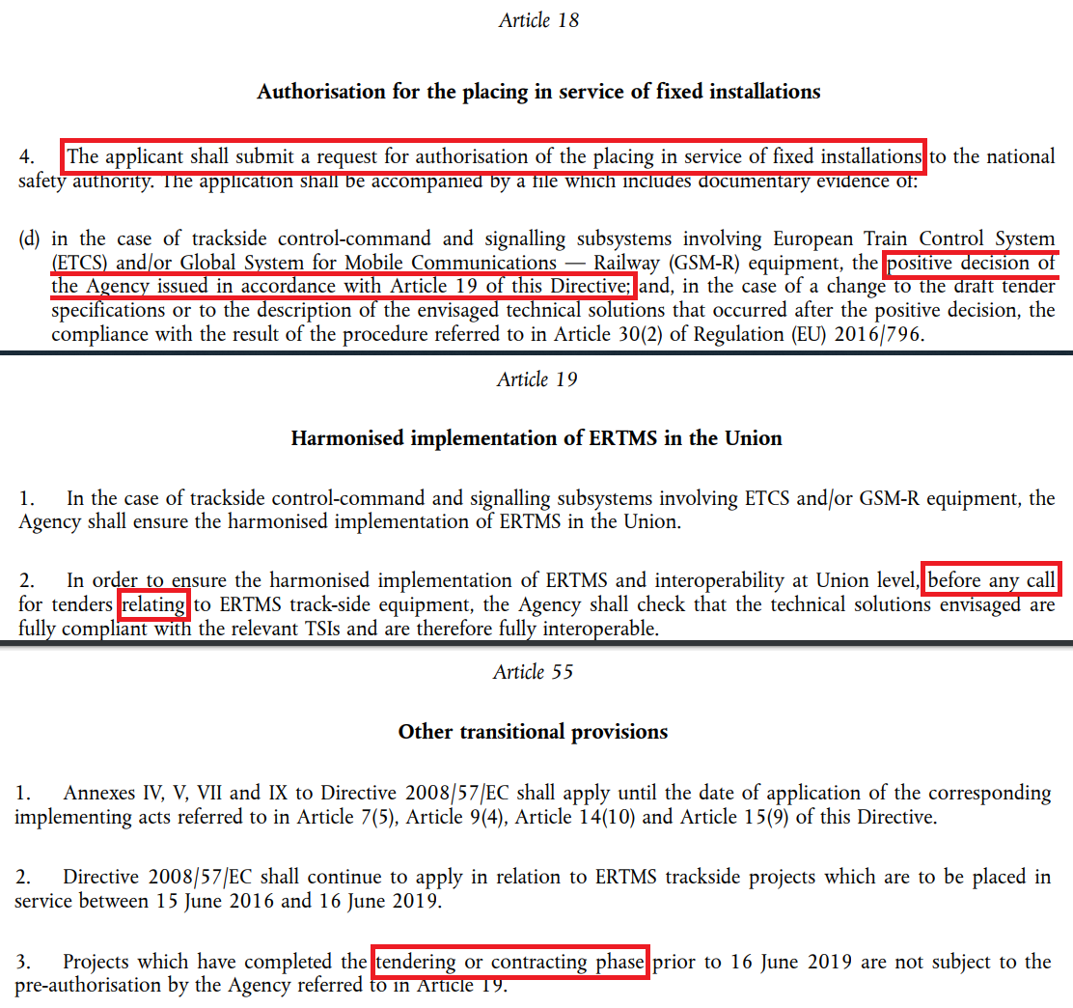
Legal issues/Guidelines
Basically, there is a gap between law and real flow of the process
Directive (EU) 2016/797 sets the focus on the tender phase, ERA requires evidence documentation that is only available after the tender phase
Actual guidelines are not available for the applicant. It’s necessary to update the current guideline
Notes:
A few information about problems with market which expect having TA decision before the tender (art. 19) - directive is misleading
Problems with the directive:
Interpretation of term „call for tender” (art.19), „tendering phase” (art.55)
Contradictions in directive on example: „every call for tender”(art. 19) and art.18 – only for those which need NSA authorisation
Lack of precise information what kind of evidence documentation is needed fot particular item/issues

Slide 10
Efficiency of the process
Trackside approval with ERA causes high costs - current ERA fees are 265EUR/h, further rate increase are expexted in the short term horizon
Processing the TA procedure takes a lot of time, processing the F+I is particularly demanding
ERA's version management from the F+I influences the ongoing TA procedures, making everything even more complex
Limited number of experts are able to respond on issues
The late completion of TA procedures results to a risk for the national authorization
Notes:
High costs – a few words about amended regulation 2018/764
In terms of: long lasting process and lots of efforts consumed by filling in issues log sheet and collecting all evidence documentation not necessarily tied with interoperability (vehicle documentation). This point might be consolidated with point „Most task force is dedicated to answering F+I list (very limited number of experts can answer the issues)”.
Influence of new versions of issues log which are published during conducting TA processes – risk which is taking in to account by suppliers during pricing offers. Risk of new issues at the end of TA process due to new version of issues log.
Due to late TA decision:
Impact of negative decision is devastating for the investment (UE funding, phase of design completed and system is already installed on site)
To the end of the process applicant do not have a clue about correctness of technical solutions - from ERA perspective.

Slide 11
3
Differences
Directive 2016/797 and the real Trackside Approval procedure
  Art. 19, Directive 2016/797
  Real workflow
  Provision of the reference documents

Slide 12
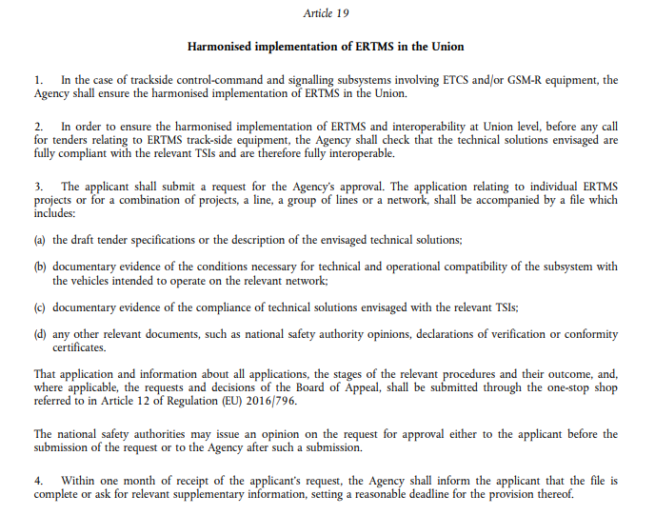
Art. 19, Directive (EU) 2016/797
We propose to optimize the process by giving the possibility to applicants to close the Trackside Approval at the early stages of the projects (e.g.by using Tender docs).
The whole process should be focused solely on interoperabilty – compatibilty between trackside and onboards.

Slide 13

Real workflow, example RFI
Initial Engagement (not mandatory but recommanded) for the definition of the Deadline
Uploading of the documentation for Trackside Approval (OSS)
Call for tender
Deadline with ERA
Declaration of completeness by ERA
Trackside approval by ERA
Request for authorization to NSA
Exchange of documentation and interaction between ERA and RFI
30 days
60 days
90 days
Realization
Trackside Approval closure 90 days before request for authorization to NSA
!
If information are available, Trackside Approval can be obtained even before the deadline

Slide 14
Provision of the reference documents
Example RFI
IM DOCS
SUPPLIER
Tender Documents
Definitive Project
Executive Project

Slide 15
Inconsistency between law and real flow of the process
The Provision of the reference documentation can only be provided over different project phases!
Notes:
A few information about problems with market which expect having TA decision before the tender (art. 19) - directive is misleading
Problems with the directive:
Interpretation of term „call for tender” (art.19), „tendering phase” (art.55)
Contradictions in directive on example: „every call for tender”(art. 19) and art.18 – only for those which need NSA authorisation
Lack of precise information what kind of evidence documentation is needed fot particular item/issues

Slide 16
4
Items of the application file
Duplicative activities in ERA‘s TA procedure?
  Problematic items

Slide 17
Application file with 14 items
  Application scope description (should correspond to that of EIGV Annex 6)
  Specification for the contract award with reference to the current TSI CCS or cpmparable document
  Project plan indicating deliverables, milestones and deadlines of the application
  Function List (=“List of ERTMS functions to implement“: also defines the scope of the authorisation review by ERA): Which functions will be implemented?
  Issues List (=“Log of interoperability problems“: is created automatically based on the functions to be implemented): Demonstration that the risks impacting interoperability have been addressed
  Engineering rules and operating test scenarios
  Test strategy and test plan
  Conditions necessary for the technical and operational compatibility of the subsystem with the vehicles intended to operate in the trackside
  (if available) previous (national) ERTMS trackside authorisation or opinions, relevant for the technical solutions envisaged
  (if available) EC Certificates and EC Declarations of comformity for the interoperability constituents
  (if available) EC Certificates and EC Declarations of verification for the trackside subsystem
  (if available) National rules related to ERTMS that must be considered in the application scope
  Exemption from the application of one or more TSIs or parts of them
  Previous approval(s) identification
  Information on the project description, tender documents, interoperability constituents, subsystem CCS test strategy, test plan, etc. must be considered.
  It is an idiosyncratic compilation of documentation the applicant has to provide for the
  TA procedure.

Slide 18
Problematic items
Statement:
  Some problematic items are listed on the following slides. They are classified by ERA as “if available” during the TA process. ERA requires the submission of evidence and certificates for them
Effect:
For the applicant, this creates effort and costs in the complex TA process.
Attention:
Materially, compliance with interoperability is achieved through certified components and the EC verification process for the CCS subsystem; here it is the task of a NoBo to check compliance with interoperability.

Slide 19
Problematic items
Item 7 – Test strategy and test plan
  The field -/acceptance tests for the use of two OBUs from two different manufacturers is not available in the early project phase especially not in the tender phase
  In addition, evidence of the use of two OBUs is a test point in the EC-verification procedure. ERA request the evidence as early as in the TA procedure.
Item 8 – Technical and operational compatibility
  Compatibility between vehicle and line is part of the contractually arrangement with the supplier. However, ERA considers that reference to the contract is not sufficient and requires additionally a list of the vehicles running for the TA application scope
  The ESC types to demonstrate ETCS system compatibility for the ETCS routes are notified by ERA. ERA requests submission during the TA process. It is a problem for the applicant ESC tests are only available almost at the end of the project

Slide 20
Problematic items
Item 10+11 – EC-Certificates for interoperability constituents and subsystem
  The provision of certified constituents is agreed in the contract with the ETCS supplier. However, ERA considers the contract as not sufficient and requires the certificates to be presented during the TA process.
  The EC-Certificate for constituents, e.g RBC, are only available at the end of the project and not in the tender phase. The same situation is given for the EC-Certificate for the subsystem.

Slide 21
5
ERA‘s functions list and issues log
  References to CR‘s
  Identified hazards
  BCA Analyses
  ERA OPI

Slide 22
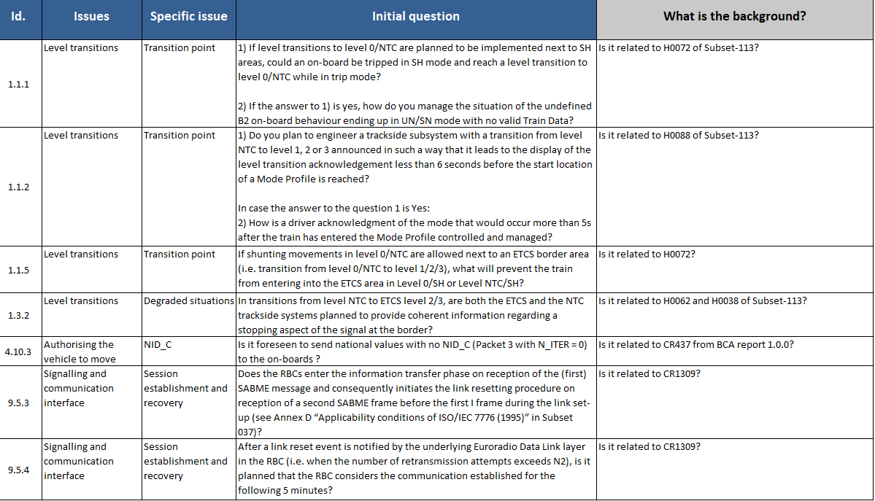
Functions list and issues log (F+I)
Since the beginning of the TA process, ERA has published version 6 of the F+I. Each new F+I has an impact on ongoing TA procedures
Depending on the functions in an ETCS project, the number of IDs to be processed has continuously increased to approximately 75 - 80 IDs for an ETCS Level 2 project (previously 55 - 60 IDs)
The questions about the IDs cannot always be clearly assigned to CR’s, hazards, BCA analysis or ERA OPI. There is also no mitigation available in some cases.
The questions in the F+I have now such a level of detail that answers with reference to the rules of the IM are no longer sufficient => ETCS suppliers must provide manufacturer-relevant information (e.g. excerpts from the project planning guidelines for balises and RBC)
In fact many of the issues inside the F+I log do not represent risks to the interoperability. The issues stand for technical flaws of the ERTMS design in general.

Slide 23
6
Statement of the applicants
The TA procedure it‘s a long and complicated process –
Especially a reduction of the issues is expected
In general way we propose to close the application with only tender documents available according to Art.19, Directive (EU) 20216/797

Slide 24
7
ERA WG-TA
Applicants expectations

Slide 25
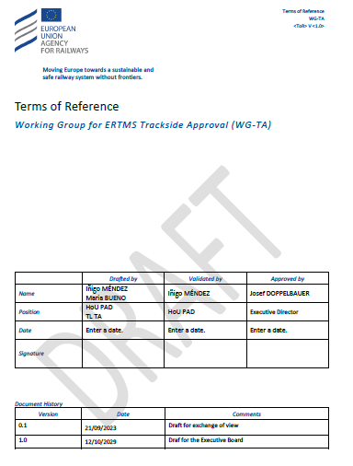
ERA WG-TA
The European rail sector request the organization of a working group to optimize the TA process. Over the last years the willingness of ERA can be classified as very cautious
In 11/2023 the ERA Executive Board decided to set up the ERA WG-TA
Milestones:
- Kick-off meeting March 2024
- 1st Meeting September 2024
- 2025 ownwards: at least two-yearly meetings
Scope:
- Exchange and return of experiences from
applications for TA
- Promotion of process improvements by
applicants and ERA

Slide 26
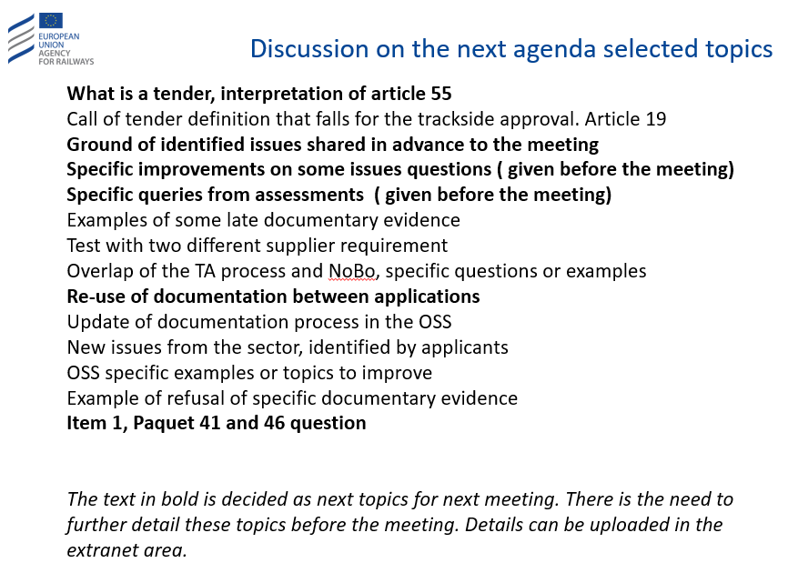
ERTMS WG TA – Next steps

Slide 27
Applicants expectations
Lower costs
Lower amount of needed documentation
Transparency of awaited information – precise guidelines
Removal of items which are part of the EC-verification process
Creating an environment which enable to obtain the “Decision Report” on an earlier stage of investment incl. limiting to information available on tender phase

Slide 28
Thank you for attention
Bahenský Michal
Hauner Markus
Koprowska Katarzyna
Marcoccio Stefano
Workshop on Trackside Approval, ERTMS 2024 Conference
23th of April 2024

