Slide 1


The CCS TSI 2023 insights within the transition regime and the error correction process explained
ERTMS Conference 2024 | Valenciennes
W. Malfait & J. Hernandez Fernandez
Photo: Adobe Srock / by Tobias Arhelger

Slide 2
Agenda
  Topic 1: ERTMS Specifications inside CCS TSI 2023/1695
  Topic 2: Examples of Transition Regime inside CCS TSI 2023/1695
  Topic 3: Summary of transition Regime inside CCS TSI 2023/1695

Slide 3

ERTMS Specifications – Digital and Green Rail
Mandate/scope for specifications in CCS TSI 2023/1695 | Link with strategic objectives | Status
Automated Train Operation GoA 1 and 2 | ATO provides capacity benefits and reduces energy consumption (green rail).
ETCS Readiness for FRMCS 5G based communication | GSM-R (2G) will become obsolete between 2035-2040 and shall be replaced by FRMCS (5G). Further digitalisation of rail as 5G opens many possibilities.
Digital ETCS reducing trackside assets | Hybrid Train Detection: Train integrity allows capacity increase and/or reduced trackside train detection systems. Note: merge of ETCS L2 & ETCS L3 + missing safety requirements. Supervised manoeuvres: Supervised manoeuvres allow safety increase and when using digital automatic coupling will allow to get rid of shunting signals
On-board modularity | On-board modularity enables further market opening which allows integration of different interoperability constituents/subsystems from different suppliers (open market). ERTMS specifications include additional specifications which provide on-board modularity focusing on a common Ethernet based system and providing harmonised interfaces between ATO, ETCS, FRMCS parts and RST-subsystem.
Additional changes to further optimise capacity, safety & security, cost reductions | The ERTMS specifications are further optimised with additional change requests based on return of experience of ERTMS projects.
Notes:
Key message: ETCS & ATO Specifications are fully mature and delivered according to the mandate/scope. Digital ETCS reducing trackside assets: add merge L2 and L3 and missing safety requirements (important for train integrity).

Slide 4
ERTMS Specifications – Evolution of ETCS Baselines/ETCS System versions
CCS TSI 2016/919
set #1 set # 2 set #3
ETCS B2
ETCS B3 MR1
ETCS B3 R2
(envelope of ETCS system
(envelope of ETCS system
(envelope of ETCS system
versions up to 1.0)
versions up to 2.0)
versions up to 2.1)
(= B2 functions + error corrections and
(= B3MR1 functions up to 2.0 + error
functional enhancements incl.
corrections and functional enhancements incl.
harmonised braking curves and limited supervision)
online key management and GPRS/PS)
CCS TSI 2023/1695 with ETCS Baseline 4 (Release 1)
ETCS B4 R1
(envelope of ETCS system
ETCS B4 R1
ETCS B4 R1
versions up to 2.1)
(envelope of ETCS system
(envelope of ETCS system
(= B3R2 functions + all error corrections
versions up to 2.2)
versions up to 3.0)
+ relocation without linking CR 1370)
(= B4 R1 functions up to 2.1 + ATO)
(=B4R1 functions up to 2.2 + all other
functional enhancements incl. ETCS
SS-153 indicates which on-board
readiness for FRMCS/DAC)
requirements/documents do not
SS-153 indicates which on
apply or are modified compared to
requirements/documents do not
ETCS up to system version 3.0
apply or are modified compared to
B4R1 (ETCS up to system version 3.0)
Notes:
Workshop:
Explanation of ETCS OBU implementations received today in VA: B3MR1 (partial fulfilment/deviations) or B3R2 (=B3MR1+error corrections without GPRS/online key management)
ETCS & 3 configurations: CCS TSI focuses on 3 standard configurations. Why? short term: error corrections for existing functions including 1370, otherwise NTR could be created; short term (optional): ATO; mid term: ETCS ready for FRMCS/DAC)
ETCS & SS-153: Show table of content

Slide 5
ERTMS Specifications – Transition regime of ETCS Baselines/ETCS System versions
  EU Policy: SERA - Why are there multiple ETCS B4R1 OBU configurations in the CCS TSI 2023/1695?
  - Removal of partial fulfilment. Clause on partial fulfilment is used in many different situations leading to restrictions/deviations in operation, uncoordinated development of multiple ETCS OBU variants with associated high assessment costs. The removal of partial fulfilment requires the definition of the ETCS standard configurations.
  Which market segments are identified for the short-term and mid-term?
    ETCS B4R1 (up to SV2.1): required short-term as mandatory functionality (incl. relocation without linking).
    Note: this configuration is the maintenance of ETCS B3R2 OBU including all error CRs which could prevent normal service linked to existing functionality and includes enhancement ‘relocation without linking’ required for some existing L1 LS trackside implementations.
    ETCS B4R1 (up to SV2.2): required short-term as optional in case of implementing ATO-functionality.
    ETCS B4R1 (up to SV3.0): required mid-term as mandatory functionality (i.e. ETCS ready for ‘FRMCS’ and ‘Supervised Manoeuvres’ incl. DAC). Mid-term strategy shall be defined by Member State (NIP) and expected outcome is that ETCS SV3.0 will be triggered by GSM-R obsolescence.
Notes:
Workshop:
Explanation of ETCS OBU implementations received today in VA: B3MR1 (partial fulfilment/deviations) or B3R2 (=B3MR1+error corrections without GPRS/online key management)
Note: request from sector (CTO Council) to evaluate if for existing vehicles already equipped with ETCS B3R1/B3R2 an alternative (partial) solution can be evaluated. Technical Opinion will be drafted after receiving the proposal.

Slide 6
Agenda
  Topic 1: ERTMS Specifications inside CCS TSI 2023/1695
  Topic 2: Examples of Transition Regime inside CCS TSI 2023/1695
  Topic 3: Summary of transition Regime inside CCS TSI 2023/1695

Slide 7
ERTMS Specifications – Appendix B1.1 – Transition Regime
  Transition regime concept is introduced across all on-board related TSIs and based on 4 categories for the vehicle:
    Design phase started after TSI enters into force (linked to first/new authorisation of a vehicle type);
    Design phase started before TSI enters into force (linked to first/new authorisation of a vehicle type);
    Production phase (linked to C2T-authorisation);
    Vehicles in Operation (linked to vehicles in operation, incl. extension area of use);
  Why is this transition regime concept introduced in the TSIs?
    - The return of experience of vehicle authorisations (i.e. assessors being involved in vehicle authorisation) demonstrated the need to align the transition regime across TSIs and would be facilitated by providing details on transition regime for each TSI change in a coherent way (i.e. delta approach).
    - For each TSI change, the CCS TSI 2023/1695 states the conditions ‘if’ the TSI change is mandatory (e.g. ETCS is installed for the first time, functionality notified by the IM) and the timeframe ‘when’ it becomes mandatory (as described in Appendix B);
Notes:
Workshop:
Explanation of ETCS OBU implementations received today in VA: B3MR1 (partial fulfilment/deviations) or B3R2 (=B3MR1+error corrections without GPRS/online key management)
ETCS & 3 configurations: CCS TSI focuses on 3 standard configurations. Why? short term: error corrections for existing functions including 1370, otherwise NTR could be created; short term (optional): ATO; mid term: ETCS ready for FRMCS/DAC)
ETCS & SS-153: Show table of content

Slide 8
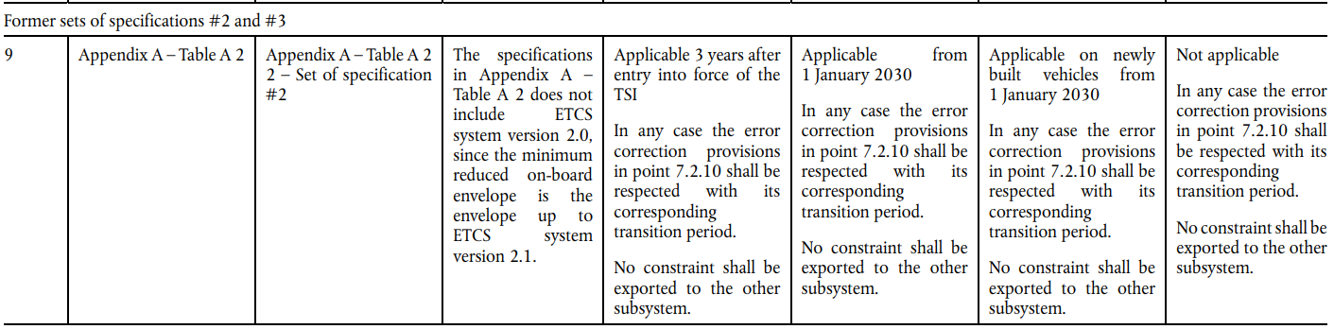
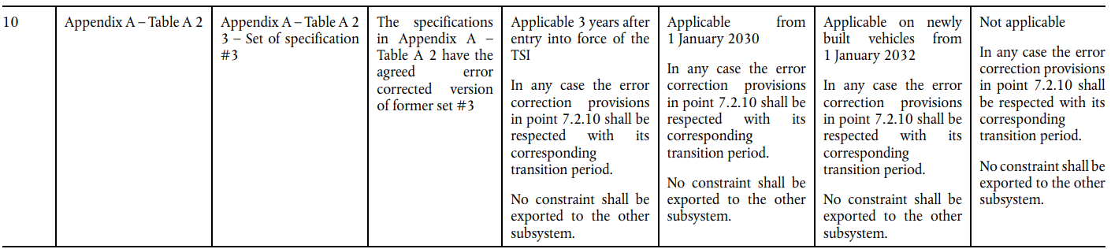
ERTMS Specifications – Phasing out set #1, #2 and #3 – Transition Regime
  ETCS OBU: Gradual phasing out set # 2 and # 3 from CCS TSI 2016/919 (see row 9 & 10)
Notes:
Workshop:
Explanation of ETCS OBU implementations received today in VA: B3MR1 (partial fulfilment/deviations) or B3R2 (=B3MR1+error corrections without GPRS/online key management)
ETCS & 3 configurations: CCS TSI focuses on 3 standard configurations. Why? short term: error corrections for existing functions including 1370, otherwise NTR could be created; short term (optional): ATO; mid term: ETCS ready for FRMCS/DAC)
ETCS & SS-153: Show table of content

Slide 9
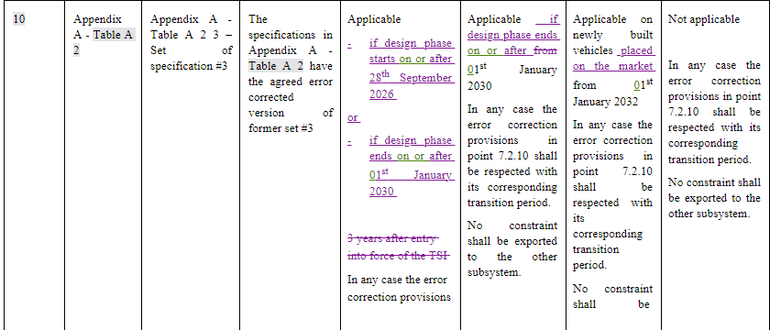
ERTMS Specifications – Phasing out set #1, #2 and #3 – Transition Regime
  ETCS OBU: Additional clarification in CCS TSI Application Guide (cascading principle)
Notes:
Workshop:
Explanation of ETCS OBU implementations received today in VA: B3MR1 (partial fulfilment/deviations) or B3R2 (=B3MR1+error corrections without GPRS/online key management)
ETCS & 3 configurations: CCS TSI focuses on 3 standard configurations. Why? short term: error corrections for existing functions including 1370, otherwise NTR could be created; short term (optional): ATO; mid term: ETCS ready for FRMCS/DAC)
ETCS & SS-153: Show table of content

Slide 10
ERTMS Specifications – ATO GoA2 and ETCS B4R1 (up to SV2.2) – Transition Regime
  ATO GoA2 Trackside implementation:
    ATO trackside can be implemented on any ETCS TS system version (X=1; X=2 or X=3);
    Transition regime: ATO trackside implementation is optional, however if implemented it shall be compliant to the specifications in the CCS TSI 2023/1695 (see row 4 of Appendix B2); Implementation of ATO trackside will depend on the National Implementation Plan.
  ATO GoA2 On-Board/vehicle implementation:
    - ATO on-board functionality requires ATO OB, ETCS B4R1 (ETCS up to SV2.2; ETCS up to SV3.0) and additional radio implementation for ATO (based on PS);
    - Transition regime: ATO on-board implementation is mandatory in case
    ‘If’: ETCS is implemented for the first time in a vehicle design
    ‘If’: IM has notified the use of ATO on certain lines of its network
    ‘When’: according to the timeframes included in Appendix B1.1 (see row 6 & 12).

Slide 11
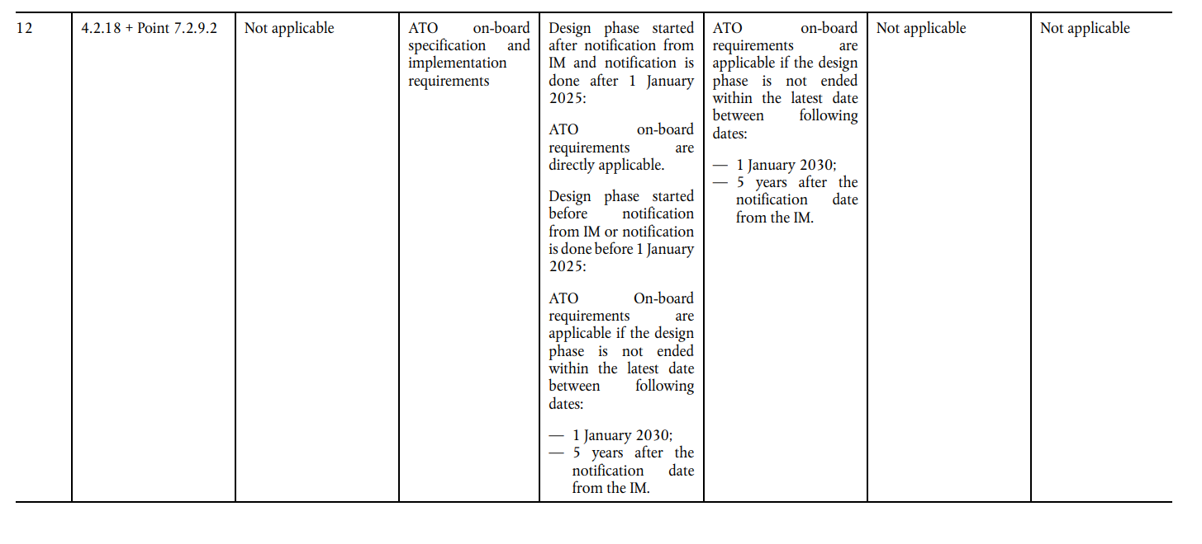
ERTMS Specifications – ATO GoA2 and ETCS B4R1 (up to SV2.2) – Transition Regime

Slide 12
ERTMS Specifications – FRMCS and ETCS B4R1 (up to SV3.0) – Transition Regime
  FRMCS Trackside:
    Full set of FRMCS-specifications is not part of CCS TSI 2023/1695;
    Transition regime: FRMCS implementation plan as part of NIP (even if specifications are not yet part of the CCS TSI 2023/1695). Note: CCS TSI provides the obligation to IMs to provide at least a minimum notification period of 5 years before GSM-R services are stopped (timeframe only starts when FRMCS-specifications for on-board are part of the CCS TSI).
  FRMCS On-Board/vehicle:
    - FRMCS on-board functionality will require FRMCS OB, ETCS B4R1 (ETCS up to SV3.0) integrated into the vehicle;
    - Full set of FRMCS on-board specifications are not part of the CCS TSI 2023/1695. ETCS B4R1 (ETCS up to SV3.0) specifications are part of CCS TSI 2023/1695, so ETCS suppliers can develop these products.
    - Transition regime: FRMCS and ETCS up to SV3.0 are not mandatory yet (see row 7 & 15). Vehicle projects can contract and implement ETCS B4R1 (ETCS up to SV3.0) on a voluntary base based on the available set of specifications.
Notes:
Workshop:
Explanation of ETCS OBU implementations received today in VA: B3MR1 (partial fulfilment/deviations) or B3R2 (=B3MR1+error corrections without GPRS/online key management)
ETCS & 3 configurations: CCS TSI focuses on 3 standard configurations. Why? short term: error corrections for existing functions including 1370, otherwise NTR could be created; short term (optional): ATO; mid term: ETCS ready for FRMCS/DAC)
ETCS & SS-153: Show table of content

Slide 13
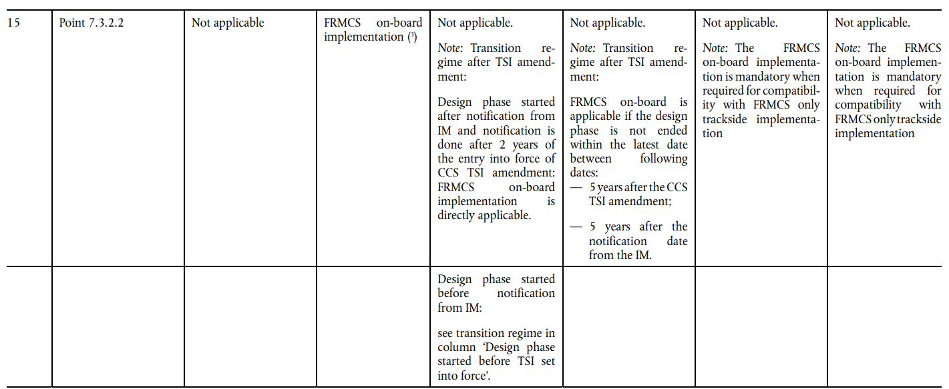
ERTMS Specifications – FRMCS and ETCS B4R1 (up to SV3.0) – Transition Regime
Notes:
Workshop:
Explanation of ETCS OBU implementations received today in VA: B3MR1 (partial fulfilment/deviations) or B3R2 (=B3MR1+error corrections without GPRS/online key management)
ETCS & 3 configurations: CCS TSI focuses on 3 standard configurations. Why? short term: error corrections for existing functions including 1370, otherwise NTR could be created; short term (optional): ATO; mid term: ETCS ready for FRMCS/DAC)
ETCS & SS-153: Show table of content

Slide 14
ERTMS Specifications – Error corrections – Transition Regime (7.2.10)
Notes:
Workshop:
Explanation of ETCS OBU implementations received today in VA: B3MR1 (partial fulfilment/deviations) or B3R2 (=B3MR1+error corrections without GPRS/online key management)
ETCS & 3 configurations: CCS TSI focuses on 3 standard configurations. Why? short term: error corrections for existing functions including 1370, otherwise NTR could be created; short term (optional): ATO; mid term: ETCS ready for FRMCS/DAC)
ETCS & SS-153: Show table of content

Slide 15
ERTMS Specifications – Error corrections – Transition Regime (7.2.10)
Notes:
Workshop:
Explanation of ETCS OBU implementations received today in VA: B3MR1 (partial fulfilment/deviations) or B3R2 (=B3MR1+error corrections without GPRS/online key management)
ETCS & 3 configurations: CCS TSI focuses on 3 standard configurations. Why? short term: error corrections for existing functions including 1370, otherwise NTR could be created; short term (optional): ATO; mid term: ETCS ready for FRMCS/DAC)
ETCS & SS-153: Show table of content

Slide 16
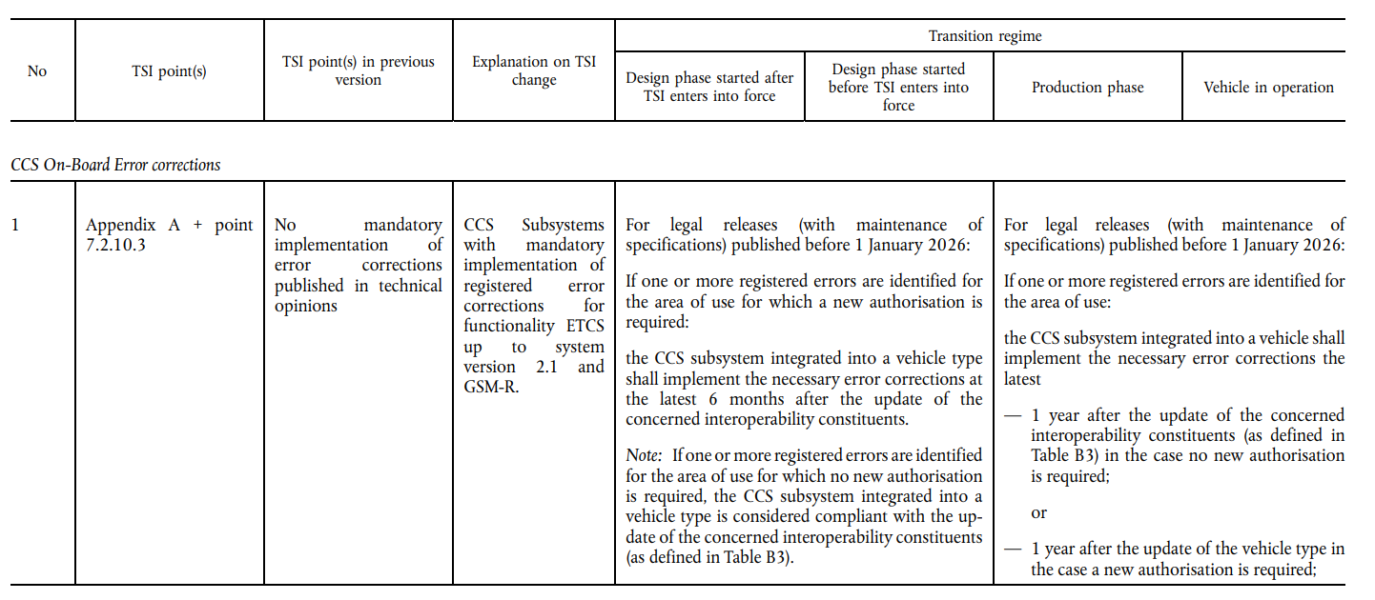
ERTMS Specifications – Error corrections – Transition Regime (phase 1)
Notes:
Workshop:
Explanation of ETCS OBU implementations received today in VA: B3MR1 (partial fulfilment/deviations) or B3R2 (=B3MR1+error corrections without GPRS/online key management)
ETCS & 3 configurations: CCS TSI focuses on 3 standard configurations. Why? short term: error corrections for existing functions including 1370, otherwise NTR could be created; short term (optional): ATO; mid term: ETCS ready for FRMCS/DAC)
ETCS & SS-153: Show table of content

Slide 17
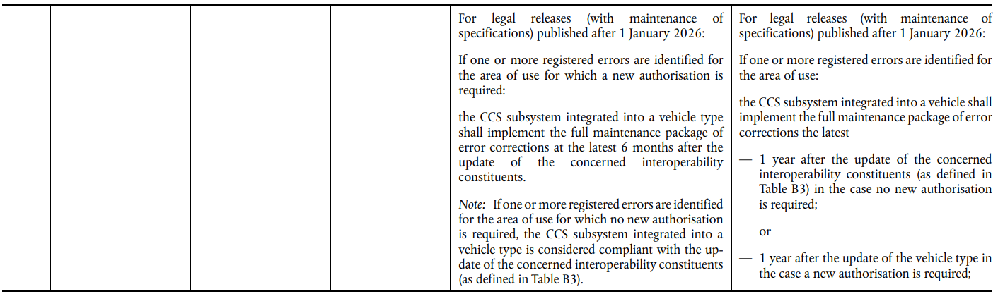
ERTMS Specifications – Error corrections – Transition Regime (phase 2)
Notes:
Workshop:
Explanation of ETCS OBU implementations received today in VA: B3MR1 (partial fulfilment/deviations) or B3R2 (=B3MR1+error corrections without GPRS/online key management)
ETCS & 3 configurations: CCS TSI focuses on 3 standard configurations. Why? short term: error corrections for existing functions including 1370, otherwise NTR could be created; short term (optional): ATO; mid term: ETCS ready for FRMCS/DAC)
ETCS & SS-153: Show table of content

Slide 18
Agenda
  Topic 1: ERTMS Specifications inside CCS TSI 2023/1695
  Topic 2: Examples of Transition Regime inside CCS TSI 2023/1695
  Topic 3: Summary of Transition Regime inside CCS TSI 2023/1695

Slide 19

CCS TSI 2023/1695 – Transition regimes for innovations based on National Implementation Plans
  Balancing IM/RU economic interests:
  How to handle innovations for the railway system which have a different business case for the Infrastructure Managers and Railway Undertakings.
  Example: Reduce trackside assets (‘digital rail’) might require new mandatory on-board
  functions to be implemented for existing and new vehicles (e.g. Digital Automatic Coupling,
  Train Integrity, FRMCS and associated changes to interface ETCS with FRMCS).
  CCS TSI 2023/1695:
  - National Implementation Plan: Member State’s obligation to balance different expressed needs between impacted stakeholders (IM and RUs) to decide on ATO implementation, new FRMCS radio system or new ETCS system version;
  - If implementation of new functions occurs, framework of a minimum timeframe (notification period) of at least 5 years shall be provided.
Notes:
Workshop:
- Limitations of TSI framework on funding criteria (ERA is not economic regulator).
- New: ATO for compatible changes can now be mandatory in case of notification of ATO, but only for impacted vehicle designs
- Change for incompatible changes: FRMCS/DAC: What could we do? Force MSs to reflect on financial migration strategy + minimum notification period of 5 years.

Slide 20


CCS TSI 2023/1695 – Transition regimes for error corrections (maintenance process)
  EU Policy objective: Providing fully compliant ERTMS products (without errors/deviations/partial fulfilment) allowing vehicles to operate across the EU (without additional restrictions/modifications if the area of use of a vehicle is extended).
  IMs/RUs depend on their suppliers for
  Integration of error corrections in their products.
   Key Commitment #7 of ERTMS MoU 2016:
  Balancing IM/RU economic interests:
    IMs would like that on-board error corrections are implemented in the vehicles in order that temporary mitigation measures can be removed.
    RUs would like that trackside error corrections are implemented in trackside projects in order to allow the operation of TSI compliant vehicles without any restrictions.
  CCS TSI 2023/1695: Responsibility of (the trackside and on-board) suppliers for implementation of errors corrections in products; If errors are preventing normal service in specific projects, IMs and RUs shall implement those corrections within a maximum timeframe of 3 years.
Notes:
Workshop:
Explain why is it regulated (e.g. see VA-authorisations with multiple deviations/restrictions; ESC/RSC tests linked to errors; …)?
Explain steps for error corrections

Slide 21

THANK YOU
Moving Europe towards a sustainable and safe railway system without frontiers.
Follow us:
Notes:
TSI (Transition, Combined Tr),
Revision of TEN-T Regulation: real opportunity to make Trans-European Transport Network fit for the future, to align the development of the TEN-T network to the European Green Deal objectives and the climate targets of the EU Climate Law. Cutting greenhouse gas emissions from the transport sector by 90%, compared with 1990 levels, by 2050, is key to achieving climate-neutrality by the same date.
New intermediary deadline of 2040 to advance the completion of major parts of the network ahead of the 2050 deadline that applies to the wider, comprehensive network. Core network will also be extended.
New term: 9 European Transport Corridors (ECTs) - integration of Core Network Corridors (CNCs) and Rail Freight Corridors (RFCs).
CT-related infrastructure parameters specified (CT profiles for all types of loading units) and strengthen the concept of network resilience by introducing mandatory interconnections between corridors as well as bypass options, with the aim of improving the reliability of transport services.
More transhipment terminals
High-speed rail network between the main nodes of Europe. The major TEN-T passenger rail lines should allow trains to travel at 160 km/h or faster by 2040.

Slide 22
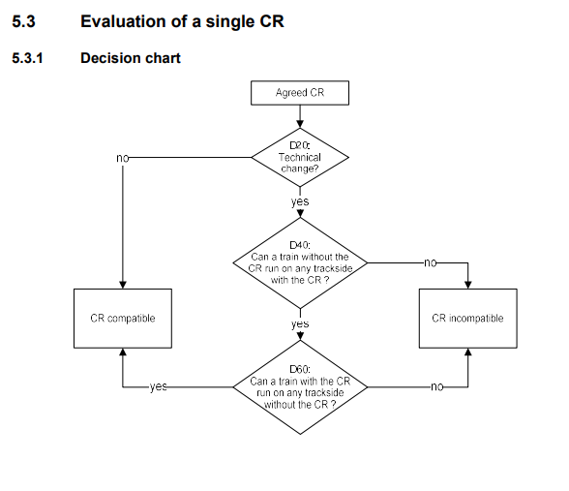
ETCS system version management –
Compatible vs incompatible change
Notes:
Workshop:
- Limitations of TSI framework on funding criteria (ERA is not economic regulator).
- New: ATO for compatible changes can now be mandatory in case of notification of ATO, but only for impacted vehicle designs
- Change for incompatible changes: FRMCS/DAC: What could we do? Force MSs to reflect on financial migration strategy + minimum notification period of 5 years.

Slide 23
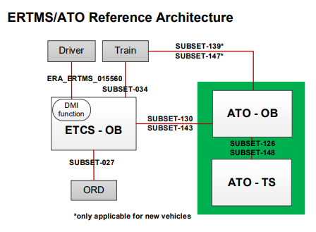
ATO and link with ETCS
Notes:
Workshop:
- Limitations of TSI framework on funding criteria (ERA is not economic regulator).
- New: ATO for compatible changes can now be mandatory in case of notification of ATO, but only for impacted vehicle designs
- Change for incompatible changes: FRMCS/DAC: What could we do? Force MSs to reflect on financial migration strategy + minimum notification period of 5 years.

Slide 24
ATO classified as compatible change

Slide 25
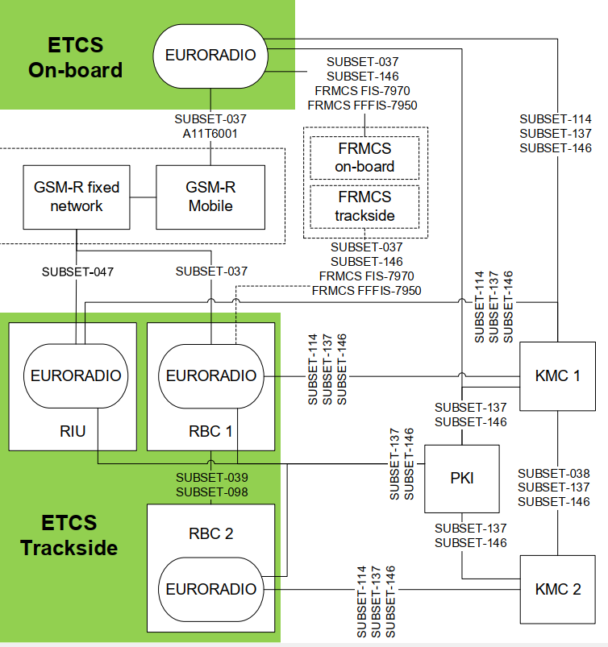
FRMCS and link with ETCS
Notes:
Workshop:
- Limitations of TSI framework on funding criteria (ERA is not economic regulator).
- New: ATO for compatible changes can now be mandatory in case of notification of ATO, but only for impacted vehicle designs
- Change for incompatible changes: FRMCS/DAC: What could we do? Force MSs to reflect on financial migration strategy + minimum notification period of 5 years.

Slide 26
FRMCS classified as incompatible change in case GSM-R services are stopped
Notes:
Workshop: same reasoning for SM: Supervised Manoeuvres as incompatible change in case shunting signals are decommissioned

