Slide 1
DAC programme
and
Interaction with ERTMS
Workshop ERA conference
Valenciennes, 23 April 2024

Slide 2




Karel van Gils
EU-RAIL
Frédéric Henon
UIC
Johannes Gräber
Knorr-Bremse

Slide 3
Agenda
Welcome and introduction 13:15 – 13:20
DAC, the bigger picture 13:20 – 13:40
    Organisation
    Planning
Interaction with ERTMS 13:40 – 14:30
    Operational rulebook
    Train length/-integrity
    Other interactions
Questions and discussion 14:30 – 14:45

Slide 4
2. Digital automatic coupling (DAC),
the bigger picture

Slide 5
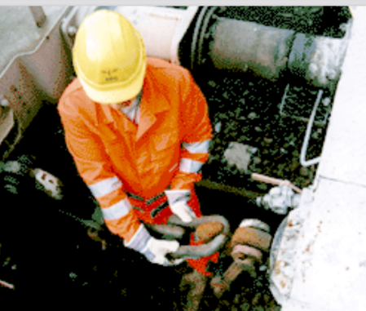

The challenges for EU rail freight
Capacity
from bottleneck
to green backbone
Productivity
from manual intervention
to automation
Quality
from paper
to digital
+ 50% rail freight
- 55% GHG emissions
by 2030
Courtesy of ÖBB
5

Slide 6
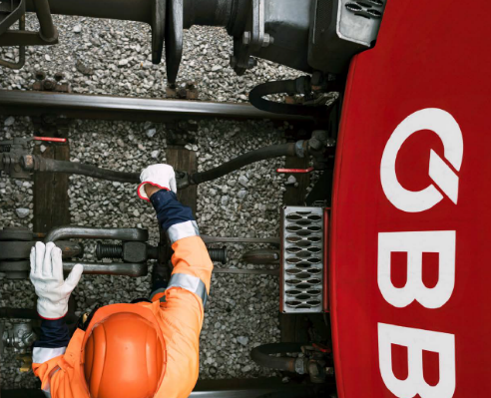
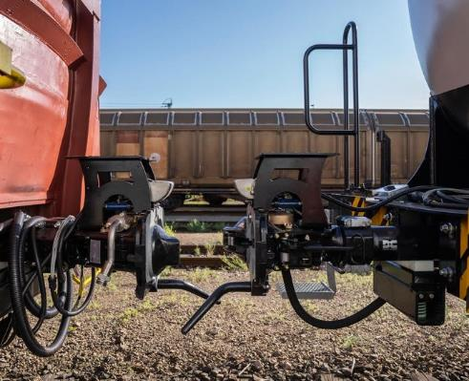
Processes today – and tomorrow
manual
freight wagon
coupling
automatic
freight wagon
coupling
mechanical, pneumatical, energy & data coupling
Courtesy of ÖBB
Courtesy of DAC4EU consortium

Slide 7
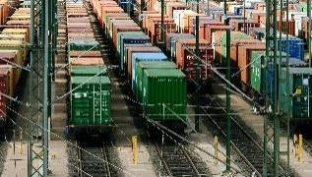
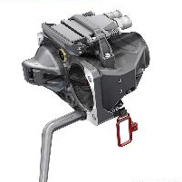
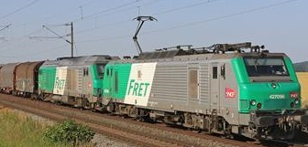

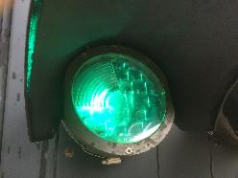
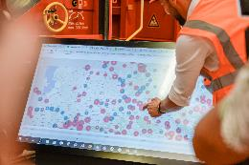
DAC core system & applications
(Full Digital Freight Train Operations)
benefits =
gains in the
processes
(time,
system time, cost savings, capacity, reliability, quality,
safety)
+ induced modal shift
DAC core system
DAC shunting
Automated coupling & manual uncoupling and digital backbone
Recording of train composition
Automatic (in-train and remote) uncoupling
Heavier & longer trains (within existing infra limitations)
Increased payload
Increased speed via improved longitudinal forces
Automated parking brake
Rear view camera for train driver
Proximity detection
Sound signals when train in motion
DAC train run
DAC train preparation
Train integrity, enabling ETCS L3 moving block operations
Increased speed via better braking performance
Multiple loco traction and trains up to 1500m
Derailment detection
Automatic brake test & calculation of brake capacity
Automated technical wagon inspection
DAC loading
& unloading
DAC telematics
(wagon & goods monitoring)
Automatic loading/unloading processes (replacement of hydr/pneum components, electro-mechanical actuators for bridge plates, automated cargo securing, heating elements for defrosting, …) via ext. energy supply
illumination for worker's safety & interior
Predictive / preventive maintenance
detection of cargo condition
Cargo surveillance, intrusion alarm
Wagon data & loading information on mobile device
red colour = components of the DAC basic package (only those use cases are linked to the pre-deployment trains)

Slide 8
Preconditions for investing in DAC deployment
(= everything that needs to be proven before investment decisions will be taken)
DAC-Technology (incl. additional DAC based technology) and DAC-operations/ functionalities are clearly defined (tech. package) and harmonised (Single European DAC System)
The technology meets all essential requirements - in particular in the area of RAMS (reliability-availability-maintainability-safety/security) - proven through large demonstrations
The operational functionalities/use cases bring the expected benefits - proven through large demonstrations incl. safety aspects
Positive CBA incl. adequate funding programs (by EU and MS) are made available and guaranteed
  to all European wagon and locomotive operators (RU) and keepers (as they will have to invest)
  in order to generate positive business cases in a maximum 10y perspective
  considering the individual/regional conditions such as the cases where upgrading is not possible/feasible
Simple, tailor-made “fast-lane” authorisation procedures are available & authorization risks are mitigated procedures for wagons and locos (incl. availability of relevant documentation)
A sound migration plan is set, guaranteeing simultaneous deployment in Europe (sector agreement and legal framework) based on available and adequate funding programs, established capacities for production and upgrading of wagons and locomotives, staff training, and availability of the necessary infrastructure and IT adaptations
2.
Proven technology
1.
Single European
DAC system
3.
Proven operational functio-
nality
4.
available adequate funding
6.
Sound migration plan
5.
Simple authorisation
DAC Deploy-ment
Precon-
ditions for investing

Slide 9











All DAC-related activities
Europe’s Rail
Flagship Project 5
EDDP
EC/ERA
Europe’s Rail System Pillar
ESOs
Stakeholder Management
DAC migration roadmap
DAC/”Full Digital Freight Train Operations”
target operat. proc.
functional requ’mts
system architecture
tech. development
testing & demos
tech. specification
authoris. dossiers
FP 5 FDFTO
sounding boards
Fleet Analyses
& rtf Engineering (rtf readiness)
Retrofit
capacity plan
(workshops, work-force, components)
Funding & Financing plan
development of efficient & suitable authorisation process & requirements
preparing TSI
drafts for the EC
Operational procedures standardization (plan & execution)
Technical
harmonisation: preparing inputs for ERA TSI drafting process & driving
EU standardisation
Alignment of
rail & DAC system architecture
Executing
European standardisation
Technology
(mirroring &
sector feedback)
CBA (updates)
Infrastructural
& IT adaptations
Retrofitting plan
(traffic & customer sidings analysis,
operational plan)
Investment plan
& procurement framework plan
TSI revision
Operational
Procedures
(mirroring &
sector feedback)
Placing into service plan (safety, workforce training, rulebooks etc.)
Other regulatory
& legal framework plans
Operating “100” DAC pre-deployment trains

Slide 10
The DAC General Master Plan 01 [June 2023]
2023 | 2024 | 2025 | 2026 | 2027 | 2028 | 2029 | 2030 | 2031 | 2032/33?
pre-deployment
deployment
Major amendments/NEW:
DAC pilot deployment projects
DAC framework conditions development
Deployment Management Entity
Technology Development
(incl. component testing and 4 demo trains)
(ER JU FP5 FDFTO + ER JU SP)
deployment incl.
procurement, preparation
& ramp-up
complete draft
tech.
specs
Final
validation & inclusion in TSIs
€€€€€
€
€€
DAC pre-
deployment trains
(100 in EU)
Ramp-up
€
Budget and resource need
(already funded)
DAC Migration Plan
Development (EDDP)
Deployment Mgmt. Entity
PREPARATION PHASE
Deployment Management Entity
EXECUTION PHASE
€
Budget and resource need
(currently mainly unfunded)
€
€
€
€
DAC framework conditions development
underway: CBA, suitable authorisation provisions, …
to be started: EU/MS policies, legal, funding, procurement, …
Determining milestone:
DAC Legal Package to be implemented before this deadline
P
P
Sector Statement
Funding Pilot Deployment Projects
Specific access
to the network for
commercial pilot
test operations
(based on draft
technical specs)
DAC Legal Package:
TSIs final (technical + migration + operations)
Deployment Management Entity Deployment Funding Instrument
Suitable authorisation provisions
existing
to be prepared
10

Slide 11
Functions and components considered
within the pre-deployment trains
The 100 pre-deployment trains shall be equipped with the DAC basic package:
DAC coupler incl. energy and data system
train composition detection
Automated brake test
Train integrity/train length determination
Automated uncoupling (in-train from loco)
  coupler with mechanical or push-button uncoupling from wagon side and including “prevent coupling” function
(Hybrid coupler for locos and DAC for special wagons, e. g. T3000 – if applicable)

Slide 12
Why large-scale testing and a
pre-deployment phase is needed
Three objectives:
Ensure full reliability of the DAC technology
- Test DAC technology in commercial operations
- Assess the validity of assumptions developed in EDDP (Migration) / FP5 (Design)
- Assess technology integration by collaboration with FP5 technology providers and suppliers of existing assets
Prove added value and optimise EDDP processes for full DAC roll-out
- Gather information for full-scale deployment and roll-out
- Learn and develop. Create a steppingstone towards full DAC deployment
- inform and communicate with stakeholders
Ensure smooth integration of DAC into the overall railway system
- Ensure (mass) authorisation provisions can effectively be applied
- Test interchangeability/broad interoperability with other digital systems on trains, tracks and central IT systems
- Assess operational rules effectiveness
1
2
3

Slide 13
3. Interaction with ERTMS
Operational rulebook
Train length/-integrity
Other interactions

Slide 14
Operational DAC rulebook
From operational processes to a rulebook
Two examples of a DAC rulebook
Links between CCS/OPE based rulebooks and DAC rulebook

Slide 15
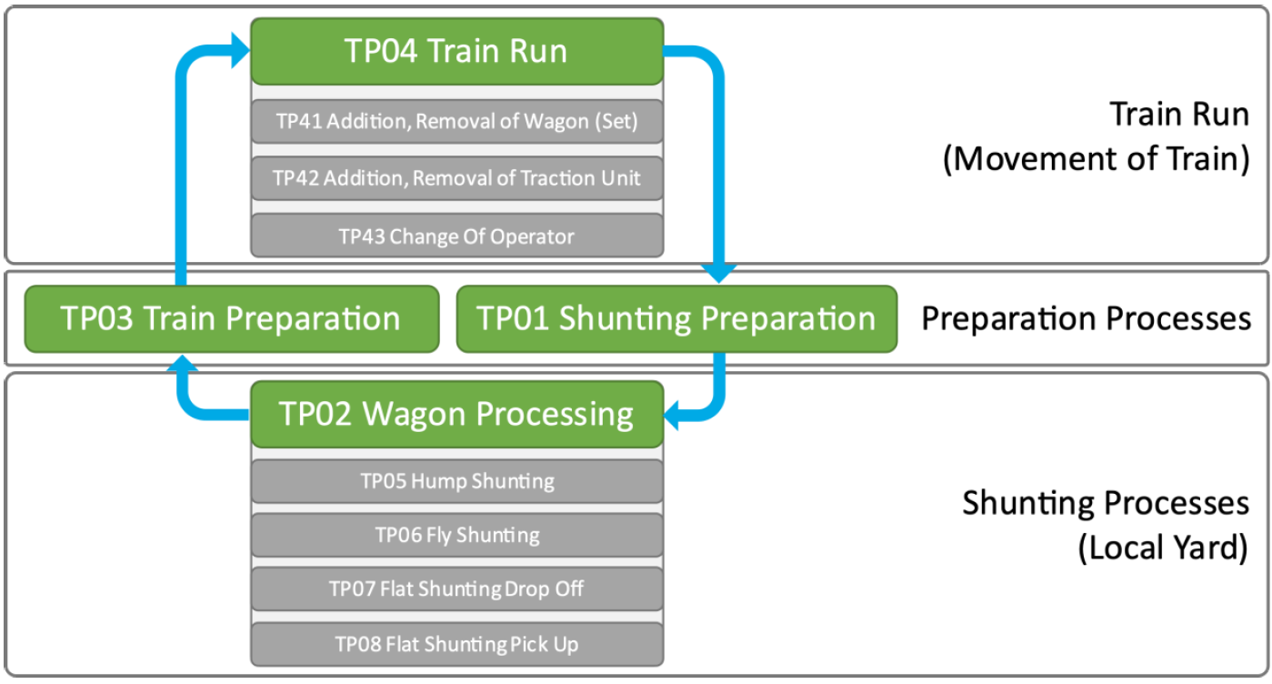
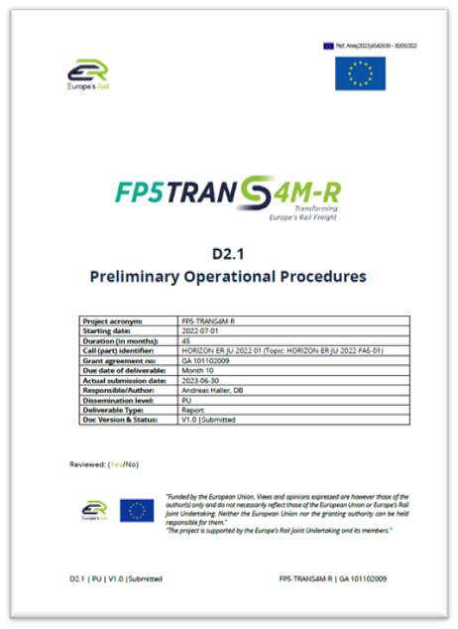
From prelimniary operational procedures to a rulebook
How the processes in D2.1 are organized

Slide 16
From preliminary operational procedures to a rulebook (2/2)
Last agreement on Rule Book Design :
Must be based on D2.1 but also next/other IP5 documents (i.e. D2.2, etc. ) and does not question the content
For the objective of pre-deployment trains, it will be based as first target on “EP” ERJU Processes (i.e. with no FDFT backend yet available)
In a further iteration, it will take into consideration the interaction with the FDFT System described in the “TP” Target Processes
It doesn’t describe at first stage all technical details, unless available (i.e.or push a button or to pull a lever)
It must describe Processes in a way that National Rules will no longer be necessary (nor allowed), and that the contents will be harmonized for all users and operators (Yard Manager, Shunting Operators, etc.) , still allowing adaptations due to geographical/local different organizational structures
The format will be aligned with Task 2 and finally agreed with ERA

Slide 17
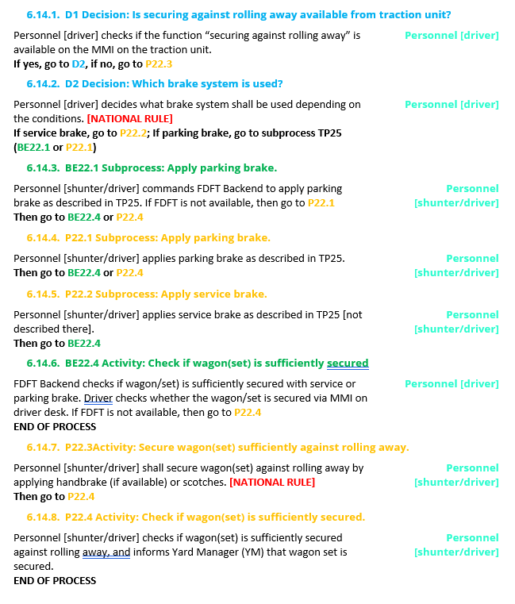
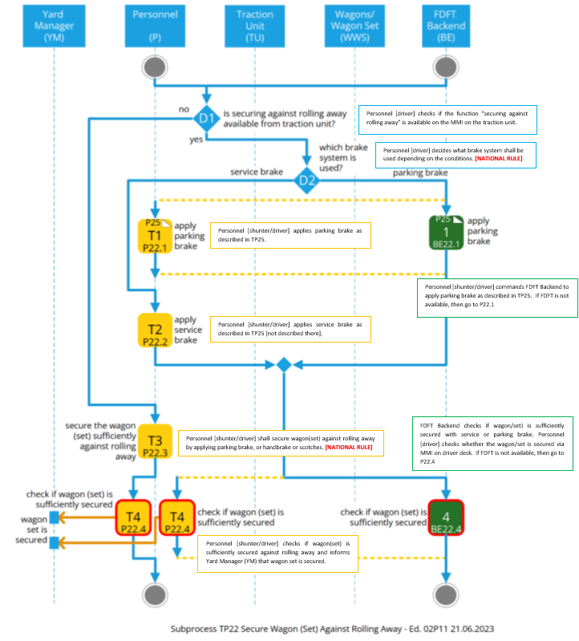
Two examples of a DAC rulebook
2 examples of Harmonized Operational Rules – general criterias
In both cases, considering that the content of D2.1 has already been validated, the processes are not re-evaluated nor re-discussed

Slide 18
Two examples of a DAC rulebook (2/2)
Testing a Content Management System (CMS)
By using a Content Management System (CMS) it is be possible to manage both option (flowchart and textual), thus allowing the users of DAC/FDFT to choose the format they prefer for the rulebook: textual, flowchart, or both.
It is important to remark that the Operational Rules will have the same holistic approach of D2.1 and will thus be elaborated for all FDFTO actors.
The CMS will in any case allow the final users to distribute to specific roles only the rules that are applicable to them. It is also about readiness of digitalisation of Rule Book.

Slide 19
Harmonized Operational Rules:
Creating links between T2 and T4
ERTMS and FDFTO scenarios are quite different, especially regarding the timeframe, but it’s possible to identify a common approach to similar topics
Three topics were discussed:
TSIs and Rulebook future developments
Examples of Rulebooks, scenario-based, and flow-chart based.
Relation between TSI and Rulebooks

Slide 20
Link between Rulebooks T2 & T4 System Pillar
SOM 101
Text based
Scenario based
Flowchart based
Scenario 101 perform Start of Mission
You are the driver of a train, and you will have to perform a Start of Mission
Enter the cab of the train
Open the cab by activating the power button / switch
- the automatic data entry is performed by the system
- all data is shown on de DMI in one overview
If all data are complete, start button is available, press start
If data is missing, press “main” on the DMI Menu, then “data entry” and submit the missing data
If all data are complete, start button is available, press start
Proceed with Scenario 102: departure
Driver enters cab
Driver opens cab
Automatic data entry is performed
n
All data complete?
y
Input data manually
Start button available
Press start
20

Slide 21
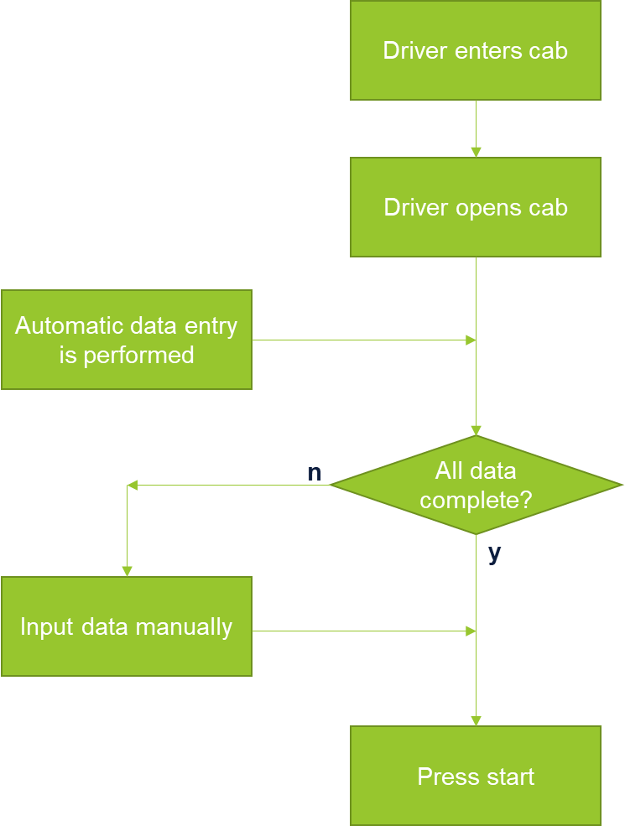
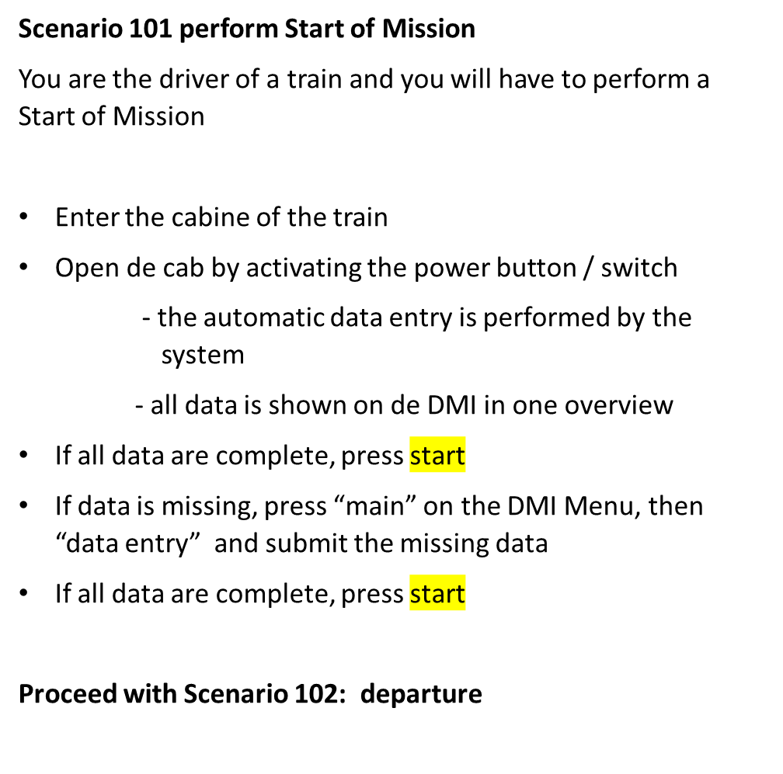
Link between Rulebooks
Example Task2:
Flow chart based
Text (instruction) based
Or both
SOM 101
21

Slide 22
agreeing on a common target picture on the rulebook
Key statement :
We will make the DAC/FDFT Rule Book self-mandatory in Europe
22

Slide 23
Safe Train length/-integrity

Slide 24
Result of investigations of System Pillar Task 4
Through the work in Task 4, mainly regarding the high-level specifications and providing the system view, System Pillar will be supporting the improvement of freight train composition, operation and capacity of tracks.
Within this overall remit, an investigation on interfaces from train-internal (covered in full responsibility of FP5) to the “outside” world was conducted.
Regarding ERTMS, one major point was identified, to be covered by FA5:
Enabling ETCS moving block operations (or L2 hybrid) of freight trains by delivering a Safe Train Length and Train Integrity.

Slide 25
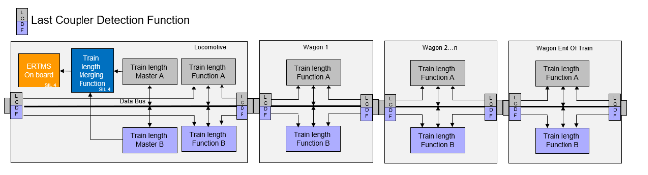
Recommendation by System Pillar Task 4
3
1
2
  Basic concept:
  In addition to a continuous train integrity monitoring, 2 independent SIL 2 functions shall deliver a safe train length using 2 different type of information
  1 “merging function” (SIL 4) to achieve a SIL 4 information to be transferred to the trackside (as foreseen in TSI CCS SS 091 already)
1
2
3
  Delivered through Polarion document “SPT4-WP3.1 FDFTO-ERTMS Trainlength/-integrity” to
  FP5 TRANS4M-R for consideration

Slide 26
Current state of play in FP5 TRANS4M-R – realisation for “basic package” (= start of pre-deployment)
  Considering the high time pressure on pre-deployment trains, FP5 decided to concentrate on the following solution:
3
1
2
  Current concept:
  In addition to a continuous train integrity monitoring, only one SIL 2 function delivers a safe train length information
  The “merging function” to achieve a SIL 4 information to be transferred to the trackside shall be reached for the “target system” by combining the SIL 2 information provided by the FDFT system with a safe information from the train preparation process (decision also due to limiting the costs per wagon for the FDFT system)
  However, the FDFT system architecture, currently being described in FP5 D3.2, does not hinder to integrate a solution with two independent SIL 2 information from the FDFT system. If required, this approach could be developed at later stage, e.g. in FA5 CALL 2.
1
3
2

Slide 27
Common understanding System Pillar / FP5
Flagship Area 5 is responsible to deliver a SIL 4 safe train length information to enable ETCS moving block (and L2 hybrid).
Common final target is to have a fully automated FDFTO system, therefore it is agreed, that in the end not to involve the driver in safety-related functions.
For the start of the pre-deployment, FP5 TRANS4M-R will realise one SIL 2 channel delivering a safe train length information (see slide before)
In parallel, 2 alternatives are further evaluated for the “target system” to provide a second SIL 2 information to be sent to the “merging function”
  The 2-channel in-train solution recommended by SP Task 4
  FDFT onboard or TCMS (both SIL 2) to receive from FDFT backend a parallel independent safe train length information

Slide 28
Planning of System Pillar Task 2 and FP2 R2DATO to realise the “merging function”
3
  Current planning:
  Task 2 (in close cooperation with FP2, Task 4 and FP5) will issue a CR to include the “merging function” into the CCS onboard unit by September 2024
  Adaptation and entering into force of TSI CCS expected by 2027
  FP2 R2DATO to provide an onboard unit merging 2 independent SIL 2 functions of safe train length (provided by FA5) by 2026

Slide 29
Other interactions ?

Slide 30
4. Questions and Discussion

Slide 31
Are you interested for further information?
Join the EDDP work packages and sounding boards:
https://ec.europa.eu/eusurvey/runner/DACIdentificationGridforOperation
31

Slide 32
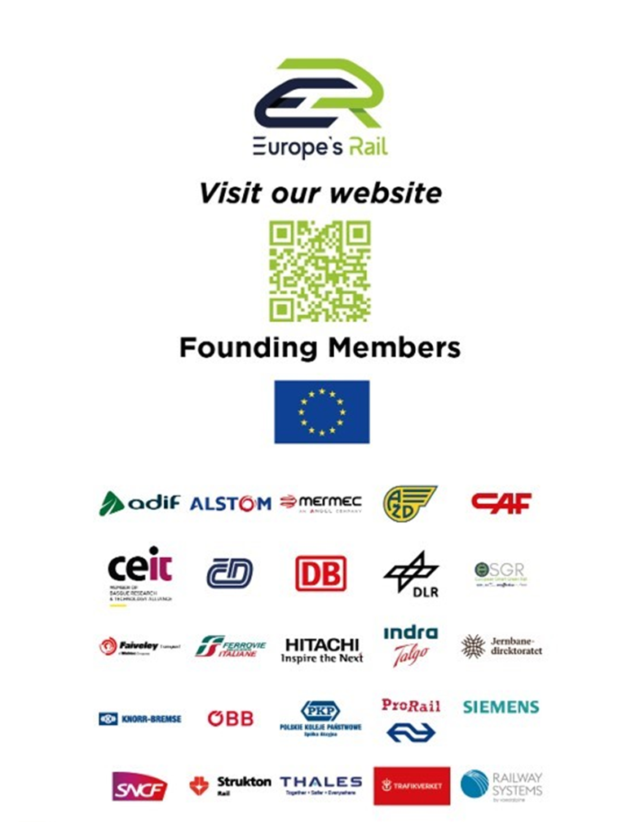
Johannes.Graeber@knorr-bremse.com
Henon@uic.org
Karel.vangils@rail-research.europa.eu

