Slide 1


ERTMS Conference
Human and Organisational Factors workshop
Emanuele Mastrodonato – Clarisse Lagaize-Davoine
23/04/2024 | Valenciennes
Photo: Adobe Srock / by Serjiob74

Slide 2

Overview
Photo: Adobe Srock / by tarasylo
Automation myth busting papers
How to integrate HOF in the System?
HOF aspects in ERTMS occurrences
Q&A

Slide 3

AUTOMATION MYTH #4
Automation makes humans-automation team impossible
HOF in Automation | European Union Agency for Railways (europa.eu)
New form of teamwork: Teaming between humans and automation
Due to the execution of complex tasks, automation is increasingly discussed in terms of a team member
An example from air traffic control is used and findings are transferred to the handling of existing interlocking technologies in the rail industry.
Tendencies of teamwork between signallers and automation are emerging nowadays.
In the future, this new form of teamwork can be further developed with the help of the introduced model on the key aspects for a successful teaming between humans and automation
Notes:
Dr Michèle Rieth is researcher at the Department of Business Psychology and Human Resource Management at the University of Bremen, Germany.
She conducts research from a work psychology perspective on the effects of increasing automation on employees and on the topic of human-autonomy teaming.

Slide 4
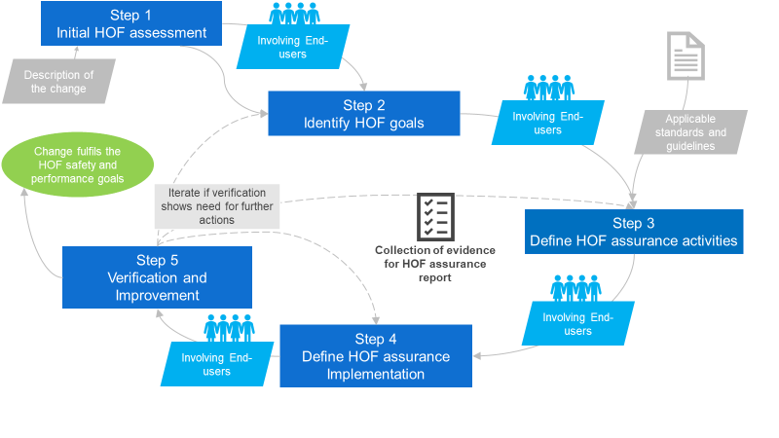
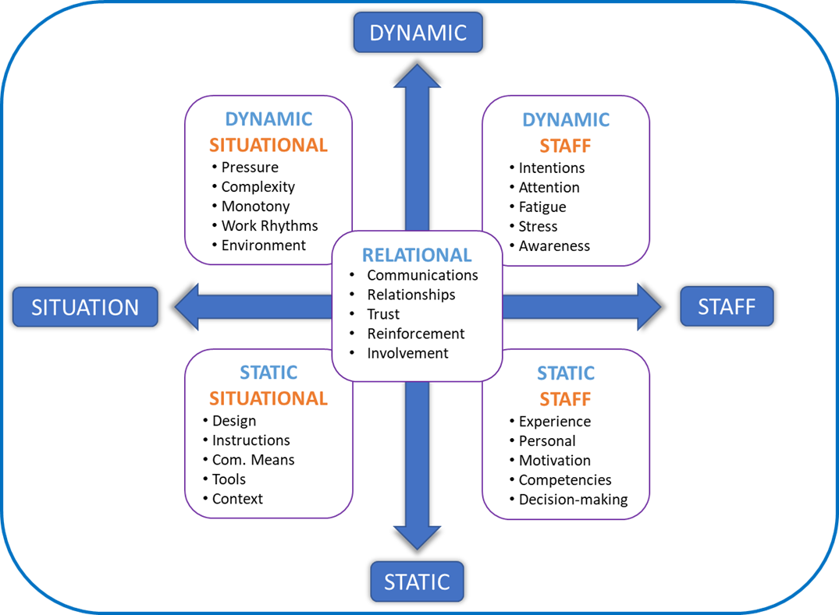
HOF Tool methodology
Five steps: integrating HOF in change management
5*5 HOF taxonomy
Human Organisational Factors questions
HOF in Change Management |
European Union Agency for Railways (europa.eu)
Notes:
Inspired from the HF case from Eurocontrol, already well implemented in the aviation sector., this methodology has been customised to better meet the needs of the railway sector and be consistent with the railway regulatory framework when a need for change is identified.
This methodology can be used for any change: from a small change to a more complex change involving many subsystem changes (ie organisational change, IT change…). A thorough description of the desired change is needed, as it may be necessary to break it down and study the interactions in several separate parts, that may not have been identified at first, this includes different systems, subsystems, teams, activities...
This methodology is composed of five steps, as can be shown in figure
This methodology should be applied from the start of a change i.e. when the need for change is identified. End-users should be involved from the very beginning, with the aim of identifying the specific HOF topics that will be included in the risk management process (and independent assessment, when needed, following requirements of Regulation EU 402/2013).
To increase efficiency, this methodology can be carried out in parallel or using the same resources (e.g. existing documentation, meetings/workshops…).
The methodology should be guided or used by a HOF specialist, and if not available by someone with HOF expertise. People using this methodology should be specifically trained to use it. Several roles mentioned can be fulfilled by the same individual, especially for smaller companies and/or smaller changes.
In conformity with chapter 1.6, this methodology should ensure that HOF is integrated in change management in a balanced manner to avoid pressure or influence, as far as possible. The first question in determining whether to apply this methodology is: could this change have any impact (direct/indirect) on staff carrying out safety-related tasks?

Slide 5

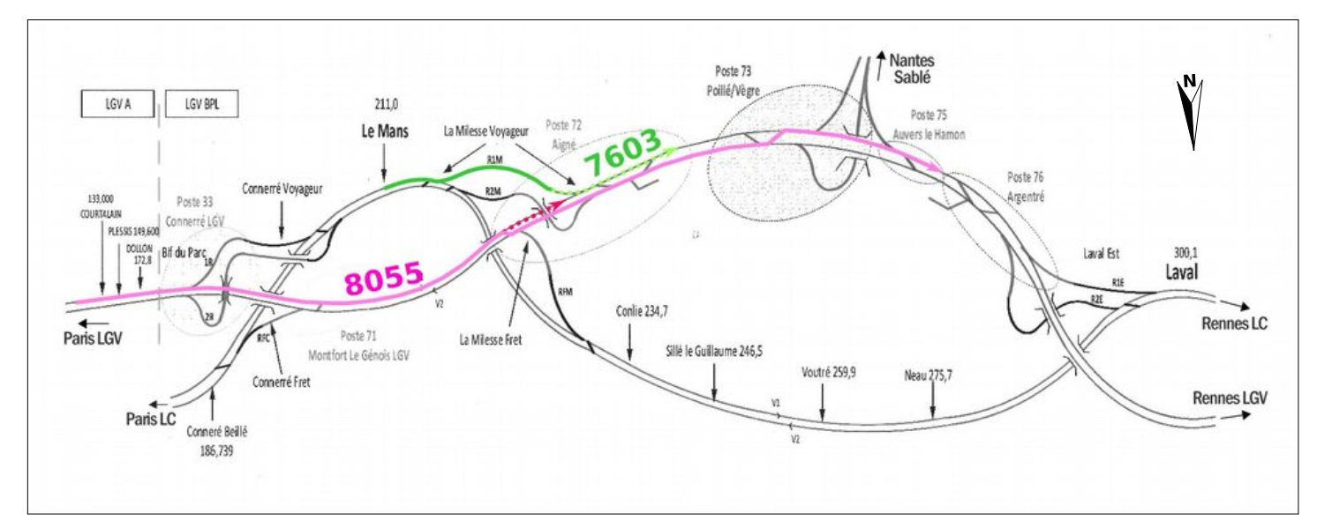

Investigation Report
Over speed of an HS train - 2019
High speed train diverted
DMI: Maximum speed 170 km/h
Service staff about to fell
Overspeed 165km/h instead of 100 km/h
Part of HS line also operated by freight trains
Specific switches to be run at maximum 100 km/h – Exceptional on HSL
Difference in speed -> error in setting the signalling system
Error not detected by checking operators, nor during the pre-traffic validations and tests before commercial operations
Source BEATT
Notes:
Mise en service le dimanche 2 juillet 2017
Mostly operated by class B system trains
Les trains fret empruntant la LGV BPL circulent sur la voie de gauche dans leur sens de circulation, comme habituellement. Pour ce faire, des traversées ont été implantéesCes nouvelles aiguilles ne répondaient pas à un besoin pour la grande vitesse et les trains fret circulant habituellement à 100 km/h, le modèle des aiguilles utilisées limite à 100 km/h la vitesse pour leur franchissement en déviation
Le lendemain en fin de matinée, le conducteur du TGV 8055 rapporte le ressenti d’inconfort de la contrôleuse et le déséquilibre du barman à sa hiérarchie, en précisant qu’il respectait la vitesse maximale de 170 km/h permise par le système de signalisation ETCS utilisé. La hiérarchie communique alors de manière informelle l’évènement à OPERE, le gestionnaire d’infrastructure (GI) en charge de la maintenance de la LGV BPL, en localisant l’anomalie sur la traversée 7207-7208 car c’est la seule dans le secteur dont la vitesse maximale autorisée est de 170 km/h.
Ne constatant rien sur la traversée mentionnée, le GI investigue plus avant cette « bizarrerie ». Il détermine que c’est la traversée 7201-7202 qui a été utilisée. Compte tenu de la géométrie des aiguilles, la vitesse maximale de franchissement aurait dû être de 100 km/h et non de 170 km/h.

Slide 6
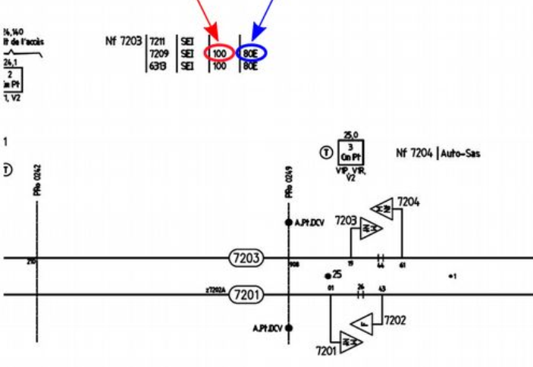
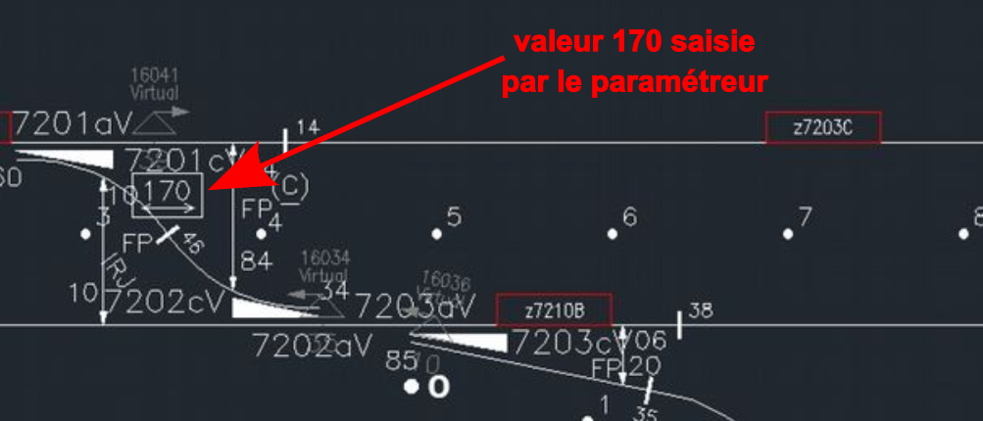
Investigation Report
Over speed of an HS train – 2019
What happened ?
Source BEATT
ETCS level 2 signalling with Standard RBCs
ETCS Max. Speed
Speed entered by operator
Paper
plan
Software
1 Operator enters data & checked by 2 Operators
No other check of the conformity
2nd & 3rd verification only based on the software data
Notes:
Une première opération de vérification du paramétrage n’a pas détecté l’erreur. Les vérifications suivantes se sont appuyées sur une base erronée. Également, des erreurs de paramétrage similaires à celle ayant conduit à la survitesse ont été corrigées mais
imparfaitement exploitées, faute de retour d’expérience formalisé.
La validation du paramétrage n’a pas été effectuée concernant la donnée de la vitesse limite sur la déviation, alors que cette opération est prescrite par les exigences des normes CENELEC de sûreté de fonctionnement qui imposent une validation exhaustive
des paramètres de signalisation. L’organisme évaluateur, chargé de contrôler la conformité des processus, n’a pas détecté cette non-conformité.
Cette analyse conduit le BEA-TT à adresser quatre recommandations et trois invitations dans les domaines suivants :
➢ la revisite des processus de production de la « signalisation ETCS » du constructeur, our que cette production soit en conformité avec la doctrine de sûreté de fonctionnement ;
➢ l’utilisation des méthodes formelles pour la validation des fichiers de paramétrage ;
➢ la revisite des processus d’évaluation dans le domaine des normes de sûreté de fonctionnement ;
➢ la structuration d’un processus d’exploitation systématisée des précurseurs en conception des systèmes de signalisation ;
➢ le champ des essais dynamiques et la qualité des comptes rendus de ces essais.

Slide 7
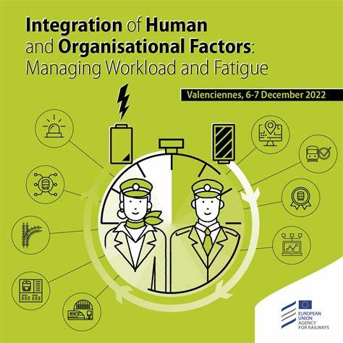
Investigation Report
Over speed of an HS train – 2019
  Peak load and tight schedule: 8hrs/day – 1 month
Subcontracted tasks
What happened ?
New team of transcription operators
  Used to trackside signalling but new to ETCS environment
Not used to the software nor to the process
Not aware that they were the final verificators
No formalisation of the training and mentoring activities
Source BEATT
Notes:
Three HSL under construction at the same time: problem of resources.
Operators were not used to work on « paper plans ».
Did not ask any question on the switches as on HSL they are always 170KM/h
Training done by the manager without formalisation, mentioned that they got two days instead of 1. Assessment by the same manager not fomalised neither in a document.
Le vérificateur ne savait pas qu’il participait à une vérification qui s’avérera unique. Il pensait que les essais ultérieurs « boucheraient les éventuels trous ». Il se représentait la vérification qu’il effectuait comme un déverminage. Il a été surpris de pouvoir passer dans
un trou non rattrapé par des essais ou par un autre test automatique. Il a été étonné d’avoir été le seul vérificateur.

Slide 8
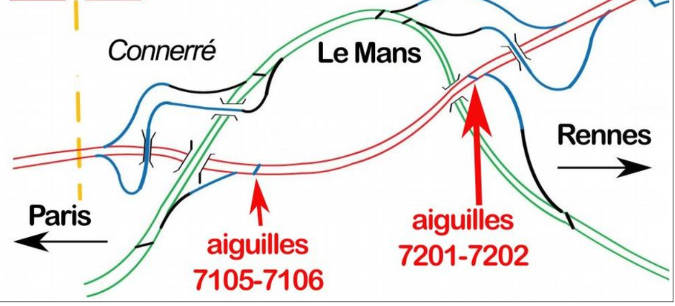
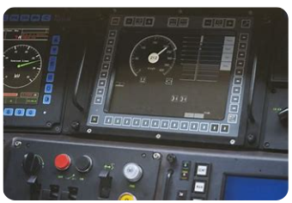
Investigation Report
Over speed of an HS train – 2019 – what happened
Operators in charge of the check did not realise the 3 track changes with presence of switches at 100 km/h
This was not discussed even if reference to freight trains
Switches
Switches
Similar errors were spotted during the verification phase
No feedback/sharing of experience process in place
As for the verification, the validation did not use the original data from the paper plan but the data from the software
  No dynamic tests for ETCS level 2 signalling on certain features presenting new operational risks.
Notes:
En parallèle, l’enquête a révélé que les essais dynamiques réalisés ont fait l’objet d’un reporting à la qualité insuffisante, retardant la compréhension de l’évènement lors de l’enquête.
La marche d’essai 3.3 du mardi 25 avril 2017 prévoyait de rentrer sur la LGV par la voie 1 en sens inverse au sens habituel, passer de la voie 1 sur la voie 2 par la traversée du poste 80 située à 200 m en aval du point de commutation TVM-ETCS, repasser de voie 2
sur voie 1 par la traversée 7202-7201 à La Milesse, puis quitter la LGV BPL par la voie 1 en continuant sur la LGV Atlantique sous TVM. Cette marche devait donc passer par la traversée dont la vitesse était mal paramétrée. Or, par suite d’opportunité opérationnelle, cette marche a circulé de bout en bout par la voie 1 sans passer par la traversée 7202-7201. Aucun des comptes rendus de cette marche d’essai ne mentionne l’écart entre le prévisionnel et le réalisé.

Slide 9
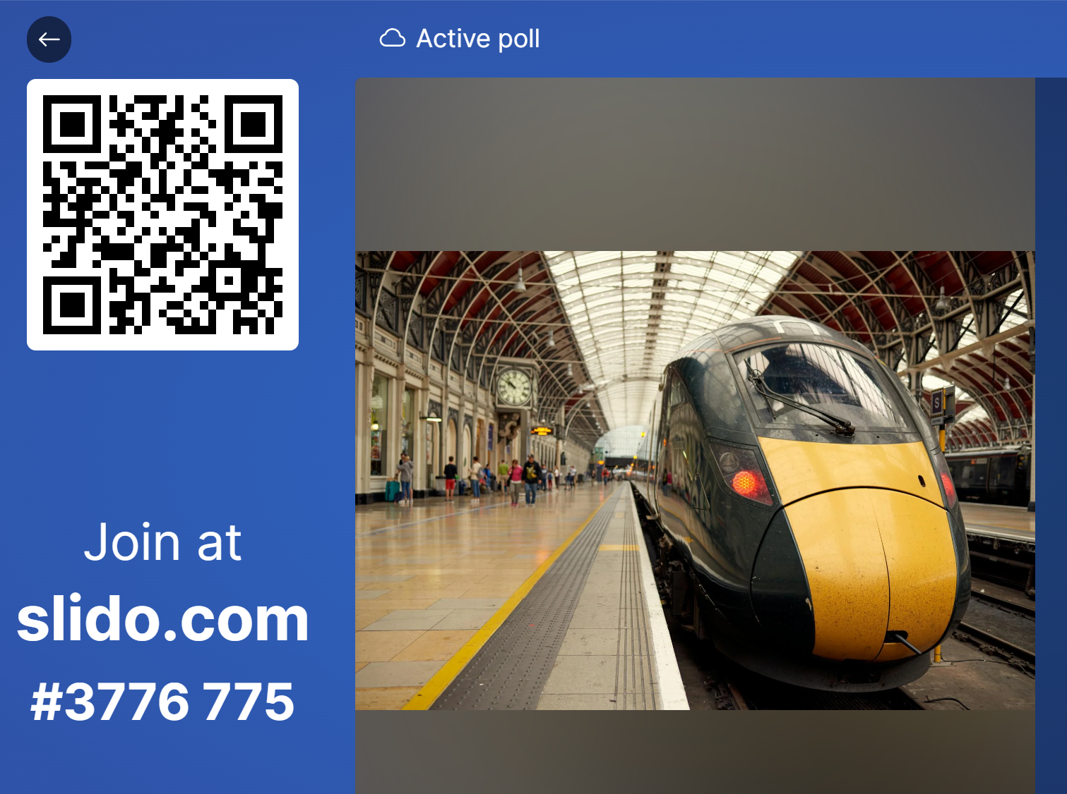

5*5 HOF taxonomy: which factors do you think were involved?
https://app.sli.do/event/5aFQ6XYPXsjUnasAXMKKWV
Notes:
The list of HOF questions is based on the fig.2 below which is designed to provide a taxonomy by which a common understanding of HOF terms and concepts can be achieved during any proactive or retroactive SMS activities.
Five categories of sources of performance variability attributed to HOF are identified. Four of these categories are organised in a 2x2 logic: static and dynamic features of the individuals (and teams), or, of the situation. The last and fifth category focuses on the socio-psychological interactions, resulting in the following five groups: dynamic staff, dynamic situational, static staff, static situational and socio-interactional. The aim is to provide non-HOF experts with a quick but well-defined taxonomy and solid overview of the most critical HOF, even if this tool should not be used without a dedicated training, which can also help to identify the interfaces existing among these factors. Moreover, some questions may also need further HOF expertise.

Slide 10

THANK YOU
Moving Europe towards a sustainable and safe railway system without frontiers.
Follow us:

Slide 11
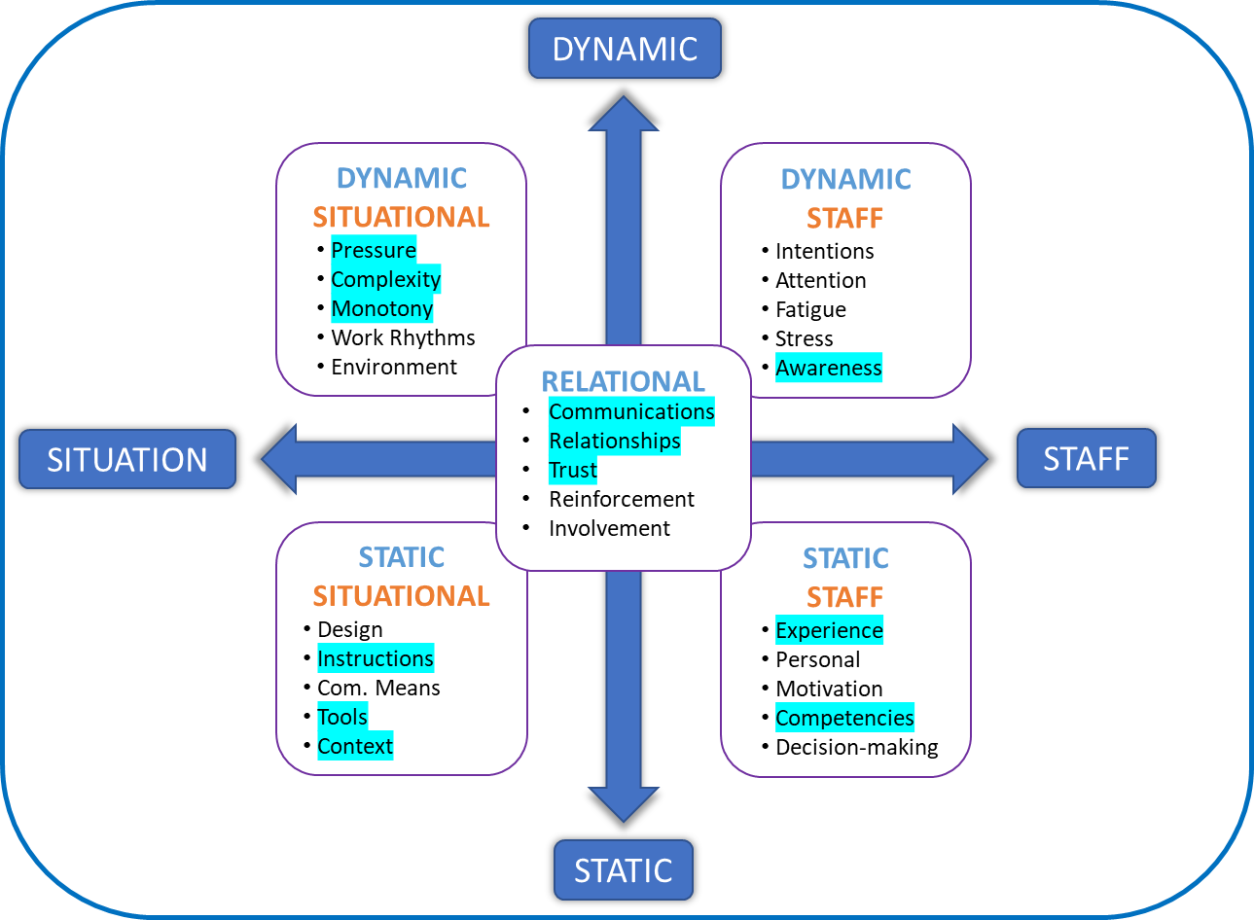
Investigation Report
Over speed of an HS train – 2019 – what happened

Slide 12
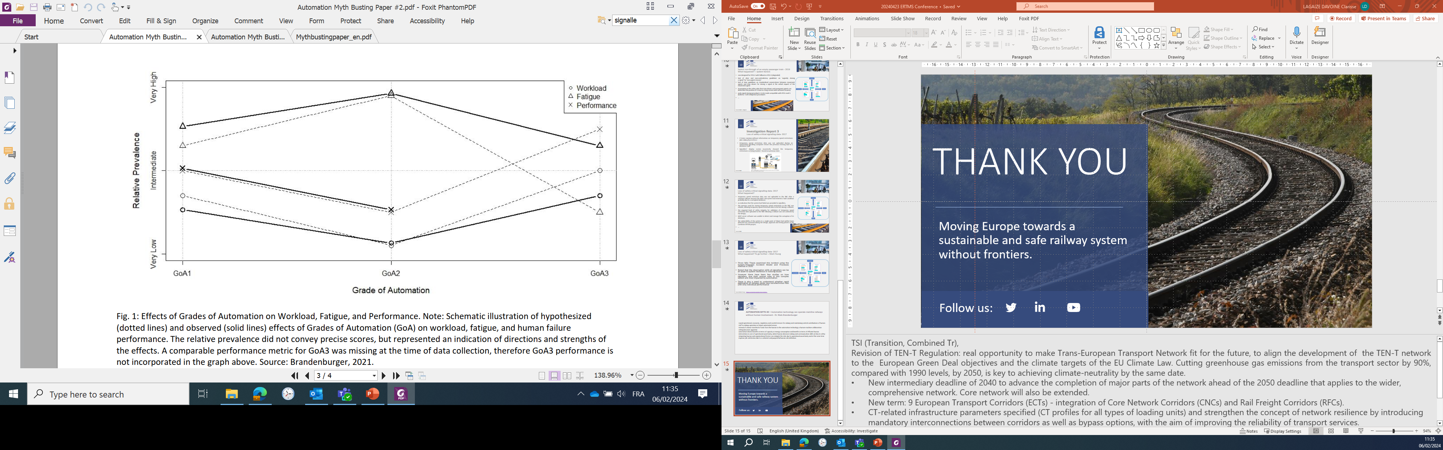
AUTOMATION MYTH #2
Automation operate mainline railways without human
HOF in Automation | European Union Agency for Railways (europa.eu)
Instead of a linear transferal of tasks from the human to the automation technology, a human-machine collaboration setting becomes apparent
Automation-driven benefits in terms of capacity or energy consumption and benefits in terms of efficient human intervention in case of operational uncertainty, where human decision-making and communication skills are key to safety
Integrating human & organisational factors can mitigate the risks due to operational uncertainty and at the same time improve job satisfaction due to a coherent and purposeful human role definition
Notes:
Dr. Niels Brandenburger is Human Factors Expert at the German Aerospace Center (DLR e.V.) at the Institute for Transportation Systems. He
works on empirically investigating, operationally defining and practically implementing the human contribution to automated railway operation on the
mainline.

