Slide 1
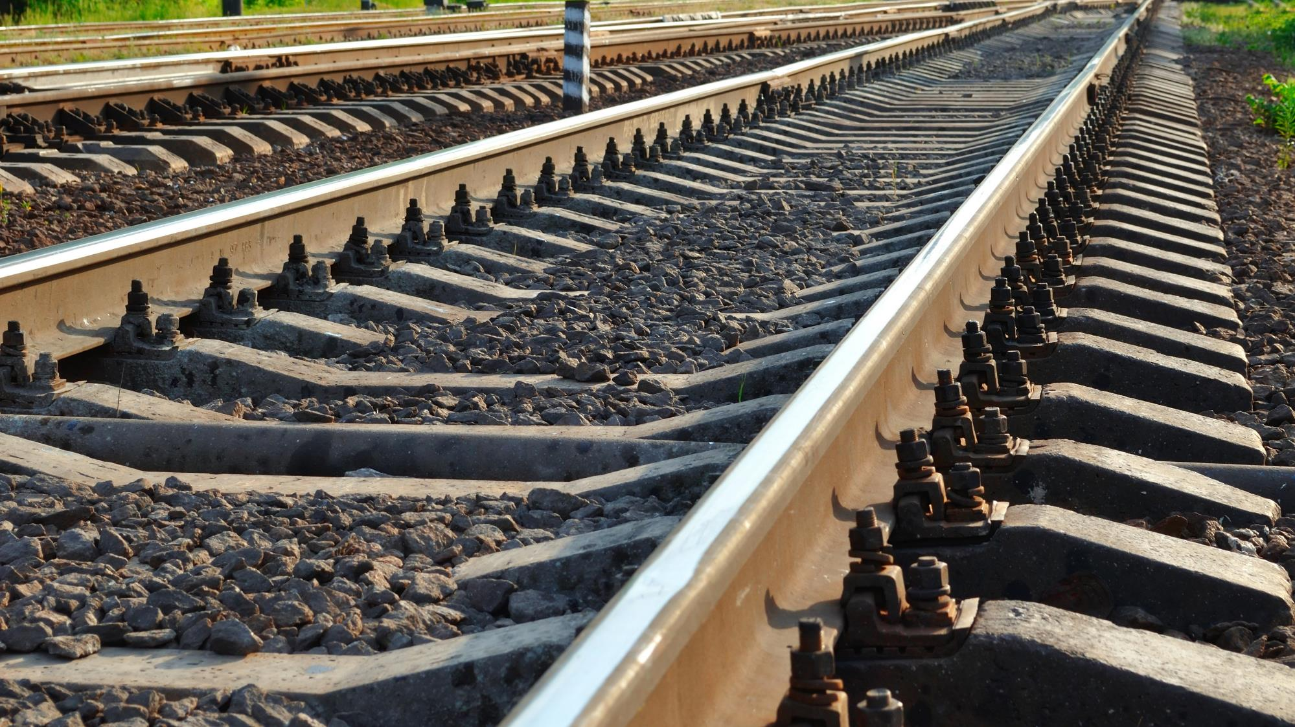

CSM ASLP
Registration of ISS Pilot users
Implementation guidance| ERA
Photo: Adobe Srock / by Tarasylo

Slide 2
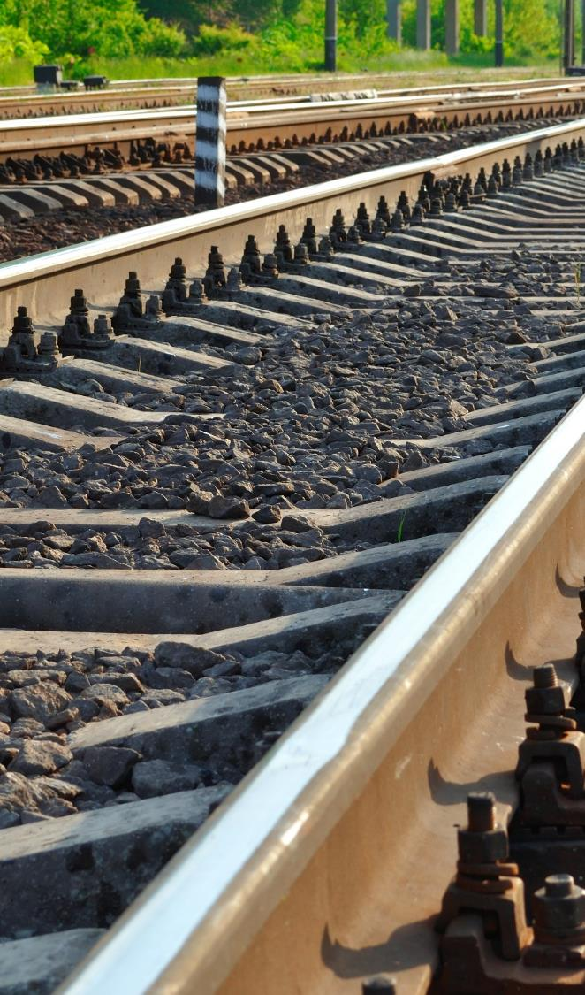
Registration Guidance
CSM ASLP requirement for registration
  Why is it used for?
  Why it is important?
How to prepare for good quality registration?
  Entity Contact (Power Users)
  Entity Contributors (Other Entity’s Users)
  Supporting justification
How to fill-out your Registration?
  First registration
How to update your Registration?
  Registration update
How to contact ERA, in case of need?
Photo: Adobe Srock / by tarasylo

Slide 3

CSM ASLP requirement for registration
Why is it used for?
1) ERA needs to know who is officially implementing the CSM ASLP requirements for each category of Entity
2) It enables the controlled sharing of information between registered entities and users working on behalf each Entity
(also called sharing rules)

Slide 4
CSM ASLP requirement for registration
Why is it important?
3) A strict management of the list of users working on behalf each Entity is required to allow the correct implementation of the sharing rules by the ISS
4) Only registered users working on behalf an Entity is allowed to contribute to the sharing of data of that Entity with the ISS
5) An individual person can also be categorised as a ‘Natural person’ sharing information on his/her own responsibility

Slide 5
Registration Guidance
CSM ASLP requirement for registration
  Why is it used for?
  Why it is important?
How to prepare for good quality registration?
  Entity Contact (Power Users)
  Entity Contributors (Other Entity’s Users)
  Supporting justification
How to fill-out your Registration?
  First registration
How to update your Registration?
  Registration update
How to contact ERA, in case of need?
Photo: Adobe Srock / by tarasylo

Slide 6

How to prepare for good quality registration?

Slide 7
How to prepare for good quality registration?
Entity Category and Power User
1) One registration template shall be prepared for each category of Entity the Entity wants to apply
2) For each category applied, Power User(s) shall be nominated by the Entity
3) The ‘Power User’ will have higher privileges, including the responsibility to declare other ISS users working on behalf that Entity

Slide 8
How to prepare for good quality registration?
Entity users (contributors)
4) For each Entity established in the ISS Pilot, the Power User(s) of this Entity shall manage the group of users working for this Entity.
5) The Entity Power User(s) is/are responsible to add/delete/set the role exercised by each Entity’s user(s) in the group.
Note1: To ensure user management continuity, it is recommended that each entity nominates
– at least – 2 power users.

Slide 9
How to prepare for good quality registration?
Supporting documents
6) Valid supporting document(s) shall be attached with the registration record to justify the applicable entity category
(e.g. certificate / authorization …)
7) ERA will check the Entity supporting documents to confirm the Category to which each Entity is entitled to be allocated

Slide 10
Registration Guidance
CSM ASLP requirement for registration
  Why is it used for?
  Why it is important?
How to prepare for good quality registration?
  Entity Contact (Power Users)
  Entity Contributors (Other Entity’s Users)
  Supporting justification
How to fill-out your Registration?
  First registration
How to update your Registration?
  Registration update
How to contact ERA, in case of need?
Photo: Adobe Srock / by tarasylo

Slide 11
How to send your registration to ERA?
First registration in accordance with CSM ASLP
Go to Information Sharing System (ISS) Pre-Registration | European Union Agency for Railways (europa.eu) and download the registration template
Fill-in each purple-marked data and save your registration file
(If relevant, fill-in optional fields)
3) Send your file to iss.pwu@era.europa.eu
OR
3) Use the ‘contact us’ / ‘CSM ASLP and Information Sharing System’ page of the Agency website to send your file

Slide 12
Registration Guidance
CSM ASLP requirement for registration
  Why is it used for?
  Why it is important?
How to prepare for good quality registration?
  Entity Contact (Power Users)
  Entity Contributors (Other Entity’s Users)
  Supporting justification
How to fill-out your Registration?
  First registration
How to update your Registration?
  Registration update
How to contact ERA, in case of need?
Photo: Adobe Srock / by tarasylo

Slide 13
How to fill-out the Registration template?
Manage Entity users directly with ISS Pilot
1) a Power User shall log in the ISS Pilot
2) Go to ‘Administration / Groups Management’
3) Update the list of users working on behalf your entity (add, delete or amend user roles), as needed
4) Save the changes or Cancel.
Important note:
The management of the users working on behalf an entity is the sole responsibility of this entity.
The entity power user(s) are the sole responsible for adding/deleting/amending entity’s user(s).

Slide 14
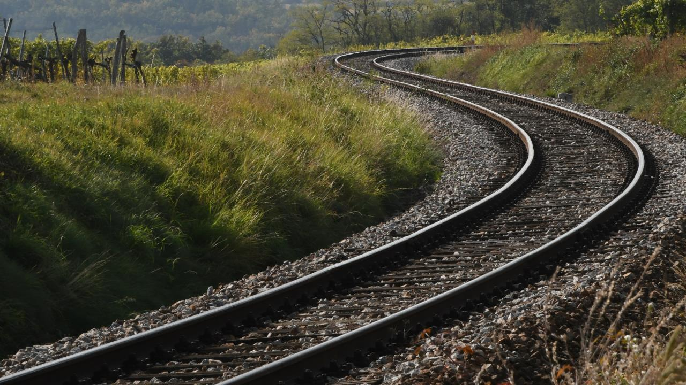
THANK YOU
Moving Europe towards a sustainable and safe railway system without frontiers.
Follow us:
Notes:
TSI (Transition, Combined Tr),
Revision of TEN-T Regulation: real opportunity to make Trans-European Transport Network fit for the future, to align the development of the TEN-T network to the European Green Deal objectives and the climate targets of the EU Climate Law. Cutting greenhouse gas emissions from the transport sector by 90%, compared with 1990 levels, by 2050, is key to achieving climate-neutrality by the same date.
New intermediary deadline of 2040 to advance the completion of major parts of the network ahead of the 2050 deadline that applies to the wider, comprehensive network. Core network will also be extended.
New term: 9 European Transport Corridors (ECTs) - integration of Core Network Corridors (CNCs) and Rail Freight Corridors (RFCs).
CT-related infrastructure parameters specified (CT profiles for all types of loading units) and strengthen the concept of network resilience by introducing mandatory interconnections between corridors as well as bypass options, with the aim of improving the reliability of transport services.
More transhipment terminals
High-speed rail network between the main nodes of Europe. The major TEN-T passenger rail lines should allow trains to travel at 160 km/h or faster by 2040.

