Slide 1
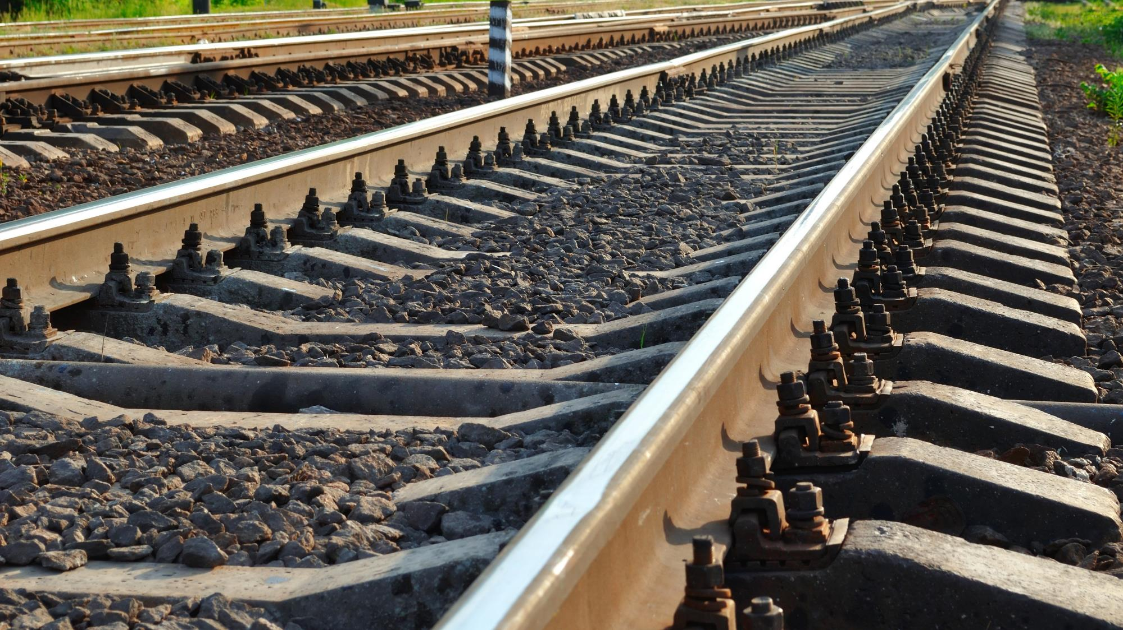

CSM ASLP
Registration of ISS users
Implementation guidance| ERA
Photo: Adobe Srock / by Tarasylo

Slide 2

Registration Guidance
CSM ASLP requirement for registration
  Why is it used for?
  Why it is important?
How to prepare for good quality registration?
  Entity Contact (Power Users)
  Entity Contributors (Any Users)
  Supporting justification
How to fill-out the Registration template?
  First registration
  Registration update
How to send your Registration?
  First registration
  Registration update
How to contact ERA, in case of need?
Photo: Adobe Srock / by tarasylo

Slide 3

CSM ASLP requirement for registration
Why is it used for?
1) ERA needs to know who is officially implementing the CSM ASLP requirements for each category of Entity
2) It enables the controlled sharing of information between registered entities and users working on behalf each Entity
(also called sharing rules)

Slide 4
CSM ASLP requirement for registration
Why is it important?
3) A strict management of the list of users working on behalf each Entity is required to allow the correct implementation of the sharing rules by the ISS
4) Only registered users working on behalf an Entity is allowed to contribute to the sharing of data of that Entity with the ISS
5) An individual person can also be categorised as a ‘Physical Entity’ sharing information on his/her own responsibility

Slide 5
Registration Guidance
CSM ASLP requirement for registration
  Why is it used for?
  Why it is important?
How to prepare for good quality registration?
  Entity Category and Contact (Power Users)
  Entity Contributors (Any Users)
  Supporting justification
How to fill-out the Registration template?
  First registration
  Registration update
How to send your Registration?
  First registration
  Registration update
How to contact ERA, in case of need?
Photo: Adobe Srock / by tarasylo

Slide 6

How to prepare for good quality registration?

Slide 7
How to prepare for good quality registration?
Entity Category and Contact person
1) One registration template shall be prepared for each category of Entity the Entity wants to apply
2) For each category applied, corresponding Contact person(s) shall be defined by the Entity
3) The Contact person(s) will have ‘Power User’ privileges (read and write entitlements)

Slide 8
How to prepare for good quality registration?
Entity users (contributors)
4) For each entity category applied, corresponding list of users working for this entity shall be defined. Those users are viewers only, with lower privileges than the Contact person(s).
5) The list of user(s) for the entity may also contain users reporting on behalf this entity even when this user is staff member of another entity
6) If the later case apply, this other entity shall also proceed with its own registration process beforehand

Slide 9
How to prepare for good quality registration?
Supporting documents
7) Valid supporting document(s) shall be attached with the registration record to justify the applicable entity category
(e.g. certificate / authorization …)
8) ERA will check the Entity supporting documents to confirm the Category(ies) to which each Entity is entitled to be allocated

Slide 10
Registration Guidance
CSM ASLP requirement for registration
  Why is it used for?
  Why it is important?
How to prepare for good quality registration?
  Entity Category and Contact (Power Users)
  Entity Contributors (Any Users)
  Supporting justification
How to fill-out the Registration template?
  First registration
  Registration update
How to send your Registration?
  First registration
  Registration update
How to contact ERA, in case of need?
Photo: Adobe Srock / by tarasylo

Slide 11
How to fill-out the Registration template?
First registration in accordance with CSM ASLP
1) Fill-in each mandatory field corresponding to the entity to be registered (one file per entity category)
2) Verify that the minimum completion checking has changed to green aspect
3) If not complete check the missing purple signaled row(s) and fill it/them in
4) Fill-in all conditionally applicable fields
5) If relevant, fill-in optional fields
6) Do not forget to declare the record status as ‘NEW’ and to provide the link / reference of the supporting documents

Slide 12
How to fill-out the Registration template?
Updating a registration in accordance with CSM ASLP
1) Open the last version of the pre-existing registration
2) Modify only the fields which need(s) to be modified
3) Save the file as an updated registration file with the record status field set to ‘Updated’
4) Upload the updated file in the concerned Entity partition
Important note: The sharing of information is depending on the correctness of the submitted data and applicable user list. Thus, any applicable change shall be reflected as early as possible in the update of the entity registration under the entity responsibility.

Slide 13
Registration Guidance
CSM ASLP requirement for registration
  Why is it used for?
  Why it is important?
How to prepare for good quality registration?
  Entity Category and Contact (Power Users)
  Entity Contributors (Any Users)
  Supporting justification
How to fill-out the Registration template?
  First registration
  Registration update
How to send your Registration?
  First registration
  Registration update
How to contact ERA, in case of need?
Photo: Adobe Srock / by tarasylo

Slide 14
How to send your registration to ERA?
First registration in accordance with CSM ASLP
1) Go to Information Sharing System (ISS) Pre-Registration | European Union Agency for Railways (europa.eu) and download the registration template
2) Use the ‘contact us’ link of this page
3) Check that the selected topic is
‘CSM ASLP and Information Sharing System'
4) Attach your filled-out registration
5) Press ‘send’ button
Note: Based on the above element ERA will create your entity partition, only accessible to your declared list of users

Slide 15
How to send your registration to ERA?
Updating a registration in accordance with CSM ASLP
Upload your updated registration form directly in your entity library, within the ISS Temporary Solution workspace
Update/add any applicable record, in your library, when you need

Slide 16

THANK YOU
Moving Europe towards a sustainable and safe railway system without frontiers.
Follow us:
Notes:
TSI (Transition, Combined Tr),
Revision of TEN-T Regulation: real opportunity to make Trans-European Transport Network fit for the future, to align the development of the TEN-T network to the European Green Deal objectives and the climate targets of the EU Climate Law. Cutting greenhouse gas emissions from the transport sector by 90%, compared with 1990 levels, by 2050, is key to achieving climate-neutrality by the same date.
New intermediary deadline of 2040 to advance the completion of major parts of the network ahead of the 2050 deadline that applies to the wider, comprehensive network. Core network will also be extended.
New term: 9 European Transport Corridors (ECTs) - integration of Core Network Corridors (CNCs) and Rail Freight Corridors (RFCs).
CT-related infrastructure parameters specified (CT profiles for all types of loading units) and strengthen the concept of network resilience by introducing mandatory interconnections between corridors as well as bypass options, with the aim of improving the reliability of transport services.
More transhipment terminals
High-speed rail network between the main nodes of Europe. The major TEN-T passenger rail lines should allow trains to travel at 160 km/h or faster by 2040.

