Slide 1
CCS TSI
Regulation (EU) 2023/1695
Questions received at TSI-QA-2023@era.europa.eu

Slide 2
CCS TSI Scope
Why does the CCS TSI not specify any interoperability requirement for the interlockings, level crossings and certain other elements of the CCS?
Is it possible to certified as Interoperability Constituent (IC) an OBU which is capable to work only in Level 0 and Level 1 ?
Must Ethernet bus be mandatory for new vehicles? Is it possible by using the gateway/converter e.g. MVB to Ethernet to fulfill the requirement?
Notes:
Juan

Slide 3
CCS TSI Scope
Scope :
TSIs define the optimum level of harmonisation to achieve the objectives defined in the Interoperability Directives (EU) 2016/797.
CCS subsystems are defined in Annex II of Interoperability Directive
CCS TSI defines the interoperability requirements for subsystems: ETCS, RMR (GSM-R/FRMCS), ATO, track-side Train Detection.

Slide 4
CCS TSI Scope
ETCS On-board Unit:
Trackside Levels:
CCS TSI point 2.3 define the options for trackside levels.
In point 7.2.9 options and mandatory functions are described.
A vehicle may not be equipped Data Transmission Part, but the ETCS OBU shall be functionally complete.
Ethernet:
ATO/FRMCS interface is based on an Ethernet-interface, so ETCS IC will require an Ethernet based connection. Existing ETCS ICs might implement the Ethernet-interface to ATO/FRMCS based on adapters from CAN/MVB to Ethernet. Newly built ICs, even if ATO or FRMCS functionality is not yet included (ETCS version up to 2.1), should always implement the Ethernet based connection(s) as defined in SS-147.

Slide 5
ETCS Installation requirements
Existing vehicles: Installing a new type of class B device in a vehicle, for example, the addition of a German PZB system in a vehicle previously equipped with Polish class B systems?
For extension of area of use without any modification of the vehicle, only previous TSI can be still applied according to table B1.1?
Notes:
Juan

Slide 6
ETCS Installation requirements
Existing vehicles:
Point 7.4.2.2: If the CCS on-board subsystem is modified to add an additional Class B system, the vehicle shall be also equipped and ready for operation with ETCS. Replacement/renewal of existing Class B system does not require installation of ETCS.
Extension of area of use:
Point 7.4.2.3:

Slide 7
Special vehicles
When special vehicles should be equipped with ETCS?
Cold Movement Detector (CMD). Is this requirement applicable also to Special Vehicles to be equipped with ETCS, as the space available on wheels may make it difficult to implement this feature? Can derogation request be submitted for Special Vehicles?
Notes:
Juan

Slide 8
Special vehicles
Scope:
Special vehicles are in the scope of CCS TSI as defined point 1.1:
National requirements:
Point 7.4.3.2: Member states may decide to exclude them, under the defined conditions.
Transition regime:
Specific requirements in Table B1.1 row 2, where extended time is provided.
Non application of TSI remains always possible since it is in the Interoperability Directive

Slide 9
Interfaces between ETCS onboard and Rolling Stock
Notes:
Nordine

Slide 10
Questions received at TSI-QA-2023@era.europa.eu
What was the situation of in previous TSIs?
What was changed in TSI LOC&PAS 2023?
What was changed in TSI CCS 2023?

Slide 11
What was the situation of in previous TSIs?
All interfaces where not identified and specified end to end. Only few parameters in TSI LOC&PAS were referring to Train interface unit (subset 34) (eg doors, Emergency braking command, Running through separation sections) other where missing or incomplete.
Scope of work between CCS and RST Notified Bodies was not always clear.
Clarification needed on some train interface functions :
Requirement applicable to rolling stock
Application to Newly developed design vs existing vehicle type and rolling stock in operation
Conditions under which a function is to be implemented or not (depending on the designer choice, vehicle characteristics)
There was no predisposition requirements to new RST type when ETCS is not installed.

Slide 12
What was changed in TSI LOC&PAS 2023?
Chapter 4 :
Applicable requirements to RST when ETCS onboard is installed are defined in specific parameters of chapter 4 of TSI LOC&PAS that refer to appendix J2, index B.
They cover train interface functions such as brake command (service, emergency), special brakes (status, inhibition), station platform, traction (cut off, running through separation, pantograph), ETCS mode etc.
Appendix J2, index B refers to subset 34
Provide the detailed requirements and conditions the RST should comply with.
Point 6.2.10 :
Provide provisions regarding EC verification when ETCS is installed in RST/RST type. It covers newly developed vehicle designs and all other vehicle types and RST in operation.
Compliance of the RST with train interface functions requirements can be assessed only when ETCS is installed.
Assessment of the train interface functions part of the EC verification for the CCS on-board in accordance with point 6.3.3 of TSI CCS : CCS NOBO.
Other TSIs requirements applicable to RST are assessed by RST NOBO.

Slide 13
What was changed in TSI LOC&PAS 2023?
Chapter 7.1.5 Pre fitment requirements for new RST design where ETCS is not yet installed
Applies to newly developed vehicle design, including special vehicle referred in 7.4.3.2 of TSI CCS, where ETCS on-board is not yet installed, with the aim to have RST ready when this system will be installed:
Compliance with requirements related to Train interface functions.
Description of train interface functions implemented including interfaces and protocols of communication shall be documented in technical documentation.
Space shall be available for installation of ETCS on-board equipments defined in TSI CCS (e.g ETCS DMI, antennas, etc.). The conditions for installation of equipments must be documented in the technical documentation.
NoBo RST shall verify that the documentation requested is provided.
When ETCS on-board is installed, the assessment of the integration of the interface functions in the vehicle is part of the EC verification for the CCS on-board by CCS NoBO according to point 6.3.3 of TSI CCS.

Slide 14
What was changed in TSI CCS 2023?
Point 4.2.2 - ETCS onboard functionality : Requirements regarding forwarding information/orders and receiving state information from RST are defined in
Subset 34 (train interface FIS) applicable to all vehicles when ETCS is installed
For newly developed design following subsets are mandatory :
Subset 119 (train interface FFFIS) : physical implementation of the interface
Subset 120 (Train interface – safety requirement) : safety analysis of the interface
Chapter 3 of Subset 34 : Provide a table that contains conditions for the application of the Train Interface functions by the RST subsystem covering:
‘newly developed vehicle designs’ / ‘all other vehicle types and RST in operation’
Indicates which function is Optional:
To be understood as a designer’s choice which has to be decided by the vehicle designer and/or the train operator depending on the characteristics of the respective vehicle, project requirements or if the corresponding function is implemented (e.g. Eddy current brake).
A condition for use shall clearly state that a vehicle has not implemented the corresponding train interface functions.
Indicates which function is Mandatory : means that the function has to be implemented in the RST.

Slide 15
Appendix B On-board
Definition of phases applicable for a project: It is for the complete series or for each vehicle?
Which are the applicable dates for design phases and production phases?
Validity of the certificates? Can the NoBo issue a certificate in accordance with Regulation (EU) 2016/919 and does not have to explicitly mention Regulation (EU) 2023/1695?
Notes:
Juan

Slide 16
Appendix B On-board
CCS TSI text defines the new requirements.
Appendix B defines the transition regimes and dates to temporarily use requirements from previous TSI.
Phases and dates :
This topic will be further clarified in the CCS TSI Application Guide under preparation.
Definition of phases in point 7.2.4.1:
Design phase: From contract to the NoBo to the issuing of the EC Certificate
Production phase: Allows to place on the market each vehicle
Dates in Appendix B – Tables B1.1 (subsystems) and B3 (specific IC):
Production phase: The latest date to place vehicles on the market according to the design.

Slide 17
Appendix B On-board
Validity of certificates:
From the Entry into force of the new CCS TSI, new certificates shall be issued according to CCS TSI (EU) 2023/1695.
Existing certificates are still valid under conditions for Subsystems (point 7.2.4.1.3) and ICs (point 7.2.4.3).
Appendix B allows in defined cases to use requirements from previous TSI.
CCS TSI allows (Table 6.2.1 – row 1c) to use ICs certified against a different version of the TSI if ensures compliance of the subsystem with the TSI in force. (E.g. SIM Card)

Slide 18
Appendix B Trackside
Definitions of §7.2.4.1.1 are also applicable to CCS Trackside Subsystem?
A CCS trackside project in an advanced stage of development shall demonstrate the compliance with all the requirements from CCS TSI 2023 or only with the requirements from transition regime?
Notes:
Juan

Slide 19
Appendix B Trackside
Phases and transition regime:
This topic will be further clarified in the CCS TSI Application Guide under preparation.
The definition of phases in point 7.2.4.1 is not applicable for trackside.
Trackside transition regimes are defined in Appendix B – Table B2.
Projects in advance stage can be finished according the previous set of specifications, but in the defined deadlines, the error correction process shall be performed.

Slide 20
Radio
Is specification GSM-R B1 MR1 backward compatible with the previous specification GSM-R B1 ?
Which transition regime from TSI CCS table B2 is specifically applicable for GSM-R ?
Should RMR (GSM-R or FRMCS) have a System Identifier?
Notes:
Juan

Slide 21
Radio
Compatibility:
GSM-R B1MR1 is compatible in general. There are some errors corrected in it, and the BCA will be issued shortly, with the mitigations to be applied in the trackside to overcome the potential issues.
Transition regime:
The transition regime applies also to GSM-R. Regarding the use of previous specification GSM-R B1, please refer to the sections on “Former sets of specifications #2 and #3” in Appendix B.
System identifier:
Yes, GSM-R also shall have a system identifier. As defined in the section 4.2.20.3, the Functional identifier shall indicate the functions implemented (e.g. Baseline 0, Baseline 1,…), while the Realisation identifier refers to a specific configuration (e.g. configuration of Group IDs – such as 555 or 200-,level of patching,…). This identifier shall be provided by the supplier.

Slide 22
ATO
Is it possible to have an On-board in complaint with new TSI but without ATO functions (until when)?
ATO Trackside functionality requires a new authorization for the track?
Is it allowed for the Infrastructure Manager want to use the public 4G or 5G to communique to the onboard?
In ATO GoA1/2 the Class B trackside is 4G and 5G?
Notes:
Juan

Slide 23
ATO
ATO on-board:
ATO is an optional part of ERTMS. ATO GoA1/2 trackside implementation can lead to new mandatory on-board requirements triggered by the IM notification within the RINF or Network statement.
ATO trackside:
The deployment of ATO trackside requires authorisation.
The use of public 4G or 5G for the ATO functionality (to communicate the ATO OB and the ATO TS) is possible.
There is no concept of “Class B trackside” for the communication system for ATO. ATO application may use any transmission mean to achieve the data communication.
The CCS TSI 2023 only includes GSM-R PS. The ATO TS includes the OBapp interface to be ready to use FRMCS when available.

Slide 24
TSI OPE App. A
End of Authority: different definitions between CCS TSI and OPE TSI?
DMI indications vs lineside marker boards (MBs): which takes precedence?
Authorisation to start in SR through European Instruction 7 (OPE TSI App. A rule 6.2.4)
OPE TSI App. A rule 6.44 – App. B2 rule 7 and use of European Instruction 8
Notes:
George

Slide 25
End Of Authority (1/2)
EOA was originally defined for ETCS (CCS TSI Annex A Subset 023):
In OPE TSI 2023, it was agreed to extend the applicability of EOA as a generic term also in non-ERTMS applications (App. J):
The OPE TSI definition of EOA covers the CCS TSI definition (Ss 023) - it does not contradict it (“target speed” is an ETCS-specific term; in the OPE definition the driver is still expected to stop at the EOA).
Notes:
The ETCS definition of EOA can be viewed as a sub-case of the generic definition.
The addition of “up” is meant to compensate the abolishment of “where the target speed is zero“ and it also helps clarify that if multiple EOAs are applicable for the same train movement at the same time (e.g. when following an EOA indicated on the DMI while also watching for the Stop Marker installed lineside for the same EOA), the earliest of them in the direction of travel shall be the one to be respected (being the one that satisfies the “up to” condition of both EOAs at the same time).

Slide 26
End Of Authority (2/2)
“EOA” will designate the end location of any kind of movement authorisation in any operational situation (not only in ERTMS), regardless of the means used to identify or indicate it (DMI, Light Signal, Stop/ Location Marker, buffer stop etc.).
There are several benefits by adopting a common definition of EOA:
Simplified operational rules (no need to list all possible EOAs)
Simplified European Instructions
Applicable to both: trains/shunting compositions
Last but not least: it paves the way for ERTMS operation
Notes:
Example of simplification to App. B2: rule 16 “END OF AUTHORITY PASSED WITHOUT PERMISSION”

Slide 27
DMI indications vs lineside marker boards (MBs)
OPE TSI App. A rules accommodate both DMI indications and lineside MBs.
The high-level principle is defined in 5.1.1:
Primary source of information for the driver in cab signalling context shall be the DMI.
However, lack of harmonization in ETCS trackside engineering may require the driver to look out for lineside MBs. Examples:
Stop/Location marker identifying the exact position of the EOA, if the EOA indicated on the DMI has not been reached yet; the driver shall respect the earliest of the two.
Track Conditions not implemented on the trackside; driver shall observe the MBs.
LX function not implemented on the trackside; driver shall obtain information otherwise.

Slide 28
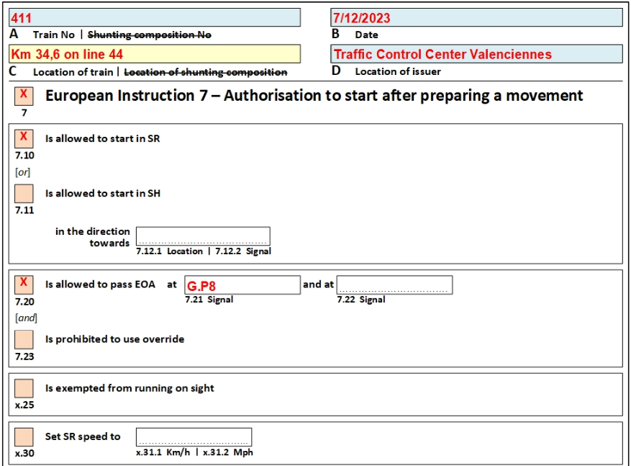
Authorisation to start in SR through European Instruction 7 (OPE TSI App. A rule 6.2.4)
Applies where no lineside signals exist to authorize train movement.
Two cases:
A. The train is located at an ETCS Stop Marker
Notes:
Box 7.20 shall always be filled

Slide 29
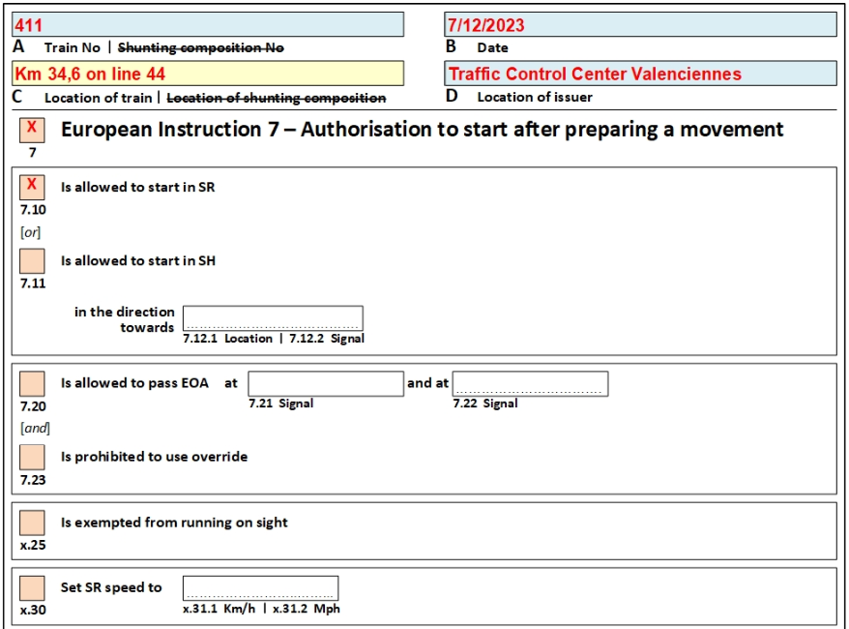
Authorisation to start in SR through European Instruction 7 (OPE TSI App. A rule 6.2.4)
B. The train is not located at an ETCS Stop Marker
Notes:
Box 7.20 does not have to be filled-in (but it can be filled-in if the signaller wants to avoid issuing another EI (1) for passing the first and second EOA)

Slide 30
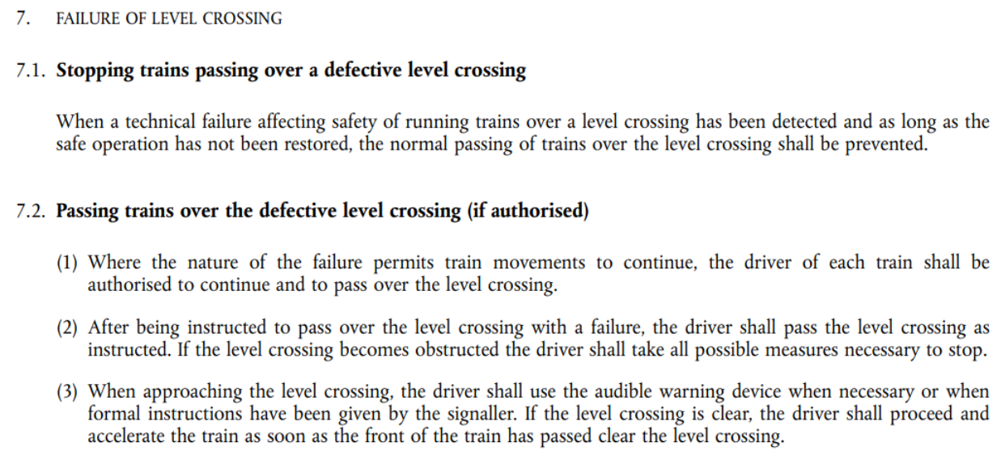
OPE TSI App. A rule 6.44 – App. B2 rule 7 and use of European Instruction 8
The driver can be informed about a non-protected LX either through the DMI (icon/text message) or by other means (lineside signal, EI 8).
If the LX function is implemented (Packet 88), ETCS will supervise train movement.
In all cases the driver shall apply OPE TSI App. B2 rule 7 (high-level requirements):

Slide 31
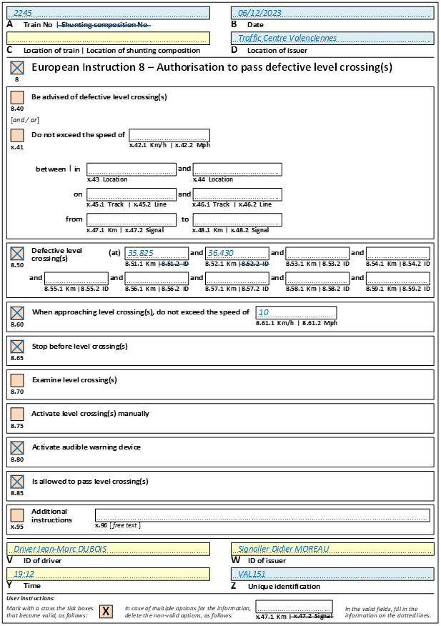
OPE TSI App. A rule 6.44 – App. B2 rule 7 and use of European Instruction 8
If the LX function is not implemented on trackside, then EI 8 is the only harmonized instrument to instruct the driver how to pass a defective LX
EI 8 offers many possibilities to define the exact driver actions, in line with App. B2 rule 7.

Slide 32
Other CCS questions
Error correction procedure.

