Slide 1


Fixed installations
TSIs INF,ENE and PRM
24.11.2023 | Webinar
Photo: Adobe Srock / by Tarasylo
Notes:
JOAO

Slide 2
Clarification note
Competence and emergency management
Q&A session| 24/11/23
Photo: Adobe Srock / by Tarasylo

Slide 3
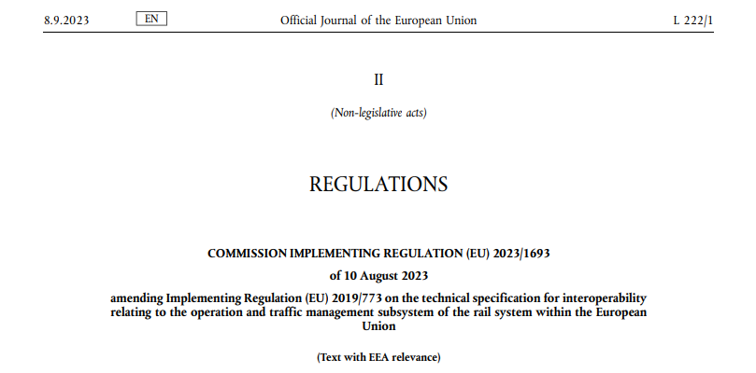
TSI OPE- 2023
TSI OPE amendments have been published on the 08/09/2023 with the Commission Implementing Regulation(EU) 2023/1693.

Slide 4
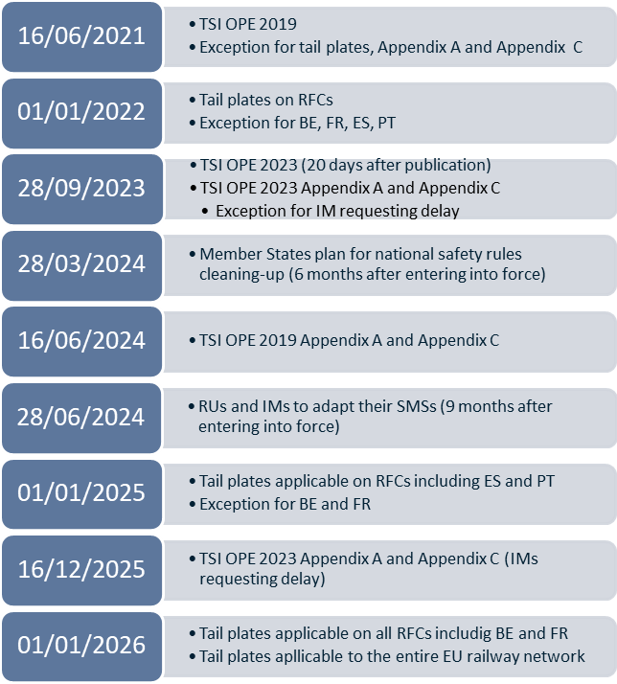
TSI OPE- 2023

Slide 5
ERA Clarification note on competence and emergency management

Slide 6

Regulation 2023/1693 introduced novelties regarding competencies and emergency management, which necessitate clarification in order to:
facilitate their definition and description in the Safety Management Systems (SMS) of the Railway Undertakings (RUs) and the Infrastructure Managers (IMs),
make the process of cleaning up national rules smooth and consistent.
The clarification was shared with the European Commission
https://www.era.europa.eu/system/files/2023-10/Clarification%20note_v1.pdf

Slide 7
Legal text (Point 4.2.1.1 as replaced with regulation 2023/1693)
RUs and IMs shall define and describe in their SMS procedures and requirements to train, assess and monitor the competence of their staff executing safety-critical tasks, except the requirements laid down in the following provisions:
(i) training, fitness and certification requirements for train drivers (addressed by Directive 2007/59/EC of the European Parliament and of the Council**));
(ii) elements relevant to professional qualification applicable to staff ‘accompanying trains’ other than the train driver, to which Appendix F of this Annex shall apply;
(iii) elements relevant to professional qualification applicable to staff ‘preparing trains’ other than the train driver, to which Appendix G of this Annex shall apply.
Legal text (Point 4.6.1 as replaced with regulation 2023/1693)
Railway undertakings and Infrastructure managers shall define their own risk-based competence management system within their Safety Management Systems processes, in accordance with Annexes I and Annex II to Commission Delegated Regulation (EU) 2018/762.
It is necessary to clarify that the exception set out in Point 4.2.1.1 is NOT from the SMS competence management system process. The exception points to the harmonized requirements as set out in the Train Driver Directive and in the TSI OPE Appendices F and G. These harmonized requirements shall apply and shall not be subject to description and definition by each RU and IM. Therefore, Member States are not allowed to set in national rules any additional requirements to those already set out in a harmonized manner by EU legislation. National rules on competences requirements shall not exist, except as permitted by the TSI OPE Appendix I. However, the process for applying the harmonized EU provisions of Appendix F and G and Train Driver Directive shall be implemented through the SMS (4.6.1 of OPE TSI).

Slide 8
Appendix I point 2 contains a list of open points. One of these points is point (f). It has to be clarified that the second element point (f) concerns merely a harmonized way of providing evidence, namely of documenting the professional competences of staff. This harmonized documentation is used in cases such staff moves to a new employer. Point (f) does neither introduce nor relate to a national certification regime, which is not permitted as a national rule. Only the format of the evidence/documentation can be considered as a national rule.
Legal text (Appendix I 2 (f) as replaced with regulation 2023/1693)
Professional competences (see point 4.2.1.1 and 4.6)
Evidence of professional competences

Slide 9
Legal text (Appendix I 2 (f) as replaced with regulation 2023/1693)
Professional competences (see point 4.2.1.1 and 4.6 as replaced with regulation 2023/1693)
Elements relevant to professional qualification for the tasks associated with despatching trains and authorising train movements.
This open point should relate exclusively to IM staff who are signallers and/or IM staff dispatching trains and authorising train movements.

Slide 10
The harmonised safety critical tasks referred to in the TSI OPE7 are those covered by the Train Driver Directive and the TSI OPE Appendices F and G as well as tasks carried out by IM staff dispatching trains and/or authorizing train movements. Other safety-critical tasks (and the staff executing them) which are not covered by TSI OPE and Train Driver Directive) shall be defined and described in the SMS of RU/IM (e.g. track workers, staff operating in a marshalling yard, etc.).
There are also staff which can have safety related functions; such staff are, for example, train and timetable planners, train driver managers, safety managers (e.g., Betriebsleiter - AT, RSGS – IT). Both safety critical tasks and safety related functions must be covered by the SMS. There cannot be any national rules on issues such as the identification of such staff, selection principles (except those for train drivers and staff covered by TSI OPE Appendices F and G which set out educational and medical fitness requirements), training methods and requirements or competence schemes. All these aspects shall be described in the RU and IM competence management system processes.
Legal text (Point 4.2.1.1 as replaced with regulation 2023/1693)
In its Safety Management Systems (SMS) established in accordance with Annexes I and II to Commission Delegated Regulation (EU) 2018/762, each RU and IM shall identify its safety-critical tasks and safety-related functions, and the staff responsible for executing them.

Slide 11
The SMS of the RU and IM shall set up and document the processes they put in place on the medical requirements be implemented. Train Driver Directive and TSI OPE point 4.7 set them for some staff. For all other staff (e.g. staff having safety-related functions) the RU and IM should determine what is needed on a risk-based approach (having in place procedures to control the risk, pursuant also to Point 4.7.1.1.). National rules are only permitted for alcohol, drugs, and psychotropic medication limits.
Legal text (4.7.1 as replaced with regulation 2023/1693)
…Railway undertakings and infrastructure managers shall set up and document the process they put in place to meet the medical, psychological and health requirements for their staff within their safety management system in accordance with EU Regulation 2016/762 defining common safety method on SMS.
Medical examinations as specified in point 4.7.2 and 4.7.3 on the individual fitness of staff shall be conducted by a person established as medical doctor or a psychologist qualified to carry out such examinations. The results must be accepted by every IM and RU as proof of fitness of staff or potential staff members.
Such examinations shall allow the member of staff executing safety-critical tasks to undertake similar tasks for another RU or IM, subject to the identification of additional medical, psychological and health requirements in the SMS of the RU or IM and to the satisfactory fitness of staff or potential staff members….
Legal text (Appendix I 2 (g) as replaced with regulation 2023/1693)
Health and safety conditions (see point 4.7)
Alcohol, drugs and psychotropic medication limits (see 4.7.1).

Slide 12
Appendix I sets out areas for national rules. It must be clarified that the area under point 1(i) is only limited to aspects of communication with and information transfer to the external entities mentioned; In parallel, the CSM on SMS requirements contains all RUs’ and IM’s obligations vis-à-vis planning, execution, monitoring and reviewing of their SMS processes and instructions. In addition, training of all relevant staff to deal with emergency management shall be also part of the SMS.
Legal text (Appendix I 1 (i) as replaced with regulation 2023/1693)
Managing an emergency situation and emergency responses (see point 4.2.3.7)
Role of local/national authorities and emergency services, and their contact details.
Methods and procedures in emergency situation not covered by the requirement of this Regulation, including notification of accidents and incidents: national instructions on modalities for notifications to authorities.

Slide 13

Questions received at
TSI-QA-2023@era.europa.eu
Many can be summarized as:
Will I need to move to the latest TSIs INF and ENE?
How is my project impacted?

Slide 14
New infrastructure and energy subsystems
No transition regime apply to INF and ENE TSIs – Application since 28 September 2023
TSI INF - 7.2 Application of this TSI to a new infrastructure subsystem:
  For a new infrastructure subsystem, the application of this TSI shall be compulsory.
  A ‘new infrastructure subsystem’ means an infrastructure subsystem placed into service after 28 September 2023 which creates a route or a part of a route where none currently exists.
  Any other infrastructure subsystems shall be considered as ‘existing infrastructure subsystems’
  TSI ENE - 7.2 Application of this TSI to a new energy subsystem:
  For a new energy subsystem, the application of this TSI shall be compulsory.
  A ‘new energy subsystem’ means an energy subsystem placed into service after 28 September 2023, which is created where no traction power supply and OCL previously existed.
  Any other energy subsystem shall be considered as an ‘existing energy subsystem’.

Slide 15
Existing infrastructure subsystem (1/2)
UPGRADING PROJECT - Application since 28 September 2023
TSI INF 7.2 (3) :
  The following cases are considered as upgrading and not as the placing into service of a new infrastructure subsystem:
  (a) the realignment of part of an existing route;
  (b) the creation of a bypass;
  (c) the addition of one or more tracks on an existing route, regardless of the distance between the original tracks and the additional tracks
  TSI INF 7.3.1 - Performance criteria of the subsystem
  In addition to the cases referred to in point 7.2.(3), ‘upgrading’ is a major modification work of an existing infrastructure subsystem resulting in at least compliance with one additional traffic code or a change in the declared combination of traffic codes (referred to Table 2 and Table 3 in point 4.2.1).
  TSI INF 7.3.2 (1) :
  For the upgraded infrastructure subsystem, the application of this TSI shall be compulsory, and applied to the upgraded subsystem within the geographical coverage of the upgrading. The geographical coverage of the upgrading shall be defined based on locations on tracks and metric references and shall result in the compliance of all basic parameters of the infrastructure subsystem associated with the tracks that are subject to the upgrading of the infrastructure subsystem.
  The addition of one or more rails supporting a further track gauge is also considered as upgrade when the performance criteria of the subsystem is triggered as described in point 7.3.1.

Slide 16
Existing infrastructure subsystems(2/2)
OTHER THAN AN UPGRADING - Application since 28 September 2023
TSI INF 7.3.2 (2) :
  In the event of a change other than an upgrading of the infrastructure subsystem, the application of this TSI for each basic parameters (referred to in point 4.2.2) affected by a change shall be compulsory when the change requires to carry out a new ‘EC’ verification procedure in accordance with Implementing Regulation (EU) 2019/250 (*). Provisions defined in Articles 6 and 7 of Implementing Regulation (EU) 2019/250 shall apply.
  TSI INF 7.3.2 (3) :
  In the event of a change other than an upgrading of the infrastructure subsystem and for those basic parameters that are not affected by the change, or when the change does not require a new ‘EC’ verification, the demonstration of the level of compliance with this TSI is voluntary.
  TSI INF 7.3.2 (4) :
  In case of upgrading or renewal of the infrastructure subsystem, the compliance with the requirements which are laid down for new lines is not required
  Cant, cant deficiency, platform height and offset
REQUIREMENTS FOR NEW LINES not REQUIRED
EXEPTIONS PERMITTED in 7.3.2 (7)

Slide 17
Existing energy subsystem (1/2)
UPGRADING PROJECT - Application since 28 September 2023
TSI ENE 7.2 (3) :
  The following cases are considered as upgrading and not as the placing into service of a new energy subsystem:
  (a) the realignment of part of an existing route;
  (b) the creation of a bypass;
  (c) the addition of one or more tracks on an existing route, regardless of the distance between the original tracks and the additional tracks
  TSI ENE 7.3.1 - Performance criteria of the subsystem
  In addition to the cases referred to in point 7.2.(3), ‘upgrading’ is a major modification work of an existing energy
  subsystem resulting in an increase of the line speed of more than 30km/h.
  TSI ENE 7.3.2 (1) :
  For the upgraded energy subsystem, the application of this TSI shall be compulsory, and applied to the upgraded subsystem within the geographical coverage of the upgrading. The geographical coverage of the upgrading shall be defined based on locations on tracks and metric references and shall result in the compliance of all basic parameters of the infrastructure subsystem associated with the tracks that are subject to the upgrading of the energy subsystem.
  The addition of one or more rails supporting a further track gauge is also considered as upgrade when the performance criteria of the subsystem is triggered as described in point 7.3.1.

Slide 18
Existing energy subsystem (2/2)
OTHER THAN AN UPGRADING
  TSI ENE 7.3.2 (2) :
  In the event of a change other than an upgrading of the energy subsystem, the application of this TSI for each basic parameters (referred to in point 4.2.2) affected by a change shall be compulsory when the change requires to carry out a new ‘EC’ verification procedure in accordance with Implementing Regulation (EU) 2019/250 (*). Provisions defined in Articles 6 and 7 of Implementing Regulation (EU) 2019/250 shall apply.
  TSI ENE 7.3.2 (3) :
  In the event of a change other than an upgrading of the energy subsystem and for those basic parameters that are not affected by the change, or when the change does not require a new ‘EC’ verification, the demonstration of the level of compliance with this TSI is voluntary.
  Maximum lateral deviation of the OCL
EXEPTION PERMITTED in 7.3.2 (6)

Slide 19
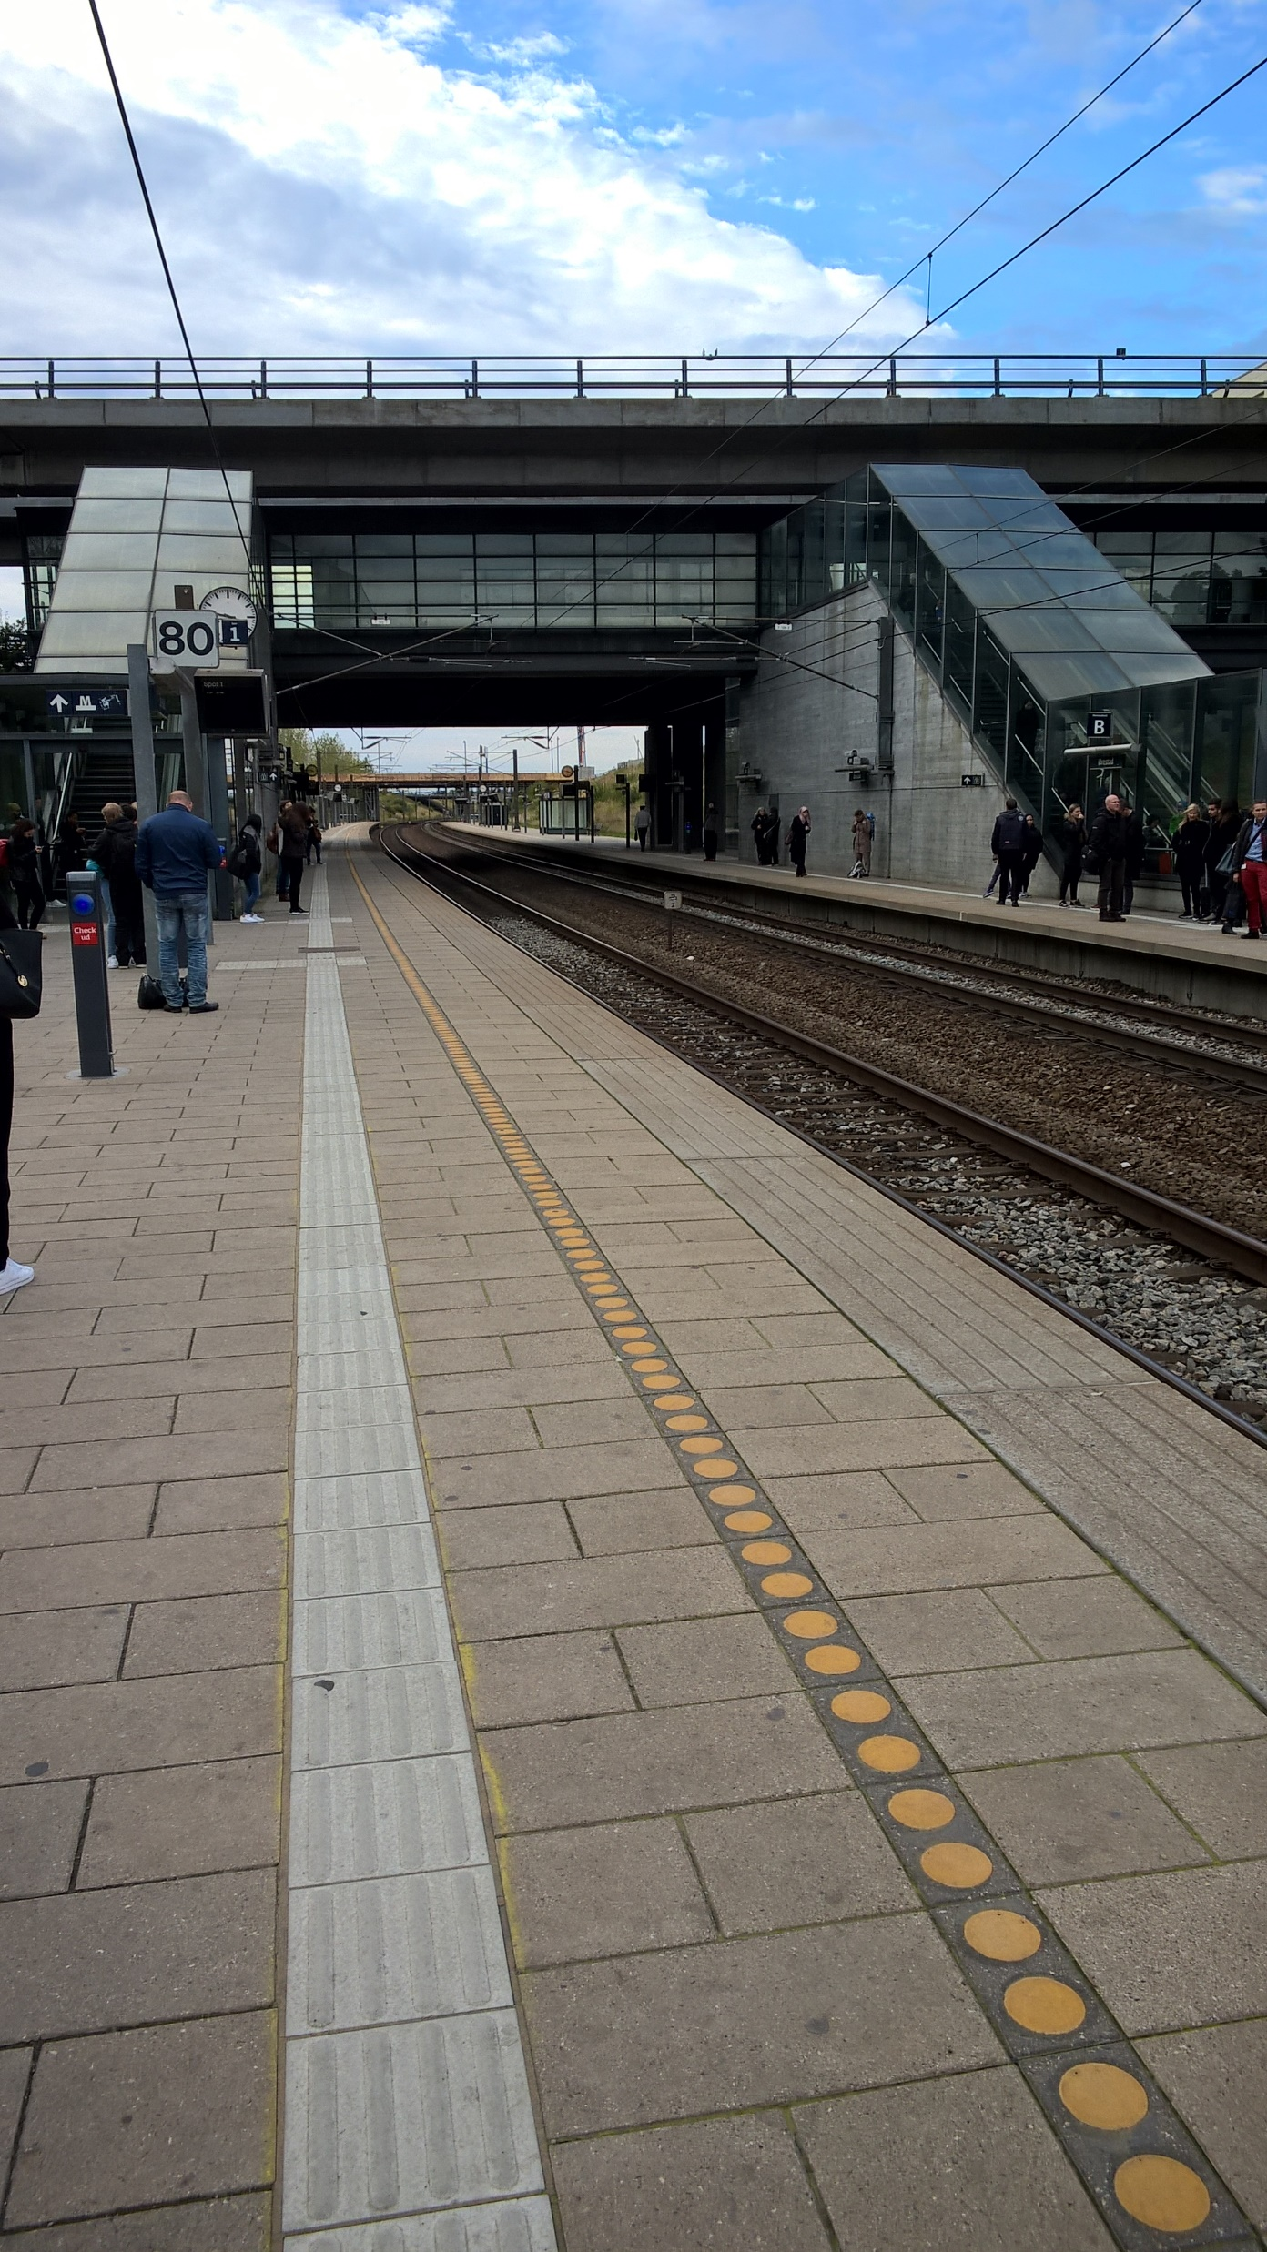
Questions received at
TSI-QA-2023@era.europa.eu
Is there a transition period in PRM TSI for fixed installations ?
What is the scope of an upgrade
Notes:
ANTOINE

Slide 20
PRM - Transition for fixed installations
New stations
No transition regime apply to PRM TSI for fixed installations – Application since 28 September 2023
7. IMPLEMENTATION OF THE TSI
7.1. Application of this TSI to new Infrastructure and Rolling Stock
7.1.1. New Infrastructure
This TSI is applicable to all new stations in its scope.
It is not mandatory to apply this TSI to new stations which have already been granted a building permit or which are subject to a contract for major construction works that is either already signed or in the final phase of a tendering procedure at the date of application of this TSI. However, an earlier version of this TSI must be applied within its defined scope. The consistence of applicable requirements of partial application of different versions of this TSI to particular sections of the station must be justified by the applicant certified by the notified body.

Slide 21
PRM – Upgrade / Renewal of existing stations
RENEWAL - UPGRADING PROJECT - Application since 28 September 2023
For infrastructure, the conformity with this TSI is mandatory for those parts that are renewed or upgraded. However, the TSI recognizes that, due to the characteristics of the inherited railway system, compliance of existing infrastructure may be achieved through a gradual improvement of accessibility.
In addition to this gradual approach, 3 exceptions:
obstacle free route created from existing footbridges, stairways and subways : requirement related to width is not mandatory
width of the platform is not mandatory for existing stations
historic building protected by national law,

Slide 22
Principle of application of the PRM TSI to existing stations
Improvement of accessibility :
A coordinated approach : National Implementation Plans Persons with reduced mobility - PRM TSI NIP (europa.eu)
  a strategy, including a prioritisation rule laying down the criteria and priorities for stations to be designated for renewal or upgrading
  extent of the upgrade or renewal of stations
Other upgrades/renewals
  case by case approach

Slide 23
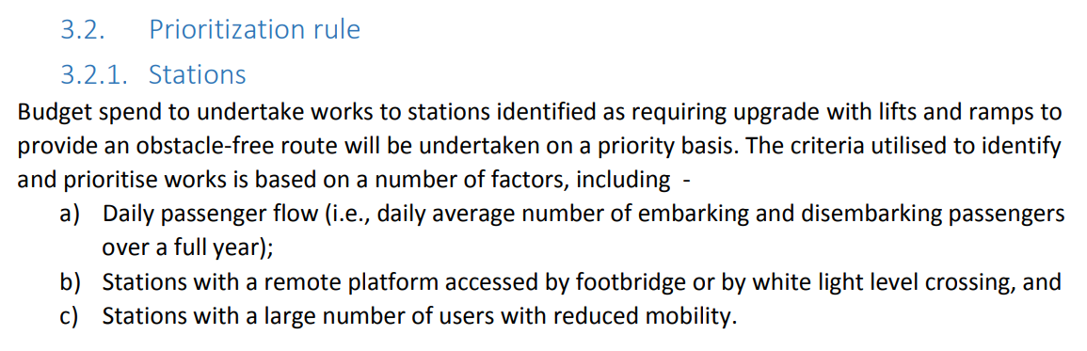
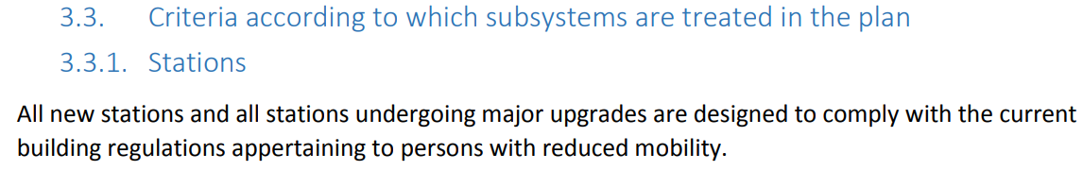
Example of application of the PRM TSI to existing stations
Priority and criteria taken from a NIP:

Slide 24
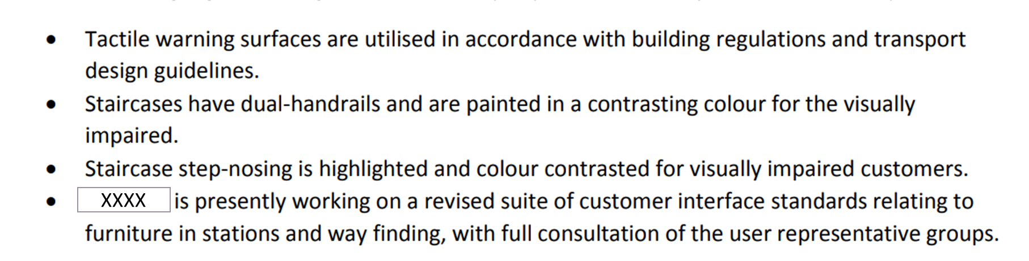
Example of application of the PRM TSI to existing stations
Example of extent of renewal taken from the same NIP:
No requirement on the width of the stairs: gradual improvement
  Not all station areas
  Not all TSI characteristics

Slide 25
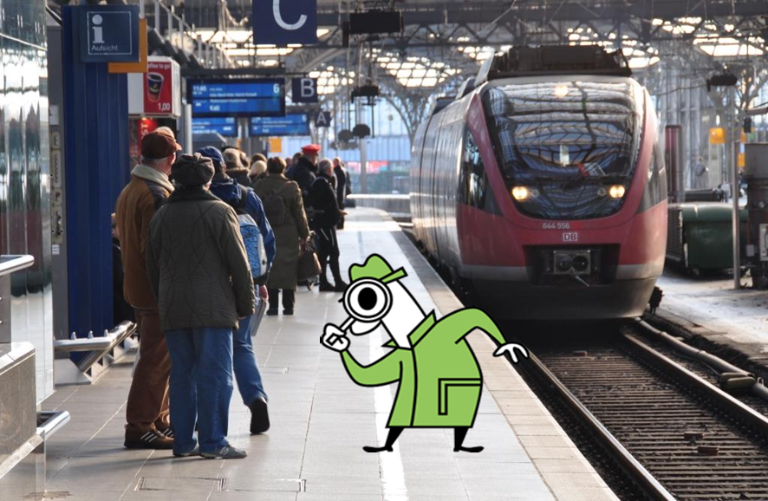
Role of the Notified Body
When assessing a station, difficult to close the eyes on non-conformities…

Slide 26
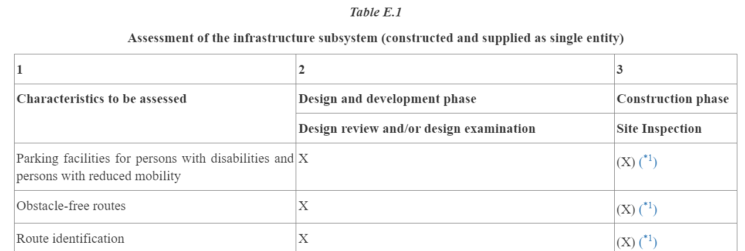
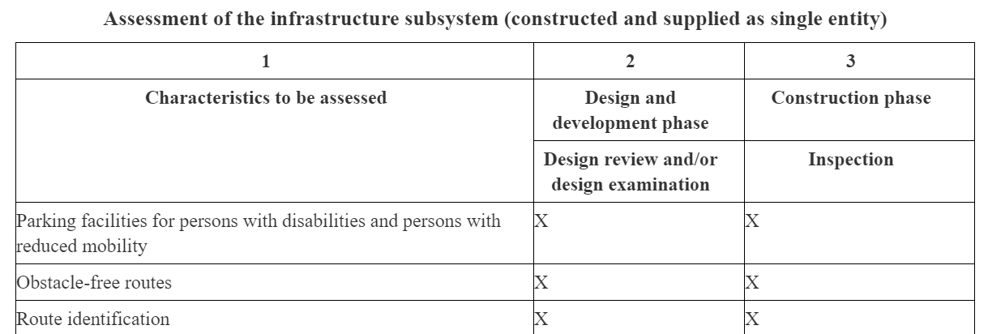
What’s changed in PRM TSI
(*1) As-built drawings shall be provided or a site inspection shall be carried out when the realization differs from the design rules or drawings that were examined
2014
2023

Slide 27
Scope of NoBo assessment
For the PRM TSI part applicable to Fixed Installations, the Notified Body should assess the parts of the station that have been renewed/upgraded and, for those parts, only the characteristics that have been renewed/upgraded

Slide 28

Evolution of the ENE TSI to facilitate the charging of traction batteries
Notes:
REMENBER SPEAK SLOW AND CLEARLY!!
Good morning, dear participants in this webinar, after the implementation of TSIs, I will speak now about the Evolution of the ENE TSI and LOC&PAS TSI, reminding the subjects of our previous webinar last 5th July:
the first one, facilitate the charging of traction batteries and
The second one, the work performed for hamonisation of requirements in case of multiple pantograph operation (more than 2 simultaneously).
And 2 additional after some questions received in such webinar:
Evolution protective provisions against electric shock
Harmonics and dynamic effects

Slide 29
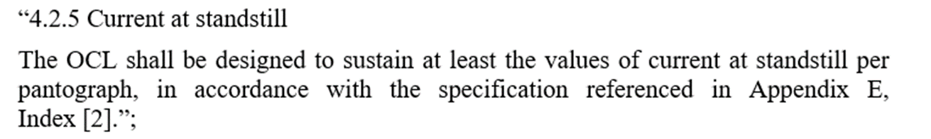
Evolution of the ENE TSI to facilitate the charging of traction batteries
PROBLEM:
ENE TSI, section 4.2.5 and LOC&PAS TSI, section 4.2.8.2.5, limit the maximum current at standstill and it limits the charging capacity for battery trains
Notes:
REMENBER SPEAK SLOW AND CLEARLY!!
ERA and members of the Topical working group have developed an important work to improve the TSI in order to facilitate the use of battery trains
In order to understand the problem, I need to explain that Section 4.2.5 Current at standstill of ENE TSI, by referring to EN 50367, limits the maximum current at standstill for vehicles. STANDSTILL is the situation when the train is stop, not in movement, with the pantograph could be raised and in contact with the OCL. This requirement is corresponded by section 4.2.8.2.5 of LOC&PAS TSI.
"READ THE TEXT OF 4.2.5"
The purpose of this requirement is to avoid the overheating of OCL contact wire and the pantograph. However, it has a negative impact in the charging capacity of battery trains, increasing the time needed for charging the batteries.

Slide 30
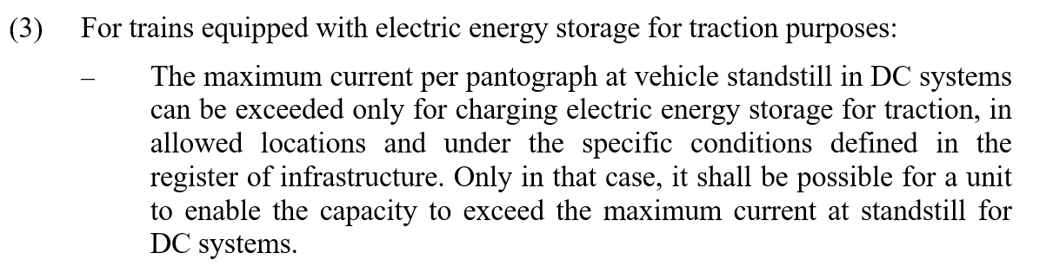
Evolution of the ENE TSI to facilitate the charging of traction batteries
SOLUTION:
Include reference to new version of standard EN50367:2012+A1:2022 in both TSIs
Limit values of current at standstill can be exceeded for battery trains when charging
Notes:
REMENBER SPEAK SLOW AND CLEARLY!!
In order to solve It, the current limit at standstill is set up now by updated reference to EN 50367:2020+A1:2022 in section 4.2.5 of ENE TSI and section 4.2.8.2.5 of LOC&PAS TSI
In parallel, and more important, section 4.2.8.2.5 of TSI LOC&PAS was amended
"READ THE TEXT OF (3)
In other words, it is allowed to overpass such limits for trains equipped with electric energy storage for traction purposes (i.e., battery trains). This permission is based in the fact that some IMs allows higher values of current at standstill than the ones in EN 50367 in certain points of their infrastructure (values that are in the register of infrastructure). In these cases, the battery train can require a higher value of current reducing the time for charging the battery and enabling better performance and operation of these trains.
It is important to remark that we have to continue forward in next TSI revision to have interoperable rules/solutions for the network. This requires additional information for the technical solution at pantograph and contact line, but also for operation and signaling of such charging sections

Slide 31
Multiple pantograph operation (more than 2)
Notes:
REMENBER SPEAK SLOW AND CLEARLY!!
I will speak here about multiple pantograph operation, which means operation of a train with more than 2 pantographs SIMULTANEOUSLY. It is the interest of the sector to enable better performance and operation of electric trains by using more than 2 pantographs at the same time. However, the operation of more than 2 pantographs simultaneously is subject to different rules and practices in the MSs; this does not facilitate the authorization and operation of trains with this specific configuration. ERA and the sector performed a research on the possibilities to harmonize the requirements at European level, it means in ENE TSI and LOC&PAS TSI

Slide 32
Multiple pantograph operation (more than 2)
Design of the OCL and pantograph distribution
in case of multiple pantograph operation (more than 2):
Analysis of rules in different Member States
Analysis of results from measurements and simulations
Check of actual TSI regarding necessary improvements
Notes:
REMENBER SPEAK SLOW AND CLEARLY!!
ERA and the sector performed a discussion on harmonised requirements for the design of the OCL and the pantograph distribution in case of multiple pantograph operation (more than 2). The discussion was based in:
The analysis of the local rules for this kind of operation in different MSs
compilation of rules for Multi-Pantograph authorisation in Europa
Identification of differences in basis ( Loco/EMU; DC/AC, … )
Systematic Compilation of results from assessments for Multi-Pantograph operation in Europa
There was also the analysis of the different types of measurements and simulations and the related possible impacted parameters. Some parameters were confirmed (not all influences were identified yet), and results were obtained for more than 2 pantographs, but only up to 160 km/h.
In parallel, TSI was checked in order to detect the possible improvements and adjustments taking into account the results from measurements and simulation

Slide 33
Multiple pantograph operation (more than 2)
It was concluded that more measurements/simulations are necessary to finally define TSI adjustments
Definition of necessary future research steps for general use of proposed rules
Adjustment in the text for a consistent use:
ENE TSI, sections 4.2.12 and 4.2.13
LOC&PAS TSI, sections 4.2.8.2.9.7 and 6.2.3.21
Notes:
REMENBER SPEAK SLOW AND CLEARLY!!
At th end, it was concluded that more measurements/simulations are necessary (for instance more pantographs distances) to finally identify all the parameters and a method for assessment of OCL and pantograph configurations, and subsequently prepare proposal(s) for TSIs provisions and eventually EN standards requests.
There were defined the necessary future research steps for general use of proposed rules, It means that additional future research program outside ERA TSIs work may be a possible way forward. Some elements were identified such as
Further research: Definition of critical distances between pantographs for the maximun speed of train based on :
Different span length
Wave propagation speed of contact line
Eigenfrequencies of contact line
Train speed
Different inter-pantograph distances (train compositions)
Targets of future research
Define rules for/ranges for best pantograph position configurations ( f(speed), AC/DC, ..)
Method for assessment of OCL and pantograph configurations
List of parameters for assessment
Proposal for legislation and standards
Additional results of research
Rules for robust contact line design
Rules for allocation design (randomizing of pole distances,… )
Design rules for positioning of pantographs on train
MORE AMBITIOUS- Steps for Research + Investigation
Identification and check of existing studies and research results
Simulations to investigate the influence of parameter changes
Span length (constant lengths, systematic/random variations)
Main parameters of OCL (forces, wave propagation, eigenfrequencies …)
Relation between pantograph distance and pole distance
Distance between pantographs
Train speed
Check of importance of pantograph parameters for criticality of distances
Measurement program for check of results with limited number of cases
Proposals for rules for next revision of TSI
In any case, we included Adjustments of the text in the following sections of TSIs in order to improve the consistent use and applicability for multiple operation
ENE TSI: references to EN 50119 and EN 50367 updated/included in sections 4.2.12 and 4.2.13
LOC&PAS TSI: clarification on dynamic behavior in section 4.2.8.2.9.7 and poorest performance configuration to be tested in section 6.2.3.21

Slide 34
Evolution protective provisions against electric shock
Notes:
REMENBER SPEAK SLOW AND CLEARLY!!
I will speak here about the evolution of section 4.2.18 of TSI ENE: protective provisions against electric shock. These section provides several requirements for energy subsystems in order to avoid the electric shock for people and it is based on the standard EN 50122-1

Slide 35
Evolution protective provisions against electric shock
TSI ENE section 4.2.18 Protective provisions against electric shock
It requires compliance with EN 50122-1 Railway Applications - Fixed installations – Electrical safety, earthing and the return circuit – Part 1: Protective provisions against electric shock.
The reference is updated to new version 2022 of the EN, specifically clauses 5.1 and in public areas: 5.2.1, 5.2.2, or 5.3.1, 5.3.2, 5.3.3, 5.3.4
[4] | EN 50122-1:2022 Railway Applications - Fixed installations – Electrical safety, earthing and the return circuit – Part 1: Protective provisions against electric shock
[4.2] | Protective provisions against electric shock | 4.2.18 | 5.1 and in public areas: 5.2.1, 5.2.2, or 5.3.1, 5.3.2, 5.3.3, 5.3.4
Notes:
REMENBER SPEAK SLOW AND CLEARLY!!
As said the TSI section requires compliance with EN 50122-1. In previous TSI the EN version was 2011 and now we have updated in the TSI Revision with the EN version 2022, with the current state of art.
In this update we have included the following clauses of EN: 5.1 and in public areas: 5.2.1, 5.2.2, or 5.3.1, 5.3.2, 5.3.3, 5.3.4
We received questions on the logic behind the update of this section of the TSI: first we need to explain that in previous TSI, there were references to clauses of EN 50122-1:2011, which were already only applicable for public areas. Therefore, following the same reasoning , the clauses of EN version 2022 for public areas have been selected for the update.
Read only if there are questions: section 4.2.18 of TSI is focused on protective provisions against electric shock in public areas as working in restricted areas is limited by trained technicians, who are operating under specific labor and maintenance provisions. Therefore, this has been clarified in the references to the new version of EN.
In addition, in previous TSI, there were also references to clauses 6.1 and 6.2 of EN version 2011 which are dealing with protection against indirect contact exposed conductive parts in all areas. These clauses have been deleted in the current update of TSI. However, in new EN version 2022, clause 6.2 is still applicable to public areas as clause 5.3.2 of EN is referring to clause 6.2 for conductive parts. So in this way we keep the link to clause 6.2

Slide 36
Evolution protective provisions against electric shock
TSI ENE section 4.2.18 Protective provisions against electric shock
Conclusions through the update of reference to new version EN 50122-1:2022:
Clarification to focus provisions in public areas
Update to last state of art in the subject
It is envisaged to follow-up series EN 50122 for next TSI revision
Notes:
REMENBER SPEAK SLOW AND CLEARLY!!
READ THE TEXT

Slide 37
Harmonics and dynamic effects
Notes:
REMENBER SPEAK SLOW AND CLEARLY!!
I will speak here about Harmonics and dynamic effects, in important phenomenon liked between energy subsystem and rolling stock

Slide 38
Harmonics and dynamic effects
Update of:
TSI ENE section 4.2.8 Harmonics and dynamic effects for AC traction power supply systems
TSI LOC&PAS section 4.2.8.2.7 Harmonics and dynamic effects for AC systems
with the reference to new version of EN 50388-1:2022
Notes:
REMENBER SPEAK SLOW AND CLEARLY!!
These 2 section of TSIs are interlinked and define the requirements for harmonic and dynamic effects respectively for energy subsystems and rolling stock. In previous TSIs, these sections referred to clauses of EN 50388:2012, including the need to perform a compatibility study by the applicant for rolling stock authorization
The EN has been replaced by a new version 2022, which it has been split in 2 parts:
part 1 being the evolution of previous EN version which continues to contain the conditions for the compatibility study to be developed by the applicant of rolling stock authorization.
a really new part 2, still under development, with conditions for common codes of practices, which is an alternative to the compatibility study

Slide 39
Harmonics and dynamic effects
Main improvements:
Update to last state of art in the subject
It opens the possibility to use common codes of practices alternatively to the compatibility study (subject to complete development of series EN 50388)
Notes:
REMENBER SPEAK SLOW AND CLEARLY!!
Therefore, in the last revision of TSIs, the reference to EN 50388 has been updated only to the part 1, EN 50388-1:2022, as part 2 is still under development. This already means an adaptation to the state of art in the subject and the facilitation of application of TSIs by the sector
In addition, with this alignment in this TSIs revision, it will be eventually possible, for the next TSI revision, to include the evolution for series EN 50388 on common codes of practices, once this alternative is ready in the standards

Slide 40

THANK YOU
Moving Europe towards a sustainable and safe railway system without frontiers.
Follow us:
Notes:
TSI (Transition, Combined Tr),
Revision of TEN-T Regulation: real opportunity to make Trans-European Transport Network fit for the future, to align the development of the TEN-T network to the European Green Deal objectives and the climate targets of the EU Climate Law. Cutting greenhouse gas emissions from the transport sector by 90%, compared with 1990 levels, by 2050, is key to achieving climate-neutrality by the same date.
New intermediary deadline of 2040 to advance the completion of major parts of the network ahead of the 2050 deadline that applies to the wider, comprehensive network. Core network will also be extended.
New term: 9 European Transport Corridors (ECTs) - integration of Core Network Corridors (CNCs) and Rail Freight Corridors (RFCs).
CT-related infrastructure parameters specified (CT profiles for all types of loading units) and strengthen the concept of network resilience by introducing mandatory interconnections between corridors as well as bypass options, with the aim of improving the reliability of transport services.
More transhipment terminals
High-speed rail network between the main nodes of Europe. The major TEN-T passenger rail lines should allow trains to travel at 160 km/h or faster by 2040.

