Slide 1

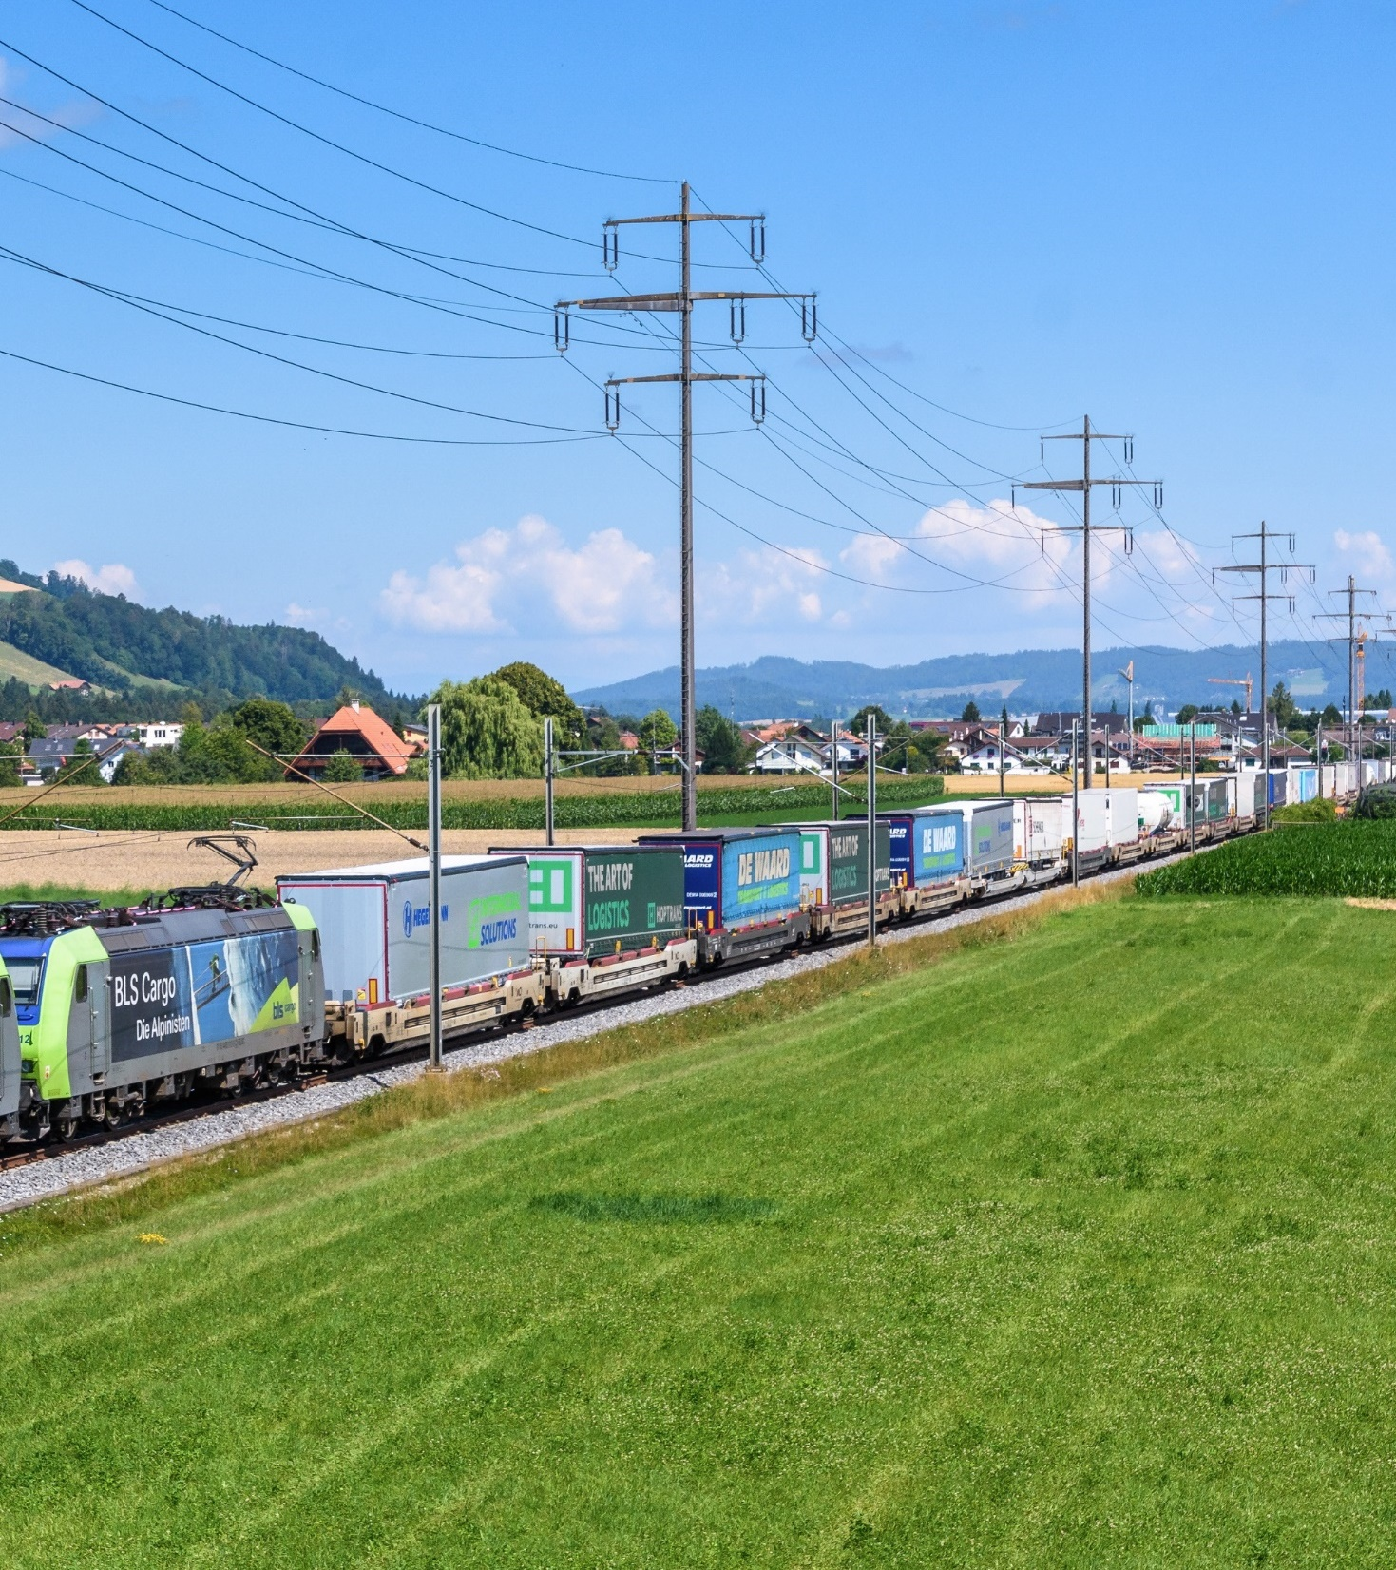
Zero Carbon
Transport
How CargoBeamer drives Innovation in the Intermodal Market
Nicolas Albrecht
CEO, CargoBeamer AG

Slide 2
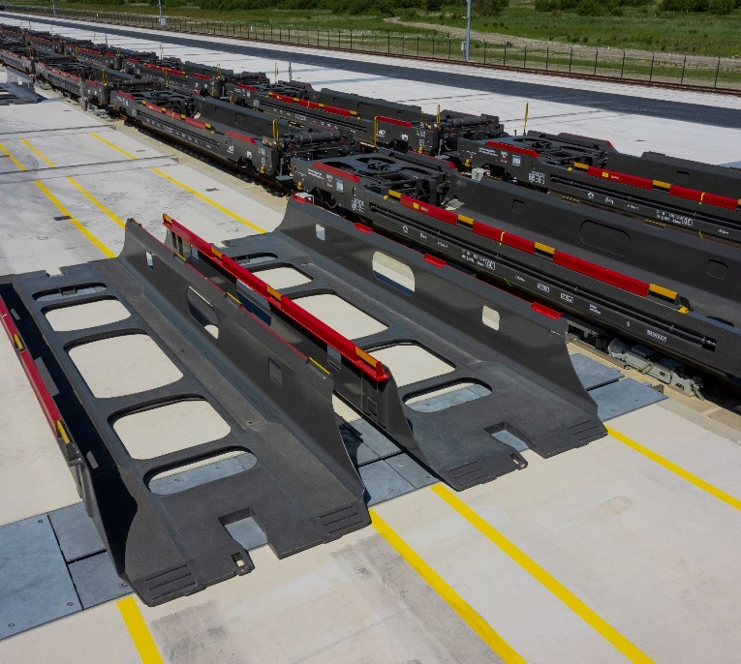
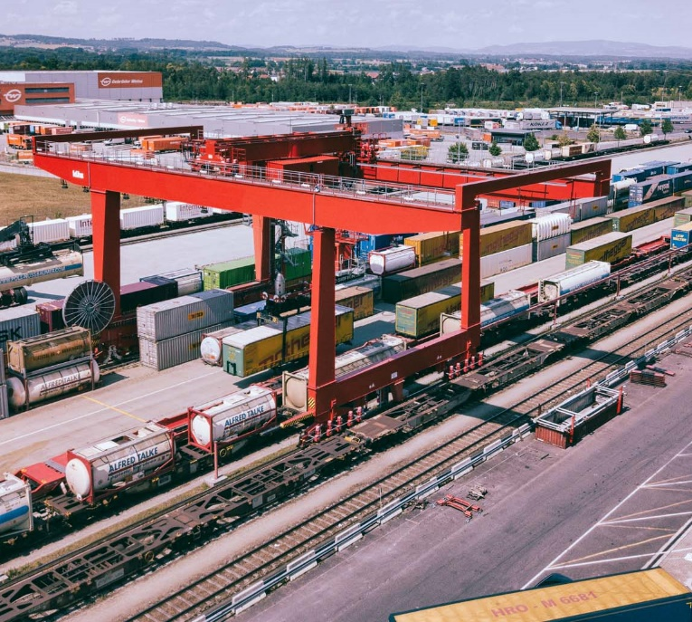
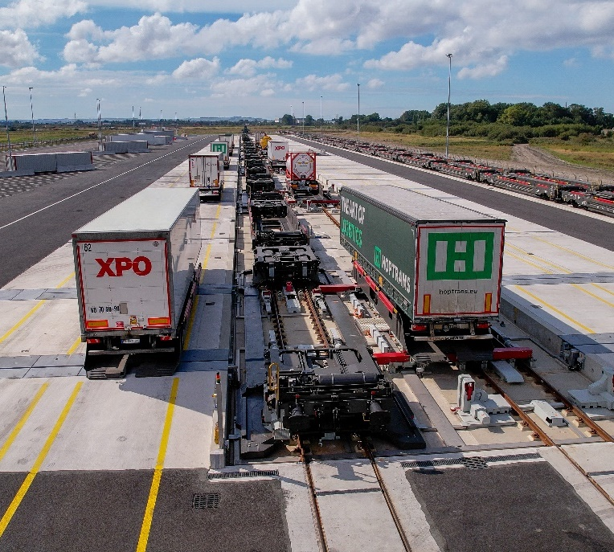
Creating a very much needed and better product:
cheaper, accessible, scalable, efficient
Problem: Barriers of Modal Shift
Solution: CargoBeamer Technology
Only 5% of semi-trailers are craneable – 95% can’t use rail with prevalent technologies
CargoBeamer Railcars allow 100% of semi-trailers to be shifted onto rail
01.
CargoBeamer is built on proprietary technology that holds the key to remove two biggest hurdles to the road to rail shift at scale – and is already a proven business
Rail access
CargoBeamer Terminals have 9 times faster loading processes: Horizontal, parallel, automatized
Terminals are a massive bottleneck, driven by slow processes
02.

Slide 3
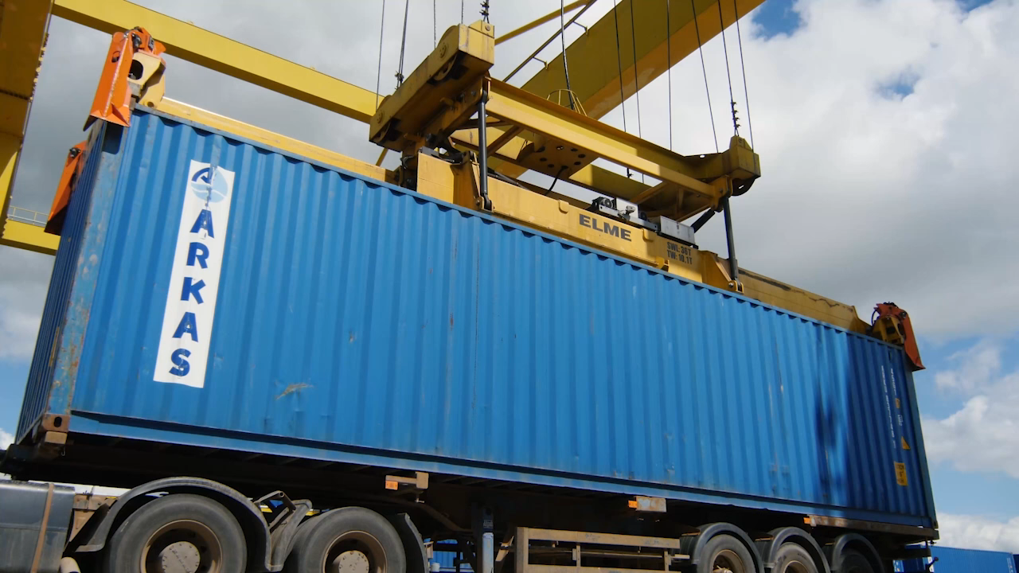
The biggest innovation rail freight has seen in the past 50 years

Slide 4
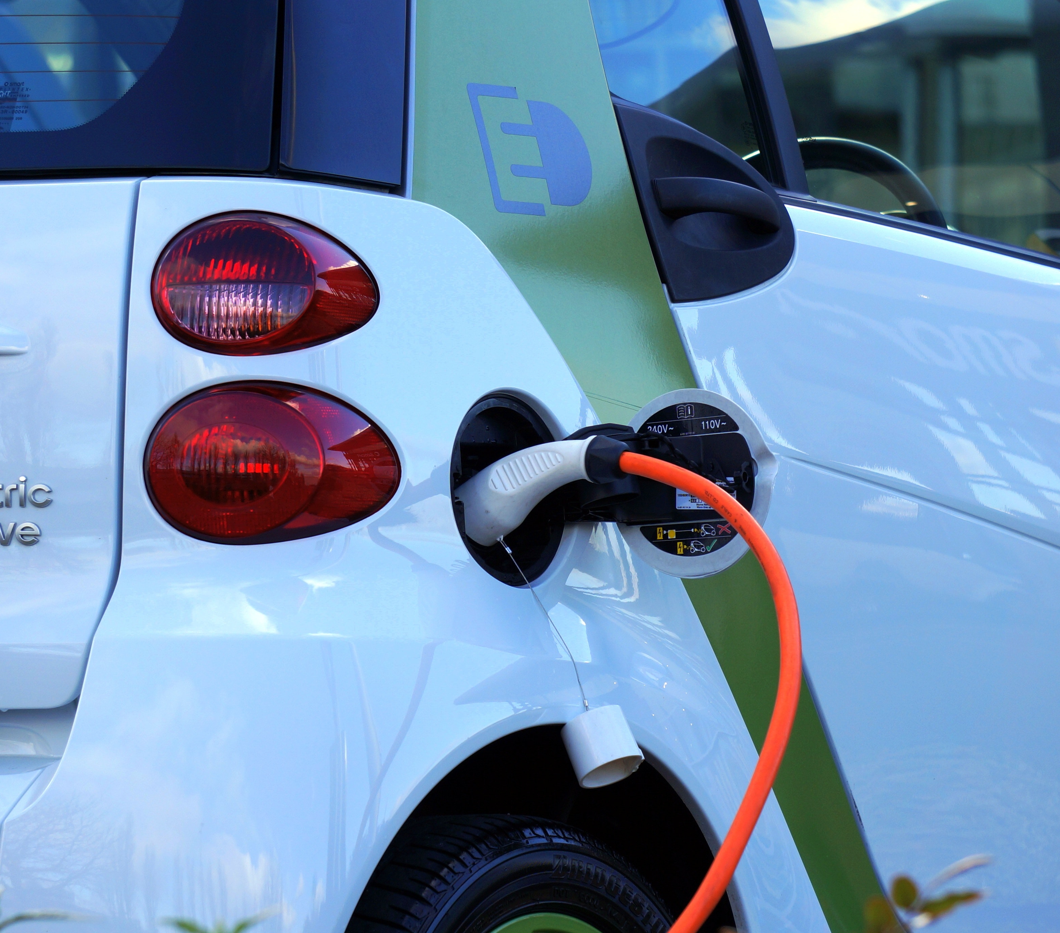
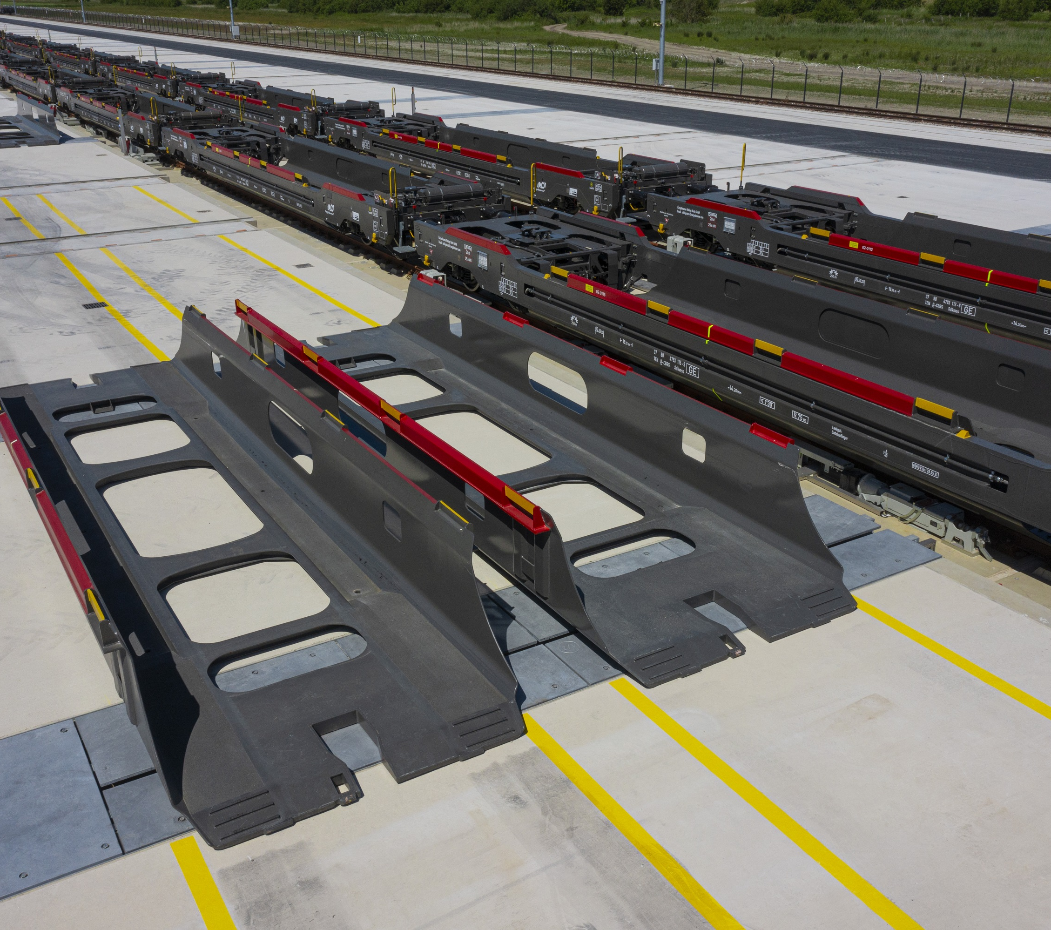
Enormous potential to reduce CO₂ emissions
Savings per electric car:
1 t CO₂/year
Savings per CB railcar:
220 t CO₂/year

Slide 5
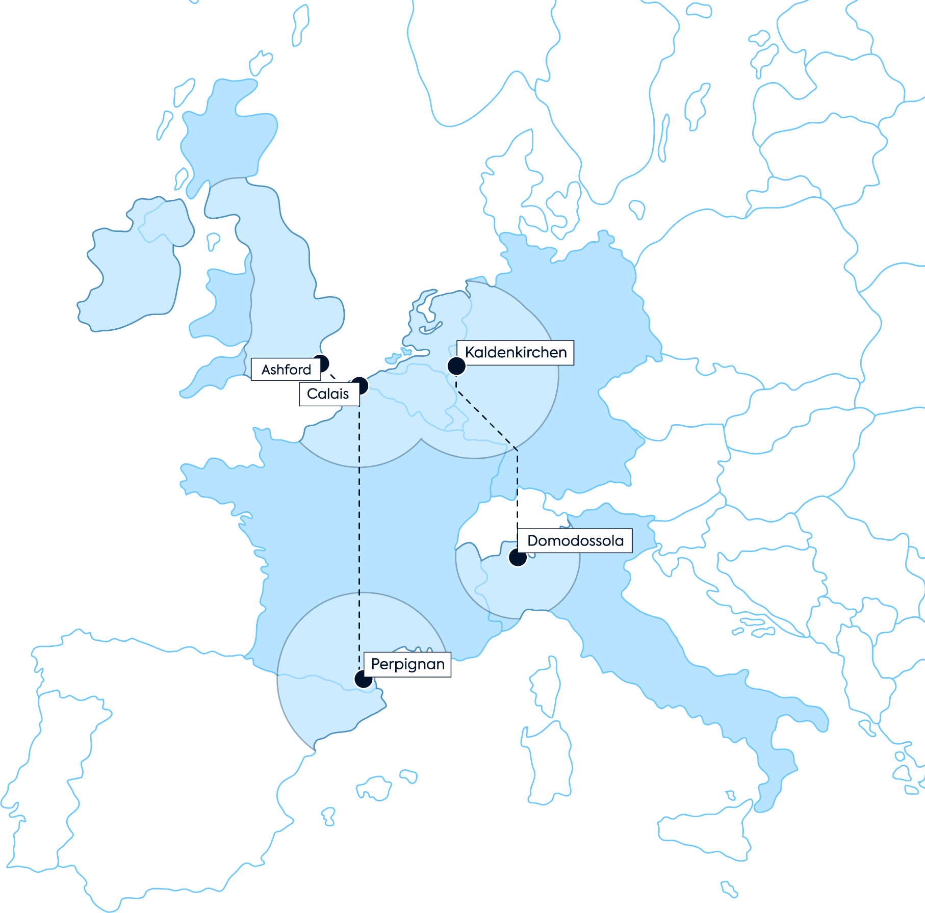






Network of High-Performance CargoBeamer Routes
Selected CargoBeamer Customers

Slide 6
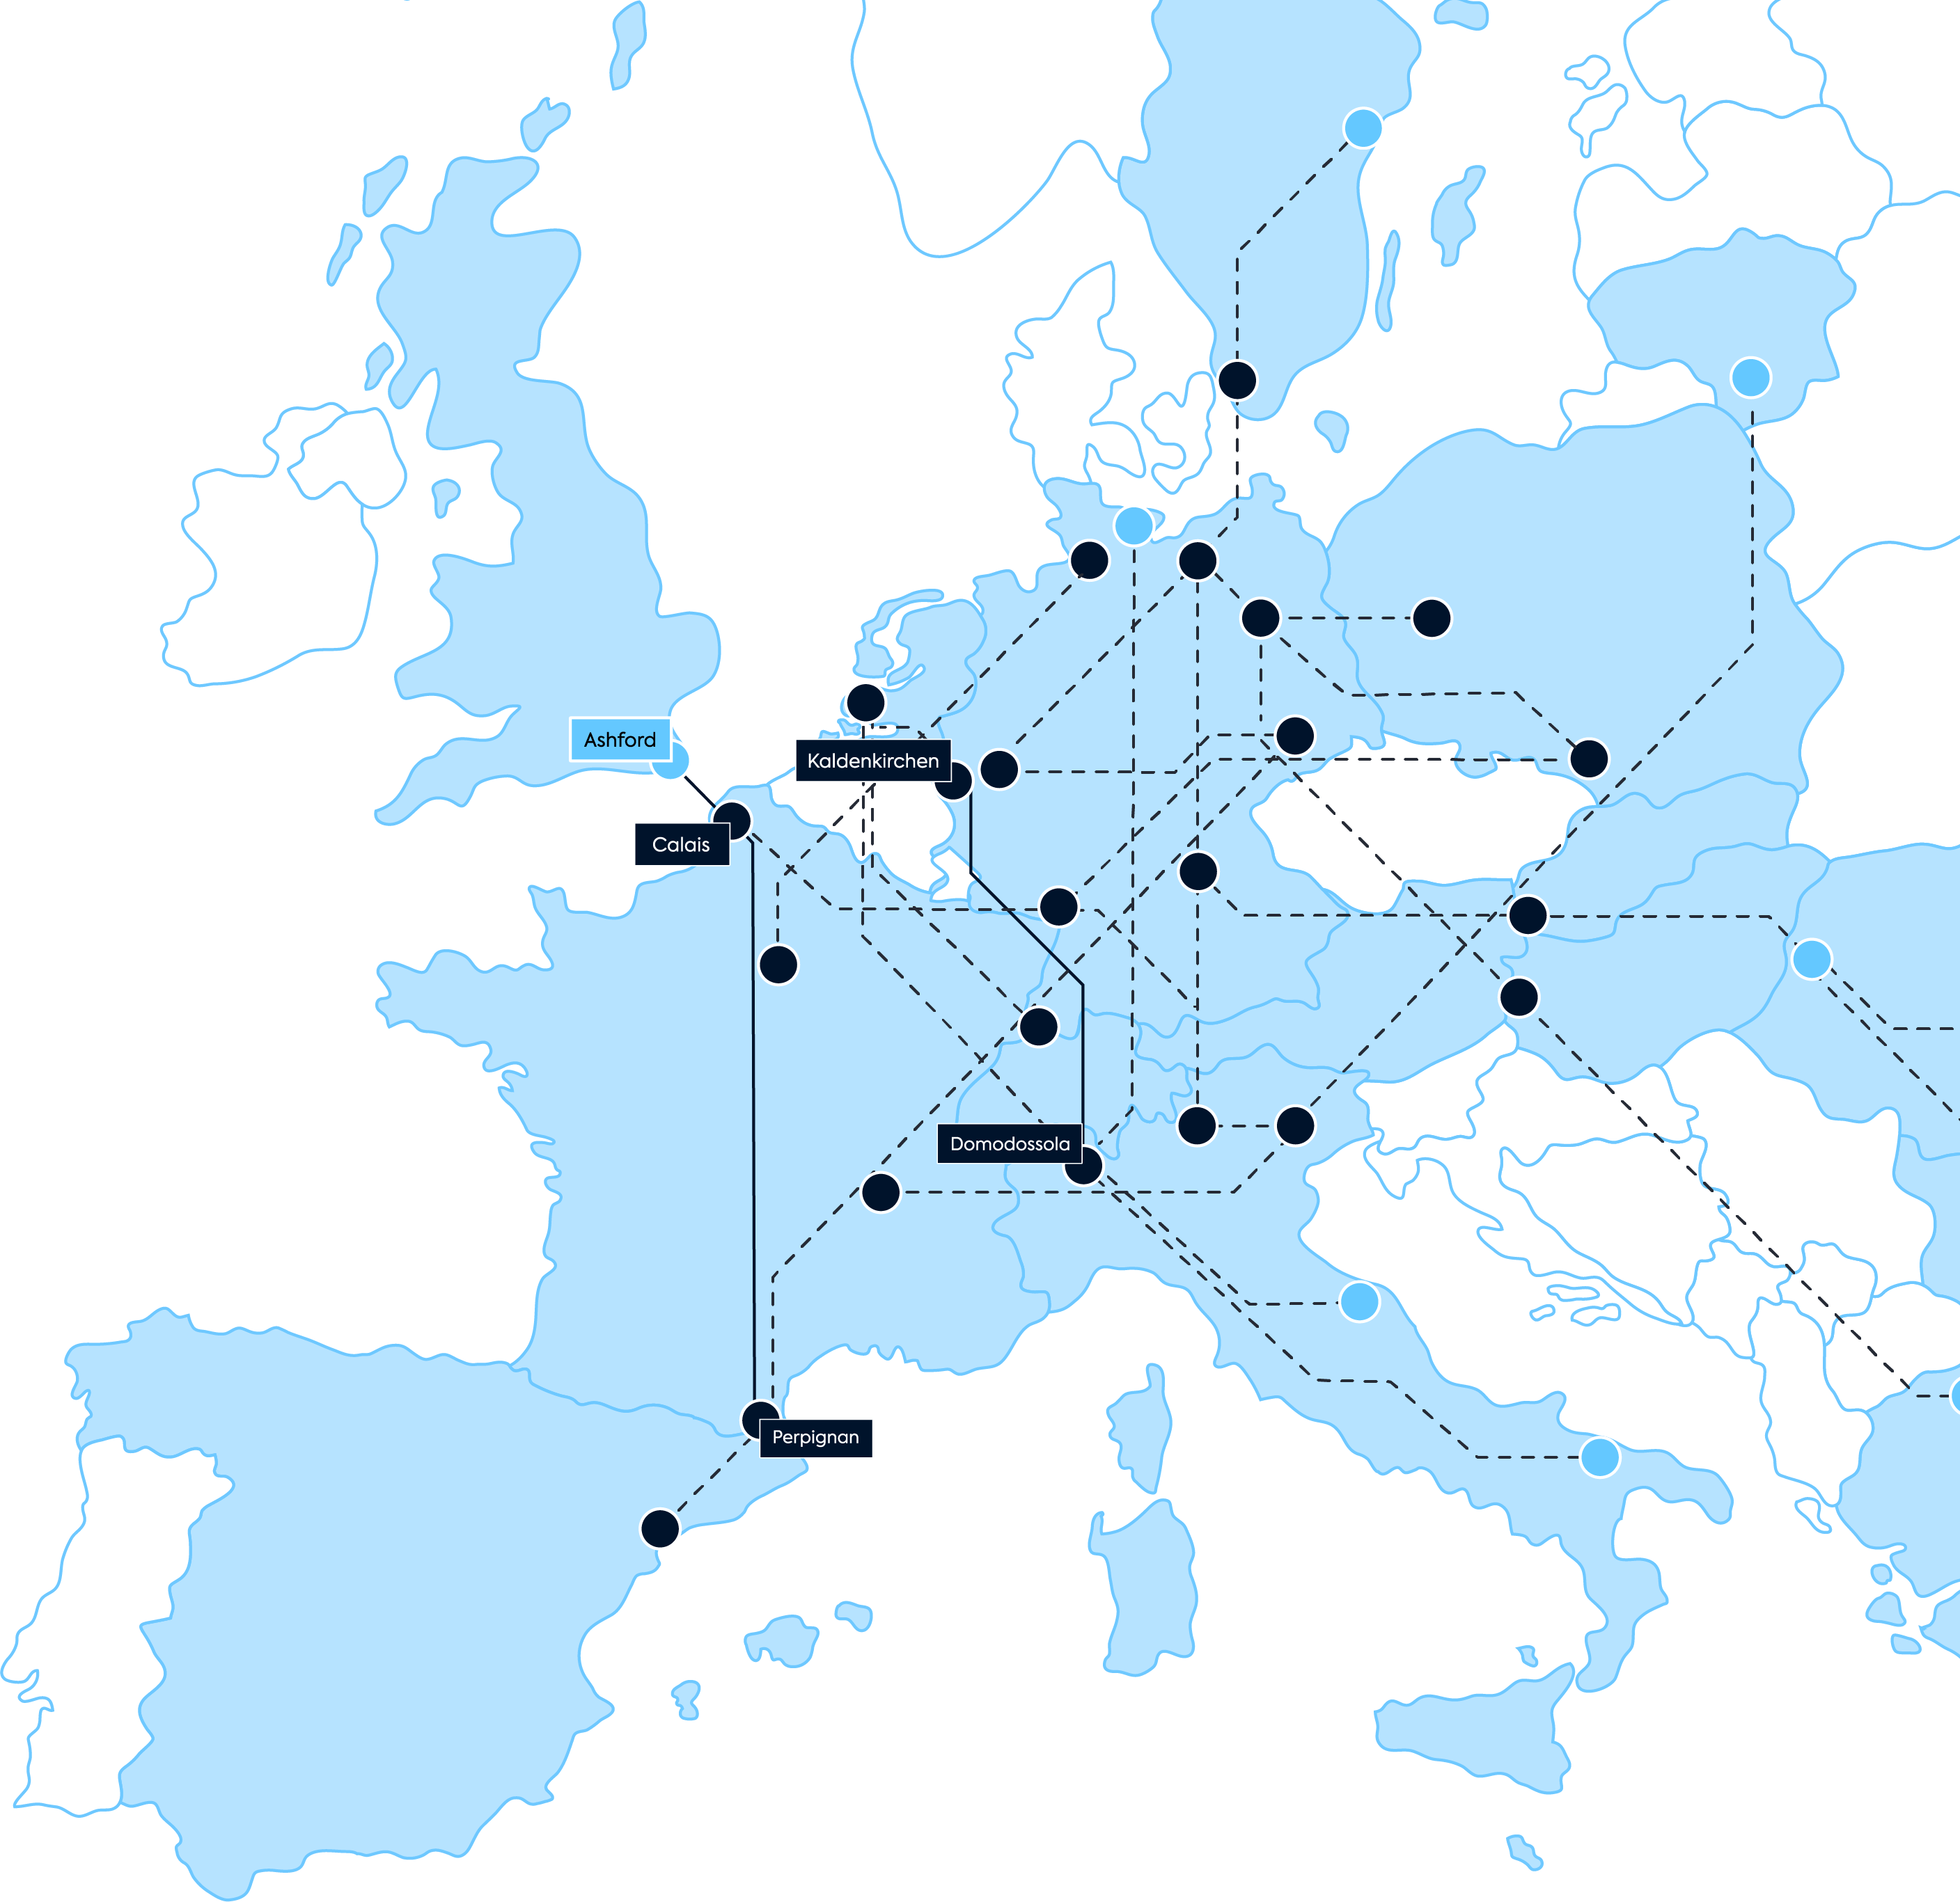
Grow into a true
European Network
CargoBeamer will scale to a European network of:
Up to
CargoBeamer-Terminals
20
and up to
CargoBeamer Routes
50

Slide 7
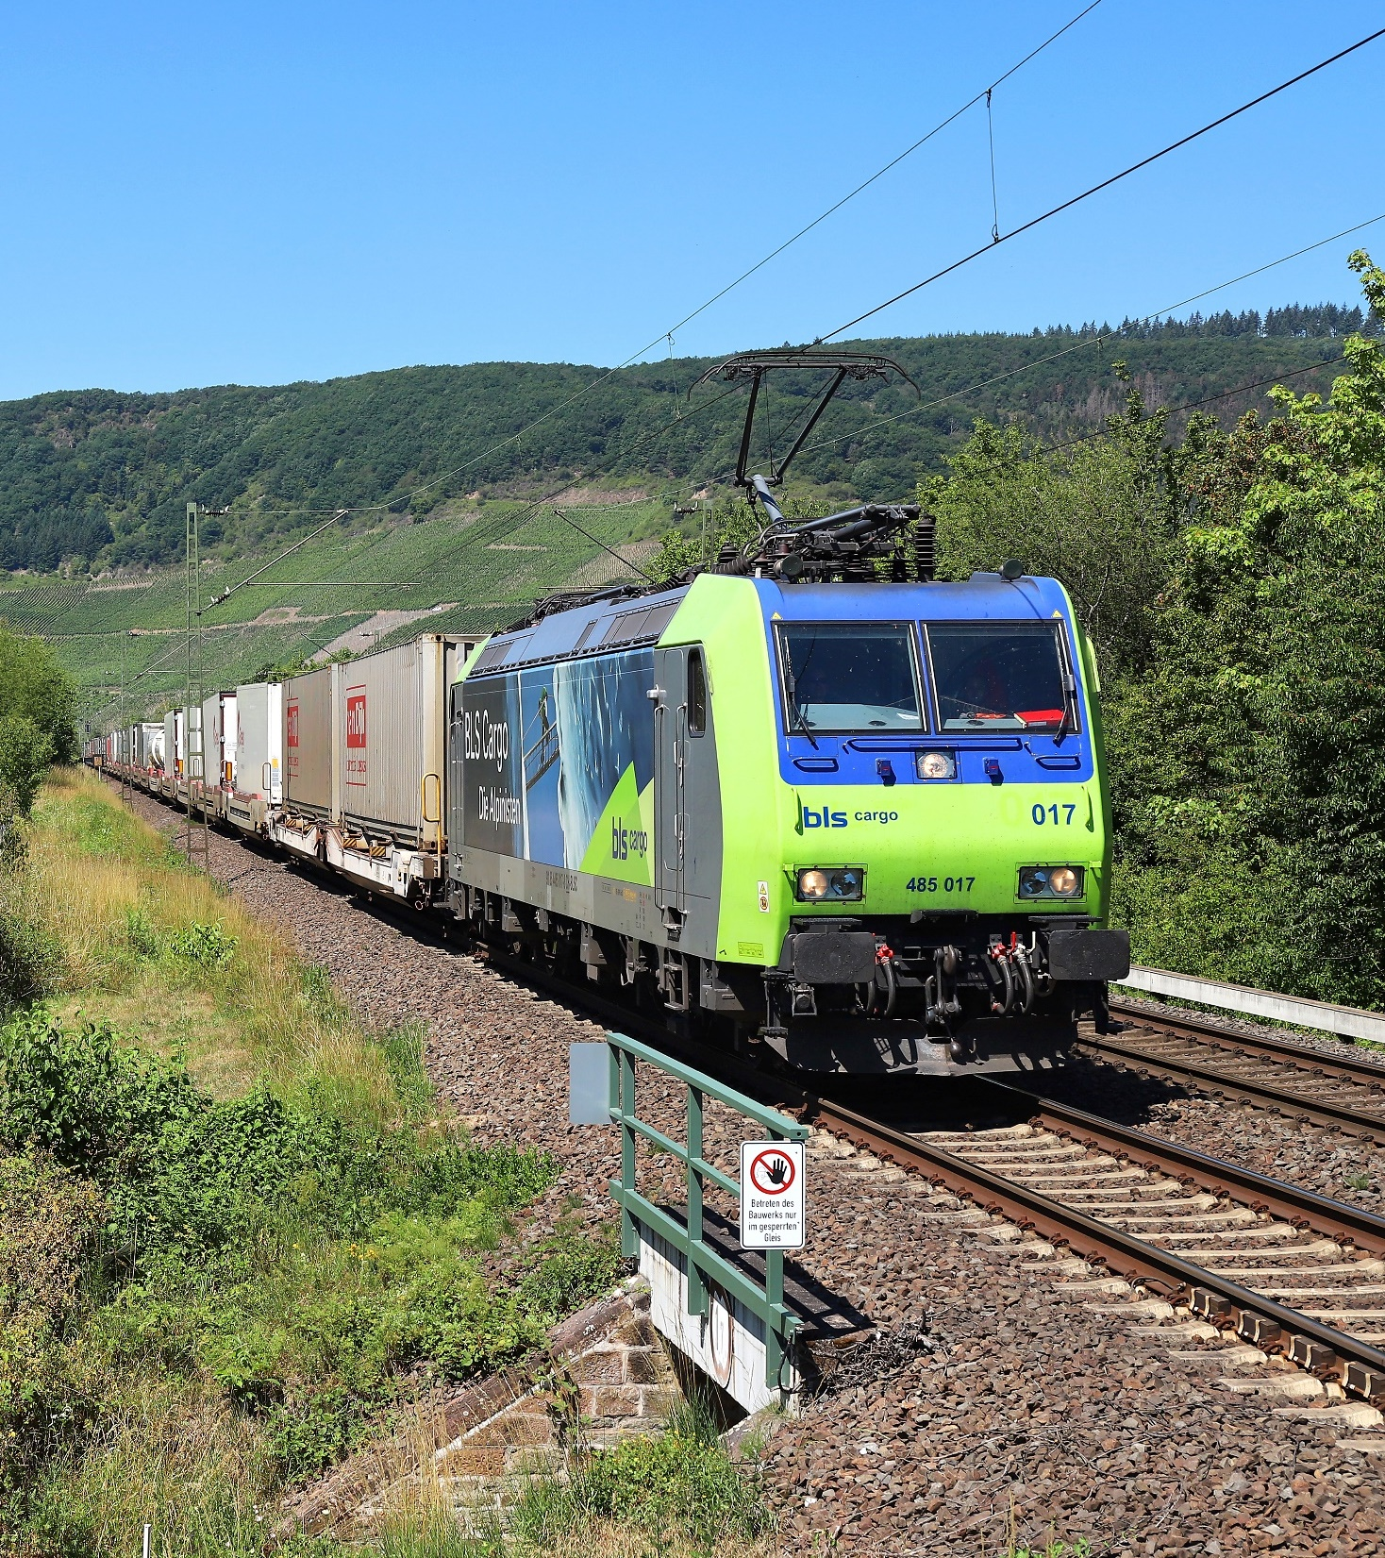
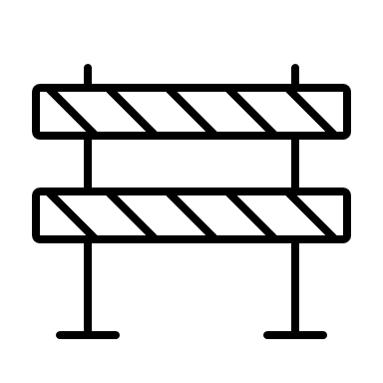
Barriers slowing down rail innovators like CargoBeamer
Lack of awareness that we need a massive step change to shift to rail at scale
Funding structure not favorable for high-growth & private innovators
Allocating public funding on uneconomical businesses, not on gaining new capacity
Approval processes and building permits taking ages until being issued
Not yet internalizing external costs thus not allowing rail competitiveness to increase

Slide 8
Thank you!
Nicolas Albrecht
Chief Executive Officer
nalbrecht@cargobeamer.com

Slide 9
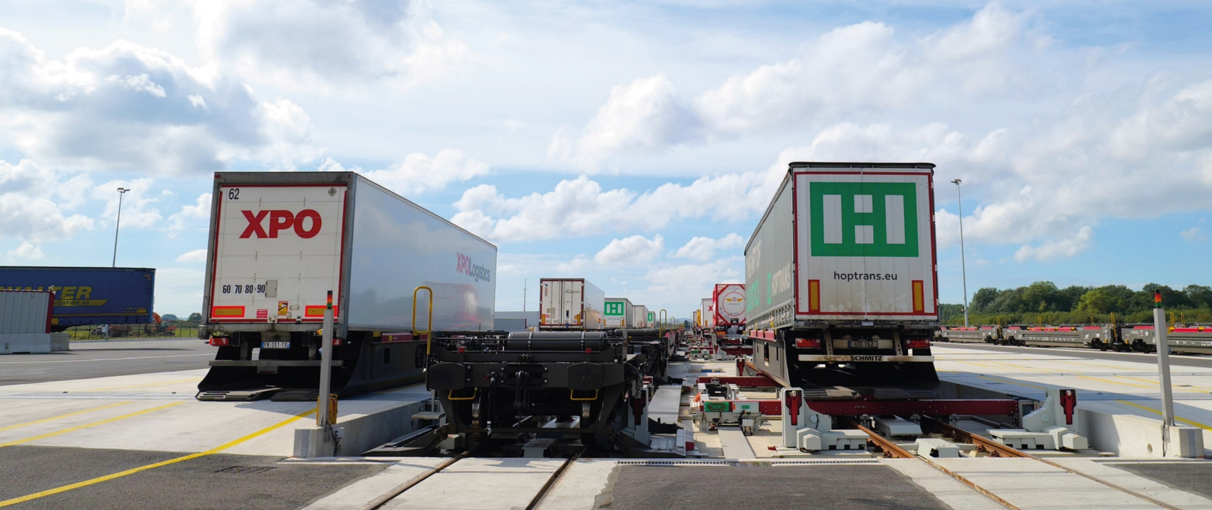
Our first CargoBeamer
Terminal in Calais
Watch it on YouTube: https://www.youtube.com/watch?v=M7Xx7AC9Zaw

Slide 10
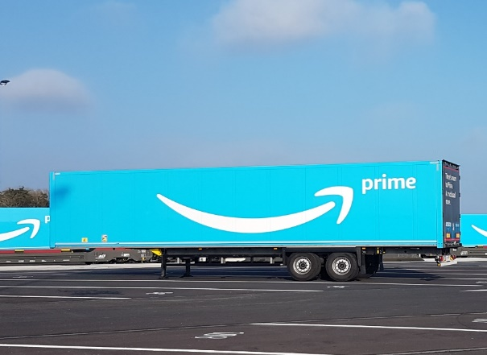
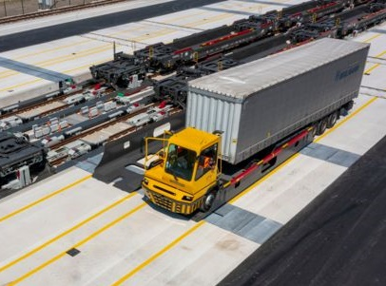
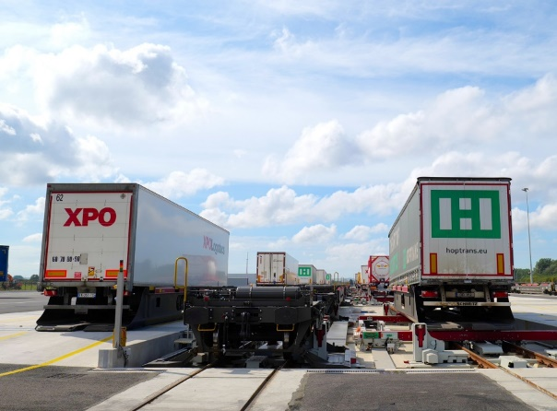
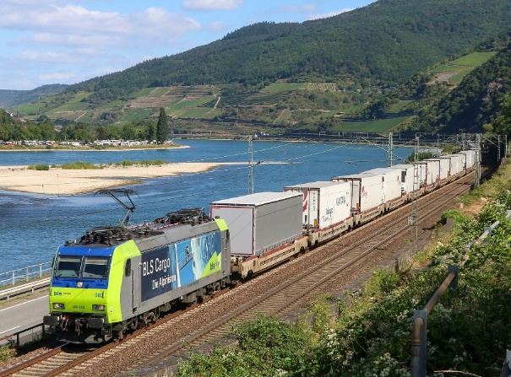
How the CargoBeamer System Works
Truck drivers arrive at the CB Terminal and place their semi-trailers in one of the parking lots, allowing them to leave immediately w/o any long waiting times
Terminal operators transfer the parked semi-trailers into empty CB Loading Basket located next to the tracks, to prepare for the train arrival
In CB Terminals, trains are unloaded and loaded automatically within 20 minutes via a horizontal shift onto CB Railcars
In 3rd party terminals, a crane or reach stacker lifts the CB Loading Basket onto the CB Railcar
The CB system enables ALL types of semi-trailers to be loaded for the subsequent departure of the fully electric long distance train transport

