Slide 1
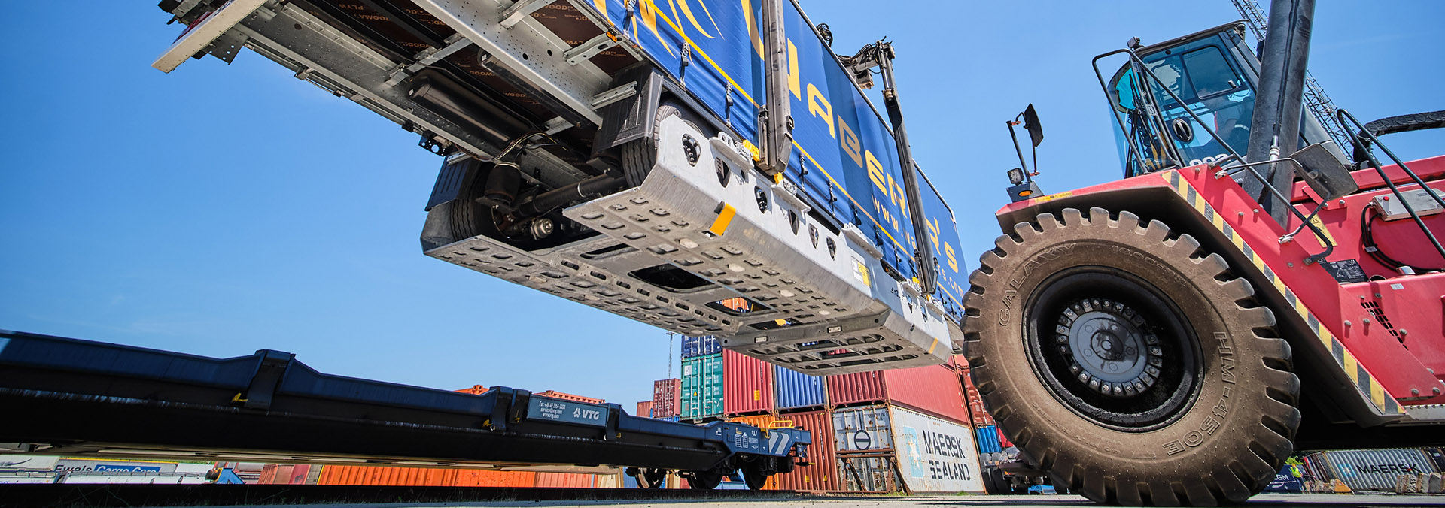
Solutions for the Modal Shift to Rail
3rd ERA Multimodal Conference 26.10.2023, Hamburg

Slide 2
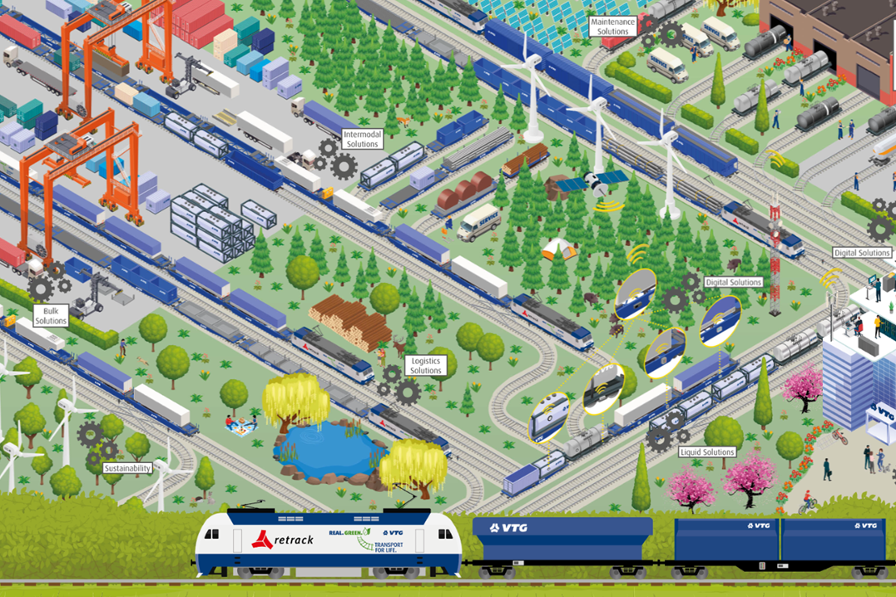
How VTG supports the Decarbonizing of the
Multimodal Logistics Chain
Smart solutions all around rail transportation
Supporting the modal shift from road to rail
  Common intermodal solutions for transportation of trailers, containers, swap bodies on rail
  Making non-craneable trailers craneable with the r2L solution
  Electrifying intermodal wagons for temperature-controlled transports
  Pushing cooperation between industries
Short term ad-hoc solution for spot transports and peak periods with
VTG Fast Track at selected locations
Digital solutions for your fleet management
Maintenance Solutions
Intermodal Solutions
Digital Solutions
Bulk Solutions
Logistics Solutions
Liquids Solutions

Slide 3
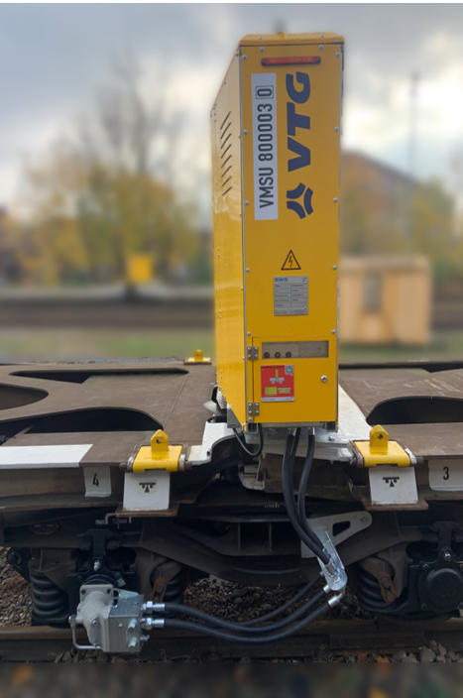
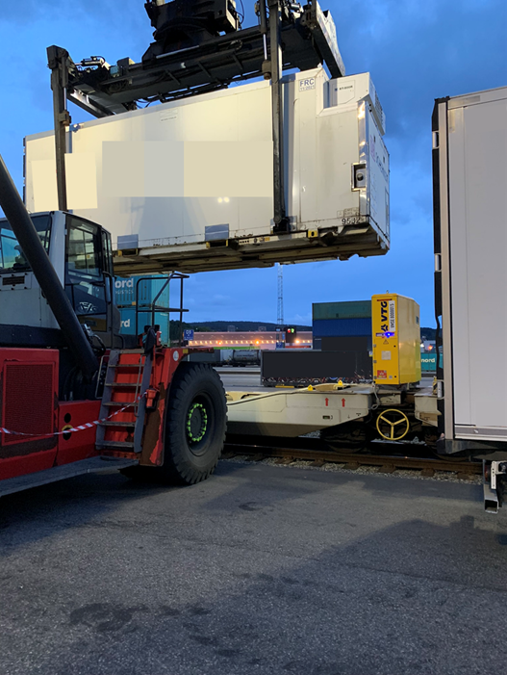
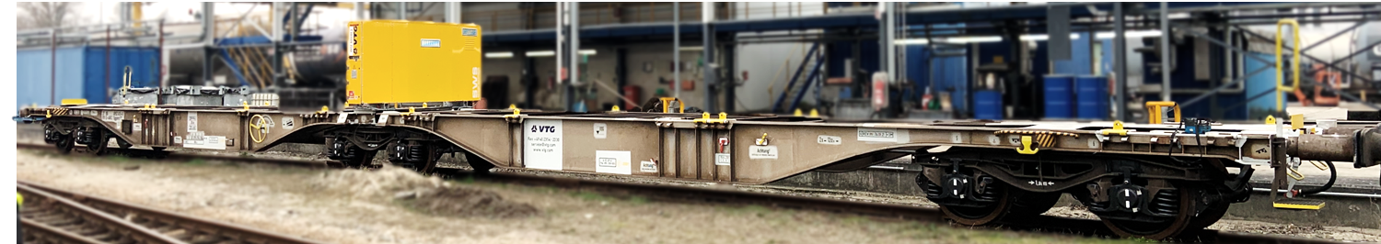
VTG electrified Wagons
Bringing environmentally friendly power to rail freight wagons
    VTG electrified – For eco-friendly, temperature-controlled rail freight transport
    Bringing power to the wagon for reefer containers, trailers and swap bodies to be transported
    Enabling the wagon to generate its own power for an easy handling, independent of the locomotive and any other wagons

Slide 4
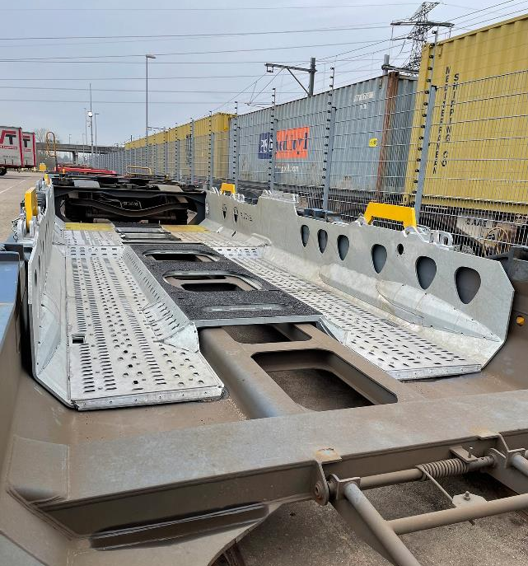
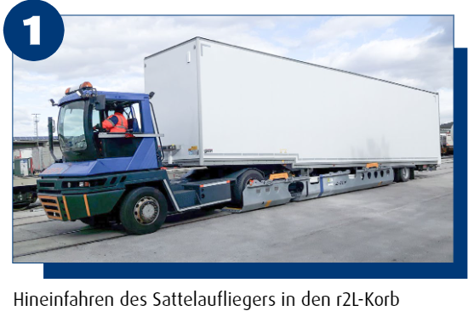
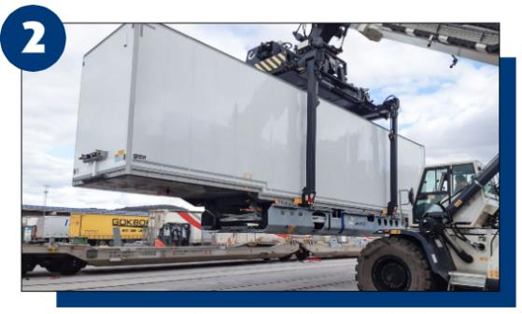
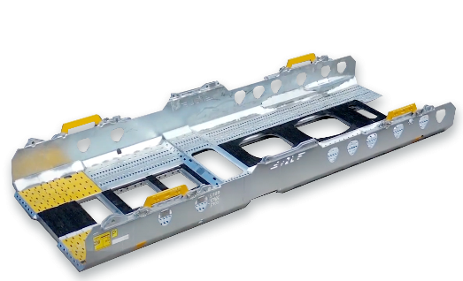



r2L Solution
Enabling non-craneable trailers to be craned and easily transported by rail
Driving the trailer into the r2L basket
Loading the r2L basket together with the trailer onto a pocket wagon
r2L Basket
A cooperation for railway transport

Slide 5
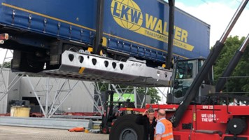
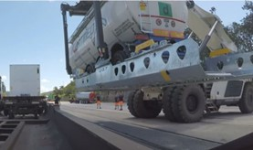
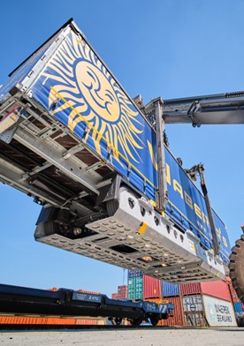
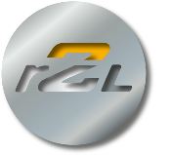
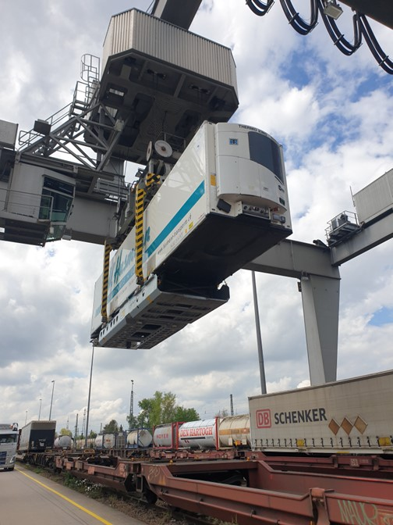
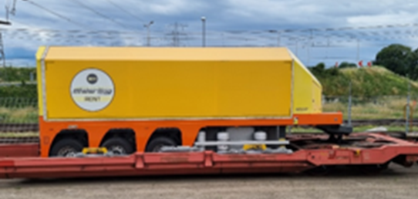
r2L Solution
Basket options and loading possibilities

Slide 6
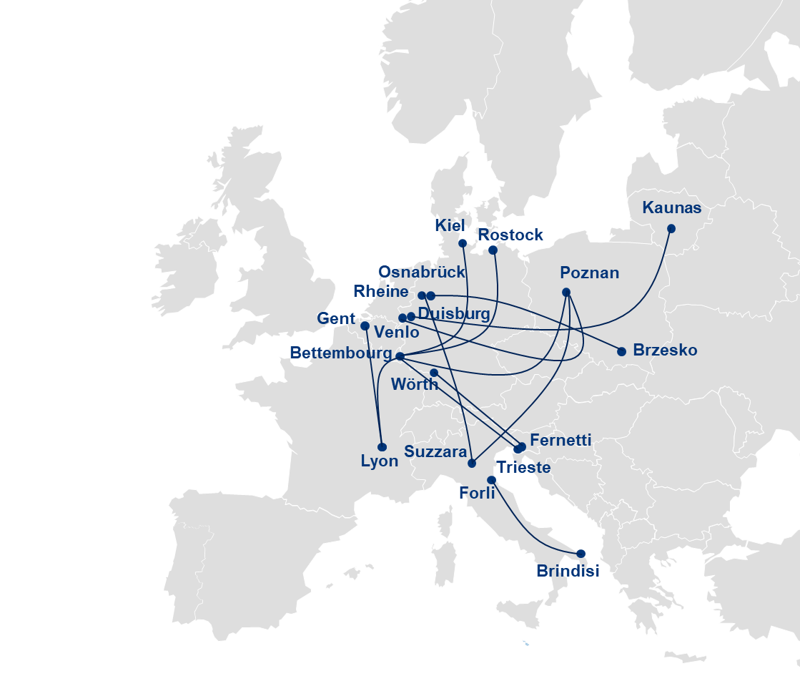
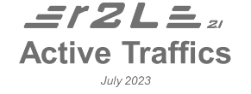
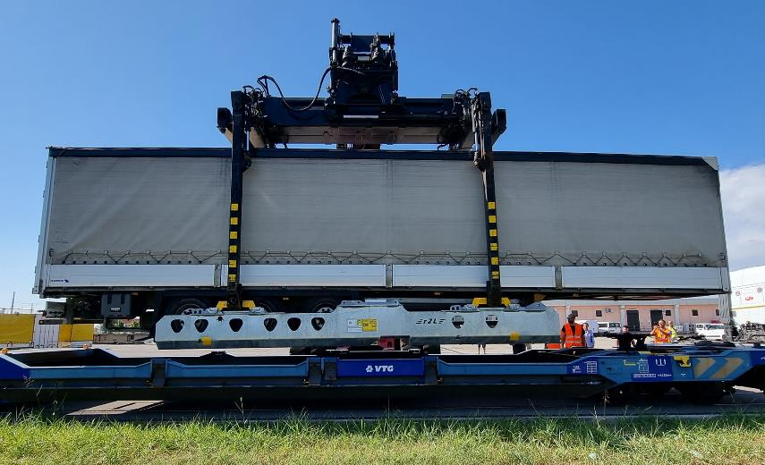

r2L Solution
Existing Network

Slide 7
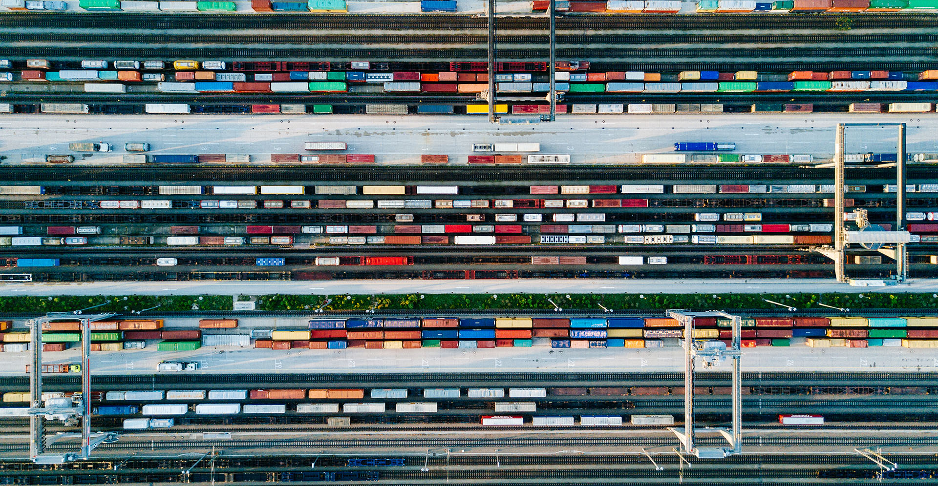
“The key to decarbonization is cooperation.”
Using the strength of each sector and creating solutions together for environmentally friendly and feasible transportation throughout Europe

Slide 8

Thank you for your attention!
Matthias Knüpling
  Head of Industry Lobbying & Associations
  P +49 40 23 54 22 21
  M +49 172 9 14 02 78
  E matthias.knuepling@vtg.com

