Slide 1
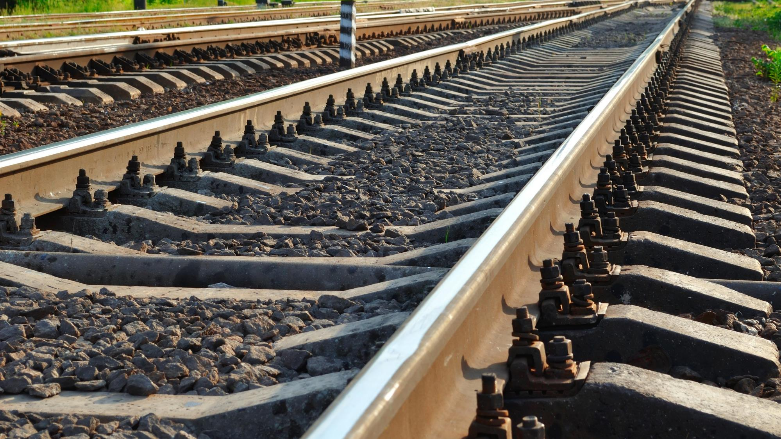

3rd ERA Multimodal conference
Panel III: Best practices – Decarbonising the multimodal logistic chains
Hamburg| 26th October 2023
Photo: Adobe Srock / by Tarasylo

Slide 2
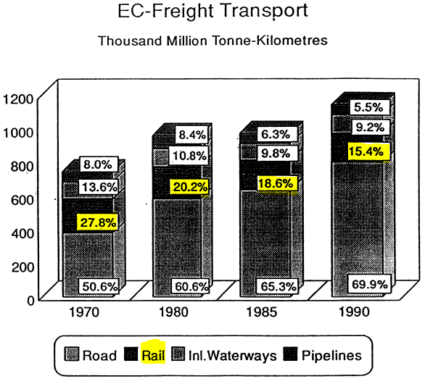
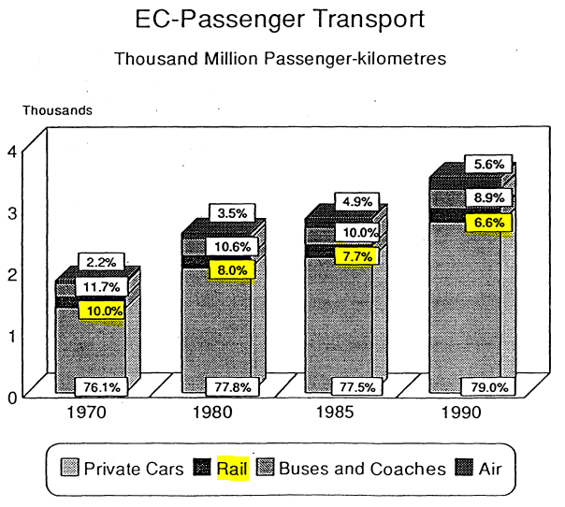
A look into the past

Slide 3


The emergence of the environmental concern
2011: Roadmap to a Single European Transport Area
50% of road freight over 300 km shift to rail and IWW by 2050
Majority of medium distance passenger transport by rail by 2050
60% reduction in transport emissions by 2050
2020: Sustainable and Smart Mobility Strategy
Foster modal shift to rail (and IWW)
90% reduction in transport emissions by 2050
Triple high speed traffic by 2050
Double rail freight traffic by 2050

Slide 4
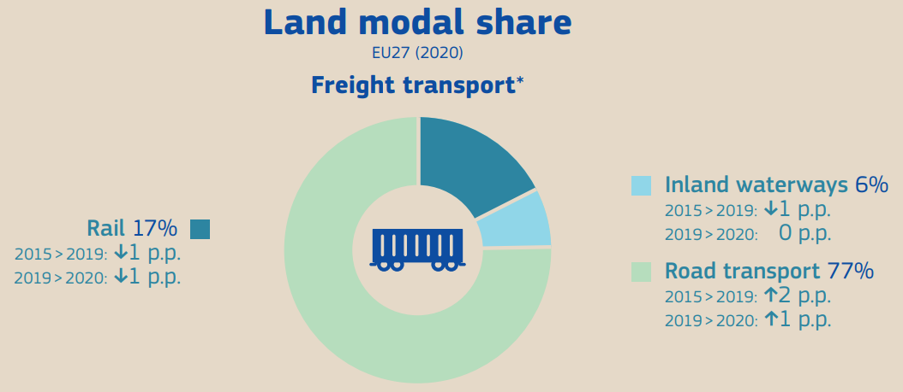
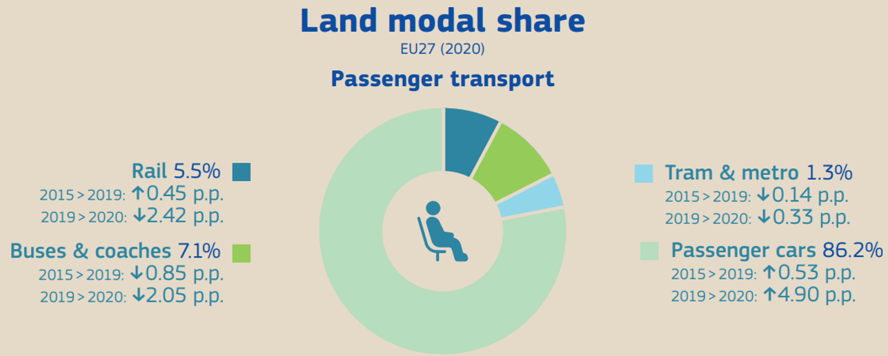
Modal shift needs a mental shift
In tonne kilometres, excluding pipelines
In passenger kilometres

Slide 5
The panelists
Nicolas Albrecht, CEO Cargobeamer
André Döring, Service engineering manager in Alstom
Matthias Knüpling, Head of Industry Lobbying and Associations VTG

Slide 6
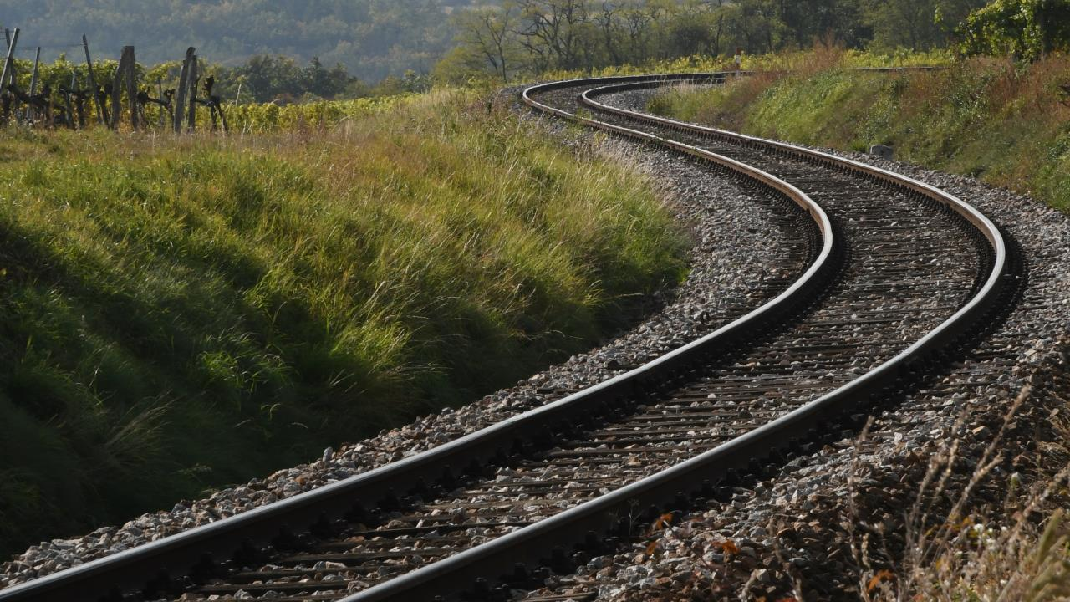
THANK YOU
Moving Europe towards a sustainable and safe railway system without frontiers.
Follow us:
Notes:
TSI (Transition, Combined Tr),
Revision of TEN-T Regulation: real opportunity to make Trans-European Transport Network fit for the future, to align the development of the TEN-T network to the European Green Deal objectives and the climate targets of the EU Climate Law. Cutting greenhouse gas emissions from the transport sector by 90%, compared with 1990 levels, by 2050, is key to achieving climate-neutrality by the same date.
New intermediary deadline of 2040 to advance the completion of major parts of the network ahead of the 2050 deadline that applies to the wider, comprehensive network. Core network will also be extended.
New term: 9 European Transport Corridors (ECTs) - integration of Core Network Corridors (CNCs) and Rail Freight Corridors (RFCs).
CT-related infrastructure parameters specified (CT profiles for all types of loading units) and strengthen the concept of network resilience by introducing mandatory interconnections between corridors as well as bypass options, with the aim of improving the reliability of transport services.
More transhipment terminals
High-speed rail network between the main nodes of Europe. The major TEN-T passenger rail lines should allow trains to travel at 160 km/h or faster by 2040.

