Slide 1

Workshop 6
How to conduct and participate to a Peer Review?
Virginie Papillault (UIC) & Fabrizio Carpinelli (ERA)
21 September 2023

Slide 2
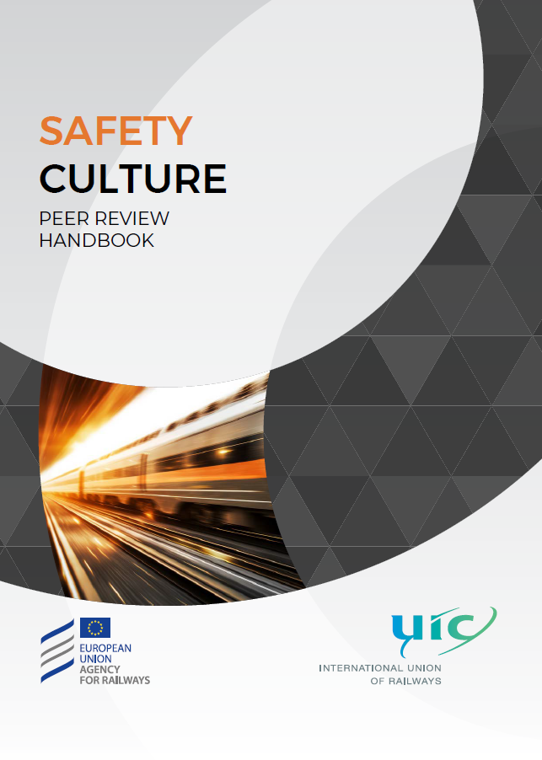
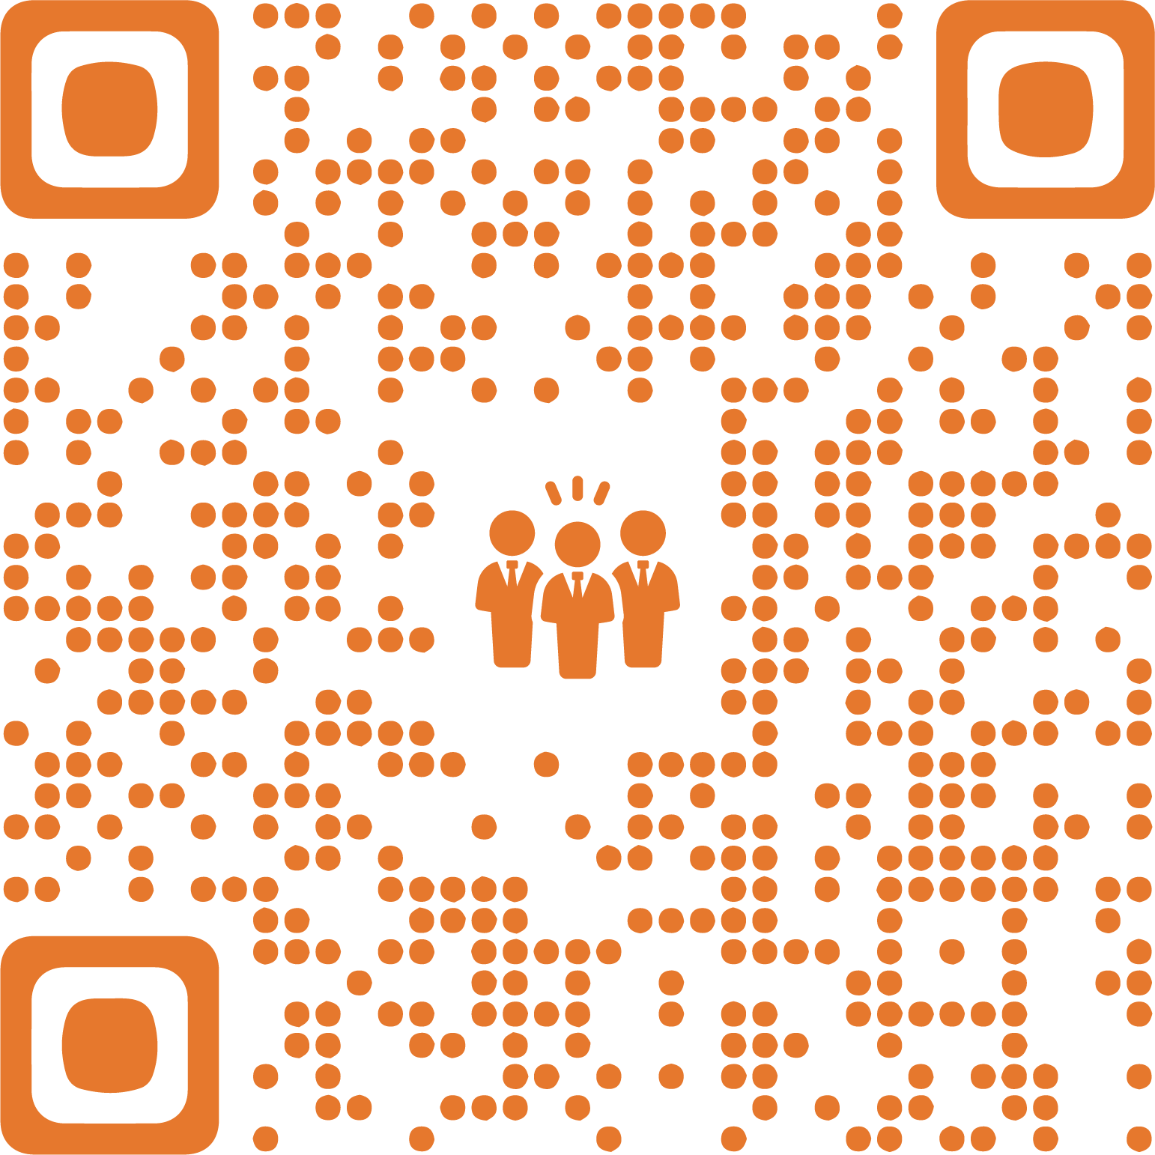
Introduction

Slide 3
Objectives of the Safety Culture Peer Review Handbook
Practical guidance for companies on how to perform a Safety Culture Peer Review
Methodology based on exchanges about good practices to develop safety culture
Role of the various stakeholders to prepare, conduct a Safety Culture Peer Review
Provide a final report for the host company with strengths and area of improvements
Support and disseminate the Safety Culture Peer Review in the Railway sector

Slide 4
Purpose of the workshop
Exchange about the Safety Culture Peer Review exercise and process
Get feedback from experienced stakeholders who already conducted a Peer Review
Engage discussion about the benefits/challenges of the Peer Review
Launch the Safety Culture Peer Review Handbook
Support from UIC & ERA in the Peer Review exercises and training

Slide 5
Panelists - Main actors of Peer Reviews
Neil Blakeley (Irish Rail) – Team Leader and Reviewer
Ken Byrne (Irish rail) – Reviewer
Paul Hodgson (CFL Cargo) – Reviewer
Thierry Saule (SNCF Réseau) – Reviewer

Slide 6
Panel discussion
What is a Peer Review?
A tool to develop Safety Culture in your company, and improve global safety performance
An exchange of good practices in between peers – everyone can learn
A tool for finding out how your company’s employees perceive the safety culture in their daily work
A practical on-site exercise
A positive approach for the Host company and the Team of Reviewers
It is not an audit!
An opportunity to understand if the fundamental safety messages and strategy of top-level management is reaching those people at the sharp / front end.
Be well-wishing, it’s not for judging but for helping
For more information on what a peer review is, please see the Safety Culture Peer Review Handbook at Chapter 3: Safety Culture Peer Review

Slide 7
Panel discussion
How long does a Peer Review last?
3 phases:
Preparing the Peer Review: before the Peer Review excercice:
  Team organisation – finding the right mix of participants
  Planning, this element is critical to a succsesful peer review. The host company must be open and honest as to what safety issues concern them. And without ‘setting the mind of the review team in a particular direction’ ensure that the right and relevant people are identified and encouraged to participate in the review.
  Prepare the collection of datas (survey ,documentation)
  Importance of roles of Team Leader and Host Company Coordinator
Conducting the Peer Review :
  6 days on site for the Teams of Reviewers,
  5 days for the Host Company
  Reporting the findings: after the Peer Review, the Host Company analyse the final report, implement the action plan, …
For more information on how long does a Peer Review last, please see the Safety Culture Peer Review Handbook at point 3.2.2.4 – Agenda Timeline

Slide 8

Panel discussion
Who are the key players?
For more information on who are the key players, please see the Safety Culture Peer Review Handbook at point 3.2. 1 – Organisation of the Team
A host coordinator with solid knowledge and with a good overview and understanding of how the organisation works

Slide 9
Panel discussion
How do you prepare for a Peer Review?
Organisation of the Team:
  Preparation and coordination of the various actors: Peer Review Team, The Host Company, the Host Coordinator, UIC, ERA (for training & methodological support)
  Important to consider the members of the peer review team – mix of backgrounds and cultures. Importance of language skills.
  Lots of meeting between Host Coordinator and Team Teader as well as the above. Building that joint rapport and understanding of what is required.
  Take the time to explain staff that is not a judgment, but a collection of their views and it is completely anonymous
For more information on how do you prepare for a Peer Review, please see the Safety Culture Peer Review Handbook at point 3.2 – Preparing the Peer Review

Slide 10
Panel discussion
What model do you refer to when carrying out a Peer Review?
ERA-SCM
Surveys
Existing recommendations from Authority
Action plan/SMS
Interviews – Although time consuming interviews allow for adaptation of questions in the live environment, it is more organic than the above options although they have their place. The time and focus afforded to peer review presents the opportunity to interview and reach a deeper understanding.
All interlocutors and reviewers are not necessarily proficient in English or any chosen language. Take the time to be sure to understand your interlocutor
For more information on what model do you refer to when carrying out a Peer Review, please see the Safety Culture Peer Review Handbook at point 2. 2 – ERA Safety Culture model attributes

Slide 11
Panel discussion
What tools are used during a Peer Review?
Interviews
Focus Group
On-site Observations
Document review
For more information on what tools are used during a Peer Review, please see the Safety Culture Peer Review Handbook at point 3.3 – Conducting the Peer Review

Slide 12
Panel discussion
How do you go from raw data to a report on strengths and areas for improvement?
Several steps, several people:
Debriefing into small groups of Reviewers is held after each interview, focus group or observation,
At the same time, each of the groups categorises the raw data in the ERA-SCM: enablers, fundamentals
At the end of each day, the raw data from each group are aggregated in a table provide for this purpose.
At the end of the peer review collection date, the Team of Reviewers meet and decide together what weight to give to each of the findings.
From there, the team decides together on the strengths and area of improvements
Don’t get lost into details, focus on the main points
For more information on how going from raw data to a report on strengths and area of improvement, please see the Safety Culture Peer Review Handbook at point 3.3.2 – Analysis of data

Slide 13
Panel discussion
What is the difference between an audit and a Peer Review?
Peer review is more holistic, it is not focusing on the paper trail more so the feeling of the organisation.
A Peer Review doesn’t identify the gap to the rules, law
A Peer Review rely on the perception and experience of safety by all staff levels
There is no recommendations produced, there are findings to be taken into account
Exchange of good practices
Whilst this is not an audit, a Peer Review can show to NSAs that organisations are taking Safety Culture seriously, thus responding also to regulatory requirements.
For more information on what is the difference between an audit and a Peer Review, please see the Safety Culture Peer Review Handbook at point 2.3 – Objectives of a Safety Culture Peer Review

Slide 14
Panel discussion
What tools do you use today to find out how your staff perceive safety and safety culture?

Slide 15

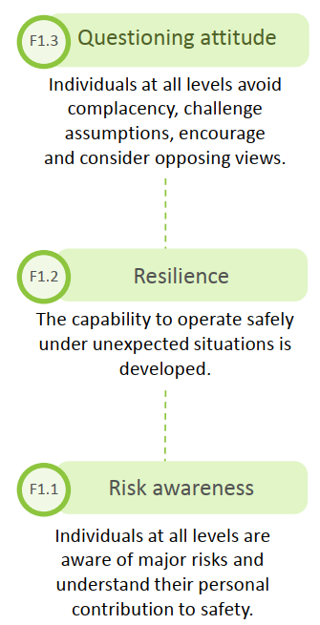
















Peer Review Exercise
A webinar has been held in May 2020 to describe the model and the safety culture attributes
Guidelines are here
Watch our video here
Discover an interactive version here
3 building blocks
Safety Fundamentals
Behaviour Patterns
Cultural Enablers
8 components
4 Fundamentals
4 Enablers
24 safety culture attributes
EXCELLENCE
CONTROL
MAJOR
RISKS
UNDERSTAND
WORKPLACE
REALITY
LEARN
FROM
EXPERIENCE
INTEGRATE
SAFETY
CONSISTENTLY
EXCELLENCE
SAFETY
SAFETY
FUNDAMENTALS
BEHAVIOUR PATTERNS
ENABLERS
ORGANISATIONAL
CULTURE
INTERACTING
FORMALISING
DISSEMINATING
REINFORCING

Slide 16
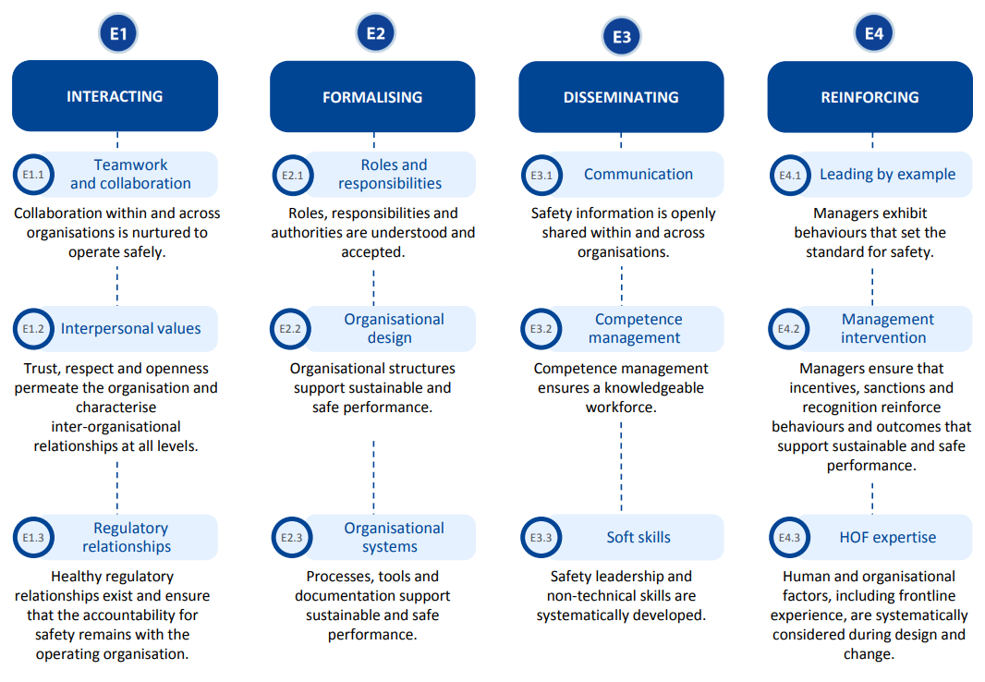
Peer Review Exercice
‘5 minutes’
According to you, what are up to 3 common cultural enablers in YOUR company or organisation:
1-3 positive attributes?
1-3 negative attributes?
+ -
you can use the given sheet
and mark the attributes
as you like + or -

Slide 17
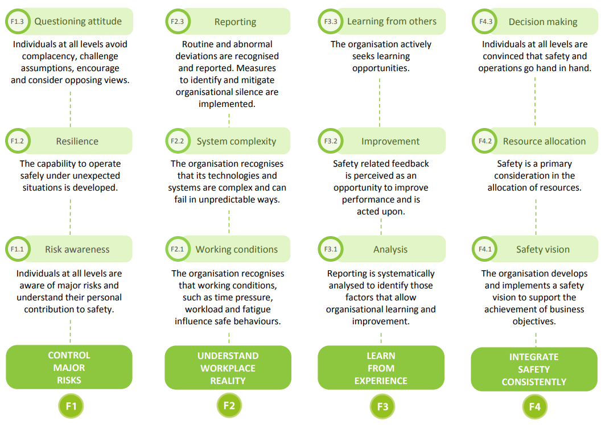
Peer Review Exercice
‘5 minutes’
According to you, what are up to 3 common cultural fundamentals in YOUR company or organisation:
1-3 positive attributes?
1-3 negative attributes?
+ -
you can use the given sheet
and mark the attributes
as you like + or -

Slide 18
The future of Peer Review belongs to you
The first Safety Culture Peer Review Handbook
ERA Training and support
UIC coordination and a pool of experienced Reviewers

Slide 19
Structure of the Handbook content
First part
Introduction:
Background
Objectives
Scope
Structure
Second part
Safety Culture:
What is a safety culture?
ERA SCM
Objectives of the peer Review
Third part
Safety Culture Peer Review:
Methodology
Preparing the Peer Review
Conducting a Peer Review
Reporting the findings
Practical illustrations

Slide 20
Timeline of a Peer Review

Slide 21
Outcomes of conducting a Peer Review
The development of a systemic view of safety
A positive approach of Safety Culture for the Host Company and the Team of Reviewers
For the Host Company:
The development of a systemic approach of safety
A proactive management of safety
Identify the strengths and area of improvements in terms of safety culture
Inspire from exchanges with Peer Reviewers on good practices and driving change method
Collective reinforcement of reporting processes
For the Team of Reviewers:
Identify good practices on safety in other companies
Identify good practices in driving change

Slide 22
ERA Training and support
On the ERA-SCM:
ex. website, guidelines, publications, webinars, videos, and soon an e-learning module
On the Peer-Review Preparation:
ex. basics on Peer Review method, on the questioning, on the ERA-SCM use to identify relevant findings into markers to be assessed and linked to its components and attributes
On the Production of the Final Report:
the first semi-automated tool which allows to produce a standard report is now stabilised and still needs manual/human checks before and after its compilation

Slide 23
UIC coordination of future Peer Reviews
Coordination of future Peer Reviews in Europe and internationally
  In the preparing phase of the Peer Review:
    Support and coordination of the Team of Reviewers, Team Leaders and Host Coordinator
    Support and coordination of the organisation process: scope, meetings, logistics, and definition of the agenda timeline
  In the conducting phase of the Peer Review:
    Support in the preparation phase of the collection of data
    Support during the conduction of the Peer reviews: interviews, focus group, observation
  In the reporting phase of the Peer Review

