Slide 1
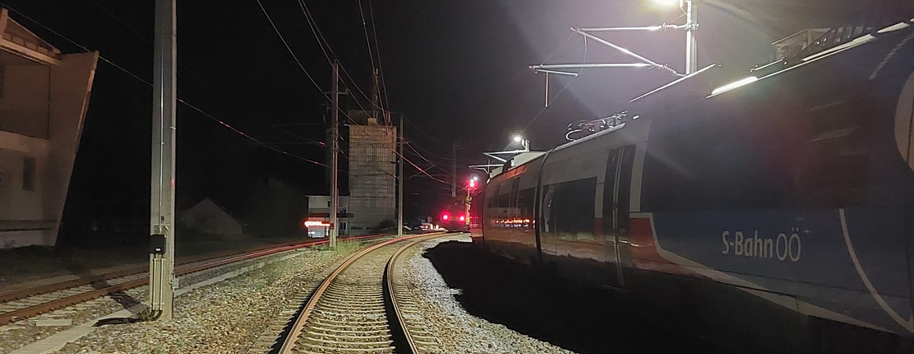

Cross-organisational SPADs – learning from each other (findings & myths)
ERA Safety Days 2023 Day 2 Workshop #1
09:45-11:00 & 11:30-12:45
Dr. Michaela Schwarz
LIVING
SAFETY

Slide 2
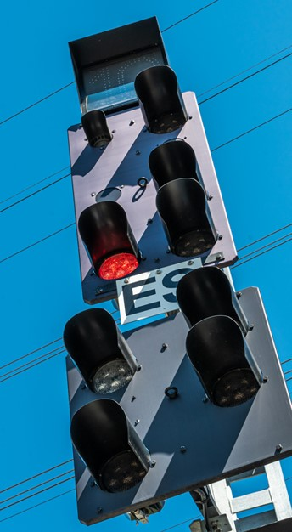
Agenda for today
SPAD introduction
SPAD benchmark EU-27
Factors contributing to SPADs
SPAD countermeasures
Scientific evidence in the SPAD literature
Workshop Groups of 5 (20 Min.)
Presentation & discussion of Results (20 Min.)
Wrap Up & Take – Aways (20 Min.)

Slide 3




Background/ Drivers for this Workshop
UK/ Belgium/ Poland

Slide 4
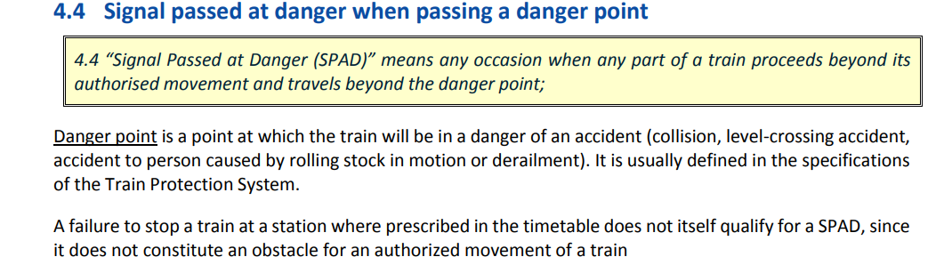
Signal passed at danger (SPAD)
ERA Common Safety Indicator (CSI)
3 SPAD categories (ITSR, New Zealand, 2011)
crew/train performance SPAD
Returned in face of driver SPAD
Runaway SPAD (unmanned)
!
Source: ERA Implementation Guidance on CSIs (2015)

Slide 5
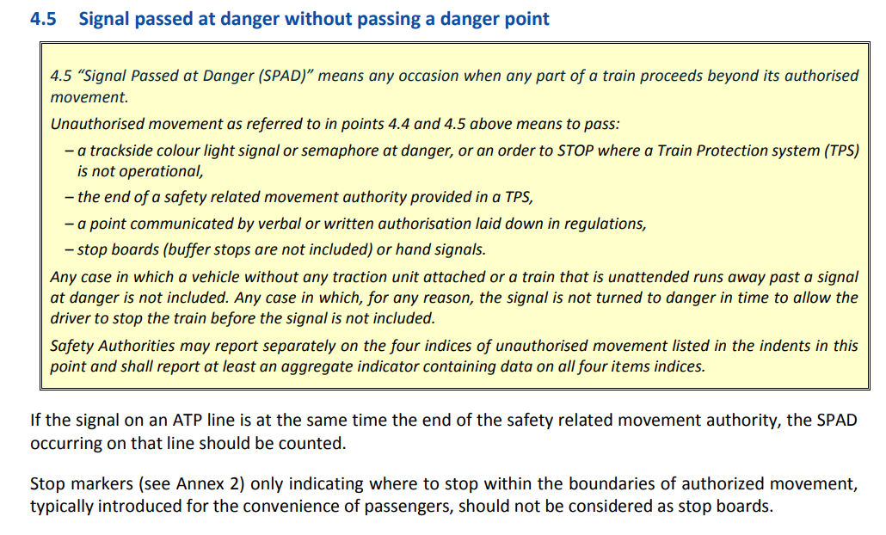
Signal passed at danger without passing a danger point
ERA Common Safety Indicator (CSI)
ATP = automatic train protection
Source: ERA Implementation Guidance on CSIs (2015)

Slide 6
In other words put simply-
SPADs are:
A near miss event, when trains or trams inadvertently exceed their movement authorities, typically by encroaching on stop/red/ danger signals
Weak link in an otherwise very safe system
One of the few points in rail where a single failure can have catastrophic consequences
SPADs occur in relatively small number compared to the large number of rail operations
Only a proportion of SPAD have the potential to result in collission or derailment
Even low risk SPADs can have far-reaching impacts:
    loss of service,
    timetable disruption,
    reduced driver wellbeing
lenghty incident investigation,
requirements for retraining,
regulator penalties
Source: Naweed et al. (2022)

Slide 7
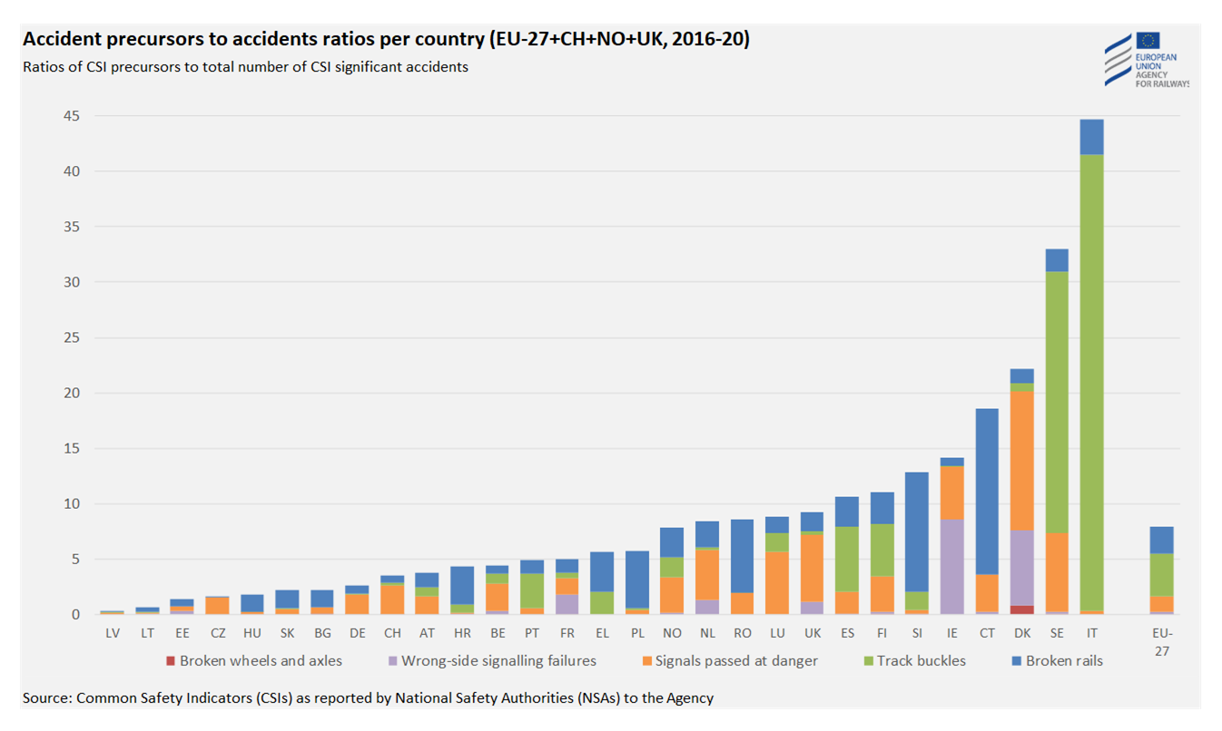
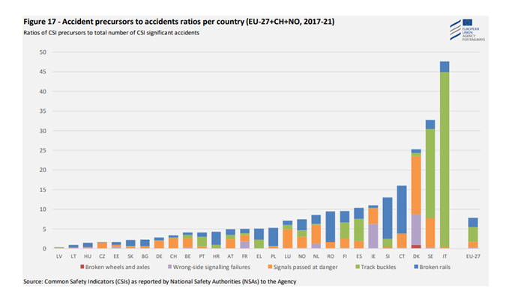

SPAD Reporting: EU-27
Top 10
Top 20
=
=
SPAD EU-27 Average
SPAD EU-27 Average
Source: ERA Safety Overview – 2022
Source: ERA Safety Overview – March 2023
All European countries report SPADs as precusors to significant accidents. The average percentage share of SPADs within EU-27 is around 3%. Some European countries report a higher percentage of SPADs (10%) with the highest SPAD reports in Denmark & Sweden.

Slide 8
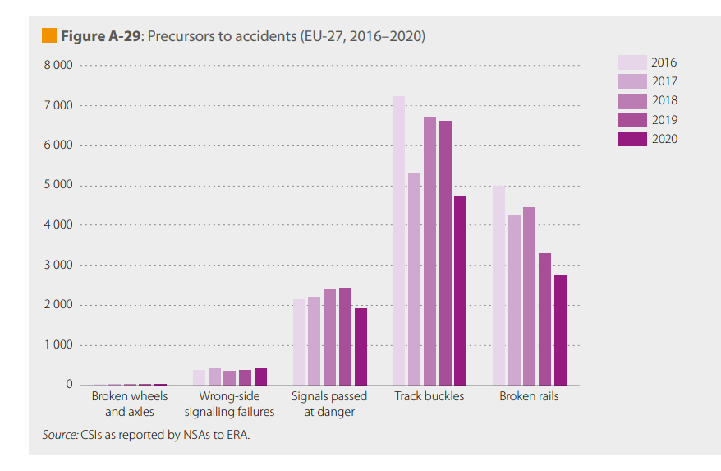
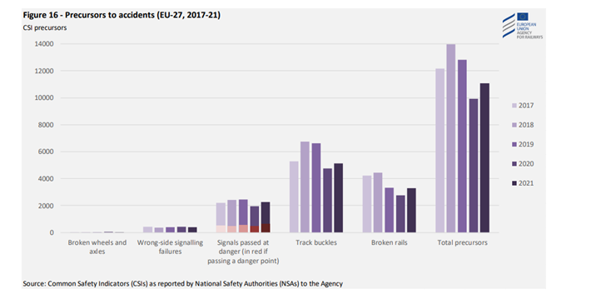
SPAD development 2016-2021
Numbers of 2022 & 2023 ?
Source: ERA Safety Overview – March 2022
Source: ERA Safety Overview – March 2023
SPAD reports have increased over the years 2016-2019. e.g. During July 2019, the UK experienced its highest number of SPADs (41!) since 2007 in a single calendar month (RSSB, 2019).
In 2020 (Corona) less SPADs were reported. For 2021 the SPAD reports increase again. → SPAD reports increase in all countries regardless of infrastructure & technical equipment. In Austria: 4000 movements/ day; on average 6.5 SPAD/month in 2022, 78 SPADs/ year. In Australia: more than 1,000 SPADs / year, each costing up to AU$110,000 (EUR ~66,5K) (Naweed et al., 2018)

Slide 9
20 factors contributing to SPADs
Traffic category (passenger vs. cargo)
Traffic type (city, regional, long-distance)
Train type (locomotive vs. control car)
Specific routes (geographical hotspots)
Signal density/ visibility
Age distribution/
generations
Length of Service/ experience level
Route
Knowledge
Type
Knowledge/ mixed modes
Operational irregularities
Seasons/ weather conditions, temperature
Time of Day/ peak hours
Shift hour/ scheduling irregularties/ fatigue
Quality of leadership/ leadership span/ safety culture
Type & duration of training
Internal distraction (private issues)
External distraction
(team-working dynamics, communication etc.)
Workload/ perceived stress
Trust in automation/ TPS levels
Any other?

Slide 10
Most recent SPAD incident in Austria:
20 January 2023, Fürnitz

Slide 11
LESSONS LEARNT:
Fürnitz Side-On Collission 20.01.2023
Light snow, 1 degree centigrade, slippery tracks, 04:00 a.m. (night time), 4th shift hour
Slow operational processing at the border due to language barrier (AT-IT)
Perceived stress: train is delayed for 131 minutes at the time of comms with signaller
Expectation bias: green wave
04:02:56 Driver decides to depart without functional train protection system in Tarivs (Italy)
04:08:44 driver reports broken TPS and arranges exchange of locomotives with signaller at the next opportunity across the border in Austria
Driver misses the yellow signal warning about the next amin signal to be in stop (external distration, wrong focus)
ENVIRONMENT
(weather conditions, visibility, temperature…)
ORGANISATION
(operating procedures, culture, training …)
EQUIPMENT
(train protection system..)
Psychological pre-conditions –
HOF analysis
Rule (ZSB12) – no departure with TPS malfunction (if TPS malfunction occurs during operations, vmax 100km/h) –> new rule: 50 km/h until the next station can be reached to repair/ exchange locomotives, in 2-person ops vmax 100 km/h!
@Infrastrucure Provider: review process on the formation of routes with regards to crossing tracks/ trains
HUMAN
(unsafe acts, active failures…)
TPS malfunction
04:17: correct signalling (automatic self-setting operation)
04:19:15
Side-On Collission

Slide 12
SPAD countermeasures: HEP logic
H-UMAN
Individual knowledge, skills & experience
Medical & personal factors (cognitive abilities)
Stress, fatigue
Motivation & attitude
E-QUIPMENT
Technical equipmen in the locomotive/ cabin
Technical equipment (r/t, tablet, apps, electronic charts)
Train protection systems
Technical infrastructure (signals, magnets, signs, stations, overhead lines)
TASK
P-ROCEDURE (ORGANISATION/ ENVIRONMENT)
Job factors, task design
Standard operating procedures, rules, norms
Man-machine-interface
Leadership & supervision
Safety & just culture
Source: HEP-Logic (ÖBB PR /M. Schwarz, 2023, adapted from Eberhard Ulich, 2005)

Slide 13
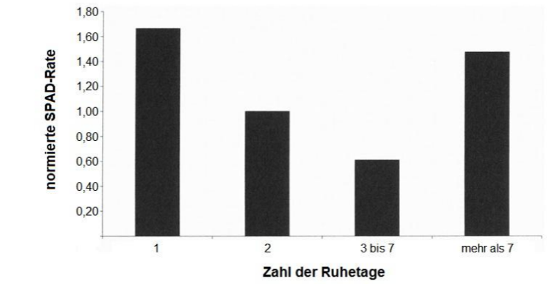
SPAD State of Research
Returning from rest days (Gibson et al., 2007)
Team-working dynamics (Naweed, 2020)
Scheduling irregularities (Dorrian et al., 2022)
Any other?
Normalised SAPD rate
Number of rest days

Slide 14
WORKSHOP
Group 3
Group 5
Group 1
Group 6
Group 2
Group 4

Slide 15

Workshop – Work in Groups of 5-6 people, please mix countries/ organisations
Icebreaker: Have a short discussion on the SPAD situation/ SPAD development in your country? Increasing/ decreasing and why? – refer to slide 7
Then please try to answer the following 3 questions with your group:
Which factors contributing to SPADs are you aware of and why? (please report reference to study OR practical experience) – refer to slide 9
Which countermeasures (HEP logic) are you aware of and how effective are they? (please report references to study OR practical experience) – refer to slide 12 & 13
How do you measure / anticipate/ predict SPAD risk and why? (please report reference to study OR practical experience) – refer to slide 17

Slide 16
Take aways
Based on workshop results…

Slide 17
SPAD Literature References
Dorrian, J. Chapman, J. Bowditch, Balfe, N. & Naweed, A. (2022). A survey of train driver schedules, sleep, wellbeing and driving performance in Australia and New Zealand. Sci Rep 12, 3956 (2022). https://doi.org/10.1038/s41598-022-07627-0
Gibson, W.H., Mills, A., Basacik, D. & Harrison, C. (2015). The Incident Factor Classification System and signals passed at danger. Paper presented at the The Fifth International Rail Human Factors Conference, London, UK.
Gibson, H. W., Shelton, J. & Mills, A. (2007). The Impact of Returning from Rest Days on SPAD Incidents. In J. R. Wilson, B. Norris, T. Clarke & A. Mills (Hrsg.), People and Rail Systems : Human Factors at the Heart of the Railway (p. 475-481). Aldershot (Hampshire): Ashgate Publishing.
Independent Transport Safety Regulator (ITSR), (2011). Managing signals passed at danger. Safe transport for NSW, Australia.
Lowe, E., and C. Turner. (2005). “A Human Factors SPADs Checklist.” In Rail Human Factors: Supporting the Integrated Railway, edited by J. R. Wilson, B. Norris, T. Clarke, and A. Mills, 182–188. Cornwall: Ashgate.
Naweed, A. (2020). Getting mixed signals: connotations of teamwork as performance shaping factors in network controller and rail driver relationship dynamics. Appl. Ergon., 82 (2020), p. 102976, 10.1016/j.apergo.2019.102976
Naweed A., Bowditch, L., Chapman, J., Dorrian, J. & Balfe, N. (2022). On good form? Analysis of rail Signal Passed at Danger pro formas and the extent to which they capture systems influences following incidents. Safety Science. Volume 151, July 2022. Elsevier.
Naweed A., Rainbird S. & Chapman J. (2015) Investigating the formal countermeasures and informal strategies used to mitigate SPAD risk in train driving, Ergonomics, 58:6, 883-896, DOI: 10.1080/00140139.2014.1001448
RSSB, 2020a. Looking at Precursors to Anticipate SPAD Risk. Retrieved, Sep. 17, 2020, from https://www.rssb.co.uk/what-we-do/key-industry-topics/spad-good-practice-guide/looking-at-precursors-to-anticipate-spad-risk
RSSB, (2019). Rail safety body voices concern over trains passing red signals. Retrieved Sep. 17, 2023 from https://www.rssb.co.uk/what-we-do/insights-and-news/news/Rail-safety-body-voices-concern-over-trains-passing-red-signals
Stanton, N.A. & Waker, G.H. (2011). Exploring the psychological factors involved in the Ladbroke Grove rail accident. Accident Analysis &/ Prevention, Vol43, Issue 3, May 2011, pp. 1117-1127. Elsevier.
Zhao, Yunshi, Stow, Julian and Harrison, Chris (2016) Estimating the frequency of trains approaching red signals: A case study for improving the understanding of SPAD risk. IET Intelligent Transport Systems, 10 (9). pp. 579-586. ISSN 1751-956X
Any other?

