Slide 1
ERA Key Learning Initiatives to support the implementation of the EU railway safety legislation
Grégory Rolina, Programme Manager
Tallinn, Safety Days, 21 September 2023

Slide 2
European Year of Rail Safety Days, Porto, 3 November 2021
2

Slide 3
European Year of Rail Safety Days, Porto, 3 November 2021
Analyse and explore the survey results with a new Task Force
Conduct a Safety Culture Peer Review Pilot (with CER)
Implement ERA-SCS as a service accessible upon request
Develop training (safety leadership, just culture, HOF…)

Slide 4
Safety Training and Assistance to Rail Stakeholders STARS Project Objectives and Scope
The project supports the rail stakeholders with the adequate application of the railway safety legislation through training and other appropriate activities
The project aims at making
ERA a leader in developing and delivering railway safety training and activities to achieve organisational excellence
European railways a mature socio-technical system oriented towards continual learning and improvement
4
4

Slide 5
1. Training and Assistance Delivered to a Single Organisation
Our portfolio
Safety Leadership (EN, FR, NL, DE, ES, PT, IT)
Investigating SMS (EN, FR, NL, DE)
Regulatory Oversight of Safety Culture (EN, FR, ES)
Organisational Just Culture (EN, FR)
ERA-SCS (23 European languages)
Safety culture assessment
More to come and open to suggestions!
Chargeable service - Formal request from a ERA network member to launch the contract (to be simplified)
5

Slide 6
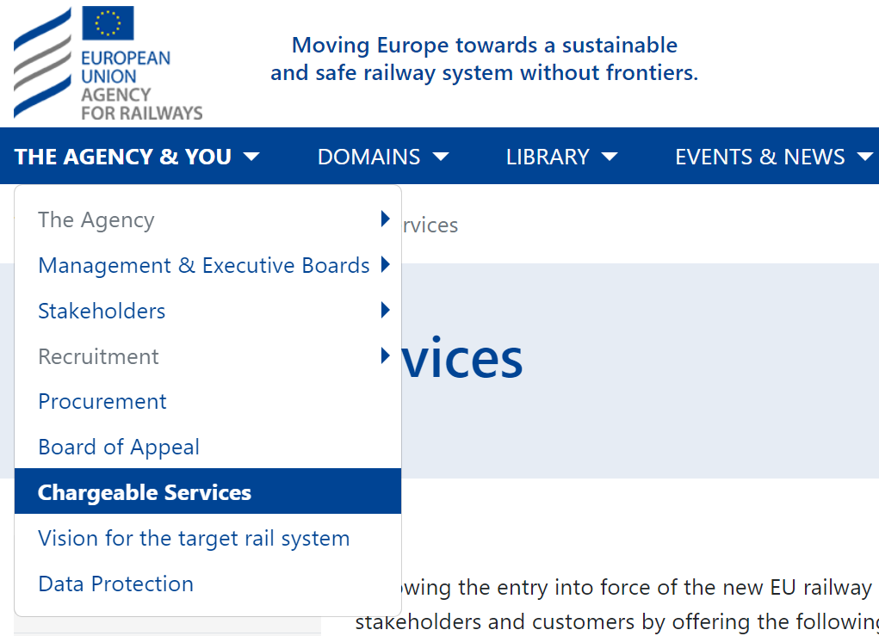
1. Training and Assistance Workflow
Contact & Preparation
STEP1
Request from ERA Network
STEP2 Chargeable Service Contract
STEP3
Delivery
STEP4
Feedback from Participants
STEP5
Invoicing
& Future cooperation
6

Slide 7
2. Open Training e-learning, online and classroom session
ERA Academy Platform including e-learning modules (Moodle)
Safety Leadership Training Pilot on 19/06/23
Training sessions for Q4 2023 are open for registration!
Organisational Just Culture (6-8 and 16 Nov.)
Investigating SMS (5-7 Dec.)
Safety Leadership (12 Dec.)
Save the date for the sessions in 2024!
Under development: HOF; SSC for Assessors; ECM
e-learning demo
by
Kim
Safety Leadership Feedback Video
7

Slide 8
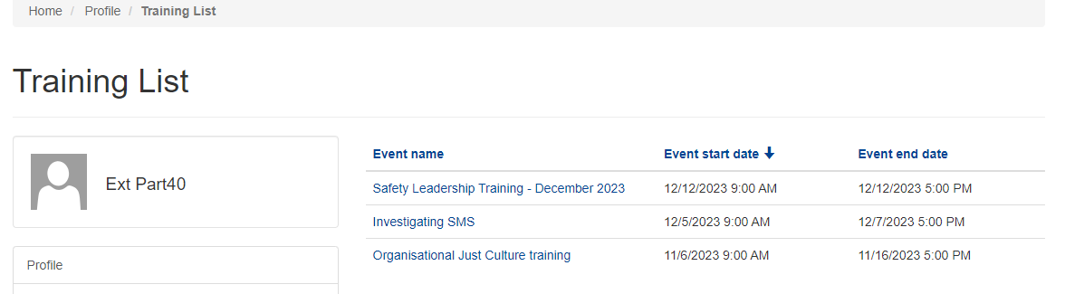
ERA Website
Social Network
…
2. Open Training Online and classroom session – Workflow
STEP1
Registration
STEP2
Payment
STEP3
Confirmation
STEP4
Delivery
STEP5
Feedback
8

Slide 9
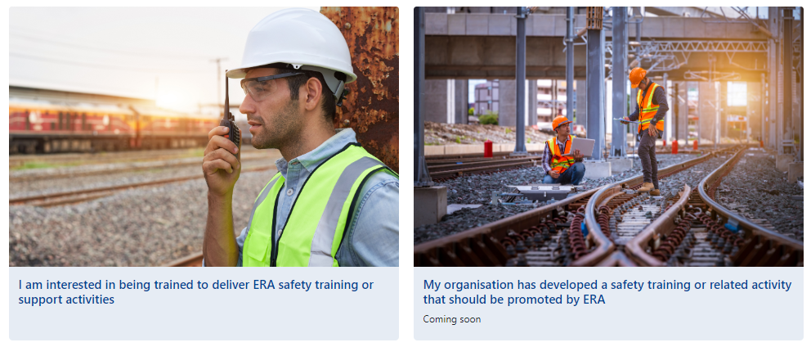
3. Qualification of Trainers
Current portfolio
Safety Leadership
Organisational Just Culture
Qualified trainers deliver courses within their organisation
Qualified trainers at National Safety Authority deliver courses within the related sector
Qualified trainers who are interested may also deliver courses with ERA
9

Slide 10
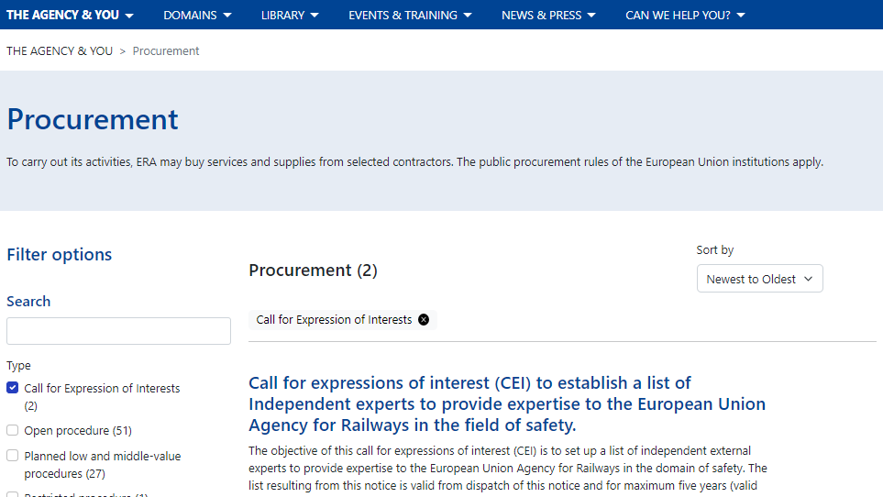
3. Qualification of Trainers Knowledge acquisition path
STEP1
Observation / participation to a training session
STEP2
Train-the-trainer preparation
STEP3
Train-the-trainer course including dry-run
STEP4
Coaching and assistance
STEP5
Qualification
Qualified trainers who are interested may also deliver courses with ERA
10

Slide 11
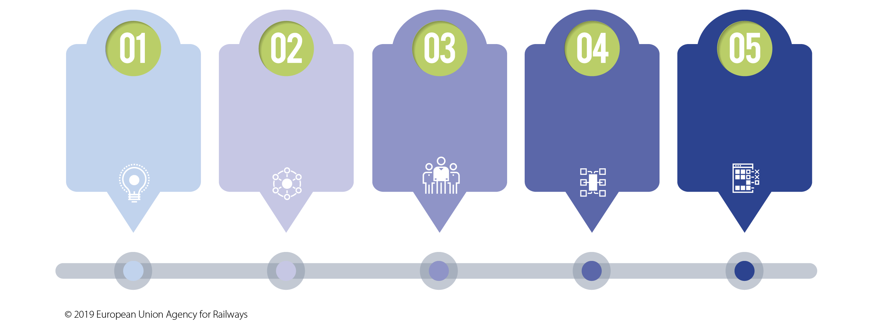
ERA Safety Leadership Principles 2.0
3. Qualification of Trainers A great opportunity to develop safety capabilities
BE INSPIRATIONAL
-
SHARE `THE SAFETY VISION
BE CREDIBLE
-
LEAD BY EXAMPLE
BE SUPPORTIVE
-
REINFORCE GOOD PRACTICE
BE BRAVE
-
INTERVENE
BE JUST
-
UNDERSTAND AND IMPROVE
11

Slide 12
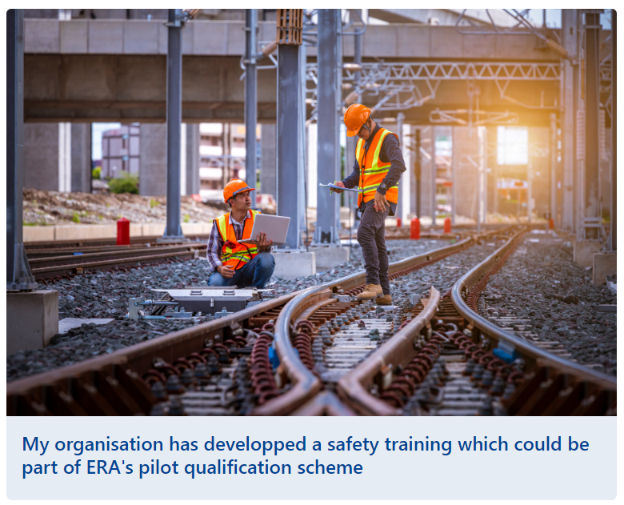
4. ERA Qualification of Safety Training Objective and Benefits
Objective:
Value existing training that effectively supports adequate application of the railway safety legislation
Qualify your training to:
Gain visibility on ERA website and during ERA events
Subject to compatibility and agreement, integrate the course into the ERA Academy platform and calendar
More benefits to be devised together!
12

Slide 13
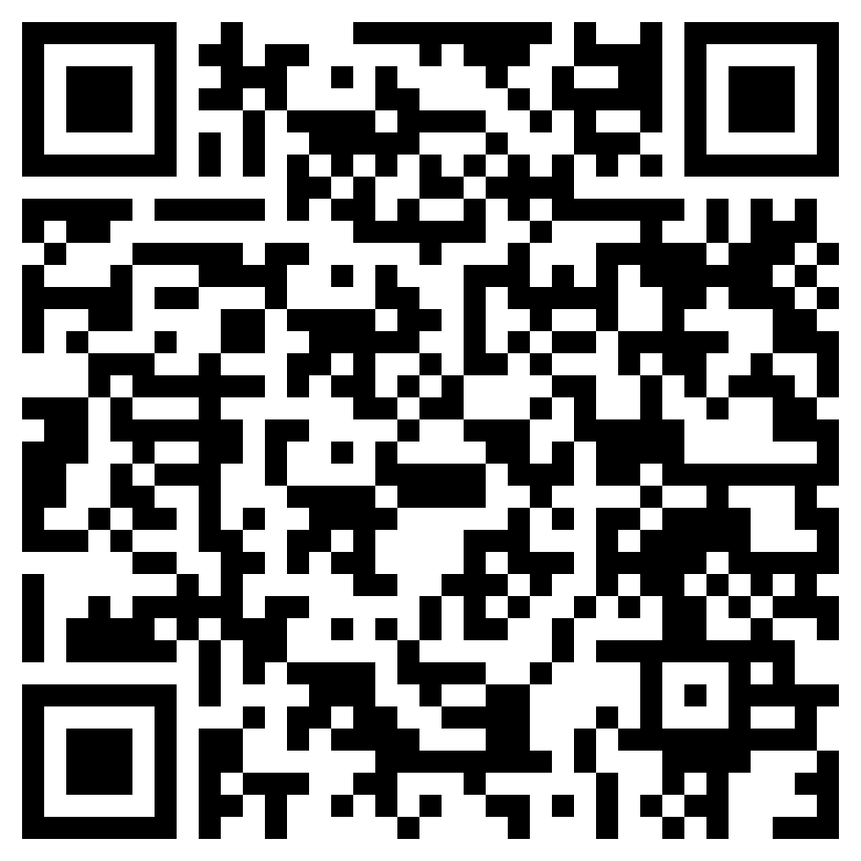
4. ERA Qualification of Safety Training Pilot Phase
To apply: fill in the form and upload documentation related to the training to be qualified
Pilot phase is open! Apply until 21/12/2023
Open to organisations who are currently delivering rail safety training in any European language
Principle “first comes, first serves” applies
Maximum capacity: 10 first applicants
Successful applicants will be qualified for 2024
No charge is imposed in the pilot phase
GO/NO-GO at the end of 2024
https://ec.europa.eu/eusurvey/runner/ ERA-Qualification-of-Safety-Training-Pilot
ERA is bound to use all documentation and material shared only for the assessment and shall not communicate it to third parties
13

Slide 14
4. ERA Qualification of Safety Training Pilot: Workflow
Applicant + Rail Safety Training
Preparation
STEP1
Application EU Survey
STEP2 Assessment ERA team 1 month
STEP3
Qualified training
2024: Pilot liaison ERA-Successful applicants
STEP4 Improved Qualification Service
STEP5 Increased high-quality training offer
Criteria: 1) Support the implementation of the EU railway safety legislation
2) Alignment with ERA approach on safety
3) Training development and trainers experience
4) Training effectiveness and participants feedback
Improvements:
Assessment criteria
Oversight and renewal
Cost and period of validity of qualification
Benefits for the applicants
14

Slide 15
Conclusions
Developing capability to achieve our vision through the adequate implementation of the EU railway safety legislation
ERA Website > Domains > Safety Training and Assistance to Rail Stakeholders
STARS@era.europa.eu
15

