Slide 1
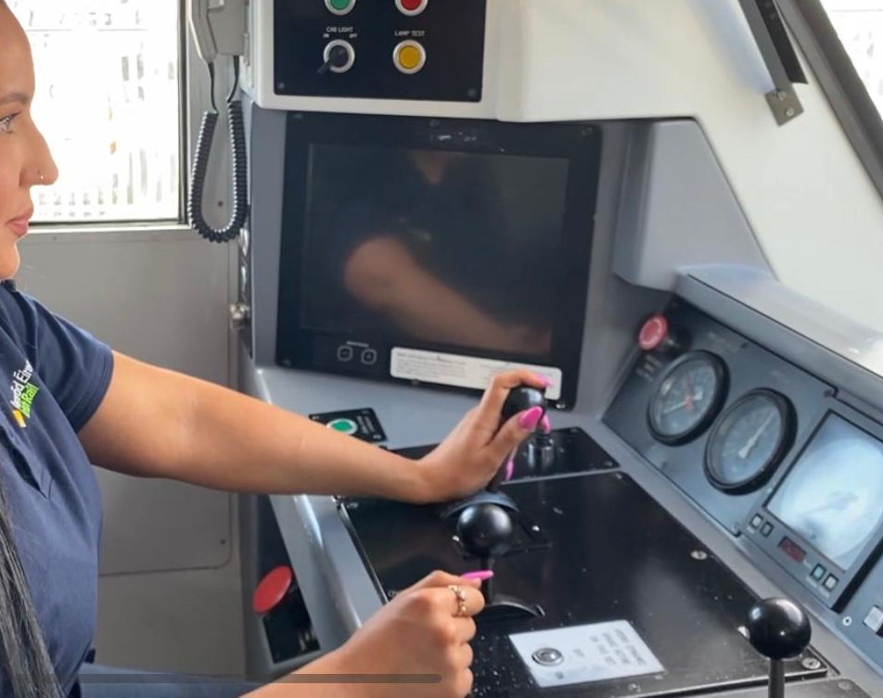
Building a leadership for safety
Case Study: Irish Rail

Slide 3
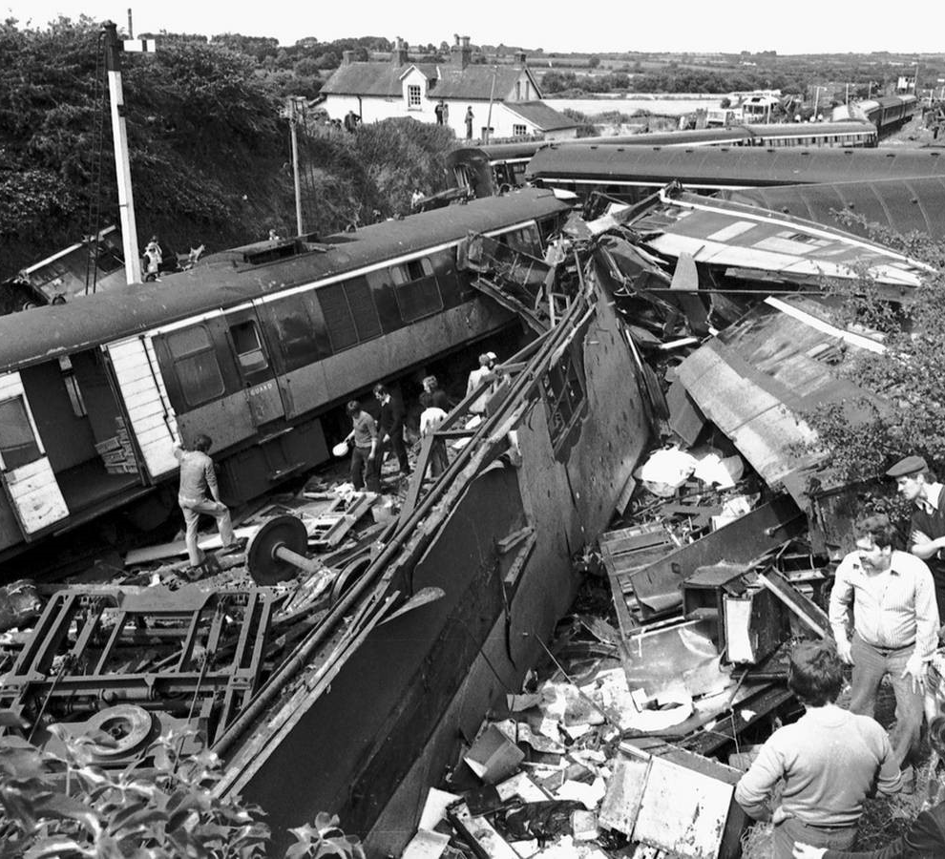
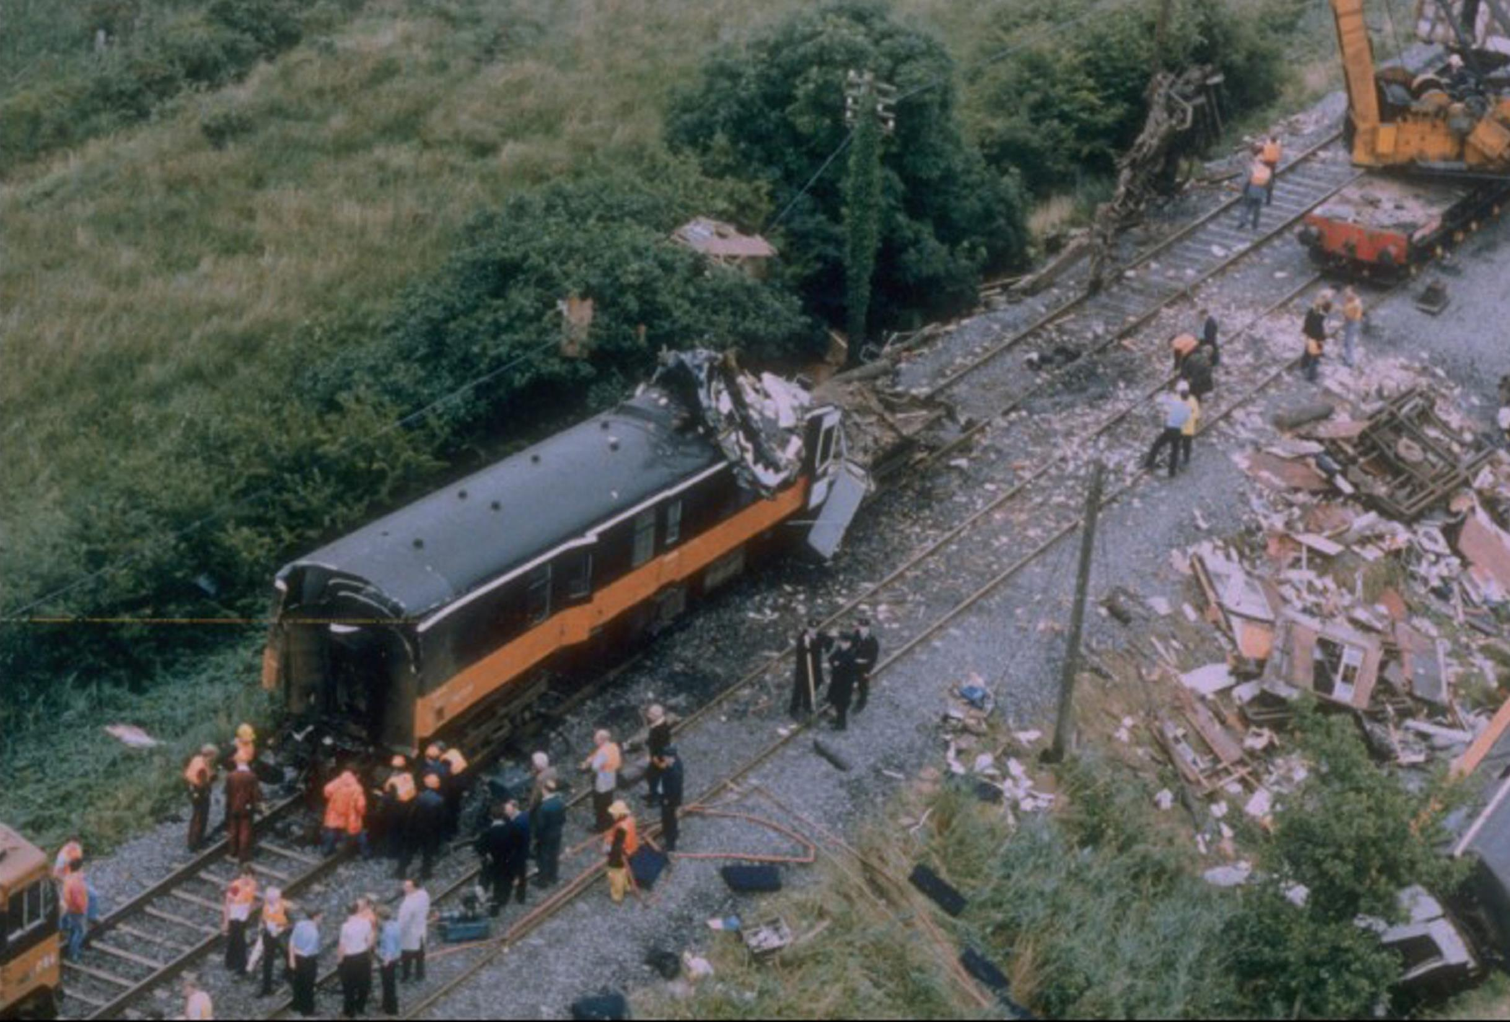
Buttevant, Cork, August 1st, 1980 →
↑ Cherryville Junction, August 21st, 1983

Slide 4
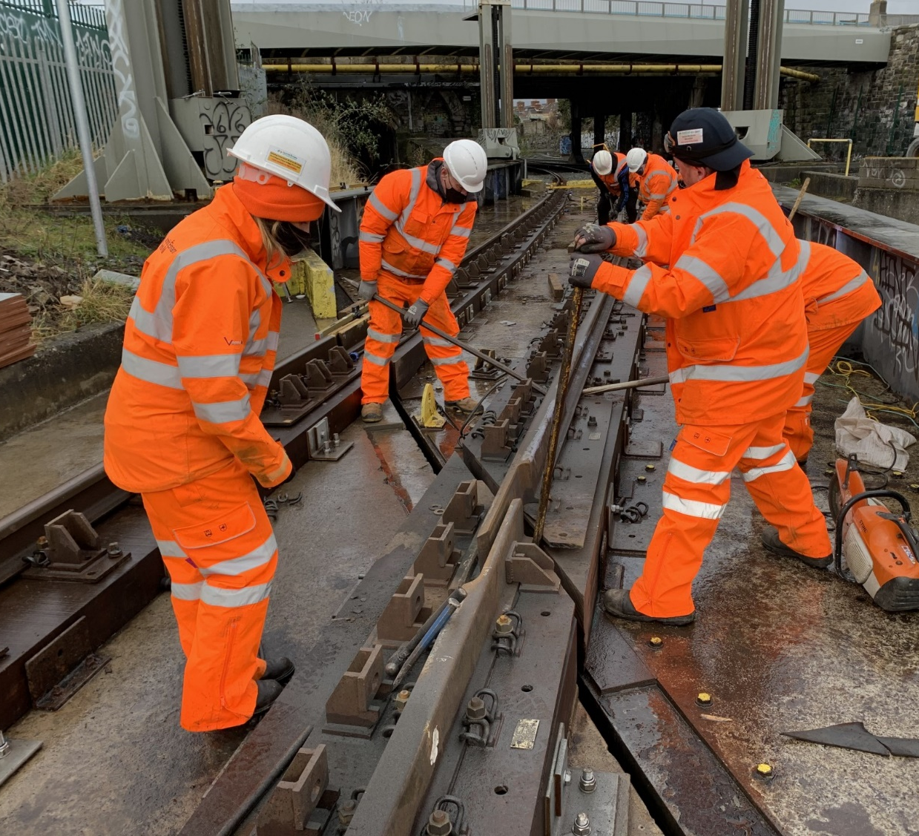

Slide 5
Safety Leadership Training:

Slide 6
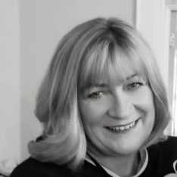
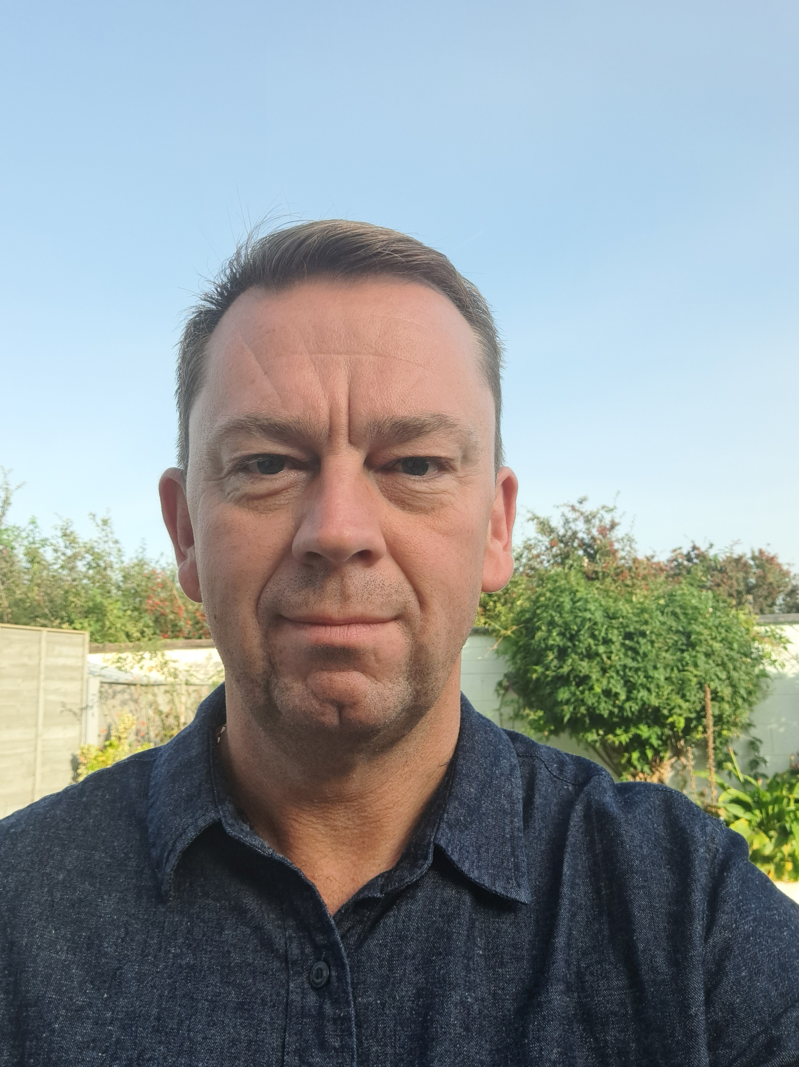
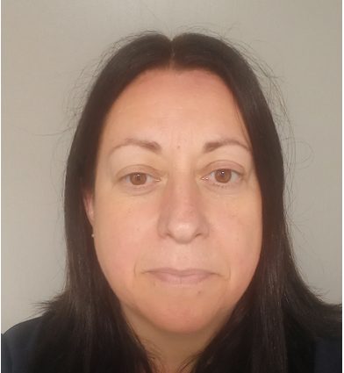
Timeline of rollout
2019
ERA delivery to Executive team
4 trainers trained in Valenciennes
Content adapted for IE
Neil
2020
2021
PANDEMIC!
2 trainers trained in Valenciennes
17 courses delivered between March and November
Aileen
2022
2023
4 trainers trained in Valenciennes
Developing adapted course for frontline managers and supervisors
Mick Ha
201 senior managers trained to date

Slide 7
Safety Leadership Training
Three Safety Pillars
Safety Vision
ABC Model
Just Culture

Slide 8
Safety Leadership Training
Safety Leadership Principles
Decision Making and Trade-Offs
Personal Engagement
Round-table interactive session
Notes:
All modules include interactive sessions that drive engagement, collaboration and knowledge sharing.
The key element that pulls the training together is a dramatic reconstruction video depicting a serious safety incident

Slide 9
Employee Feedback: What went well?
Very relevant content in an interactive setting
Great group interaction
Real-life examples are really helpful and engaging
Enjoyed the discussions with other departments
Very beneficial and topical

Slide 10
Supporting our Safety Leaders:
Safety Leaders
Safety Culture Role
Just Culture
SMS Updates
Compliance Improvements
OORs
Safety Culture Assessment

Slide 11
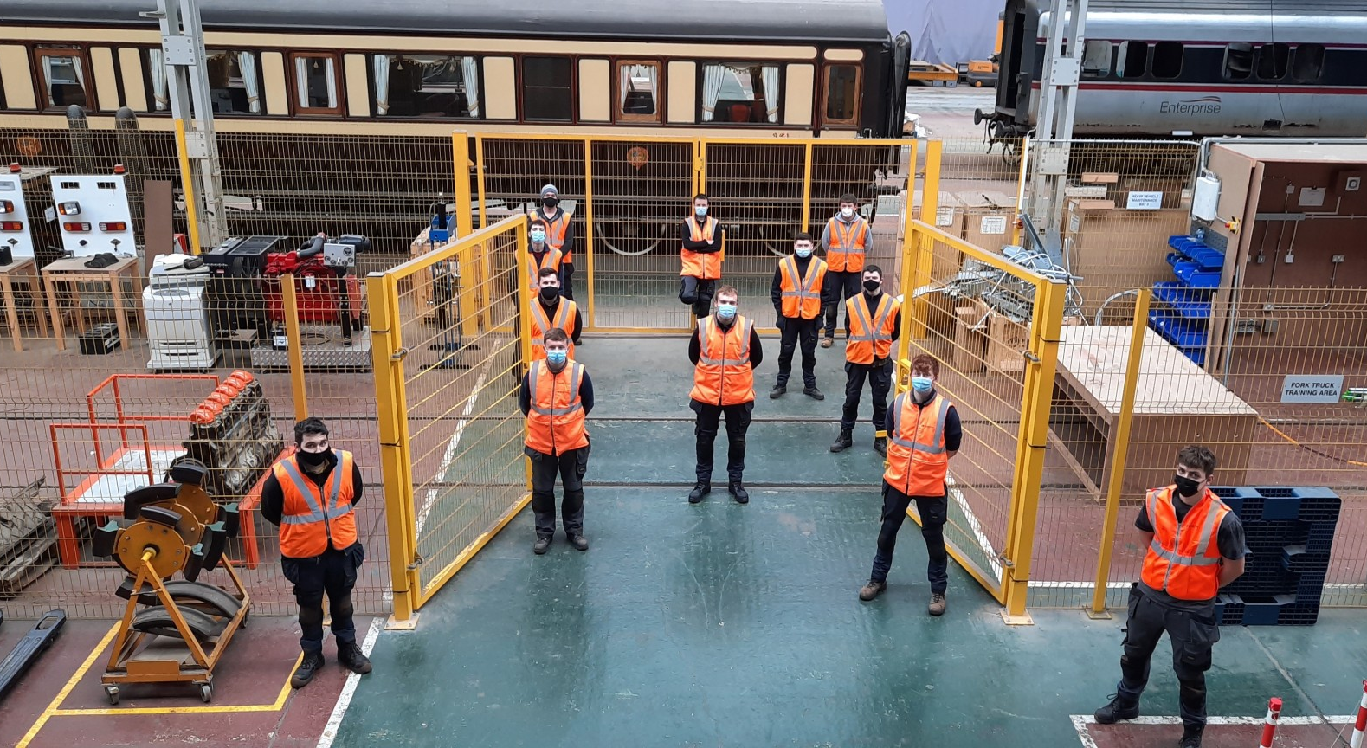
Thank You

