Slide 1

SLIDO #SafetyDays2023
WORD CLOUD
Describe in 2-3 words what you think of when you hear “Human and Organisational Factors”?

Slide 2
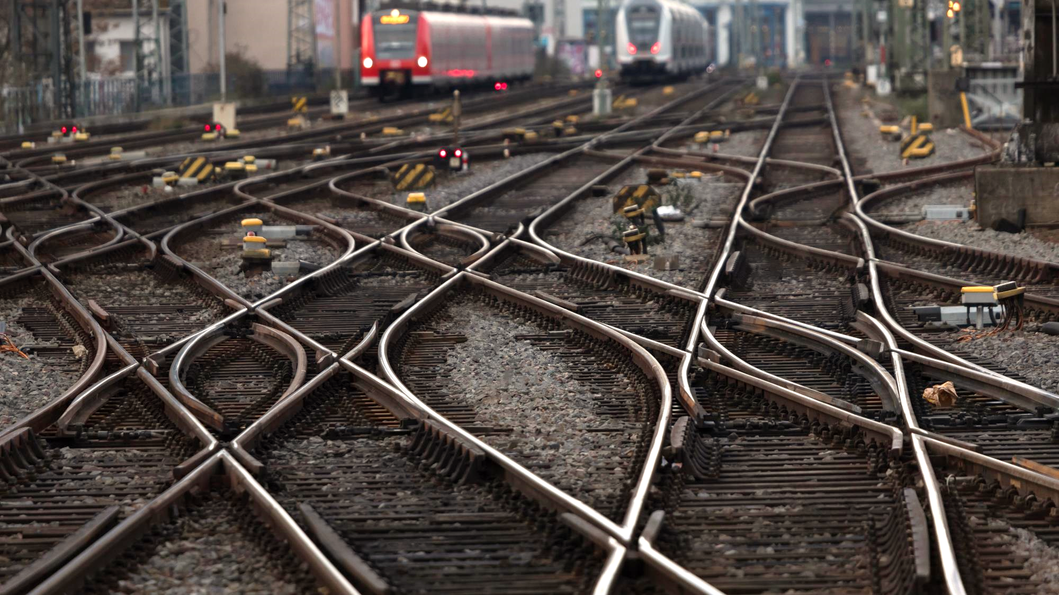


Sharing is caring - How RailHOF can help you to overcome safety issues
RailHOF team
| 21.09.2023 | Tallinn, Estonia
Photo: Adobe Srock / by Tobias Arhelger

Slide 3
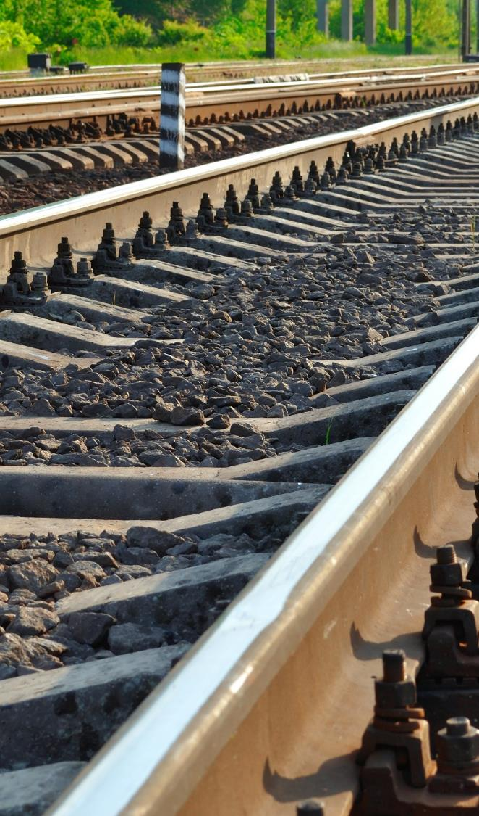

Outline
RailHOF – What is it?
How was it developed?
Analytics – RailHOF fun facts
Demonstration
“No deposit – no return”
Photo: Adobe Srock / by tarasylo

Slide 4
SLIDO #SafetyDays2023
POLL (yes/no answer)
How many of you have heard of RailHOF?

Slide 5





Slide 6


A user-centred approach has been applied to better capture user needs and then use these to determine design requirements, content and functionality and usability.
This approach was used all along the development process of RAIL HOF from the needs analysis to the development of the platform.

Slide 7
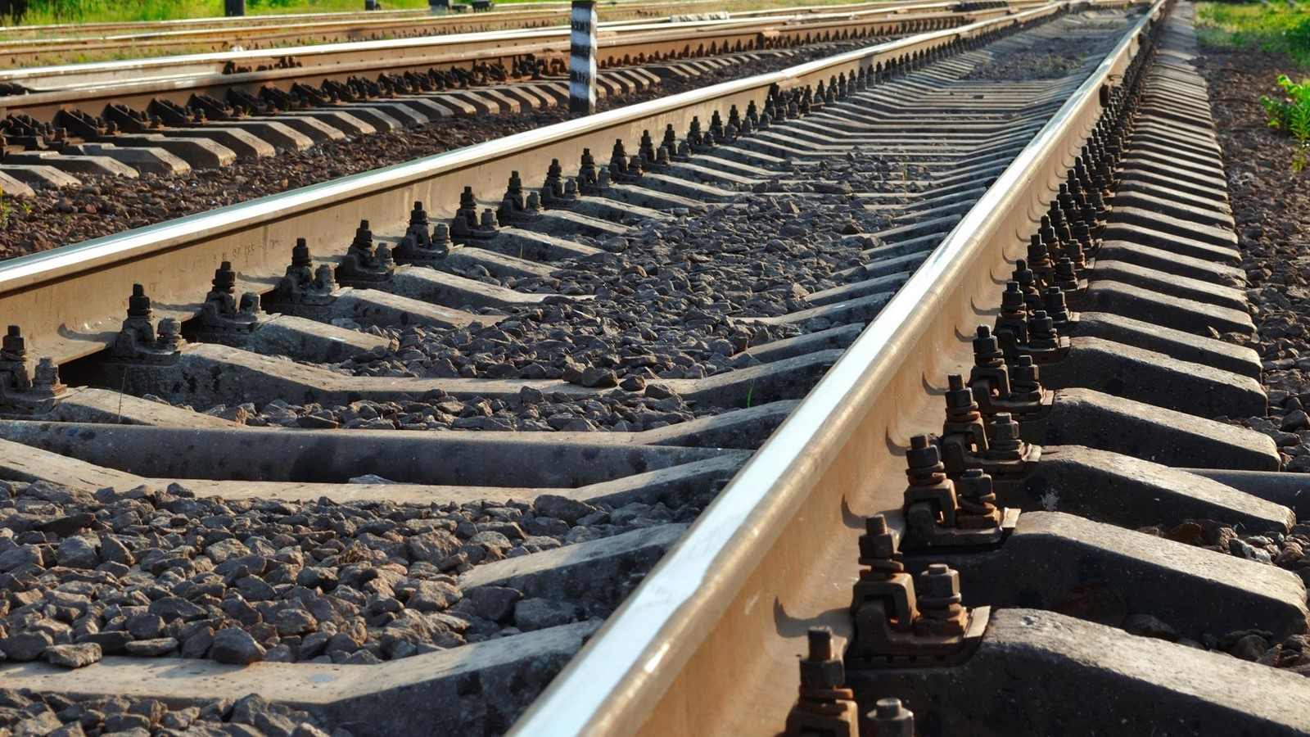
What will RailHOF be for members?
a knowledge network on HOF and safety
a virtual platform which will evolve according to your needs

Slide 8
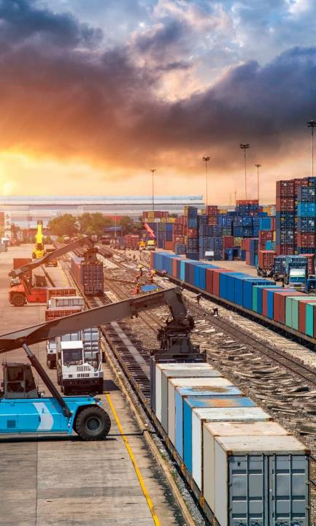
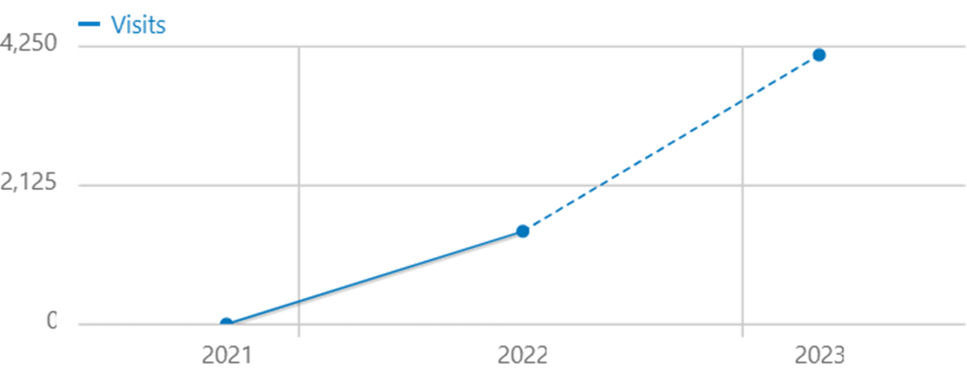
RailHOF – fun facts
CONNECT
SHARE
LEARN
Notes:
Long-distance freight: combined transport (> 75% semitrailers) – political will
Combined door-to-door transport
40 million tonnes – 21% of 190 million
More ambitious than 30 by 2030

Slide 9
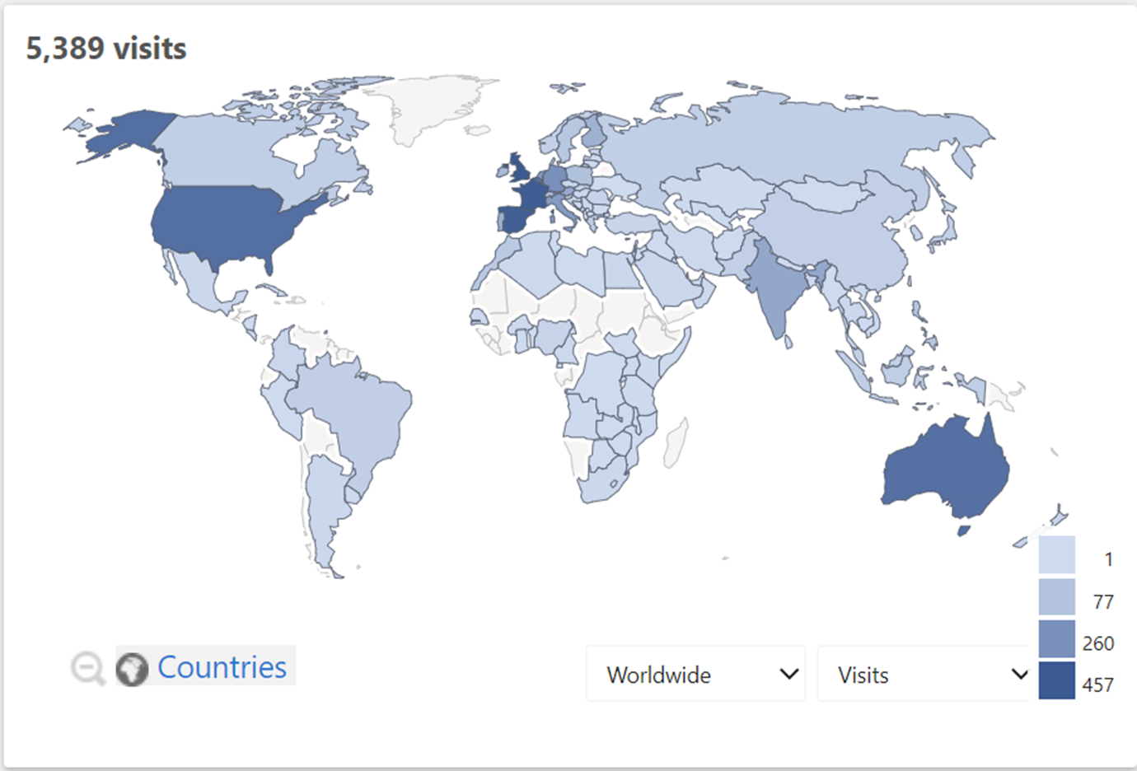
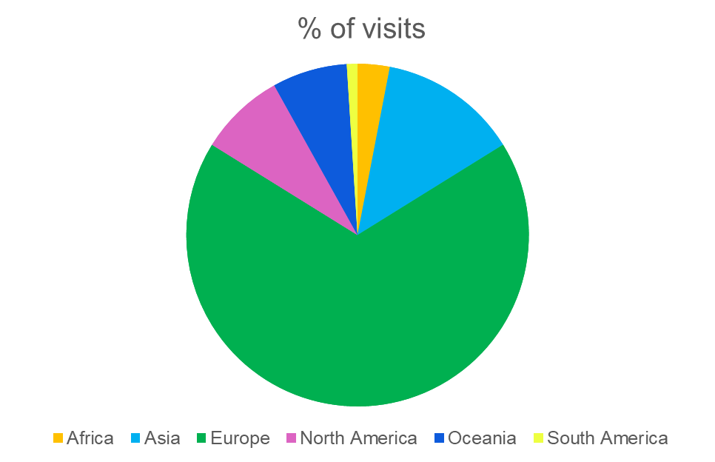
Visits – Oct 22 – Aug 23

Slide 10
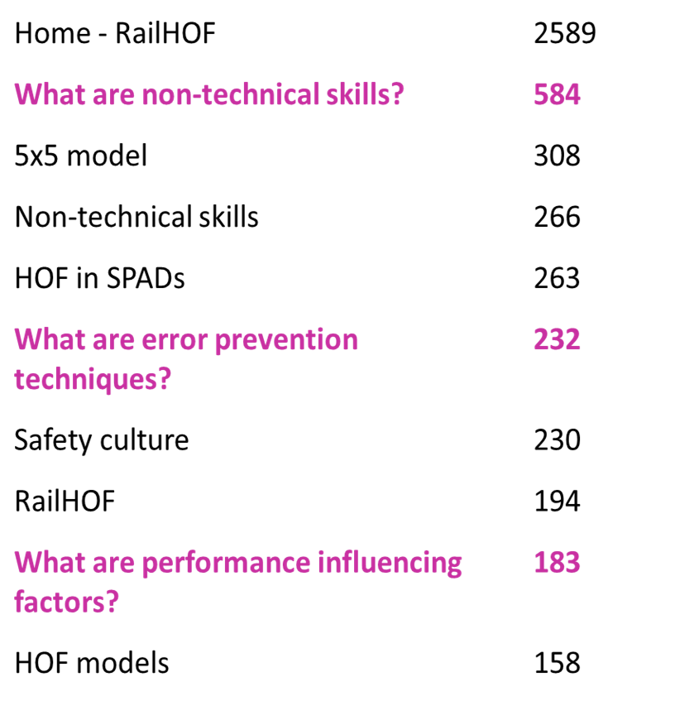

RailHOF – fun facts

Slide 11
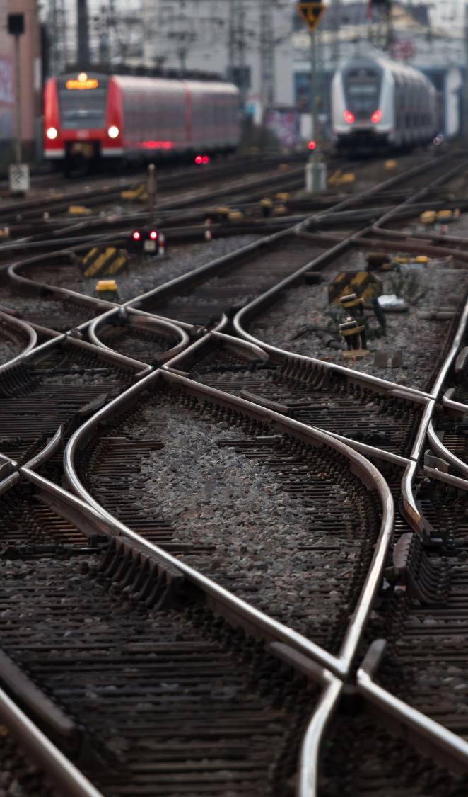
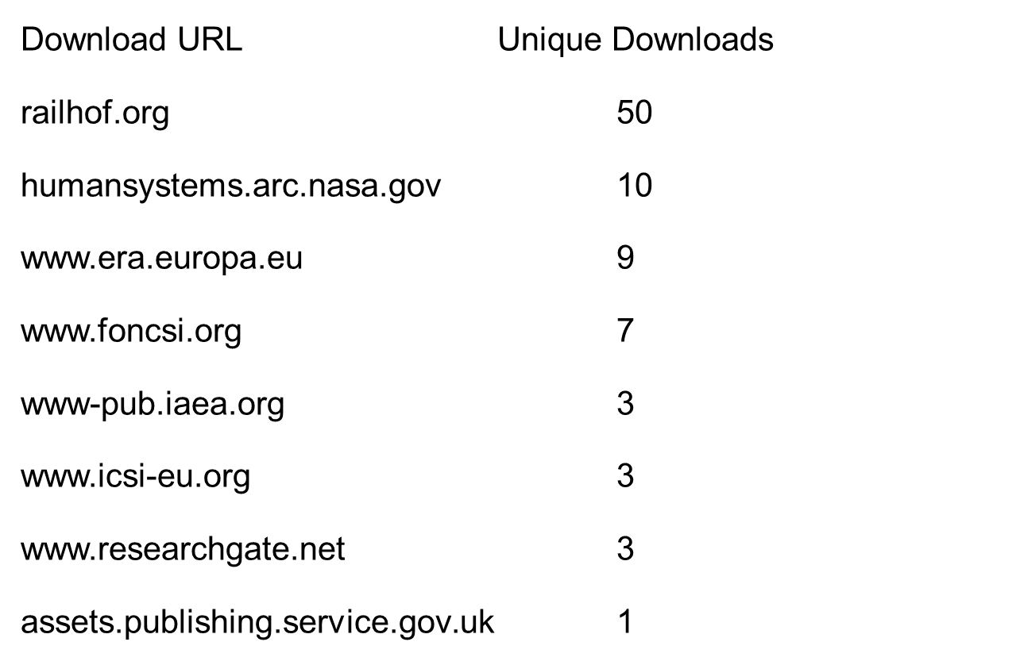


Connect
Share
Learn
.

Slide 12
SLIDO #SafetyDays2023
Multiple choice (several choices possible)
What content are you interested in?
  Legislation and standards
  Models
  Practical examples
  Research articles
  Information from other domains e.g. aviation, healthcare, nuclear, oil and gas
  Conferences/events

Slide 13
SLIDO #SafetyDays2023
Multiple choice (several choices possible)
Which format would be most interesting for you?
  Articles
  Interviews
  Video clips
  Infographics
  Training courses
  e-learning

Slide 14
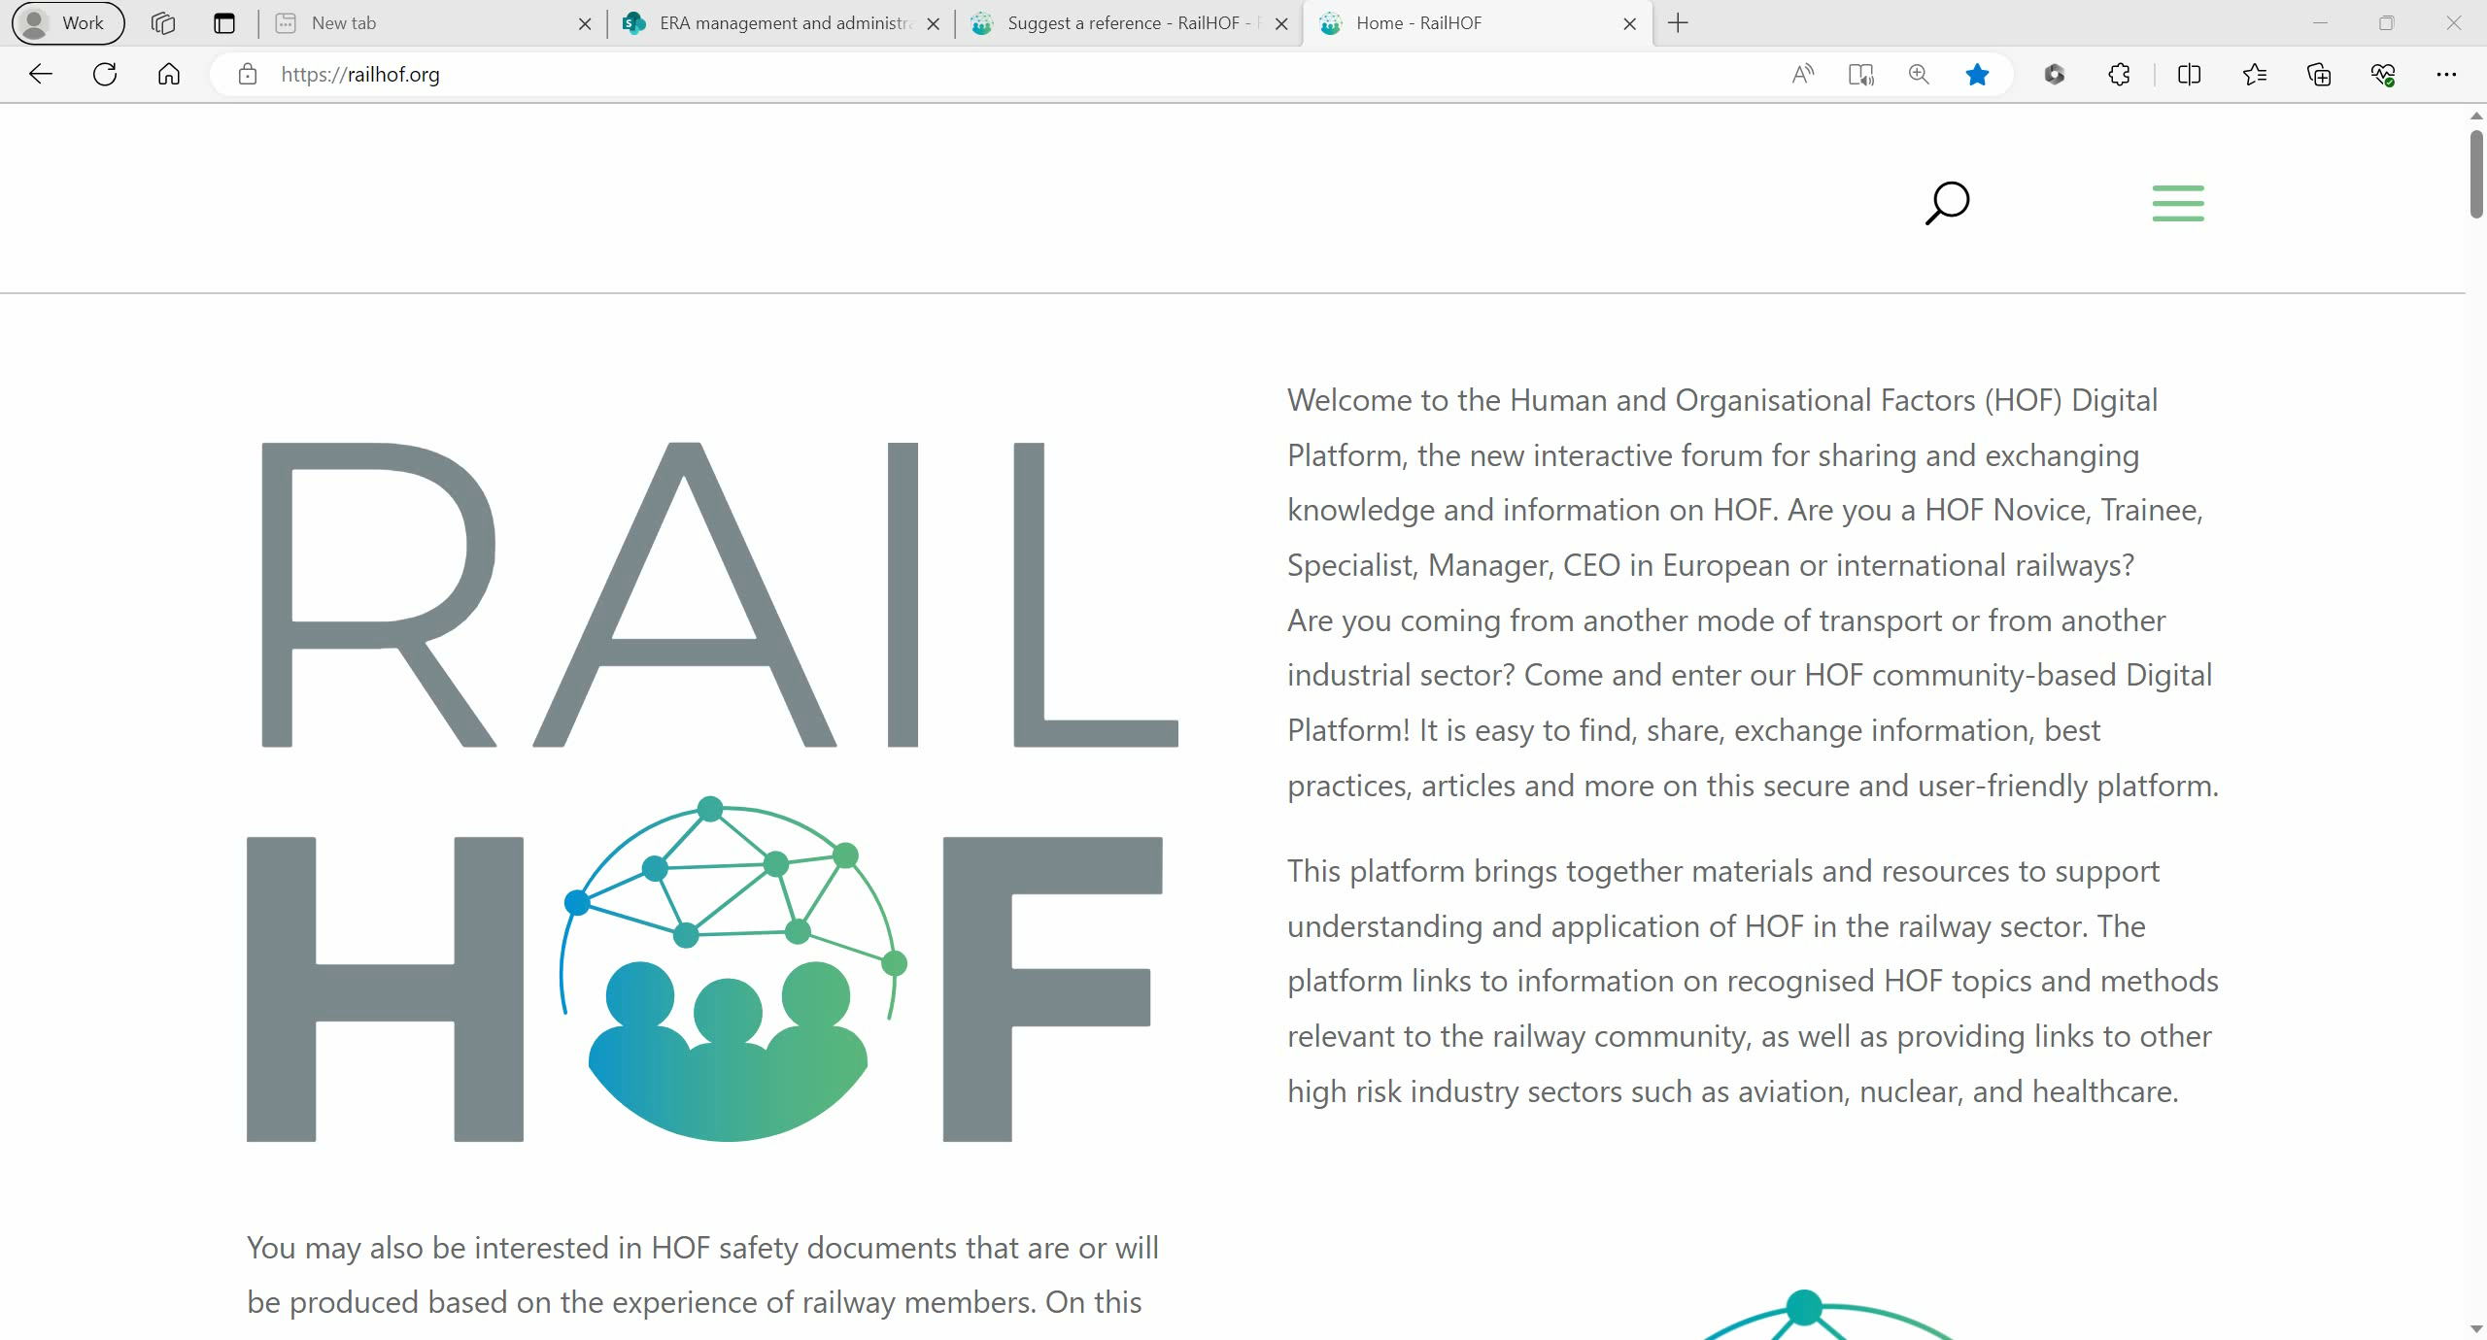

Slide 15
SLIDO #SafetyDays2023
Word Cloud
What would encourage you to share a practical experience on HOF and Safety Culture on RailHOF?

Slide 16


“No deposit – no return”

Slide 17
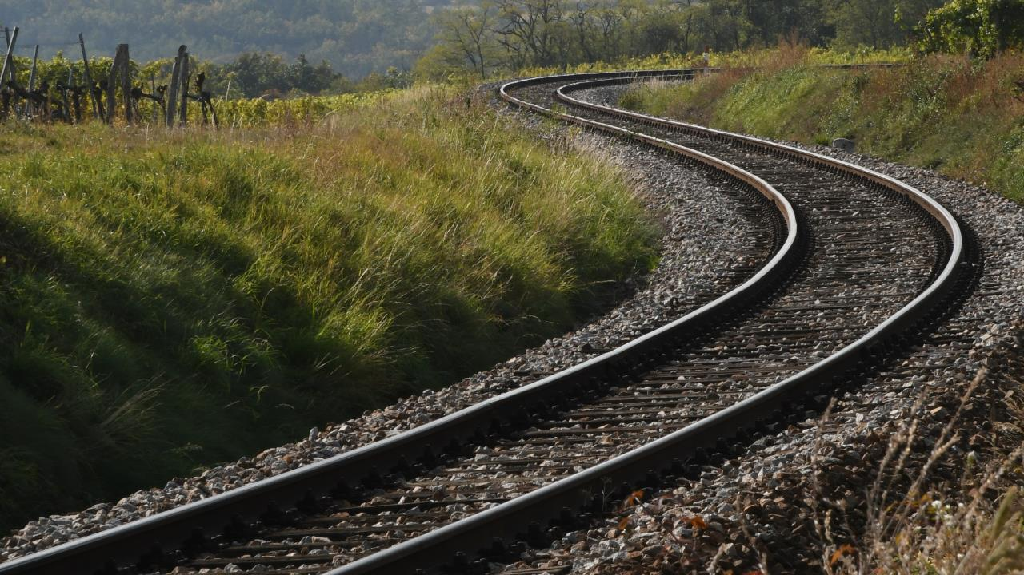
THANK YOU
Moving Europe towards a sustainable and safe railway system without frontiers.
Follow us:

