Slide 1
Immersive safety training in virtual reality
Amir Haj-Bolouri

Slide 2
About me
PhD of Informatics with a Specialization in Work-integrated Learning
Associate Professor of Information Systems at University West, Sweden
Docent of Information Systems at Jyväskylä University, Finland
Program Director
President of SIGPrag
Virtual Reality, Learning, Design Science, and Philosophy

Slide 3
Agenda
Immersive Virtual Reality (IVR)
IVR for Training
The Peculiarity of Safety Training
IVR for Safety Training
Research Projects
Some Findings

Slide 4
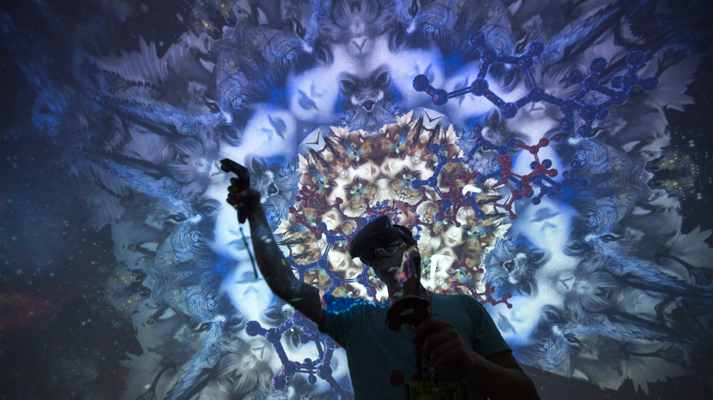
Immersive virtual reality
Virtual Reality Technology
Immersive Virtual Reality (IVR)
Presence
Immersion
Embodiment
Realism vs Non-Realism
Growing Application Range
Haptic, Tactile, Co-Extensive

Slide 5
IVR for training
Categories of skills (e.g., descriptive, procedural)
Simulating real world tasks and procedures
Increasing number of scenarios
Smart and multimodal feedback mechanisms
Training Domains:
First Responder Training
Medical Training
Military Training
Transportation
Workforce Training
Safety Training!

Slide 6
The Peculiarity of safety training
Situational Awareness
Safety Awareness
Procedural Skills
Perceptual Motor Skills
Decision Making Skills
Behavioral Skills
Spatial Skills
Self-Protect Skills

Slide 7
IVR for safety training
Reducing Risks for Injury
Reducing Costs
Hazard Awareness
Behavioral Compliance
Social Influence
Sustainability
Non-Playable Characters (NPC)
Examples:
Evacuation Training
Fire Safety Training
Readiness for Unpredicted Situations

Slide 8
Research projects
IVR Fire Safety Training for Train Operators in Sweden
Immersive Learning Environments for Sustainable Competence Development
Two Different Cases

Slide 9
IVR fire safety training
Train operators at Sj
Fire safety training Modules
Realistic train settings
Mapping and mirroring the real world
Glitches and breakdowns
Procedural skills in focus
Instructors

Slide 10
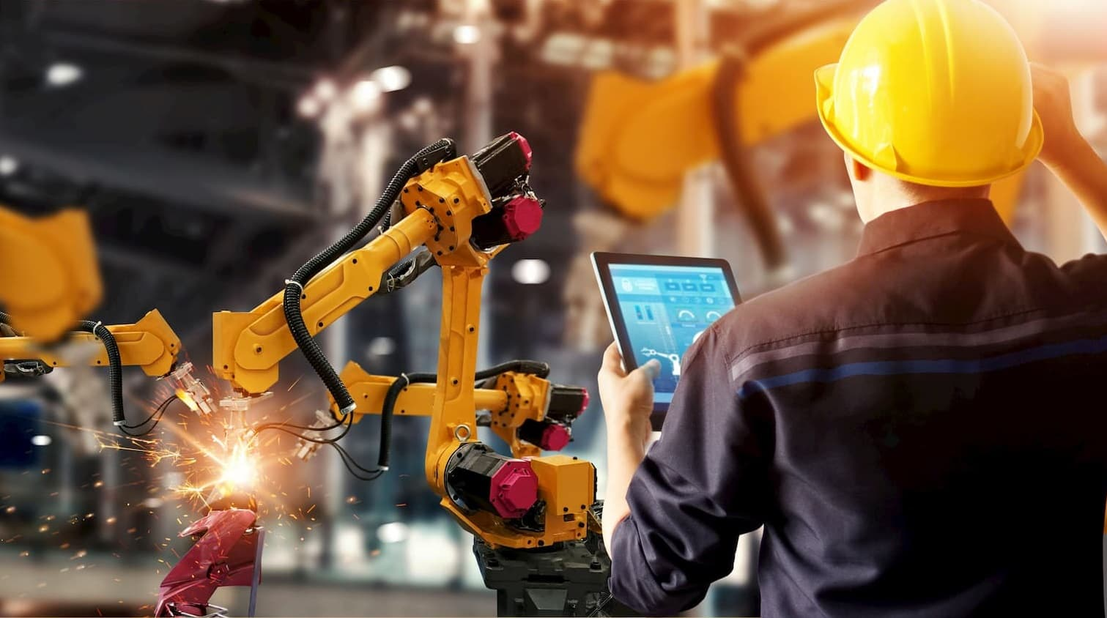
Case 1
Immersive Learning Environments for Sustainable Competence Development
Manufacturing
Robots
Simulated Knowledge Transfer
Trial-and-Error
Virtualizing Tacit Knowledge Processes
Reducing Damage and Injuries

Slide 11
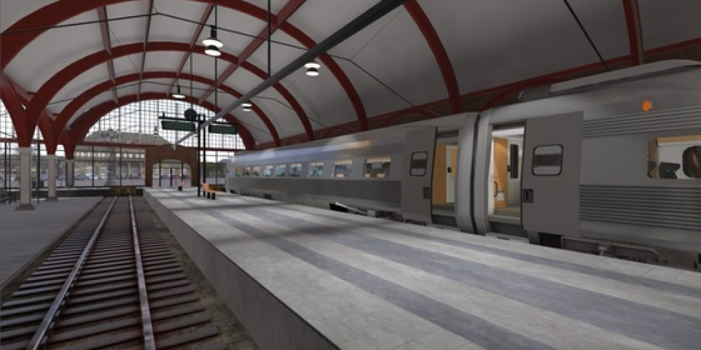
Case 2
Immersive Learning Environments for Sustainable Competence Development
Train Operators
Wicked Situations
Experimental Training
Trial-and-Error
Preparing for the Unpredictable
Muscle Memory and Procedural Skills
Key Design Elements

Slide 12
Some findings (so far)

Slide 17
Phd thesis in gamified immersive learning environments for safety training

Slide 18
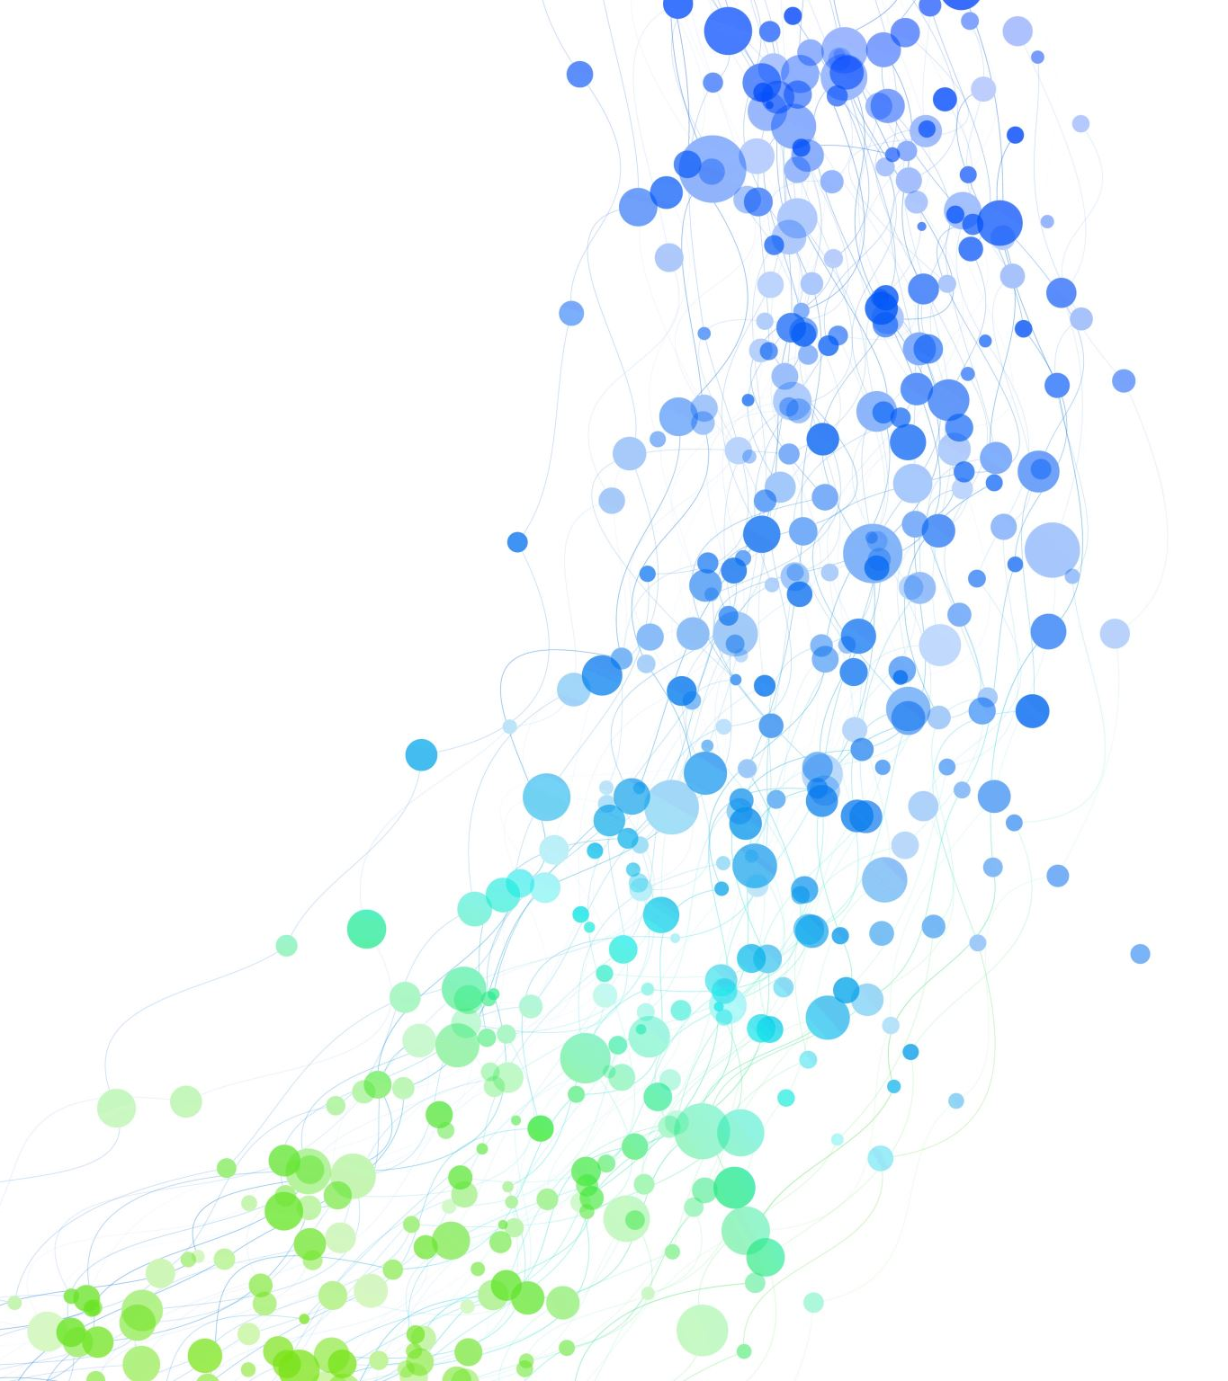
Thank you for your attention!

