Slide 1
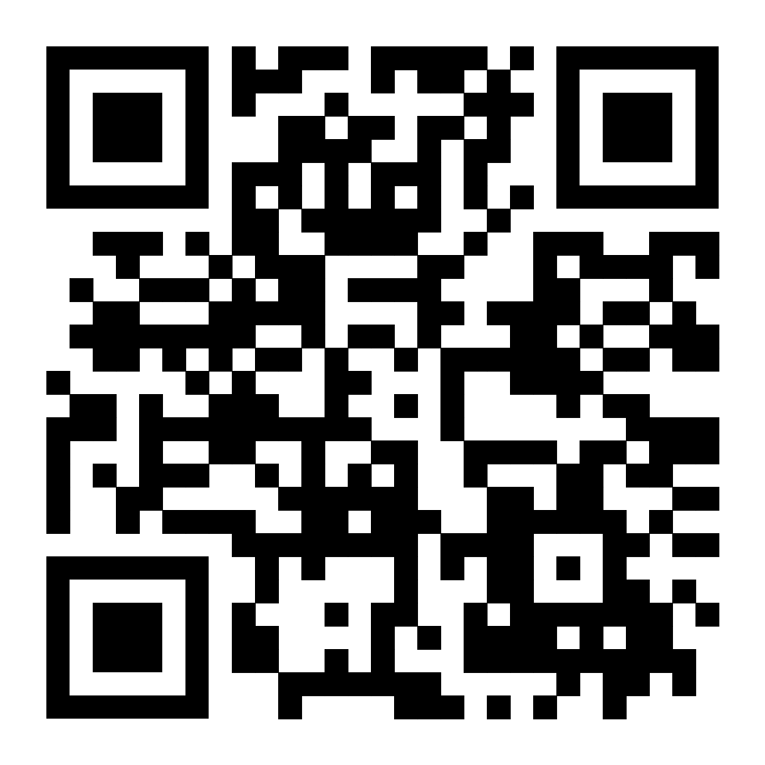
Networking dinner 19:30
www.meremuuseum.ee/lennusadam/en
30 minutes walk
Public Transport to the Seaplane Harbour
Show the QR code attached to this email to the scanner on the bus or tram. To reach the venue, Bus No. 73 will bring you right to their doorstep. Please get off at the stop called ‘Lennusadam’.
Bus No. 3 or tram No. 1 or 2 will take you to the ‘Linnahalli’ stop at Põhja puiestee. Continue along the same street and turn right down the hill towards Kalasadam. Near Kalasadam, turn to the left and enter Kalaranna street. Walk straight for approximately 1 kilometre until you see the Seaplane Harbour on your right.
REMEMBER YOUR CONFERENCE BADGE!
Google Maps

