Slide 1
Geopolitical challenges and industrial revolution 4.0. How to manage emerging railway traffic safety threats?
Martynas Čekanauskas, LTG EHS manager

Slide 2
Challenges and opportunities of industrial revolutions

Slide 3
Industrial revolution i1.0.
The First Industrial Revolution began in the 18th century using steam power and mechanization of production.
The railway era begins, the first steam locomotives are produced.
Notes:
Trumpas plano pristatymas

Slide 4
Industrial revolution i2.0.
The Second Industrial Revolution began in the 19th century through the discovery of electricity and assembly line production.
The railway network is being expanded, the first signaling systems are being installed.
Notes:
Trumpas plano pristatymas

Slide 5
Industrial revolution i3.0.
The Third Industrial Revolution began in the ’70s in the 20th century through partial automation using memory-programmable controls and computers.
Traffic centralization is underway and microprocessor signaling systems are being installed as well as other important safety systems.
Notes:
Trumpas plano pristatymas

Slide 6
Industrial revolution i4.0.
We are currently implementing the Fourth Industrial Revolution. This is characterized by the application of information and communication technologies to industry.
IoT is used in railway subsystems, big data is collected, based on which predictive maintenance is carried out as well as ChatGPT or AI is used in daily activities.
Notes:
Trumpas plano pristatymas

Slide 7
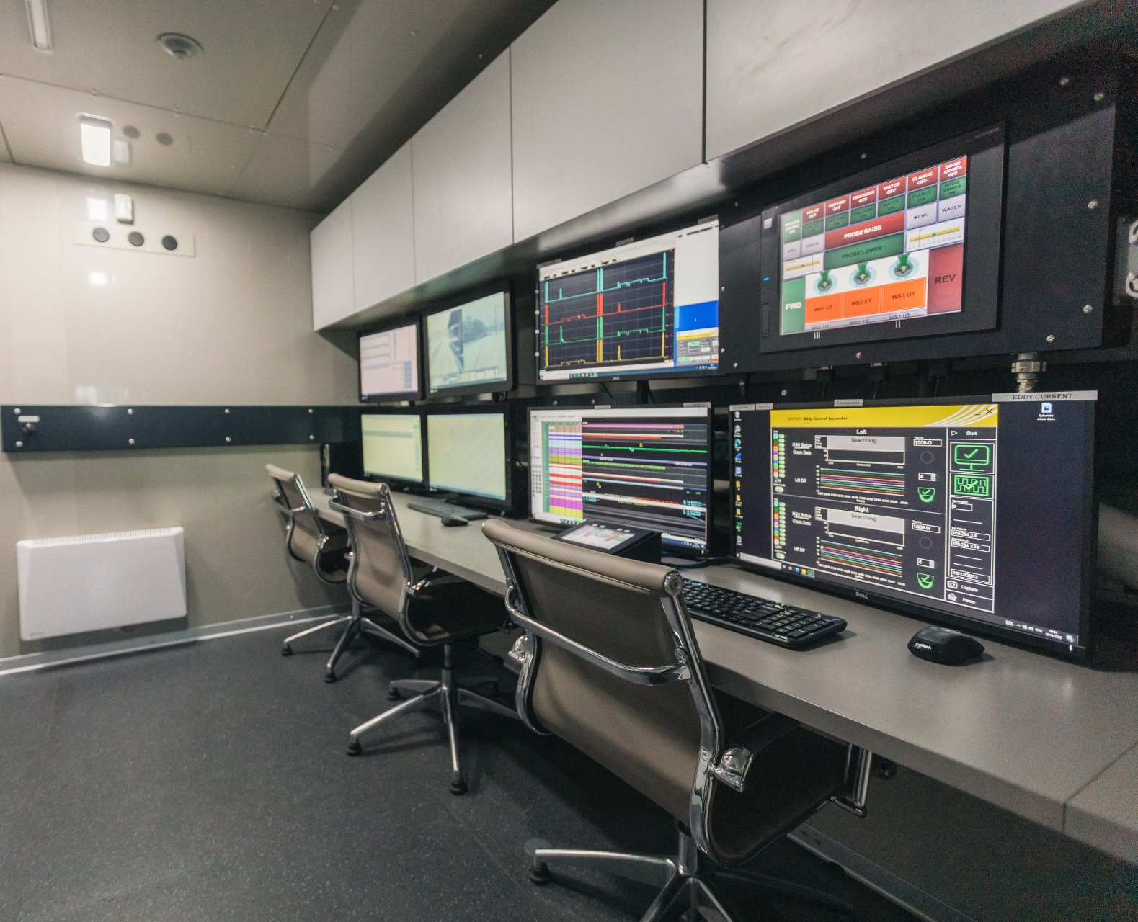
Predictive maintenance
Detection of rail surface defects.
Ultrasonic detection of rail defects.
Laser detection of rail waviness.
Laser measurement of rail profile.
Video monitoring of railway elements and measurement of railway geometry.
Parameters changes and deviations are automatically evaluated, the results are objective, and the measurement data is digitized.
Notes:
Trumpas plano pristatymas

Slide 8
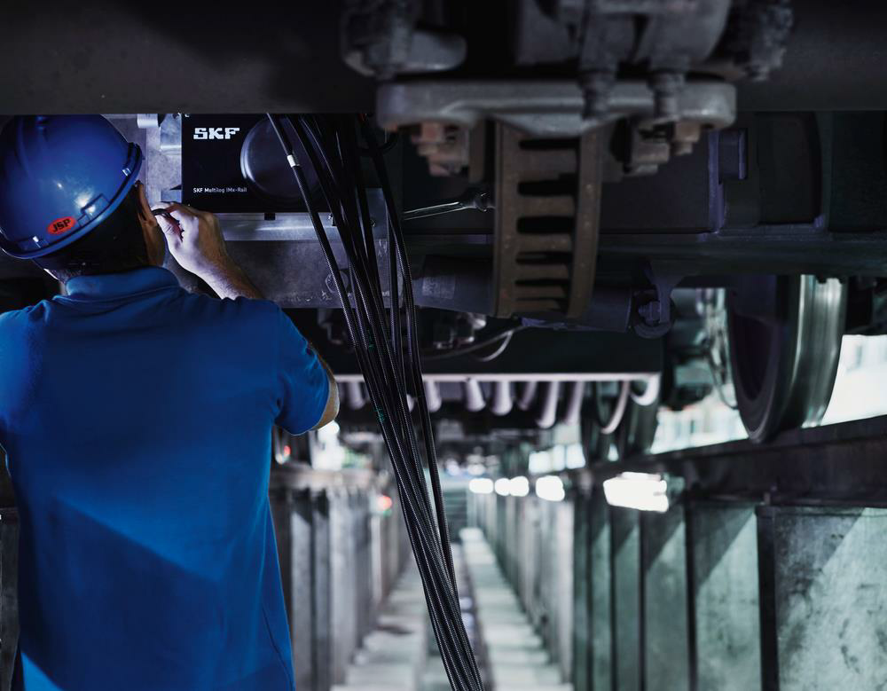
Prescriptive maintenance
Condition of bogies.
Condition of engine.
Condition of transmission and hydrostatic.
Status of control systems.
Connection with satellites.
Data is collected centrally, analyzed with the help of ML according to which maintenance decisions are made.
Notes:
Trumpas plano pristatymas

Slide 9
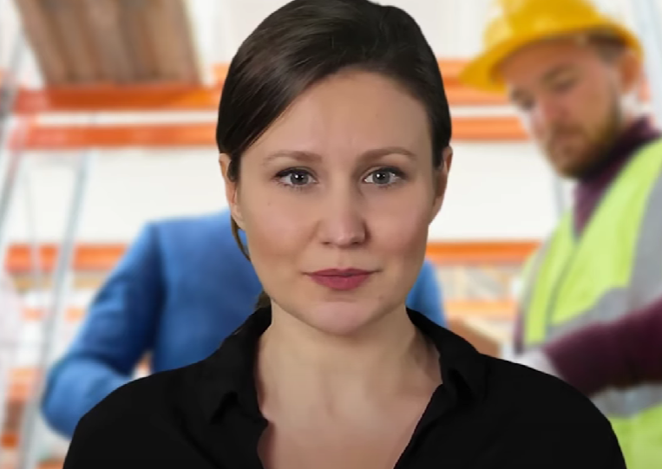
AI and ChatGPT in trainings
Systemized information.
Continuous self-learning
No intervention is required.
An effective learning tool for the future.
Notes:
Trumpas plano pristatymas

Slide 10
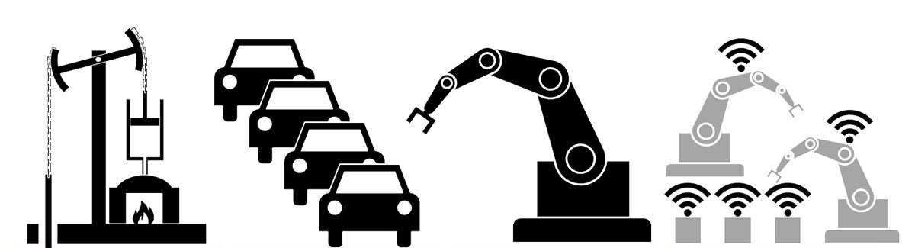
Industrial revolutions
i1.0.
i2.0.
i3.0.
i4.0.

Slide 11
What‘s different?
COMPLEXITY
i1.0
i2.0
i3.0
i4.0
TIME
Notes:
Pristatome

Slide 12
Emerging threats

Slide 13
Decision making
Geopolitics
Innovations
Economy
Pressure to improve effectiveness
Decisions to achieve these goals and other external factors creates the environment for safety threats arising from changes.
Pressure to adapt to external factors and to maintain competition
Notes:
Pristatome

Slide 14
Emerging threats
AREA
RISK MANAGEMENT
LEADING FACTORS
HOF
Safety leadership
± Proactive monitoring
± Change management:
reference systems
standards
threat level determination
Regulation
Safety culture
CS
Standartized procedures
Notes:
Pristatome

Slide 15
Threat management

Slide 16
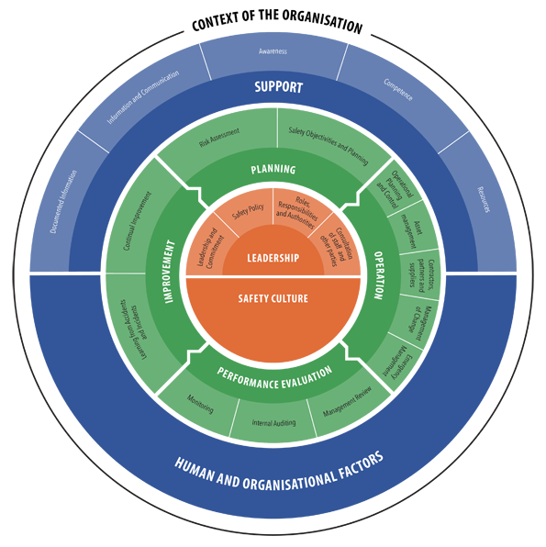
Effective risk and change management - the key!
Notes:
Pristatome

Slide 17
Strong safety leadership – enabler
A
A safety leadership course for existing and new managers at all levels.
B
Manager‘s standard interactive material.
C
Safety leadership training focuses on safe decision-making and risk-based approach.
Continuous communication and assistance in managing safety threats.
Standardized accesses to all safety-related information and materials for managers.
SAFETY LEADER

Slide 18
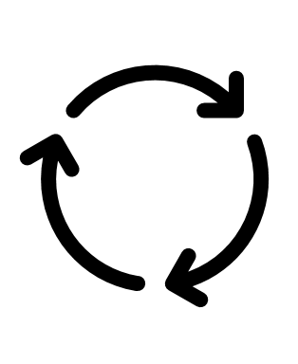
High maturity of safety culture - fundamental
Maturity level study:
once a year.
more than 60% employees.
maturity level, strengths and areas for improvement are determined.
action plans are prepared.
Reporting and just cultures:
digitized tools for reporting.
safety ambassadors activities.
determining the real cause of the behavior and selecting the right consequence.
Continuous learning:
safety academies: once a quarter, more than 3000 employees, more than 15 different topics.
safety newspaper: once a month, based on golden safety rules with risk-based advices.
safety instructors: after internal/ external accident, with positive/ negative actions as well as recommendations.
Consequent integration:
dissemination of safety vision at all levels.
inclusion of safety goals in business units strategies and safety topics in managers‘ meetings.
understanding workplace reality trough safety internships.
ensuring competency management through continuous monitoring.

Slide 19
Proactive risk management
Plan
Once a year, all managers are involved.
Do
Risk management plan is prepared.
Check
Act
Corrective measures are provided and implemented at all levels.
A unified methodology is used.
TOP safety risks are identified.
Risk management plan is implemented.
Safety status monitoring plan is established (CST, CSI, SI).
Deviations from the set values ​​are evaluated once a month.
Information about deviations is shared bottom – up trough organization.
CST
CSI
Set value |
Actual value
Validation
CSI
SI
SI
SI
Notes:
Trumpas plano pristatymas

Slide 20
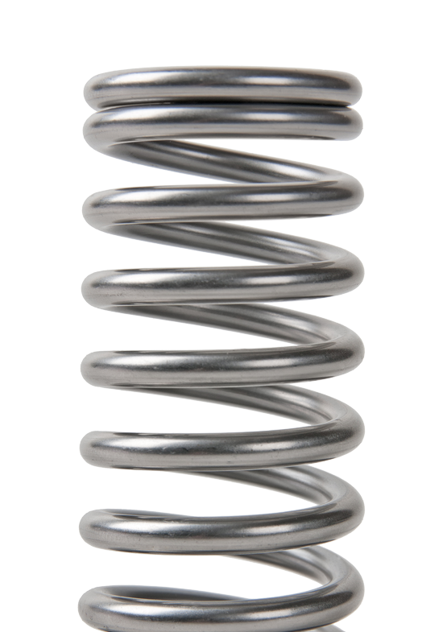
The realities of changes
Change implementation
Change implementation
as imagined
actual
Notes:
Pristatome

Slide 21
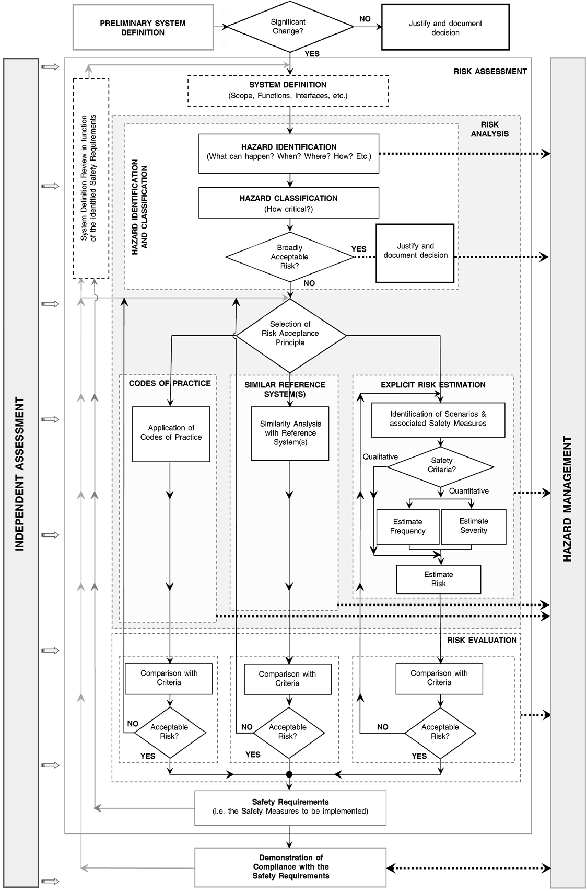
Change management process (FREE Rail approach)
ASSESSMENT
WG / COM
CM
SAFETY ASSURANCE
Bogies
Brakes
...
Critical elements
WG
Technology group
PM
PM board
COM
Technical development
COM
Investment management
AsBo
Technology change
Production
An alternative
SMS/ RM
Notes:
Trumpas plano pristatymas

Slide 22
Thank You!

