Slide 1
Seven Blind Mice
European Rail Safety Days 20-22 September 2023 Tallinn, Estonia
Lesson Learnt in Human and Organisational Factors from catastrophic railway accidents
Pilar Calvo Holgado
pilarcalvo@esm.es

Slide 2
European Rail Safety Days 20-22 September 2023 Tallinn, Estonia
All the contextual interactions that gave rise to a particular situation where a front-line worker may not have been able to effectively resolve the complex demand of the task asigned to them.
Accident Investigation
Organisations must know the human capabilities and limits before designing tasks they might fail to accomplish.

Slide 3
European Rail Safety Days 20-22 September 2023 Tallinn, Estonia
Railway System
Design
Systemic Aproach
Accident Investigation
If the railway system is designed part by part (subsystem by subsystem) and those subsystems are juxtaposed, we will not know the real work that the front- line worker has to perform in the operation.

Slide 4
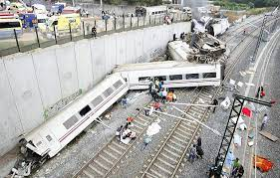
European Rail Safety Days 20-22 September 2023 Tallinn, Estonia
Catastrophic railway accidents in Spain
Valencia Metro (Underground). 2006
Santiago de Compostela, Angrois (High-Speed) 2013
43 deaths
80 deaths

Slide 5
European Rail Safety Days 20-22 September 2023 Tallinn, Estonia
Accident 1
Accident 2
Accident 3
The conclusion cannot be that human error is unpredictable, if the processes designed by the organisations are lacking risk control.

Slide 6
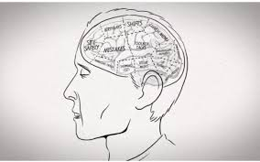
European Rail Safety Days 20-22 September 2023 Tallinn, Estonia
Humans make mistakes
Systemic Aproach
SMS
CSM
Those mistakes wil never cause a serious accident
Rail services cannot be based on human weaknesses, but on their strengths

Slide 7
European Rail Safety Days 20-22 September 2023 Tallinn, Estonia
IM RU
NSA
NIB
Santiago de Compostela, Angrois (High-Speed)
Learning from Experience
Stakeholders

Slide 8
European Rail Safety Days 20-22 September 2023 Tallinn, Estonia
IM and RU
Technical
and Organisational risk
Human error risk
SMS
The risks that are intended to be exported from the Organisation to front-lines must be efficiently managed among organisations.
The result of mitigation must be in the worst scenario.
Before introducing the train drivers in a line training process, the line must have mitigated the possible catastrophic risks.

Slide 9
European Rail Safety Days 20-22 September 2023 Tallinn, Estonia
IM and RU
The interfaces with the driving position are multiple and varied and are not limited to the interfaces for which the railway undertaking is responsible.
The infrastructure manager must evaluate critical interfaces with the driving position and must opt for the safest alternatives to ensure safe driving.

Slide 10
European Rail Safety Days 20-22 September 2023 Tallinn, Estonia
IM and RU
Evidence
Systemic Aproach
Risk- Based Aproach
HOF

Slide 11
European Rail Safety Days 20-22 September 2023 Tallinn, Estonia
IM and RU
The belief that the mere existence of a book of rules or a maximum speed table implies that any deviation from it is an infraction, cannot be accepted.
Having a rule book is not an effective barrier against inadequately designed systems nor a shield that guarantees the professional work of frontline workers.

Slide 12
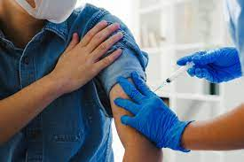
European Rail Safety Days 20-22 September 2023 Tallinn, Estonia
IM and RU
Driver training is essential,
but it is not a vaccine against unintentional human errors.

Slide 13
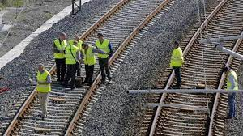
European Rail Safety Days 20-22 September 2023 Tallinn, Estonia
IM and RU
The managers and chiefs who carry out supervision (IM, RU) should not only assess possible non-compliance but also the difficulties and risks that may arise in the operation before certain tasks or sections. Redesign or regulatory change should be considered when necessary.
The drivability tests carried out by drivers must be required before inaugurating a new line

Slide 14
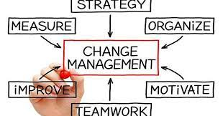
European Rail Safety Days 20-22 September 2023 Tallinn, Estonia
IM and RU
Change management always requires an assessment of the risks which takes into account those who have to work in the front-line.
ORGANISATION

Slide 15
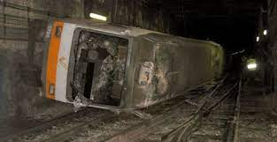
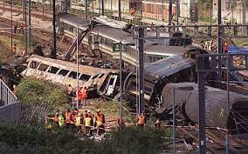
European Rail Safety Days 20-22 September 2023 Tallinn, Estonia
IM and RU
Learning from past accidents whether or not they have occurred in their own organisation should be a requirement for those most responsible for company safety.
Since the Valencia Metro accident (2006) and Landbroke accident (Paddington 1999)… where are we in terms of Organisational and Human Factors?

Slide 16
European Rail Safety Days 20-22 September 2023 Tallinn, Estonia
IM and RU
The separate processes to obtain safety certificates and safety authorisations should never obviate the joint risk assessment which takes into account how the HOFs are integrated both part by part and as a coherent whole.

Slide 17
European Rail Safety Days 20-22 September 2023 Tallinn, Estonia
IM and RU
Confidential and effective risk reporting systems should be promoted and demanded, and not a facelift of the old complaints that have remained unanswered.
Active participation of workers' representatives in safety issues should be encouraged and demanded from companies, and not only a posteriori information on the decisions made.

Slide 18
European Rail Safety Days 20-22 September 2023 Tallinn, Estonia
National Safety Authority
HOF certified capabilities should be required to all the agents with safety responsibilities, starting with those who make decisions at the highest level.

Slide 19
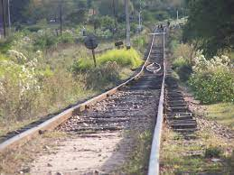
European Rail Safety Days 20-22 September 2023 Tallinn, Estonia
National Safety Authority
Mechanisms must be sought to prevent officials from becoming exposed due to political demands to inaugurate lines or sections.
In the same way that dangerous work must be stopped, anyone who claims a certain section or line is not yet in a safe condition must be protected.

Slide 20
European Rail Safety Days 20-22 September 2023 Tallinn, Estonia
National Investigation Body
Be independent and act independently. Members` previous experience in organisations to be investigated implies a conflict of interest.
Victims and those affected have the right to information transparency.

Slide 21
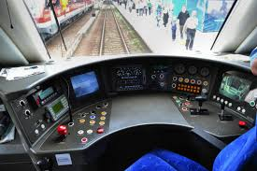
European Rail Safety Days 20-22 September 2023 Tallinn, Estonia
National Investigation Body
Understand and apply the systemic approach.
It should be looked out of the cabin.
Human error does not have to mean causation

Slide 22
European Rail Safety Days 20-22 September 2023 Tallinn, Estonia
National Investigation Body
Do not blame or point to human error as the sole cause of an accident in cases of well-intentioned acts.
Thoroughly investigate the enforcement of the Safety Management System and the barriers which failed.

Slide 23
European Rail Safety Days 20-22 September 2023 Tallinn, Estonia
National Investigation Body
The investigation of catastrophic accidents must entail a narrative change that indicates the learning and critical reflection that the companies involved must carry out.
It must involve learning how to understand risk management.
Investigation should be made of how organisations took into account earlier warnings by company members about risks in their risk analyses. It should be investigated how the risk analysis process was carried out within the companies, whether expert judgments were made, whether alternatives to mitigating the main risks were discussed.
Catastrophic accident investigations must give rise to new knowledge and not just intuitive processes, for example, the introduction of technologies that were already known in the sector and were simply not applied.

Slide 24
European Rail Safety Days 20-22 September 2023 Tallinn, Estonia
Conclusions from catastrophic railway accidents
We must stop talking about human errors as the ultimate explanation of accidents.
Just culture is based on the scientific study of human behaviour
Seek organisational learning
The concept of "human error" should only serve as a starting point

Slide 25
European Rail Safety Days 20-22 September 2023 Tallinn, Estonia
Conclusions from catastrophic railway accidents
IMs and RUs.
Understand all the business risks they are dealing with.
Attention must be paid to the concepts of interfaces and shared risks so that the task will always be safe for the end user.

Slide 26
European Rail Safety Days 20-22 September 2023 Tallinn, Estonia
Conclusions from catastrophic railway accidents
We cannot afford not to have learned from previous accidents and to repeat organisational patterns and fall into complacency.
Concluding "it was a human error" is refusing to see the elephant in front of them, being blind to the weight of organisations in the design of the rail system

Slide 27
European Rail Safety Days 20-22 September 2023 Tallinn, Estonia
Conclusions from catastrophic railway accidents
Imposing a "mainstream" from the management set a barrier to the necessary learning and change
Once an accident has taken place, it cannot become "taboo" for organisations

Slide 28
European Rail Safety Days 20-22 September 2023 Tallinn, Estonia
Conclusions from catastrophic railway accidents
There will only be organisational learning if we change the narratives of human error as causal explanations for accidents..
Serious accidents are symptoms of seriously ill organisations.
IMs and RUs should document… what have we learned from this accident?
The answer to this question must root in a self-assessment and
systematic evaluation conclusion carried out by all levels and must involve structural changes in processes as well as cultural changes.

Slide 29
European Rail Safety Days 20-22 September 2023 Tallinn, Estonia
Why the Seven Blind Mice?

Slide 30
European Rail Safety Days 20-22 September 2023 Tallinn, Estonia
An elephant!
Moral:
If you only know the parts, you will always talk nonsense,
but if you can see the whole, you will speak wisely.

Slide 31
European Rail Safety Days 20-22 September 2023 Tallinn, Estonia
“Science actually began when humans admitted their ignorance. Now we can start investigating” Yuval Noah Harari
Pilar Calvo Holgado
pilarcalvo@esm.es
https://esm.es
https://factoreshumanos.wordpress.com/

