Slide 1


Strengthening safety learning culture in shipping
Prof. Raphael Baumler
Head of Maritime Safety and Environmental Administration
European Railways Agency
Tallinn, 20-22 September 2023

Slide 2
Safety Learning culture – an indicator of safety culture
“A safety culture can be defined, as a culture in which there is considerable informed endeavour to reduce risks to the individual, ships and the marine environment […]”
in MSC 77/17 (2003) document present at the IMO by the UK

Slide 3
1- Learning mechanisms (reminder)

Slide 4
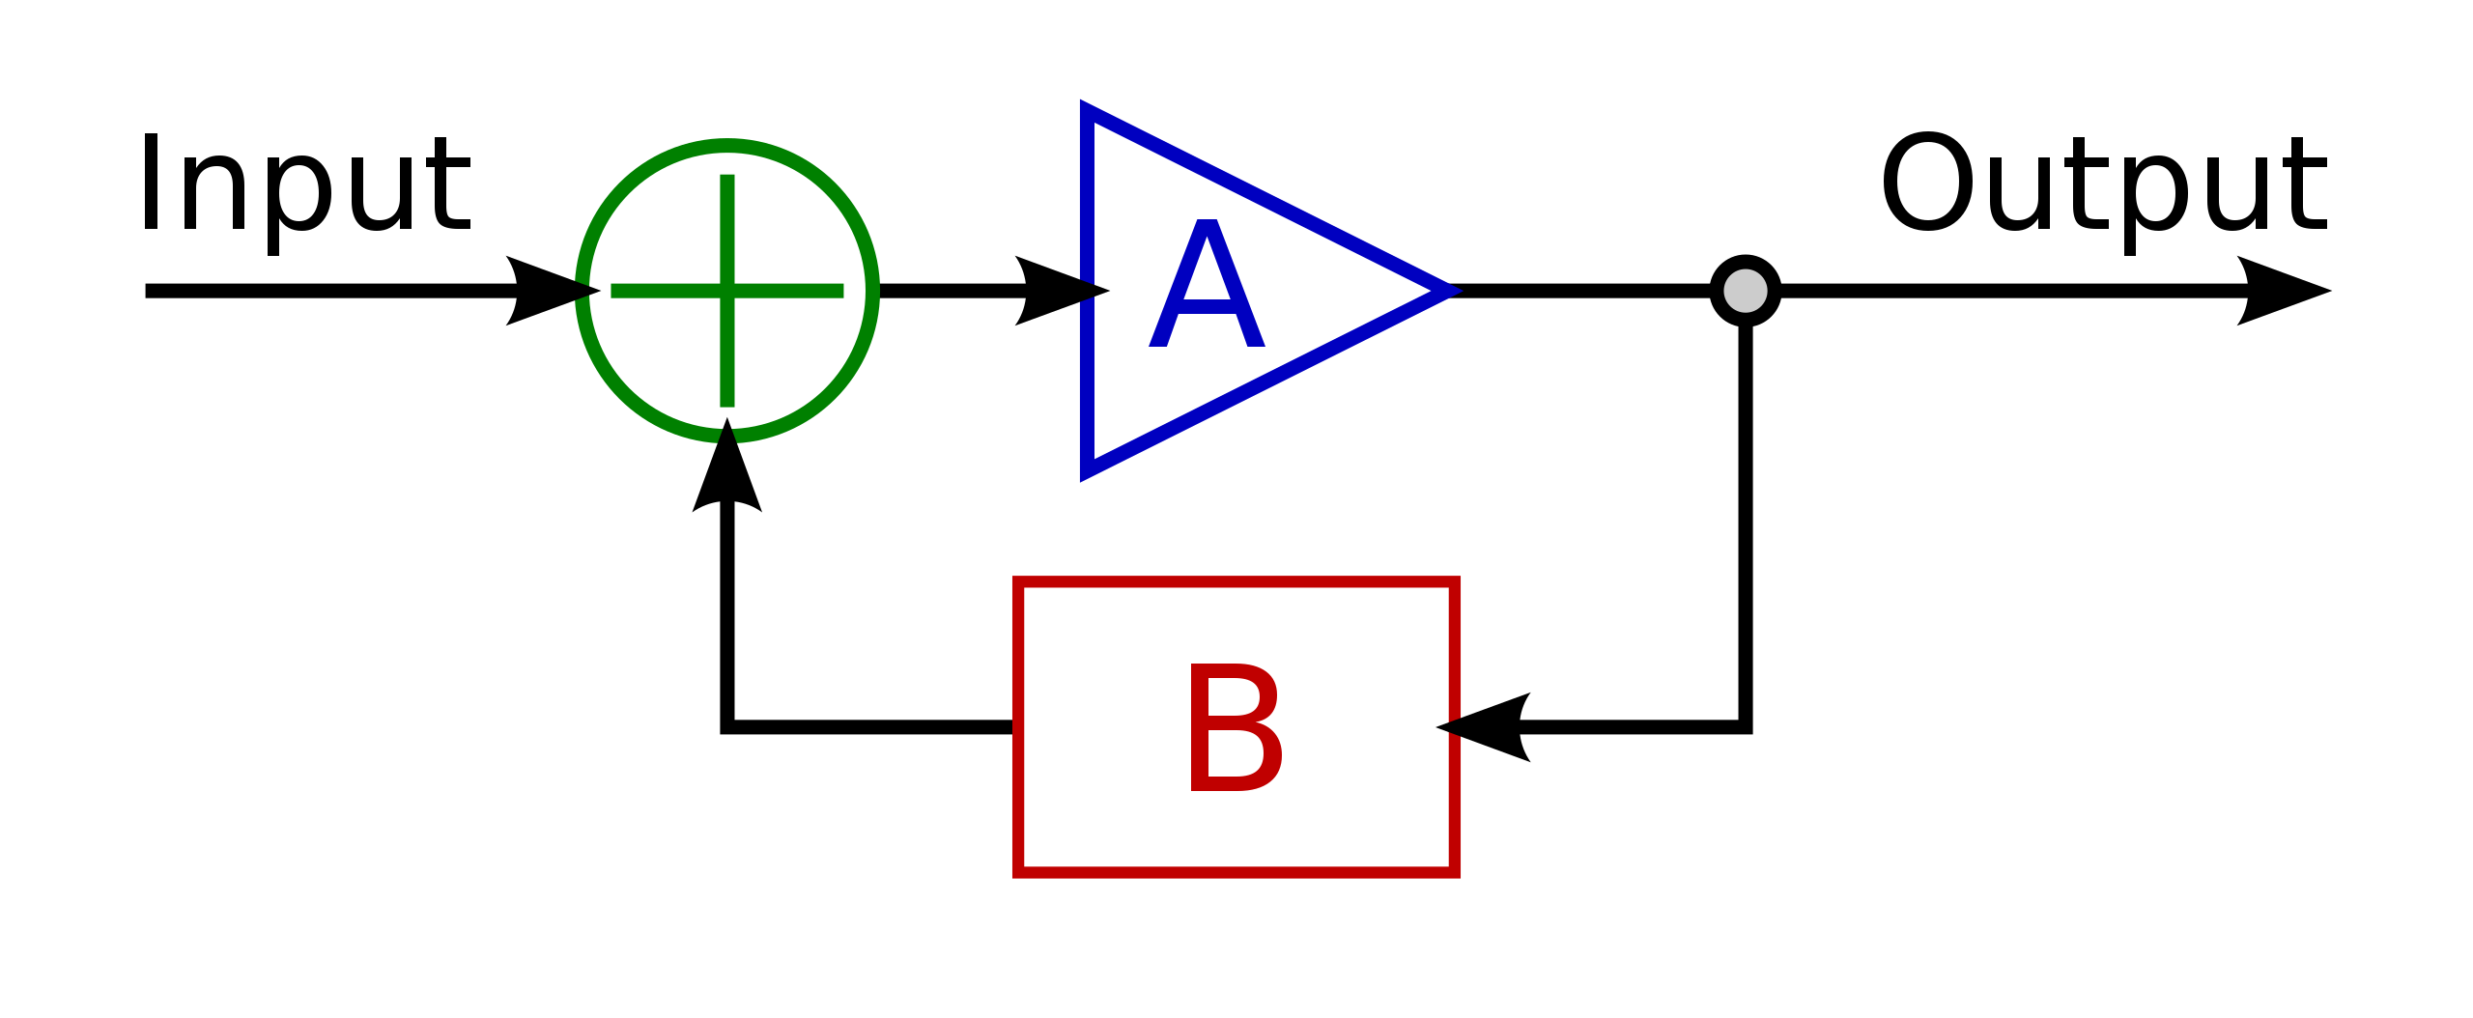
FEEDBACK PRINCIPLE IN SHORT
Ships are sociotechnical system
(e.g. instructions, supplies, energy)
(e.g., safe transport work)
System
(Ship)
+ Acceptable safety level
Data
Adjustment of system conduct
Collecting data from past process

Slide 5
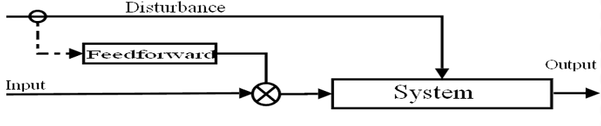
FEEDFORWARD PRINCIPLE IN SHORT
Anticipation by adjustments and preparation
External disturbance (environments)
Research identifies external/Internal disturbances and potentially impacting the system
Research feeds adjustments
Research current environments
Research internal system functioning (strengths and weaknesses)

Slide 6
Feedforward and feedback are necessary for system learning BUT both demand AVAILABLE and RELIABLE data and information flows.

Slide 7
2- Unreliable data in shipping (examples)

Slide 8
Post-accident data
“Nearly 40% of very serious casualties do not result in a flag state investigation being published, and even when governments do manage to file the mandatory reports, many of them fail to meet the basic standards set out for reporting” (LL, 26 July 2022)

Slide 9
Incidents and near-misses reporting
“[…] ineffective regulatory infrastructure, weak employment practices, the absence of trade union support and lack of organisational trust were the key underlying concerns which made incident reporting notably ineffective in the shipping context.” (Bhattacharya, 2011)

Slide 10
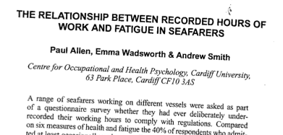
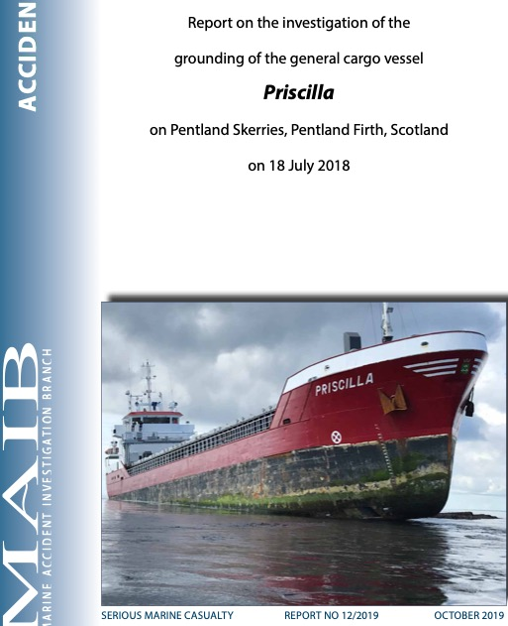
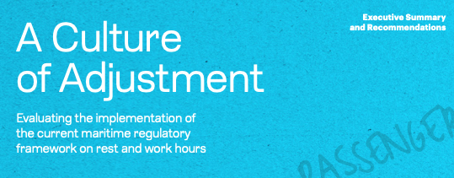
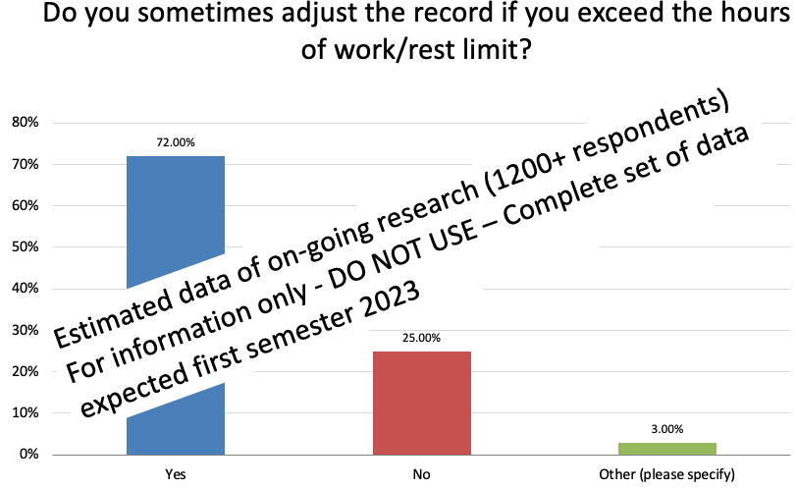
Other broken feedbacks
“Alarmingly, it seems that there is a growing culture of systemic acceptance of the existence of violations and recording malpractices by seafarers, companies and authorities.” (WMU, 2020)
Prof. Raphael Baumler - WMU

Slide 11
“Approximately 5% of containers shipped may consist of undeclared dangerous goods…”
(Capt. Rahul Khanna, global head of marine risk consulting at Allianz Global Corporate & Specialty in LL, 23 Aug. 2022)
No risk management without data quality
2013
For a 4.000 TEUs ship, it makes 200 Containers
And a 20.000 TEUs, it makes 1.000 Containers

Slide 12
US Whistleblower policy
“Federal law protects a seaman’s right to report safety concerns to federal regulatory agencies, a fact every maritime industry employer and vessel owner must know,” said OSHA Regional Administrator Eric S. Harbin in Dallas. “Failure to recognize these rights can instill a culture of intimidation that could lead to disastrous or deadly consequences. The order underscores our commitment to enforcing whistleblower rights that protect seamen.”

Slide 13
4- Navigating towards a safety Learning

Slide 14
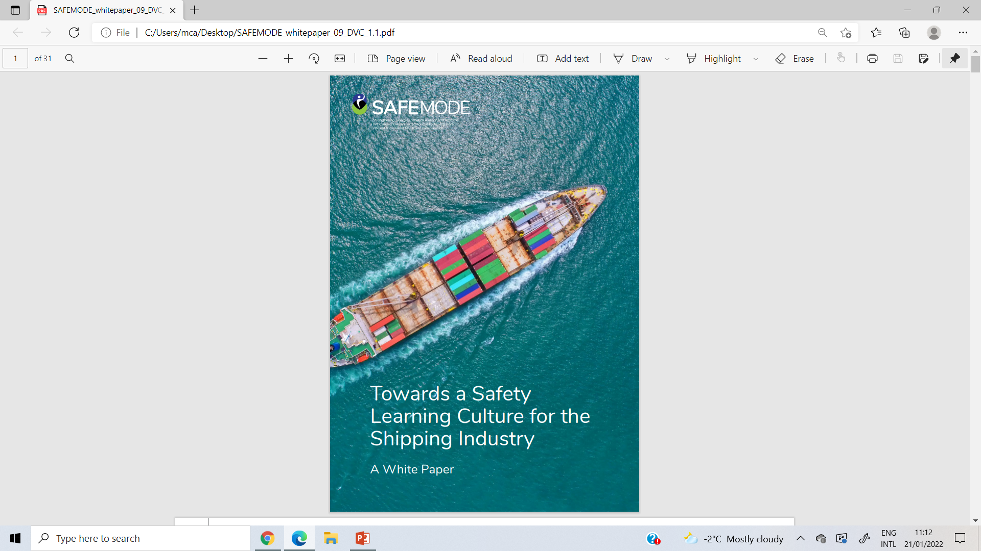
The outcome of the research identified practices previously reported such as:
Superficial investigations rarely integrating organizational analysis
Reporting and data sharing do not reflect operational realities
The lack of trustful relationships between frontline operators, companies and authorities

Slide 15



Safety Learning Culture: pre-requisites towards safety culture
DATA (QUANTITY AND QUALITY)
TRUST AND MOTIVATION
LEARNING
Willingness and competences to draw right conclusions from safety information systems
Implement recommendations
Make necessary changes
Prof. Raphael Baumler - WMU

Slide 16
From the Fear to the Trust Loops (a cultural shift for shipping)
People as solution
Focus on relationships & enquiry
Increased trust & learning
Psychological safety
Intrinsic speak up culture
Data flow & quality enhanced
People as problem
Focus on behaviour
Reward or punish
Fear & extrinsic motivation
Learning & speaking up inhibited
Data flow & quality inhibited
“Where there is fear you will get bad data” (Lloyd, 2021)
Prof. Raphael Baumler - WMU
Notes:
STRENGTHENING reporting and data quality by establishing trustful relationships:
Eliminate fear and reassure/build trust and respect & care
Recall vital priorities
Change practices and habits/establish long-term commitment
Adopt a learning culture

Slide 17
Conclusion

Slide 18
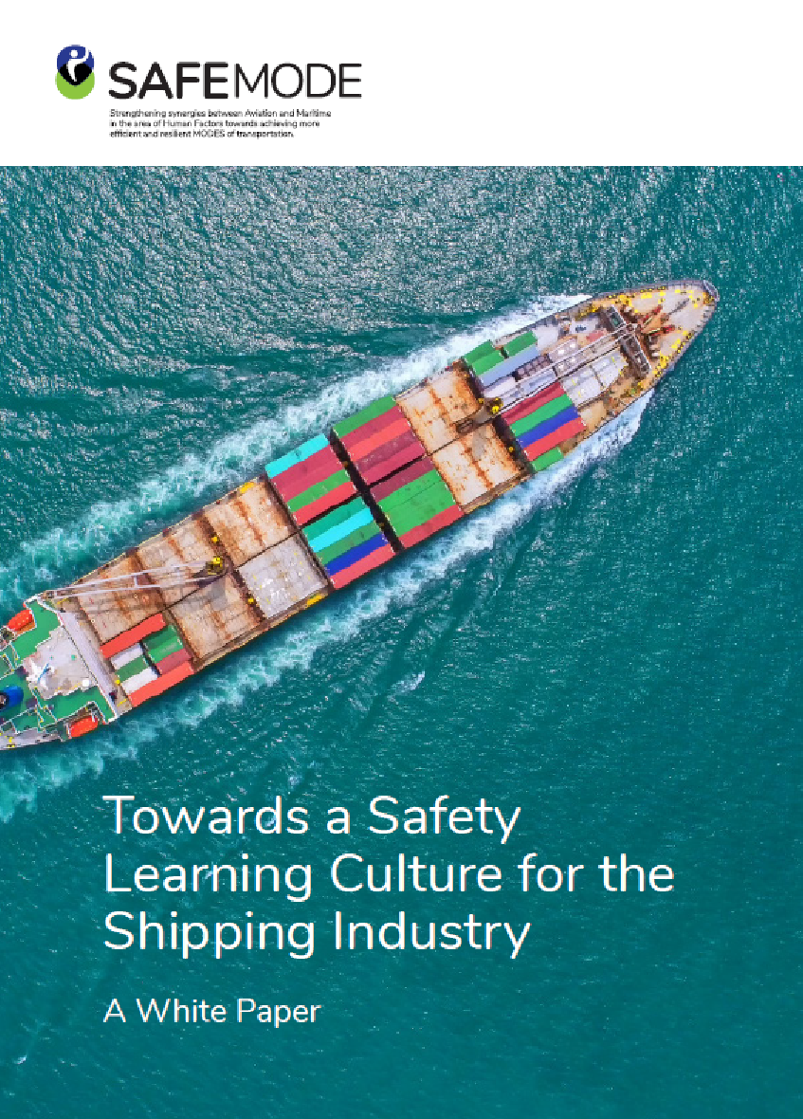
Need for Safety Learning Culture
Choose learn over blame
Ensure that learning occur at all levels
Accept and report work realities
Build TRUST and enhance cooperation (operators/designers/managers) for quality feedback
Obtain accurate pictures and consistent understanding of system’s functioning and safety
Develop systemic accident prevention strategies
Include qualitative research to anticipate failures
Prof. Raphael Baumler - WMU

Slide 19
Learning is vital to identify challenges faced by frontline operators
To select appropriate solutions

Slide 20
“It's said that a wise person learns from his mistakes, a wiser one learns from others' mistakes, but the wisest person of all learns from others' successes.”
— John C Maxwell
Prof. Raphael Baumler
rb@wmu.se
Thank you for your attention

